Slide 1

CPEN 211: Computer Systems I
Slide Set 1:
The Digital Abstraction
Combinational Logic
Prof. Tor Aamodt
By Unknown - U.S. Army Photo, Public Domain, https://commons.wikimedia.org/w/index.php?curid=55124
Notes:
0.5

Slide 2
Learning Objectives
By the end of these slides, you should be able to:
Explain how noise motivates the use of digital signals in computing systems
Explain how digital values are encoded as voltages
Evaluate the impact of noise on a digital system.
Describe how binary values can be used to encode different types of information.
Define combinational logic and explain how to build larger combinational logic circuits out of smaller combinational logic circuits
Apply boolean logic to simplify logical expressions
Notes:
1

Slide 3
Today, almost all electronics represents information digitally (e.g., using 0’s and 1’s).
Why?

Slide 4
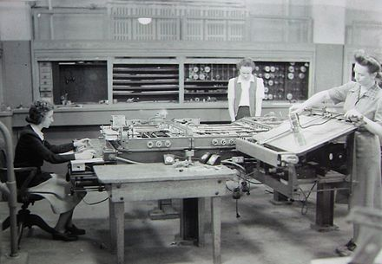
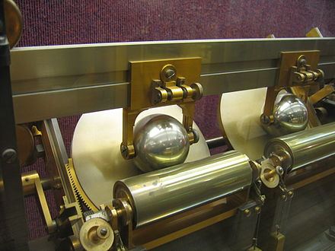
Differential Analyzer (c. 1942)

Slide 5
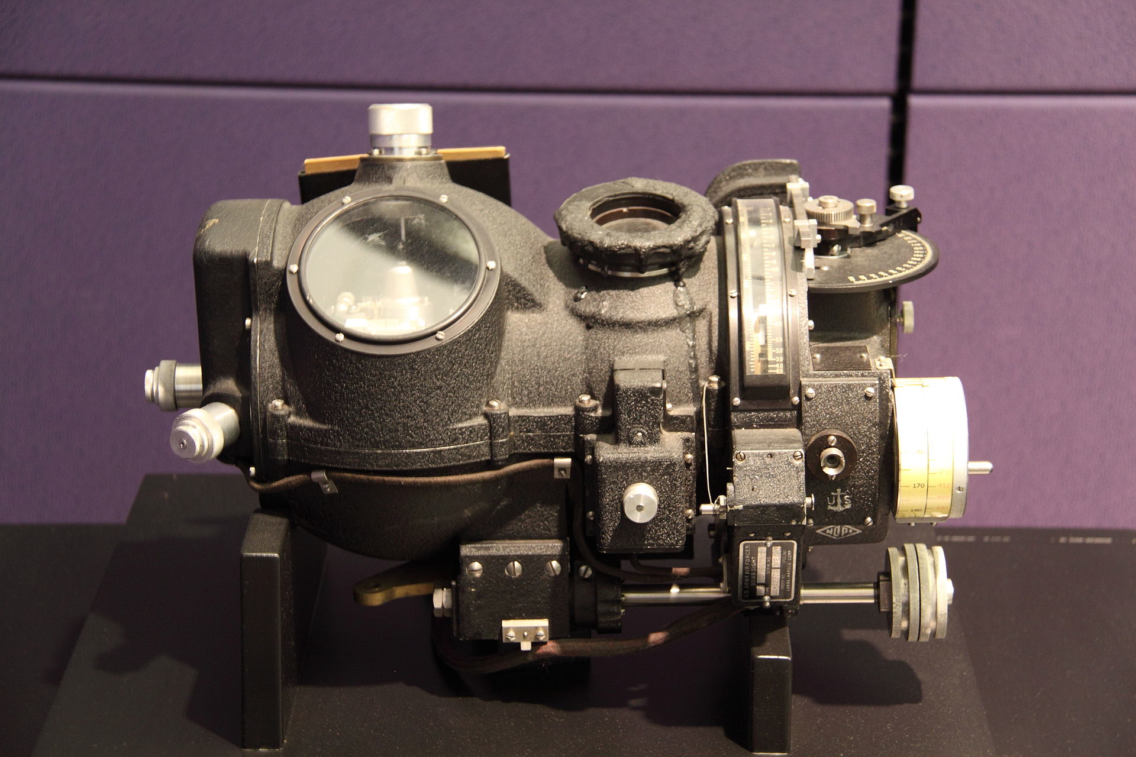
More Analog Computers…
Norden bombsight [Computer History Museum]
Notes:
1

Slide 6

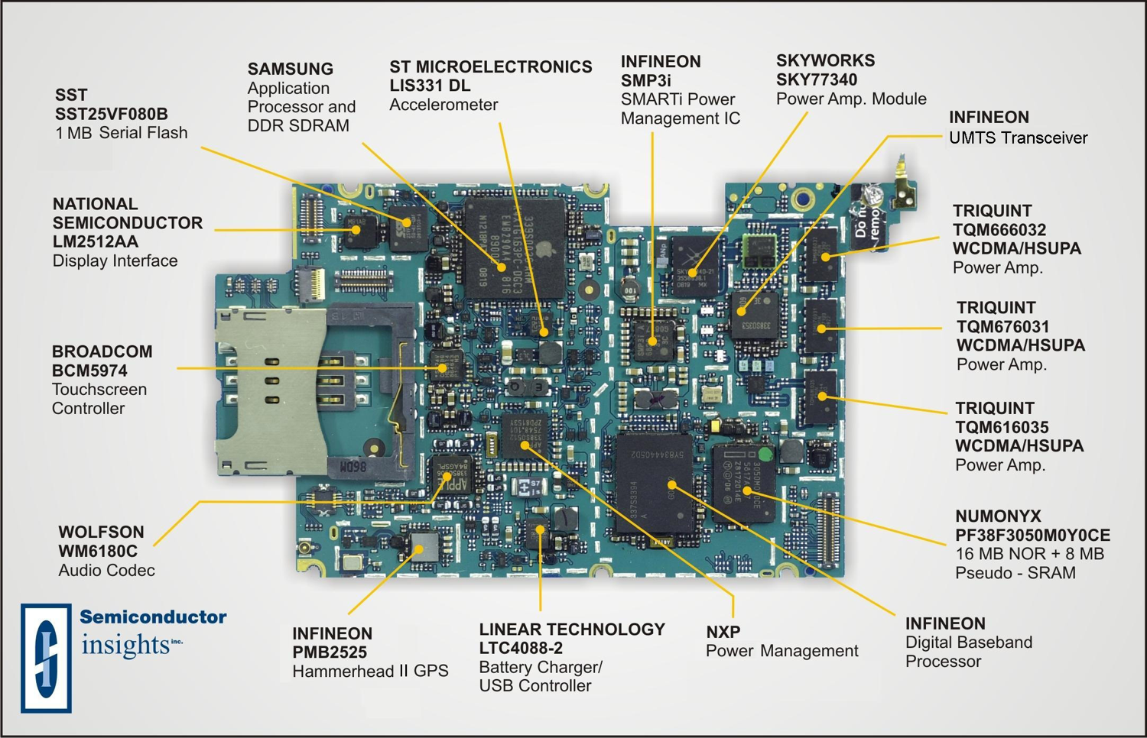

Slide 7

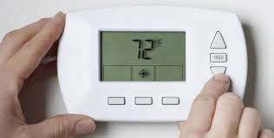
Thermostat Example
Next few slides consider an analog thermostat. We will see how noise impacts this design.
[http://www.clipartpanda.com/categories/cute-house-clipart]
[http://blogs.plos.org/obesitypanacea/2011/02/25/turn-down-your-thermostat-to-lose-weight-suggests-new-study-dripping-with-sarcasm/]

Slide 8


Thermostat Controller
Here is one possible design:
The block labeled “Temp Sensor” senses the temperature in the room.
The arrow labeled “CurrentTemp” is the current temperature measured by the temperature sensor. “PresetTemp” is the temperature the room occupant desires. The block labeled “Compare A>B” compares CurrentTemp and PresentTemp and turns on the fan if the temperature in the room is too hot.
Text: Dally §1.4
Notes:
1.5

Slide 9
Getting electrons to solve problems…
Problem
?
Devices (electrons)
Notes:
3
Slide courtesy: Prof. Yale Patt, Univ. of Texas at Austin
Problem: Compute list of suggested friends on facebook
Algorithm: Search social graph
Program: Algorithm to perform search… operating system you run the program on (Linux)
ISA: x86-64-bit
Microarchitecture: Pipelined, superscalar, out-of-order and speculative execution
Circuits: AND, OR, NOT; Half-adder, priority encoder, flip-flops, counters, registers, SRAM, DRAM, etc…
Electronic Devices: fin-FET CMOS

Slide 10

[By Fir0002 - Own work, GFDL 1.2, https://commons.wikimedia.org/w/index.php?curid=2380067]
Electrons accelerated by electric field.
Electric field generated by voltage differences.
Notes:
1.5

Slide 11
How to turn problem into voltages?
Analog approach: Use voltage to directly encode information
Example: Voltage = 0.2(Temperature − 68)
72.5 °F represented by …?
Text: Dally §1.2
Notes:
1
Need to process, transport and store information.

Slide 12
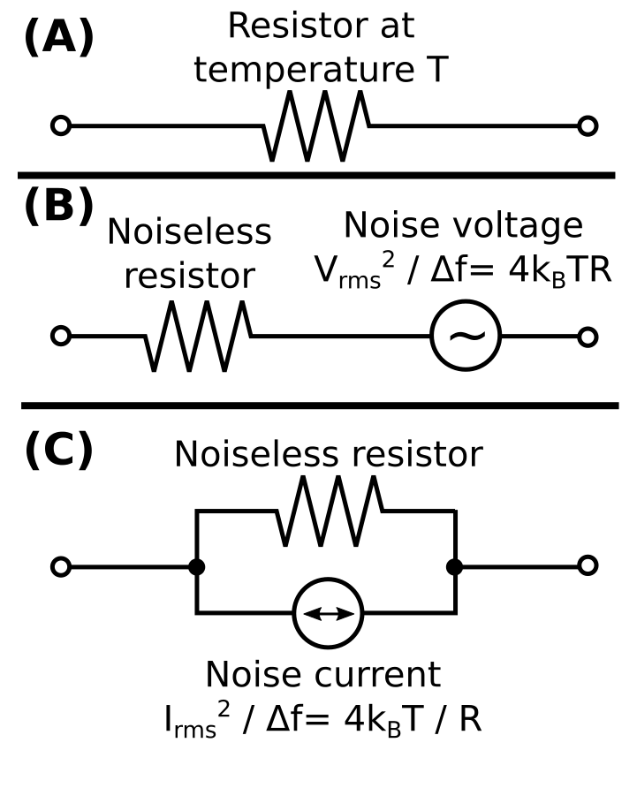
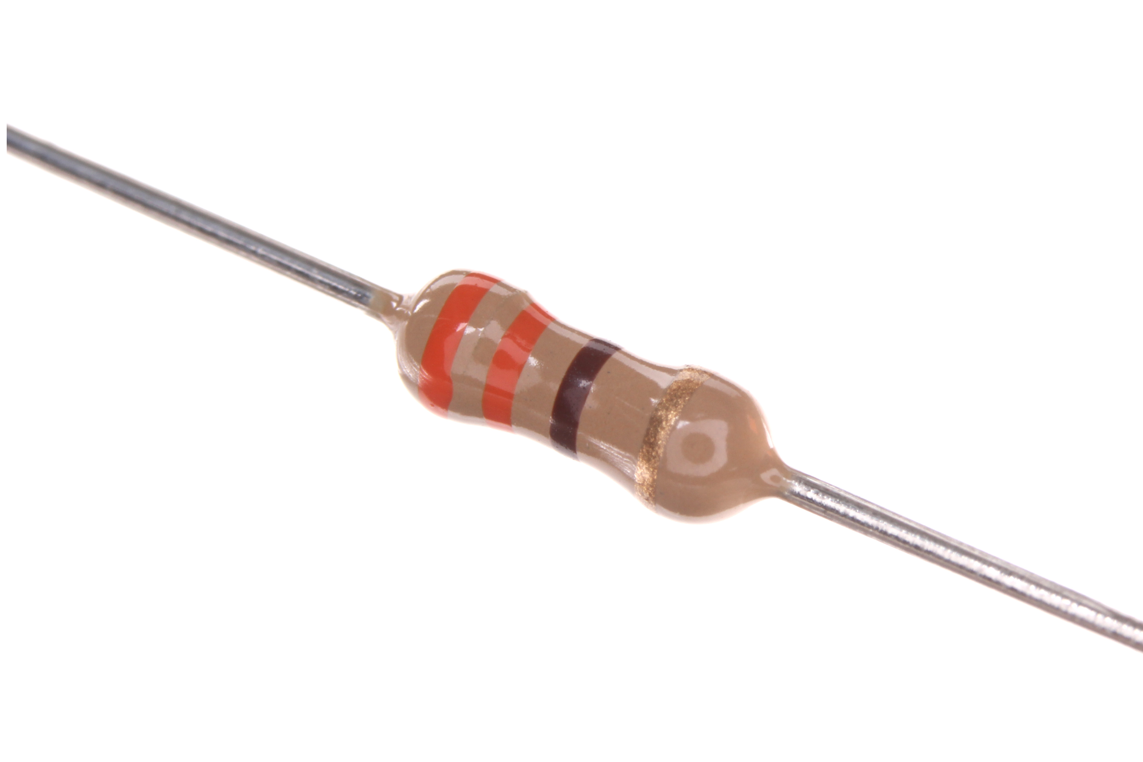
Fun Fact: Thermal Noise
You do NOT need
to know this
formula ☺
All wires have some resistance so they will have some amount of “noise”.
Resistor image: By oomlout (RESE-W04-X-O331-01) [CC BY-SA 2.0 (http://creativecommons.org/licenses/by-sa/2.0)], via Wikimedia Commons from Wikimedia Commons
Circuit Image: By Sbyrnes321 - Own work, CC0, https://commons.wikimedia.org/w/index.php?curid=28181783

Slide 13
Effect of Noise on Temperature Sensor Output
Voltage
Noise
Time
ε
V
V+
ε
Input
+
f
Output
✘
E.g., disturb temperature by ε=100mV, new temperature signal is 1V which corresponds to 73 degrees instead of 72.5
Text: Dally §1.2
Notes:
2
E.g., disturb temperature by 100mV, new temperature is 1V which corresponds to 73 degrees instead of 72.5

Slide 14

Effect of Noise on an Analog System
Consider a device that reads a voltage “x” at its input and outputs a voltage that is some function y=f(x). How it does that is not important.
Input (voltage) x
Output (voltage) f(x)

Slide 15
Effect of Noise on an Analog System
Voltage
Noise
Time
ε
Error at Output
V
V+
ε
f(V+
ε)
Input
+
f
Output
Noise added to Input
y
(output)
f(x) = 2⋅x
x
(input)
Text: Dally §1.2
Notes:
2
E.g., disturb temperature by 100mV, new temperature is 1V which corresponds to 73 degrees instead of 72.5

Slide 16
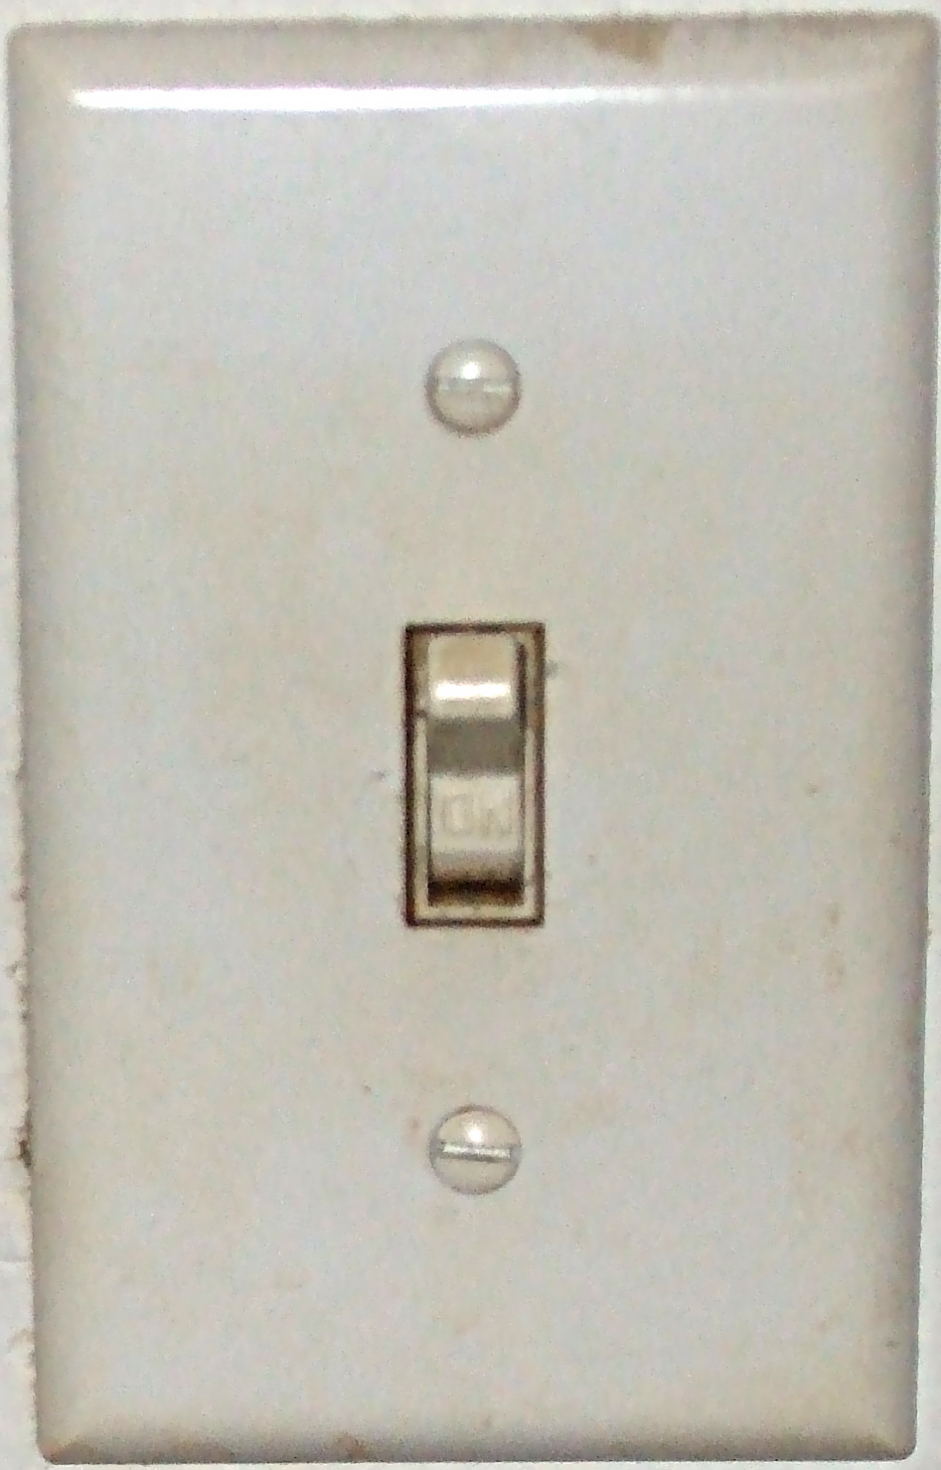
Digital Binary
Alternative to Analog: detect presence or absence of a voltage – i.e., digital binary.
Typically, binary (0 or 1) values. Higher voltage means ‘1’ (“true”) low voltage means ‘0’ (“false”)
E.g., connect bulb to 120V, light turns on (“1”)
[By I, Funpika, CC BY-SA 3.0 us, https://commons.wikimedia.org/w/index.php?curid=2336969]

Slide 17
Effect of Noise on Digital Signals
Voltage
Voltage
Noise
Time
Time
ε
V
V
+
ε
f(V
)
Input
1
+
1
f
1
Output
Restoration: Output is identical to Input despite
noise!
Simplest binary digital function “f”?
0 => 0
1 => 1
y
(output)
f(x)
x
(input)
Text: Dally §1.2
Notes:
1

Slide 18
Effect of Nonlinear Function “f”
y
f(x)
x
Voltage
Time
Input + Noise
V
+
ε
1

Slide 19
Effect of Nonlinear Function “f”
Output
f(V
)
1
y
f(x)
Voltage
x
Time
Voltage
Time
Input + Noise
V
+
ε
1
Why is this useful?
Small amount of noise leaves information unchanged. A low voltage is kept low and a high voltage is kept high.

Slide 20
Buffer
y
f(x)
x
Buffer

Slide 21
Avoiding Errors by “Going Digital”
Alternative to Analog: detect presence or absence of a voltage – i.e., digital binary.
Binary, meaning two, simpler than differentiating more than two voltages
Digital, meaning discrete, provides noise immunity.
Today’s systems move from analog to digital as soon as possible.
We will use positive logic: Higher voltage means ‘1’ (“true”) low voltage means ‘0’ (“false”)
Text: Dally §1.2
Notes:
2

Slide 22
What is the impact of noise on large circuits?

Slide 23
Impact on Large Circuits
Next consider impact of noise when there are multiple circuit elements.
We’ll look at both analog and digital systems.
We abstract the operation of each element to a simple function f(x)
For analog we examine linear function.
For digital we examine step function.
f(x)
f(x)
f(x)

Slide 24
Noise Accumulation
Voltage
Noise
Noise
Noise
Time
ε
ε
ε
1
2
3
V
V
+
ε
1
V
+
ε
1
+ε
2
V
+
ε
1
+ε
2
+ε
3
a
+
a
+
a
+
a
The more analog circuits we combine the more noise accumulation impacts the output.
Text: Dally §1.2

Slide 25


“Beacon of Gondor” Buffer Analogy
(Lord of the Rings)
Video: https://www.youtube.com/watch?v=i6LGJ7evrAg
“Gondor sends a signal to Rohan asking them for military aid”
[Analysis of fictional speed of propagation: http://scienceblogs.com/dotphysics/2010/07/30/how-fast-is-the-beacon-of-gond/ (photos above from this URL)]

Slide 26
Signal Restoration
y
f(x)
(output)
x
(input)
Noise
Noise
Noise
ε
ε
ε
1
2
3
V
V
+
ε
1
V
V
+
ε
2
V
V
+
ε
3
V
a
+
a
a
+
a
a
+
a
a
Voltage
Voltage
Voltage
Voltage
Time
Time
Time
Time
Restoration enables LARGE digital circuits to carry out complex, high-precision operations.
Text: Dally §1.2
Notes:
Here “a” is 0 or 1.
Digital systems process, transport, and store information without it being distorted by noise because they periodically *restore* a degraded 1 or 0 back to a clean 1 or 0 before an error accumulates and becomes larger than noise margin.

Slide 27
Noise Accumulation
Voltage
Noise
Noise
Noise
Time
ε
ε
ε
1
2
3
V
V
+
ε
1
V
+
ε
1
+ε
2
V
+
ε
1
+ε
2
+ε
3
a
+
a
+
a
+
a
y
f(x)
(output)
Signal Restoration
Buffer
x
Voltage
Voltage
(input)
Noise
Noise
Noise
Time
Time
ε
ε
ε
1
2
3
V
V
+
ε
1
V
V
+
ε
2
V
V
+
ε
3
V
a
+
a
a
+
a
a
+
a
a
Restoration enables LARGE digital circuits to carry out complex, high-precision operations.
Text: Dally §1.2

Slide 28
How much noise can a digital circuit tolerate?

Slide 29
Digital Logic - Requirements
Let’s revisit what we mean by “detecting the presence or absence of a voltage”.
In prior examples looked at “threshold function”.
Too simple to model real circuits as it includes portion with an infinite slope.
Different power supply voltages.
Leads to consideration of requirements that circuit elements must satisfy to be useful.
y
f(x)
x

Slide 30
Signal Restoration
Buffer gets rid of noise. Getting rid of noise also called signal restoration.
The input/output operation of a circuit can be characterized using a curve known as the DC voltage transfer function.
For the ideal buffer DC voltage transfer function (shown at top left), logic values are represented by a set of voltage values. The set of voltage values used to represent a given logic value is different at input versus the output.
E.g., Suppose supply voltage was 5 V and threshold (input voltage value when output “jumps”) is 2.5 V. What voltages represent logic “0” and “1”?
Input: logic “0” represented by voltage below 2.5 V
Output: logic “0” represented by voltage equal to 0 V
Input: logic “1” represented by voltage above 2.5 V
Output: logic “1” represented by voltage equal to 5 V
y
f(x)
x
Buffer

Slide 31
Characteristics of a “Buffer” Circuit
y
f(x)
x
Buffer
1. Logic values represented by input or output wire within a voltage range.
2. The voltage range used for a logic value is different at input and output.

Slide 32
“1”
“1”
“1”
“1”
“0”
“0”
H
W
“0”
“0”
H
Slope > 1 here
W
H
To tolerate noise: H < W.
Slope > 1 means buffer “gain” must be greater than one. => Need “active” element.

Slide 33
“1”
“1”
“1”
“1”
“0”
“0”
“0”
“0”

Slide 34
Voltage Ranges of Binary Signals
For example, 2.5V LVCMOS logic, all input voltages between V_{min}=-0.3V and V_{IL} = 0.7V represent logic value of “0”.
Damage
0
?
1
Damage
V_{min}
V₀
V_{IL}
V_{IH}
V₁
V_{max}
Voltage
-0.3V
0.0V
0.7V
1.7V
2.5V
2.8V
2.5V LVCMOS Logic
A “standard” set of voltages. Defined by an industry standards organization called JEDEC.
Text: Dally §1.1
Notes:
1.5

Slide 35
Noise Margin
Voltage
V_{max}
Key to restoration: Output range for “1” narrower than input range for “1”. This provides noise margin.
Similarly, output range for “0” narrower than input range for “0”.
V₁
V_{OH}
V_{NMH}
V_{IH}
0
Tran
0
Tran
Damage
?
Damage
V_{IL}
V_{OL}
V_{NML}
V₀
V_{min}
Text: Dally §1.2
Notes:
2

Slide 36
Example (Supply Noise)
Two chips, A and B, use the 2.5V LVCMOS encoding to send logic signals from A to B:
A
B
2.5V LVCMOS
Suppose there is a voltage shift between the two chip’s power supplies so that all voltages in A are V_{N} higher in B.

Slide 37
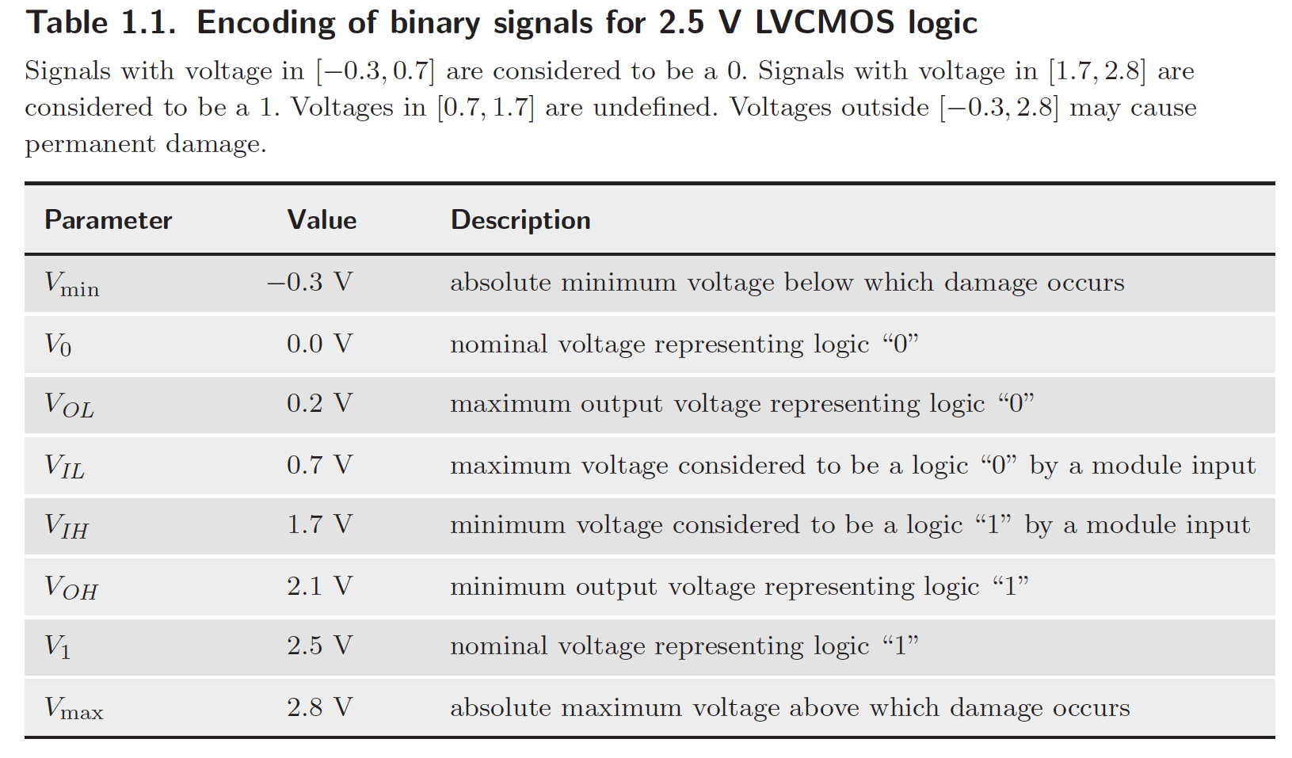
A voltage of V_{x} in system A appears as a voltage of V_{x} + V_{N} in system B. Assuming no other noise sources, what is the maximum value of V_{N} for which the system operates properly?
Chip B
Chip A
V_{max} = 2.8V
V_{N}
V_{dd} = 2.5V
V_{OH} = 2.1V
V_{IH} = 1.7V
(a) V_{dd}+ V_{N} <= V_{max} AND
(b) V_{OL}+ V_{N} <= V_{IL}
(a) 2.5V + V_{N} <= 2.8V AND
(b) 0.2V + V_{N} <= 0.7V
(a) V_{N} <= 0.3V AND
(b) V_{N} <= 0.5V
V_{N} <= 0.3V
0
Tran
Damage
?
Damage
V_{IL} = 0.7V
V_{OL} = 0.2V
V_{N}
V_{GND} = 0V
V_{min} = -0.3V

Slide 38
Representing Information
Beyond 0 and 1

Slide 39

Representing Information
By gnuckx (A red rose for Elena - Creative Commons by gnuckx)
[CC BY 2.0 (http://creativecommons.org/licenses/by/2.0)],
via Wikimedia Commons from Wikimedia Commons
“What's in a name? that which we call a rose
By any other name would smell as sweet”
[William Shakespeare, Romeo and Juliet]
Notes:
Earlier we said we would represent “false” with a low voltage and “true” with a high voltage.
It is important to recognize that in some sense the choice of associating a low voltage or logic level 0 with “false” is arbitrary. It is not unlike associating the English word “rose” with the plant shown above. However, the choice can have an impact on how easy it is to operate on the information.
Another issue that arises with digital representations is the number of different things we can represent. For the picture on the left each pixel can only be black or white. For the picture on the right, each pixel can take on any one of millions of different colors.

Slide 40
Representing Information
Earlier saw we could represent temperature with a voltage:
  Voltage = 0.2(Temperature − 68)
  0.9 V represents 72.5 °F
Also saw we could represent a binary value with a voltage:
  0 V represents “0”
  2.5 V represents “1”
Two separate things:
  The information we are interested in.
  The representation of that information.
Let’s consider how to represent information in binary…

Slide 41




With 0 and 1 we can represent two things
A description is “True” or “False”
Door “open” or “closed”
light “on” or “off”
Text: Dally §1.3
Notes:
1.5

Slide 42
Often deal with information that is NOT “binary”
Element of a set: E.g., colors
 | White
 | Red
 | Blue
 | Yellow
100
101
110
111
000
001
010
011
 | Purple
 | Orange
 | Green
 | Black
With k “bits” we can represent at most 2^{k} different things.
Text: Dally §1.3

Slide 43
Often deal with information that is not binary:
Continuous Quantities: E.g., temperature
[http://blogs.plos.org/obesitypanacea/2011/02/25/turn-down-your-thermostat-to-lose-weight-suggests-new-study-dripping-with-sarcasm/]
000 | 68
001 | 70
010 | 72
011 | 74
100 | 76
101 | 78
110 | 80
111 | 82
0000000 | 68
0000001 | 70
0000011 | 72
0000111 | 74
0001111 | 76
0011111 | 78
0111111 | 80
1111111 | 82
Text: Dally §1.3
Notes:
1

Slide 44
We pick a binary representation (name) based on the operations required

Slide 45
Example

Slide 46
Pick representation of colors to support the operation of “subtractive” color mixing
  No colors - white
  Primary colors – red, blue, yellow
  Derived colors – orange, purple, green, black
How to represent individual colors if we want to efficiently compute result of combining colors?
Binary
Encoding
Binary
Encoding
Meaning
Meaning
000 | White
 | Red
 | Blue
 | Yellow
001
010
100
101
110
111
 | Purple
 | Orange
 | Green
 | Black
011
Text: Dally §1.3
Notes:
2

Slide 47



How would you represent
A Date ?
  Days since Jan 1 0000 (20 bits)
  Month, day, year (4 + 5 + 12 bits)
  Month, day, year, day of week (4 + 5 + 12 + 3 bits)
A playing card ?
  Number in deck (6 bits)
  Suit, Number (2 + 4 bits)
  Decoded suit, decoded number (4 + 13 bits)
A 5-card hand?
Text: Dally §1.3
Notes:
735,110 days ; 2^20 = 1,048,576
12 months, requires 4-bits (16)
31 days in month, requires 5-bits (32)
How many years? 11-bits 2048, 12-bits 4096

Slide 48


Representing Numbers
Many ways to represent same value
E.g., number five can be written as “5”.
Hand with fingers+thumb extended.
Unary encoding: 11111 or . Used for counting birthdays (candles on cake).
Will see binary representation for five is 101
Will also see (in 2-3 weeks) floating-point
IMPORTANT: Digital logic always uses 0’s and 1’s. Decimal numbers in Verilog are converted to 0’s and 1’s by Quartus during synthesis.
Notes:
2

Slide 49
Unsigned (non-negative) Integers
Unsigned integers useful for counting
Example 1: Track number of times we have completed a task.
Example 2: Identify different memory locations (e.g., 129 Main St. vs 131 Main St.)
Text: Dally §10.1
Notes:
1.5

Slide 50
Unsigned Integers in Binary
Decimal: E.g., 329 = 3×10² + 2×10¹ + 9×10⁰
binary digits are 0 and 1
E.g., with five bits, represent number 6 as 00110
This means 0×2⁴ + 0×2³ + 1×2² + 1×2¹ + 0×2⁰
0×16 + 0×8 + 1×4 + 1×2 + 0×1
Text: Dally §10.1
Notes:
2

Slide 51
Converting from Decimal to Binary
Expand, convert, evaluate (not recommended)
329 = 3×10² + 2×10¹ + 9×10⁰
= 11×1100100 + 10×1010 + 1001x1
= 101001001
2. Division by 2 method
If least significant decimal digit is odd (even), then least significant binary digit is 1 (0).
329 (odd) => 1, 329 ÷ 2 =
164 (even) => 0, 164 ÷ 2 =
82 (even) => 0, 82 ÷ 2 =
41 (odd) => 1, …
Subtraction method (see text: Dally 10.1)
Text: Dally §10.1
Notes:
2.5

Slide 52
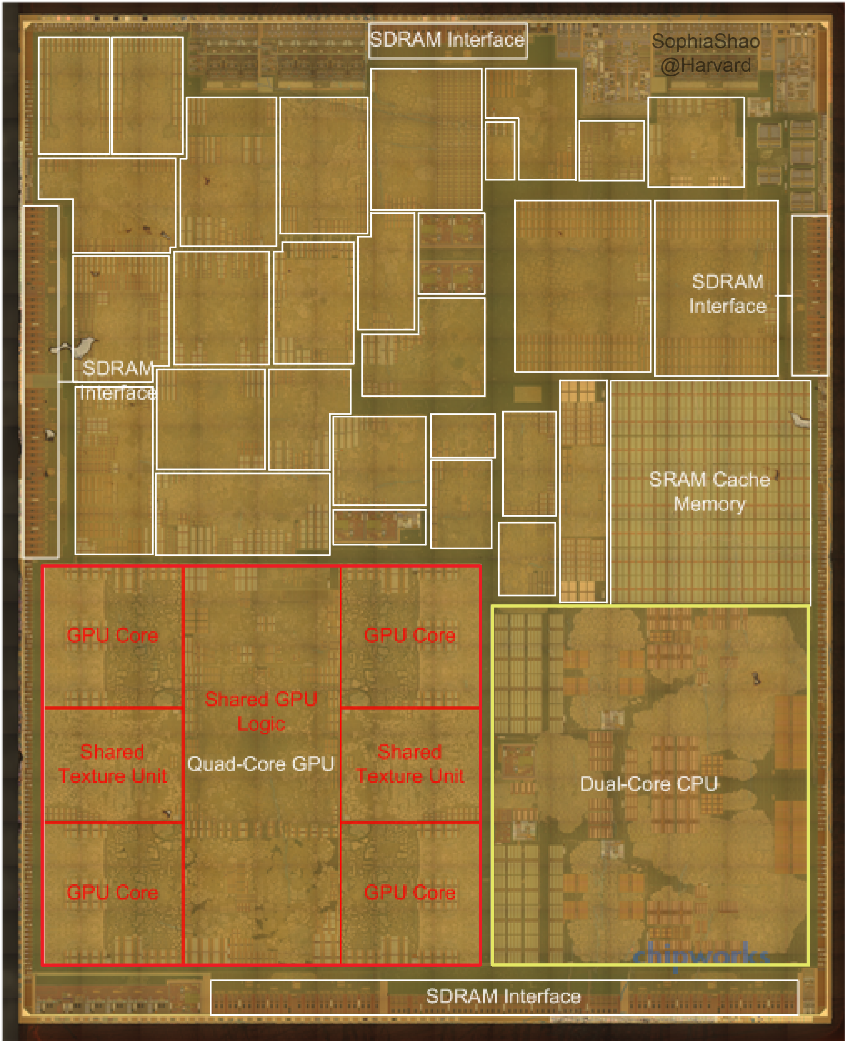
Apple A8 die photo
(application processor
used in iPhone 6)
[http://vlsiarch.eecs.harvard.edu/accelerators/die-photo-analysis]

Slide 53


Two Types of Digital Logic!
“Sequential Logic”
“Combinational Logic”
remembers things…
forgets things…

Slide 54
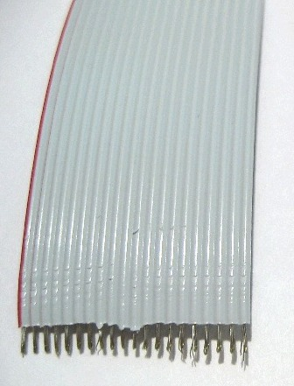
Wires and busses
Both sequential and combinational logic are built using wires and busses.
Single wire carries one bit (e.g., 0 V or 2.5 V for “0” or “1”)
If we want to send N bits (e.g., to represent one of 2^{N} temperatures) we need N wires. Often referred to as N-bit bus.
Schematic symbol:
20
Ribbon cable with 20 wires.
I.e., a 20-bit bus.
Notes:
1.5

Slide 55
Combinational Logic Circuit
Present output is a function of present input
Past input values do NOT matter
Example – digital thermostat
000 | 68
001 | 70
010 | 72
011 | 74
Means this signal is 3-bits wide
Text: Dally §1.4
Notes:
1.5

Slide 56
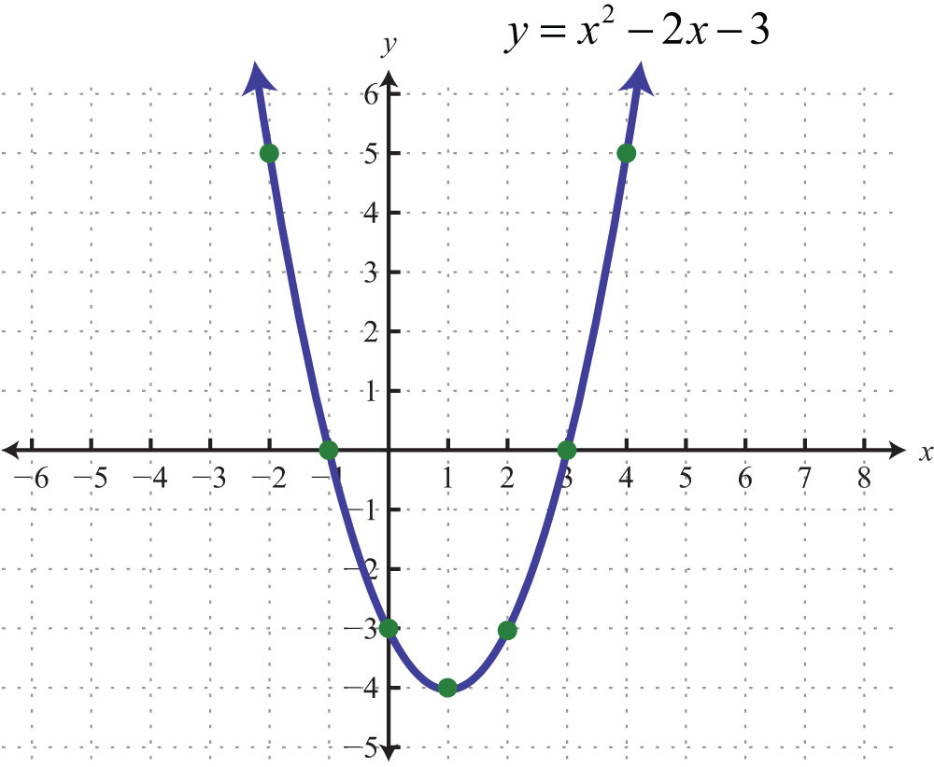
Recall: Functions
y is “output”
“x” is input
[http://2012books.lardbucket.org/books/beginning-algebra/s12-05-graphing-parabolas.html]

Slide 57
Combinational logic implements a memoryless function
output = f(input)
input output
i₁ i₂ i₃ | o₁
0 0 0 | 0
0 0 1 | 0
0 1 0 | 0
0 1 1 | 1
1 0 0 | 0
1 0 1 | 1
1 1 0 | 1
1 1 1 | 1
instead of “real” numbers
combinational logic
uses “binary"
[http://2012books.lardbucket.org/books/beginning-algebra/s12-05-graphing-parabolas.html]
Text: Dally §6.1
Notes:
1.5

Slide 58


Sequential Logic
Combinational Logic
combination = R31-L23-R0
Current output (locked/unlocked) depends upon past inputs
Current output (locked/unlocked) depends
only on current inputs
Notes:
1.5

Slide 59
Sequential logic circuits
Includes state (memory, storage)
Makes output a function of history as well as current inputs
Synchronous sequential logic uses a clock
Example: A calendar circuit that remembers current date and updates the date each morning.
September = 9₁₀ = 1001₂
9th day = 9₁₀ = 1001₂
Wednesday = 3 = 011₂
September = 9₁₀ = 1001₂
10th day = 10₁₀ = 1010₂
Thursday = 4 = 100₂
Text: Dally §1.4
Notes:
2

Slide 60
Building Larger Circuits

Slide 61
[http://www.clipartpanda.com/categories/cute-house-clipart]
[http://blogs.plos.org/obesitypanacea/2011/02/25/turn-down-your-thermostat-to-lose-weight-suggests-new-study-dripping-with-sarcasm/]

Slide 62
Can compose digital circuits
Text: Dally §1.4
Notes:
2
Suppose we want to modify our thermostat so that the fan does not run on Sundays.
Important part of digital design is partitioning up a design into smaller portions. In 259 we study in detail an example which is the digital system inside a computer.

Slide 63
Closure
(Set Theory) Combinational logic circuits are “closed” under “acyclic composition”
In plain English: If we combine two combinational logic circuits without introducing a cycle, the resulting circuit will also be combinational.
CL1
CL2
CL12
Text: Dally §6.2
Notes:
1.5

Slide 64
Text: Dally §6.2
Notes:
1

Slide 65
How to design combinational logic?

Slide 66
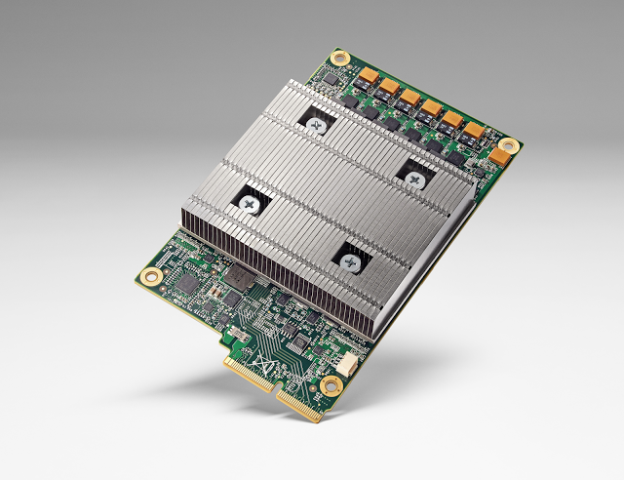
Google Tensor Processing Unit (TPU)
[Image Source: https://cloudplatform.googleblog.com/2016/05/Google-supercharges-machine-learning-tasks-with-custom-chip.html]

Slide 67

Deep Learning: Where Times Goes
~ 90% of time → dot products
X
+
100s
-
1000s
X
More details: http://www.ece.ubc.ca/~aamodt/papers/Cnvlutin.ISCA2016.pdf

Slide 68
Design Steps
Describe desired functionality (e.g., Verilog)
Minimize cost of implementation (e.g., Quartus)

Slide 69
Several ways to describe a combinational logic function
Example – “Majority Circuit”
English Language Description
  Outputs 1 if more inputs are 1 than are 0
Truth table
Logic equation (Boolean algebra)
  q = (a ∧ b) ∨ (a ∧ c) ∨ (b ∧ c)
abc | q
000 | 0
001 | 0
010 | 0
011 | 1
100 | 0
101 | 1
110 | 1
111 | 1
Notes:
2

Slide 70
Why Boolean Algebra?
If a truth table can completely describe a combinational logic function, why do we need logic equations and Boolean algebra?
Two reasons:
  Easy to convert from a logic equation to circuit
  We can use the “laws of Boolean algebra” to simplify the circuit to save cost

Slide 71
Several ways to describe a combinational logic function
Logic gate diagram
Verilog
assign f = (a&b)|(a&c)|(b&c);

Slide 72
Boolean Algebra
“high school” Algebra:
  Algebra over infinite set – e.g., real numbers (-∞, ∞)
  4 operators: Multiplication (*), addition (+), subtraction (-), division (÷)
Boolean Algebra:
  algebra over 2 element set: {0,1}
  3 operators: AND (∧), OR (∨), NOT (¬)
Text: Dally §3 (1st page intro)
Notes:
1.5

Slide 73
Boolean Algebra
AND Operation (“conjunction”)
  Definition: a ∧ b = 1 if and only if a=1 and b=1
  Similar to English definition of “and”.
OR Operation (“disjunction”)
  Definition: a ∨ b = 1 if a=1 or b=1
  Similar to English definition of “or” but note that a ∨ b is “1” when both a=1 and b=1.
NOT Operation (also called “complement”)
  Definition: ¬a = 1 iff a=0
  Other notations: ¬a = a’ = a
Text: Dally §3 (1st page intro)
Notes:
“NOT a” can also be written as a with a bar over it or a’

Slide 74
Boolean Algebra
Truth tables defining AND, OR and NOT:
a | b | a^b | a v b
0 | 0 | 0 | 0
0 | 1 | 0 | 1
1 | 0 | 0 | 1
1 | 1 | 1 | 1
a | ~a
0 | 1
1 | 0
Text: Dally §3 (1st page intro)
Notes:
1.5

Slide 75
Note on Notation
For AND logic function:
  use ∧
  don’t use x nor .
For OR logic function:
  use ∨
  don’t use +
This avoids confusion between Boolean algebraic rules and rules of “normal” arithmetic.
Text: Dally §3 (1st page intro)
Notes:
1.5

Slide 76
Axioms of Boolean Algebra
Axioms: a set of mathematical statements that we assert to be true.
Annihilation:
  0 ∧ x = 0
  1 ∨ x = 1
Identity:
  1 ∧ x = x
  0 ∨ x = x
Negation:
  ¬0 = 1
  ¬1 = 0
Text: Dally §3.1
Notes:
2

Slide 77
Example: Absorption
Prove that x ∧ (x ∨ y) = x by using perfect induction (i.e., enumerate all the possibilities).
(We will fill this in during class)

Slide 78
Example: DeMorgan’s Law
Prove that ¬(x ∧ y) = ¬x ∨ ¬y by using perfect induction (i.e., enumerate all the possibilities).
x | y | x ∧ y | ¬(x ∧ y) | ¬x | ¬y | ¬x ∨ ¬y
0 | 0 | 0 | 1 | 1 | 1 | 1
0 | 1 | 0 | 1 | 1 | 0 | 1
1 | 0 | 0 | 1 | 0 | 1 | 1
1 | 1 | 1 | 0 | 0 | 0 | 0
Text: Dally §3.2
Notes:
1.5

Slide 79
Principle of Duality
If a Boolean equation is true, then substituting ∧ for each ∨, ∨ for each ∧, 1 for each 0, and a 0 for each 1 results in an equation that is also true.
Since it holds for axioms (dual of “0 ∧ x = 0” is “1 ∨ x = 1” which is also an axiom) it also holds for rest of Boolean algebra.
Text: Dally §3.1
Notes:
1.5

Slide 80
Dual Functions
Dual of logic function f, is function f^{D} derived from f by substituting a ∧ for each ∨, a ∨ for each ∧, a 1 for each 0, and a 0 for each 1.
Useful property for understanding CMOS gates: dual of a function applied to the complement of the input variables equals the complement of the function.
Text: Dally §3.3
Notes:
1

Slide 81
Example of
f(x,y) = (x ∧ 1) ∨ (0 ∨ ¬ y)
f^{D}(x,y) = (x ∨ 0) ∧ (1 ∧ ¬ y)
f^{D}(¬ x, ¬ y) = (¬ x ∨ 0) ∧ (1 ∧ y)
x | y | (x ∧ 1) | (0 ∨ ¬y) | f(x,y) | f(x,y) | (¬x ∨ 0) | (1 ∧ y) | f^{D}(¬x, ¬y)
0 | 0 | 0 | 1 | 1 | 0 | 1 | 0 | 0
0 | 1 | 0 | 0 | 0 | 1 | 1 | 1 | 1
1 | 0 | 1 | 1 | 1 | 0 | 0 | 0 | 0
1 | 1 | 1 | 0 | 1 | 0 | 0 | 1 | 0

Slide 82
Useful Boolean Properties
All properties below can be derived from the axioms.
Useful for simplifying Boolean expressions to use less operations => reduce cost.
Communicative | x ∧ y = y ∧ x | x ∨ y = y ∨ x
Associative | x ∧ (y ∧ z) = (x ∧ y) ∧ z | x ∨ (y ∨ z) = (x ∨ y) ∨ z
Distributive | x ∧ (y ∨ z) = (x ∧ y) ∨ (x ∧ z) | x ∨ (y ∧ z) = (x ∨ y) ∧ (x ∨ z)
Idempotence | x ∧ x = x | x ∨ x = x
Absorption | x ∧ (x ∨ y) = x | x ∨ (x ∧ y) = x
Combining | (x ∧ y) ∨ (x ∧ ¬y) = x | (x ∨ y) ∧ (x ∨ ¬y) = x
DeMorgan’s | ¬(x ∧ y) = ¬x ∨ ¬y | ¬(x ∨ y) = ¬x ∧ ¬y
Highlighted = different relations than for + and ✕ with real numbers
Text: Dally §3.2
Notes:
2

Slide 83
Example
Reduce the following Boolean expression to a minimum number of literals:
f(a,b,c) = (a ∧ c) ∨ (a ∧ b ∧ c) ∨ (¬a ∧ b ∧ c) ∨ (a ∧ b ∧ ¬c)

Slide 84
Normal Form
(From Truth Table to Equations)
Can also compare Boolean expressions for equality by reducing to a normal form.
Two types of normal form: sum of product, product of sums
A product term is boolean expression with any number of inputs or their complement AND’ed together. E.g., a ∧ ¬b.
In sum of products normal form each product term corresponds to single row in truth table with a ‘1’ output.
Input variable complemented if zero in truth table.
Normal form => products in same order as in truth table.
E.g., for majority circuit:
abc | q
000 | 0
001 | 0
010 | 0
011 | 1
100 | 0
101 | 1
110 | 1
111 | 1
Text: Dally §3.4
Notes:
3

Slide 85
Example
Rewrite the following Boolean expression in normal form: f(x, y, z) = 1 if exactly 0 or 2 inputs are 1.
xyz | f
000
001
010
011
100
101
110
111

Slide 86
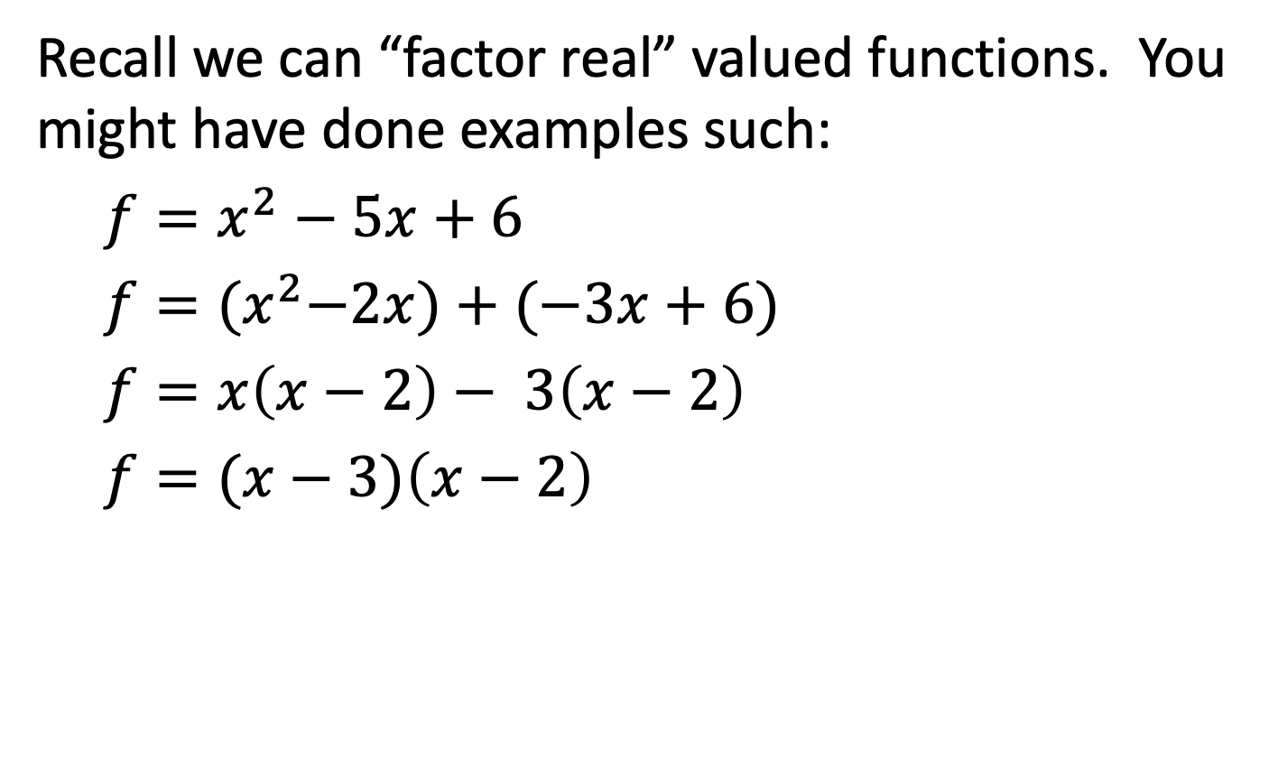
Factoring Functions
Recall we can “factor real” valued functions. You might have done examples such:
$f=x^{2}−5x+6$
$f={(x}^{2}−2x)+(−3x+6)$
$f=x\left(x−2\right)− 3\left(x−2\right)$
$f=(x−3)\left(x−2\right)$
[above example from: https://www.symbolab.com/solver/factor-calculator]

Slide 87
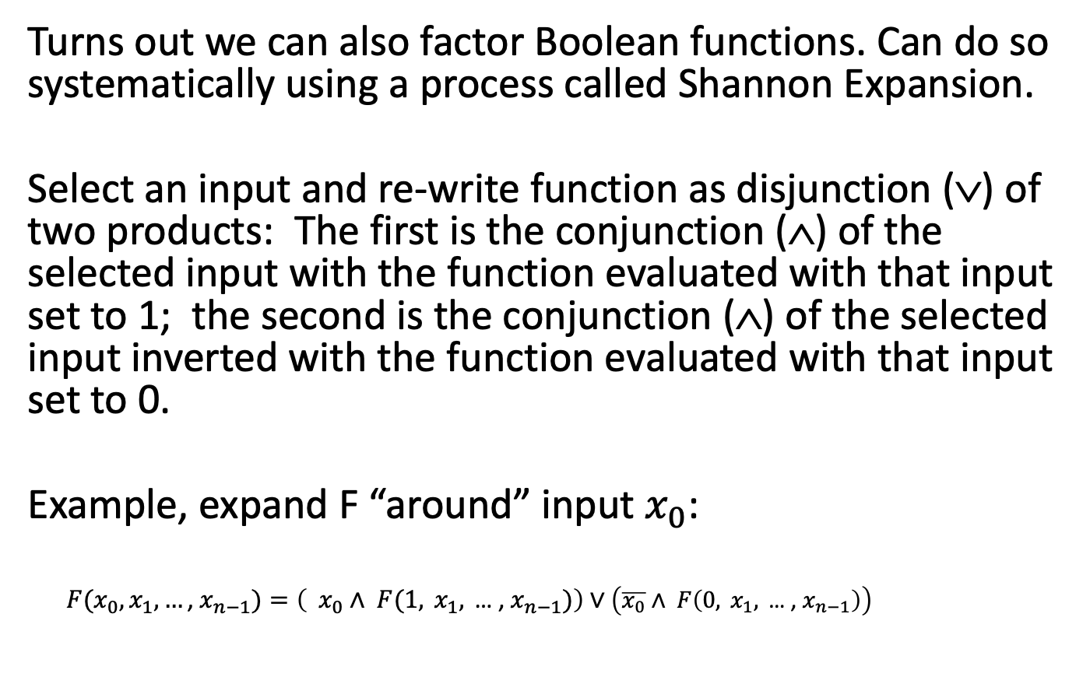
Shannon Expansion
Turns out we can also factor Boolean functions. Can do so systematically using a process called Shannon Expansion.
Select an input and re-write function as disjunction (∨) of two products: The first is the conjunction (∧) of the selected input with the function evaluated with that input set to 1; the second is the conjunction (∧) of the selected input inverted with the function evaluated with that input set to 0.
Example, expand F “around” input $x_{0}$:
$F(x_{0},x_{1},…\text{, }x_{n−1})=\left({ x}_{0} ∧ F(1, x_{1},\text{ … , }x_{n−1})\right)∨$ $\left(\overline{x_{0}}∧ F\left(0, x_{1},\text{ … , }x_{n−1}\right)\right)$

Slide 88
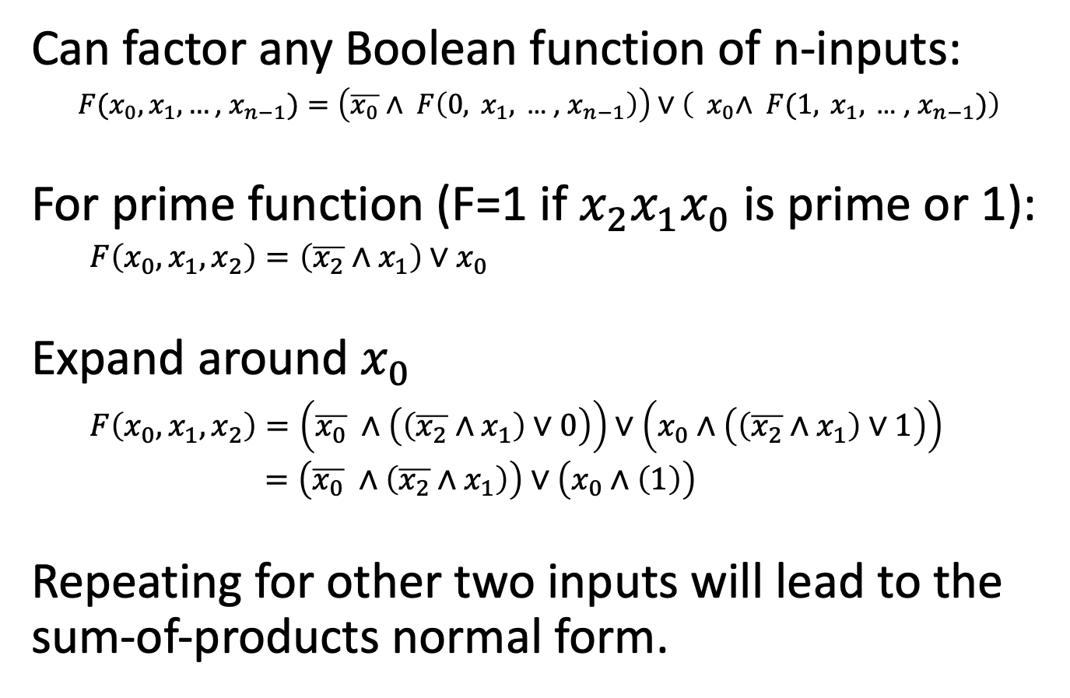
Example: Prime Function
Can factor any Boolean function of n-inputs:
$F(x_{0},x_{1},…\text{, }x_{n−1})=\left(\overline{x_{0}}∧ F\left(0, x_{1},\text{ … , }x_{n−1}\right)\right)∨\left({ x}_{0}∧ F(1, x_{1},\text{ … , }x_{n−1})\right)$
For prime function (F=1 if ${x_{2}x}_{1}x_{0}$ is prime or 1):
$F\left(x_{0},x_{1},x_{2}\right)=\left(\overline{x_{2}}∧x_{1}\right)∨x_{0}$
Expand around $x_{0}$
$F\left(x_{0},x_{1},x_{2}\right)=\left(\overline{x_{0}} ∧\left(\left(\overline{x_{2}}∧x_{1}\right)∨0\right)\right)∨\left(x_{0}∧\left(\left(\overline{x_{2}}∧x_{1}\right)∨1\right)\right)$
$=\left(\overline{x_{0}} ∧\left(\overline{x_{2}}∧x_{1}\right)\right)∨\left(x_{0}∧\left(1\right)\right)$
Repeating for other two inputs will lead to the sum-of-products normal form.

Slide 89
Summary
The world is digital
  Systems are digital at their core, only analog on the edges
Representing information
  Binary signals, sets, continuous values
Digital signals reject noise
  Voltage range divided into discrete states
  Noise margins
Combinational logic
  Output depends only on input (no state)
Boolean algebra
  Rules to manipulate logic equations

