Slide 1
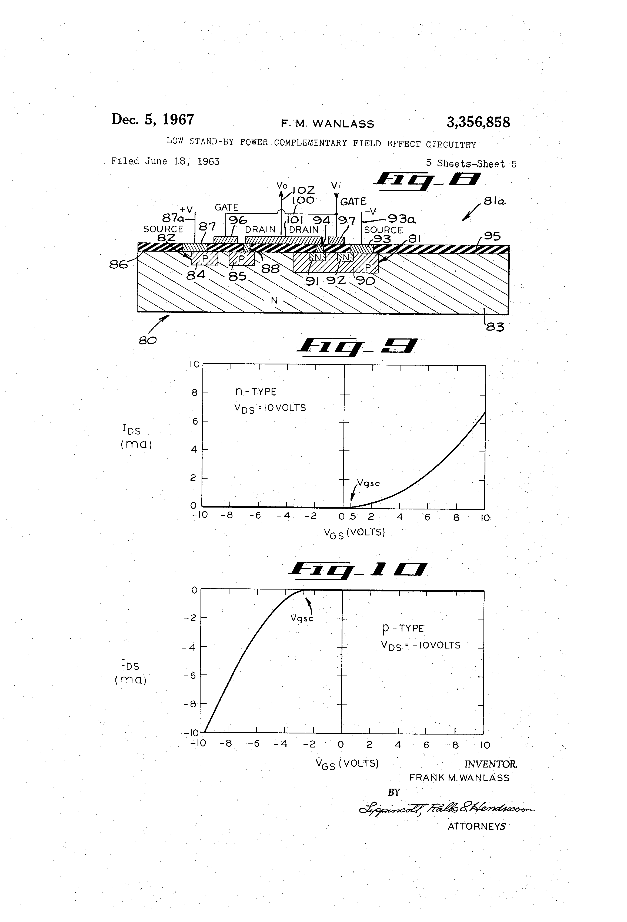
CPEN 211: Introduction to Microcomputers
Slide Set 2:
CMOS Logic Gates
Prof. Tor Aamodt
Notes:
0.5

Slide 2


Claude Shannon, A Symbolic Analysis of Relay and Switching Circuits, Master’s Thesis, MIT, 1937.

Slide 3
Learning Objectives
By end of this slide set you will be able to:
  Convert a Boolean expression into an schematic diagram of a logic circuit. Write a Boolean expression for a logic diagram. Apply the bubble rule.
  Explain the operation of CMOS transistor using the analogy of a switch
  Explain how CMOS transistors operating like switches provide the noise immunity desired in digital logic
  Draw a CMOS circuit including pull down and pull up networks for implementing simple and complex logic gates described by Boolean functions

Slide 4
[image from: https://web.stanford.edu/class/cs101/hardware-1.html]

Slide 5
[image from: https://web.stanford.edu/class/cs101/hardware-1.html]

Slide 6
From Equations to Gates
Earlier we learned about a digital circuit element called a buffer. A buffer eliminates noise.
Boolean operations can be implemented by other digital circuit elements known as logic gates.
We can implement a Boolean function by connecting logic gates. We can represent the resulting circuit using a schematic diagram consisting of symbols for individual logic gates connected together by lines for wires.
Text: Dally §3.5
Notes:
1

Slide 7
Basic Logic Gates
AND gate OR gate NOT gate
Symbol
Function
Truth
table
a | b | c
0 | 0 | 0
0 | 1 | 0
1 | 0 | 0
1 | 1 | 1
d | e | f
0 | 0 | 0
0 | 1 | 1
1 | 0 | 1
1 | 1 | 1
g | h
0 | 1
1 | 0
Text: Dally §3.5
Notes:
0.5

Slide 8
Connecting Gates Together
Using AND, OR, and NOT symbols we can draw a logic diagram for any Boolean expression.
To convert from an expression to a logic diagram, pick an operator (∨or ∧) at the top level of the expression and draw a gate of the corresponding type.
Label the inputs to the gate with the argument subexpressions.
Repeat this process on the subexpressions.
Text: Dally §3.5
Notes:
2

Slide 9
Example
How would you implement the following Boolean function using the gates we have seen so far?
a
b
f
c

Slide 10
Recall associative rule:
f
Draw using 3-input OR gate:

Slide 11
Example: Majority Circuit
f(a,b,c) = (a ∧ b) ∨ (a ∧ c) ∨ (b ∧ c)
Top level is three input OR gate
(a ∧ b)
(a ∧ c)
(b ∧ c)
Text: Dally §3.5
Notes:
1

Slide 12
Example: Majority Circuit
f(a,b,c) = (a ∧ b) ∨ (a ∧ c) ∨ (b ∧ c)
Repeat process on sub-expressions
(a ∧ c)
(b ∧ c)
Text: Dally §3.5
Notes:
1

Slide 13
Example: Majority Circuit
f(a,b,c) = (a ∧ c) ∨ (b ∧ c) ∨ (a ∧ b)
0
1
0
0
1
1
1
Text: Dally §3.5
Notes:
2

Slide 14
NAND and NOR Gates
NAND Gate
NOR Gate
NAND and NOR gates can be implemented with fewer transistors than AND and OR.
Text: Dally §3.5
Notes:
1.5

Slide 15
What is output of this circuit?
a
b
f
c
d
Notes:
3.5

Slide 16
Consider what happens if complement input before AND and then complement output:
=0
0
1
=1
0
1
1
0
a | b | a'
0 | 0 | 1
0 | 1 | 1
1 | 0 | 0
1 | 1 | 0
b'
1
0
1
0
AND
1
0
0
0
f
1
f
0
1
1
1
So we have shown:
(DeMorgan’s Law)
Notes:
2.5

Slide 17
DeMorgan Graphically
=
=
Notes:
1.5

Slide 18
Bubble Rule
Where possible, signals that are output from a gate with an inversion bubble on its output shall be input to a gate with an inversion bubble on its input.
=
=
Text: Dally §4.3.2
Notes:
2

Slide 19
Example: Exclusive-OR (XOR) Gate
a | b | XOR
0 | 0 | 0
0 | 1 | 1
1 | 0 | 1
1 | 1 | 0
Output high only if exactly one input is high
Useful for inverting one signal under control of another.
Notes:
2

Slide 20
Example: Exclusive-OR (XOR) Gate
f(a,b) = (a ∧ ¬b) ∨ (¬a ∧ b)
a | b | XOR
0 | 0 | 0
0 | 1 | 1
1 | 0 | 1
1 | 1 | 0
Output high only if exactly one input is high
Useful for inverting one signal under control of another.
XOR with more than 2-inputs: true if odd number of inputs high
Notes:
2

Slide 21
From Gates to Equations

Slide 22
Implementing Boolean operations (AND, OR, NOT) using electronic circuits
Text: Dally §4
Notes:
1

Slide 23
Consider household light switch
“for the lamp to glow, electrons must flow”
Notes:
1

Slide 24
Want to use output of one logic device to control input of other logic devices.
Need output and input carried by digital signals of same type. E.g., both use voltages of 0V and 2.5V to represent logic 0 and 1.
output
input
Notes:
1

Slide 25
Metal Oxide Semiconductor (MOS)
Field-Effect Transistors (FET)
Amount of current flowing between source and drain depends on voltage applied to gate
Text: Dally §4.2
Notes:
Recall capacitors from Physics 158

Slide 26
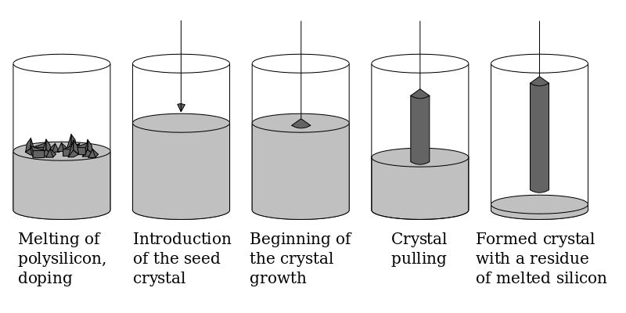
How is a Silicon Wafer created?
[Source: https://en.wikipedia.org/wiki/Wafer_(electronics)#Formation]

Slide 27
[image from: http://www.tomshardware.com/reviews/semiconductor-production-101,1590-3.html]

Slide 28
How is a chip made from a wafer?
[image above from: http://www.tomshardware.com/reviews/semiconductor-production-101,1590-5.html ]

Slide 29
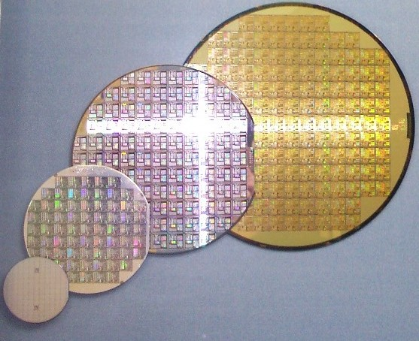
[image from: https://en.wikipedia.org/wiki/Wafer_(electronics)]

Slide 30
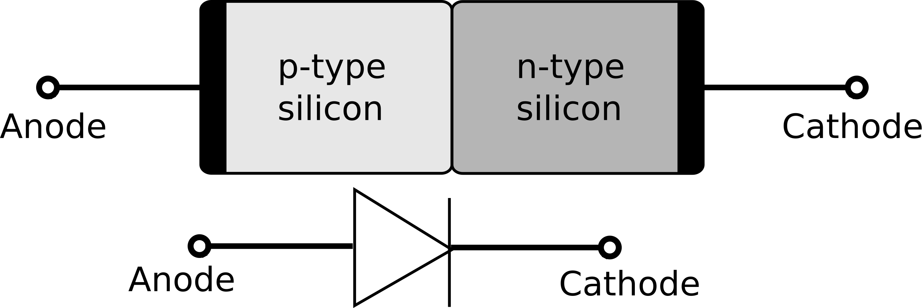
n-type MOS transistor (NFET)
0 V
With 0 volts: source and drain isolated
[diode picture: https://commons.wikimedia.org/wiki/File:PN_diode_with_electrical_symbol.svg#/media/File:PN_diode_with_electrical_symbol.svg]
Text: Dally §4.2

Slide 31
n-type MOS transistor (NFET)
2.5V
With 2.5 volts: area under gate acts almost like a wire (positive voltage attracts electrons)
Text: Dally §4.2
Notes:
Recall capacitors from Physics 158

Slide 32
NFET Circuit Symbol
Physical implementation
Circuit Symbol

Slide 33
n-type MOS transistor (NFET)
2.5V
Current
0V
Can use NFET to enable a control voltage on gate to determine whether current flows and light goes on.
Notes:
1.5

Slide 34
NOT Function
2.5V
Supply Voltage
Light is a resistor
output
2.5V
0V
??
??
input
0V
Current
0V
“Ground”
input | output
0 volts | 2.5 volts
2.5 volts | 0 volts
input | output
0 | 1
1 | 0
Notes:
1.5

Slide 35
Problem: Power consumption
Current
When input is logic value 1 current flows. This consumes significant power.
Notes:
1.5

Slide 36
Would like to replace resistor (light) with another switch that is connected to supply:
Connect output to ground ONLY
Connect output to supply ONLY

Slide 37
Problem
NFET can connect output to ground.
Needed: way to connect output to supply.

Slide 38
Aside: Why Can’t We Connect Output to Supply with NFET?
To connect drain to source we need voltage from gate to source higher than threshold voltage, Vth (e.g., Vth = 0.7V).
If logic “1” is 2.5 V, need gate voltage of 3.2 V to drive output to 2.5 V.
In practice gate voltage limited to 2.5V
Then, output voltage for “1” with NFET is V₁ = 2.5V - 0.7V = 1.8V
Recall, we wanted output to be 2.5V for “1” so we can tolerate noise.
Another issue: Would also need a way to supply opposite logic level at same time (need a NOT gate, which is what we are trying to build!)

Slide 39
p-type MOS transistor (PFET)
2.5V
p
p
n
With 2.5 volts: source and drain isolated by reversed biased diode junction
Notes:
Recall capacitors from Physics 158

Slide 40
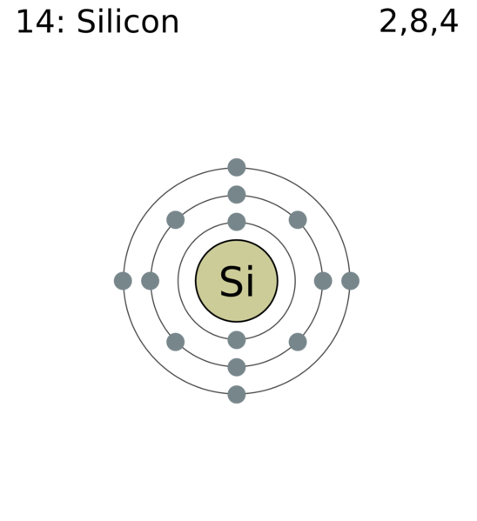
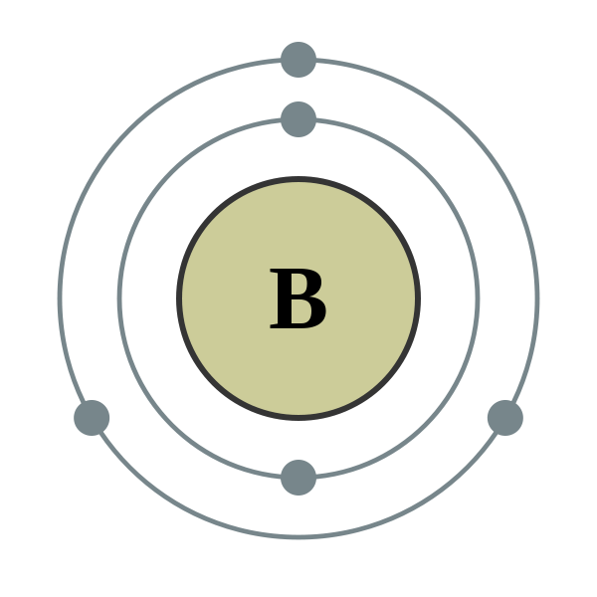

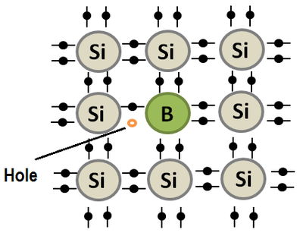


p-type MOS transistor (PFET)
Aside: What is a “hole”?
0 V
p
p
n
[picture from: https://energyeducation.ca/encyclopedia/Electron_hole]
With 0 volts: source and drain connected by layer of positive carriers (“holes”)

Slide 41
P-type MOS Transistor (PFET)
P-type has opposite function to n-type: When source connected to supply voltage (e.g., 2.5V) and gate connected to 0 volts, acts like wire. When gate connected to 2.5 volts then source and drain isolated.
Notes:
2

Slide 42
NOT function
input | output
0 volts | 2.5 volts
2.5 volts | 0 volts
input | output
0 | 1
1 | 0
Text: Dally §4.3.2
Notes:
2

Slide 43
Recall: Effect of Noise on Digital Signals
Voltage
Voltage
Noise
Time
Time
ε
V
V
+
ε
f(V
)
Input
1
+
1
f
1
Output
y
f(x)
x
Text: Dally §1.2
Notes:
1

Slide 44
Key to digital signal restoration:
Transistors don’t turn on/off at exactly 0V and 2.5V
Vin
Vout
Text: Dally §1.2

Slide 45
We have seen how to build a NOT gate
To implement any arbitrary Boolean function we also need a way to implement AND and OR gates

Slide 46
Observation: In steady state NOT output connected either to supply through pull-up OR ground through pull-down. Always one or the other but never both.
NOT uses pull-up network of one PFET transistor and complementary pull-down network of one NFET transistors.
Question: How to design pull-up and pull-down network for arbitrary Boolean function?
Notes:
3

Slide 47
Switch Logic
Input logic variable “a” controls switch and switch controls whether light is on.
Text: Dally §4.1
Notes:
1

Slide 48
AND Switch Circuit
With two switches in series, circuit only closed (light on) if both a and b are true: f = a ∧ b
E.g., if launching nuke both operators should agree
Text: Dally §4.1
Notes:
1

Slide 49
AND Switch Circuit
We omit voltage source and light, but think of switch network as “true” when light would be on.
Further simplify by denoting switch with break in wire labeled with variable controlling switch.
Text: Dally §4.1
Notes:
1

Slide 50
OR Switch Circuit
With two switches in parallel, circuit closed if either logic variable a or b are true: a ∨ b
E.g., when stopping a train apply brakes if anyone sees a problem.
Text: Dally §4.1
Notes:
1.5

Slide 51
CMOS Logic Gate Design
Can build gate to realize boolean function f(x) using NFET switch network that is closed when f(x) is true and PFET switch network that is closed when f(x) is false. Note function must be “inverting” as NFET switch is closed when input is ‘1’.
Pull up network
f(a,b,c)
Pull down network
Text: Dally §4.3
Notes:
2

Slide 52
Recall: Dual Functions
Dual of logic function f, is function f^{D} derived from f by substituting a ∧ for each ∨, a ∨ for each ∧, a 1 for each 0, and a 0 for each 1.
Dual of a function applied to the complement of the input variables equals the complement of the function.
=
Text: Dally §3.3
Notes:
2

Slide 53
Example: f(a,b) = a ∧ b
Pull down network: f(a,b) = a ∧ b
Pull up network: f^{D}(a',b') = a' ∨ b'
Notes:
2

Slide 54
Example: f(a,b) = a ∧ b
Pull down network: f(a,b) = a ∧ b
Notes:
2

Slide 55
Example: f(a,b) = a ∧ b
Pull up network: f(a,b) = f^{D}(a',b') = a' ∨ b'
NOTE: PFET input already inverted (when input ‘1’, switch open instead of closed).
Notes:
2

Slide 56
Example: f(a,b) = a ∧ b
Combine pull up and pull down network
NAND Function
1
1
0
0
a | b | f
0 | 0
0 | 1
1 | 0
1 | 1
1
0
1
0
1
0
1
1
1
0
Remember: PFET open if gate=1; closed if gate=0.
Notes:
2

Slide 57
CMOS NAND gate
a | b | f
0 | 0 | 1
0 | 1 | 1
1 | 0 | 1
1 | 1 | 0
Text: Dally §4.3.2
Notes:
2.5

Slide 58
CMOS NOR gate
A | B | C
0 | 0 | 1
0 | 1 | 0
1 | 0 | 0
1 | 1 | 0
Text: Dally §4.3.2
Notes:
2.5

Slide 59

CMOS AND Gate?
A
B
D
C
D
A
B
Notes:
2

Slide 60
CMOS AND = NAND + NOT
D
D
A
B
A
B
C
A | B | D
0 | 0
0 | 1
1 | 0
1 | 1
Notes:
2

Slide 61
Finally, consider this circuit…
e=1, a=1
e=1, a=0
So far, truth table looks like:
e | a | x
0 | 0
0 | 1
1 | 0 | 1
1 | 1 | 0
Text: Dally §4.3.4
Notes:
2.5

Slide 62
… called a Tri-State Inverter
e=0, a=0
e=0, a=1
e | a | x
0 | 0 | Z
0 | 1 | Z
1 | 0 | 1
1 | 1 | 0
“e” input usually called “enable”
When e=1, acts like a normal inverter
When e=0, output is disconnected
Verilog value for disconnected: z (see use later)
Used if want to drive single wire from two or more places.
Notes:
3

Slide 63
How Are CMOS Gates Used?
Digital Circuit Implementation Approaches
Custom
Semicustom
Cell-based
Array-based
Standard Cells
Macro Cells
Gate Arrays
FPGA's
Compiled Cells

Slide 64
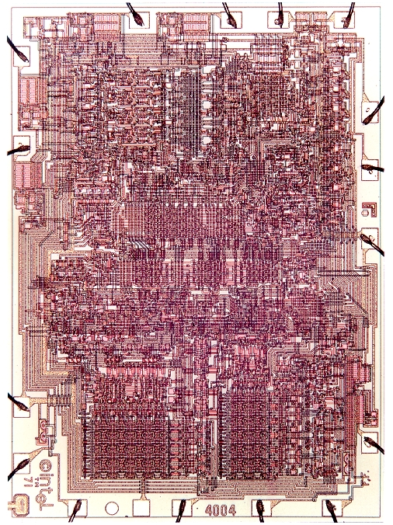
Custom Approach
Intel 4004
NOTE: The Intel 4004 was built using PFETs only (called pMOS).

Slide 65
Cross Section of an Integrated Circuit
M6
via5
Cu
M5
via4
via1
M4
via3
M1
M3
contact
via2
(W)
M2
silicon

Slide 66
[image above from: http://www.tomshardware.com/reviews/semiconductor-production-101,1590-5.html ]

Slide 67
Implementing Logic Circuits
Design Iteration
Design Capture
Behavioral
HDL
Pre-Layout Simulation
Structural
Logic Synthesis
Floorplanning
Post-Layout Simulation
Placement
Physical
Circuit Extraction
Routing
Tape-out

Slide 68
Standard Cell Design
Library of cells that implement different gates
Cells can have different width but all cells have same height (hence Standard Cells)
Cells are placed on rows on Si substrate
Many variants of the same cell (2 input NAND, NOT, 3-input NAND, etc…)

Slide 69
Standard Cell Design
Logic Synthesis
Transform the HDL description into library cells
Placement
Where to place a cell ?
Routing
Connect the placed cells.

Slide 70
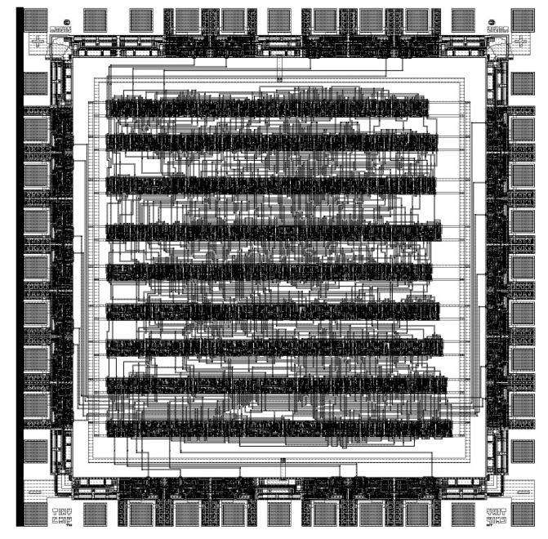
Standard Cell Design: An Example

Slide 71
Standard Cell Design
Routing channel can be narrowed if more interconnect layers are available

Slide 72
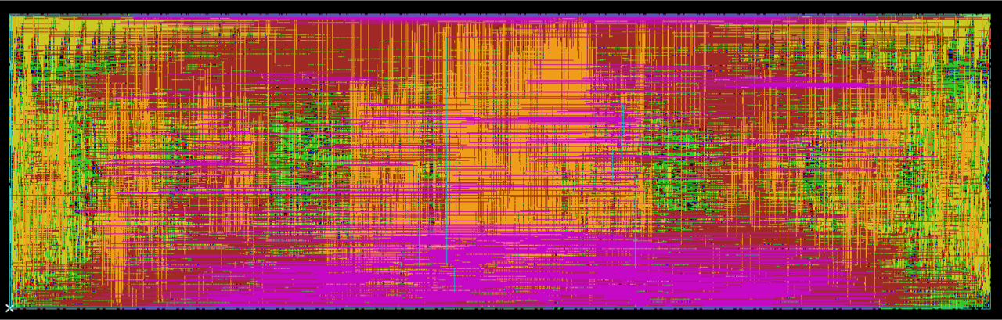
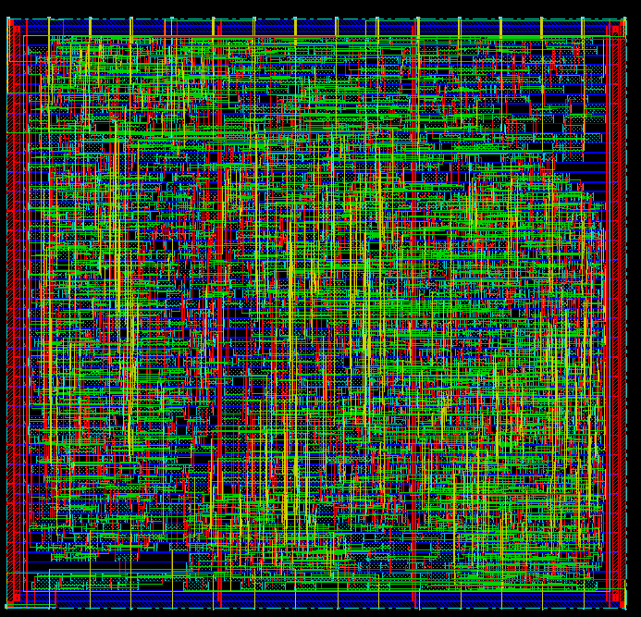
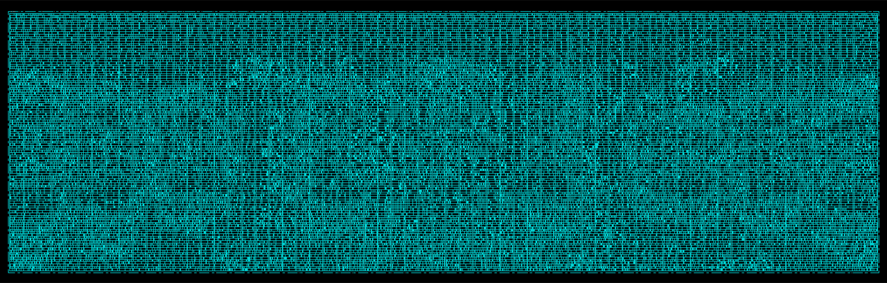
Standard Cell Design: New Generation
Place and route of a special function unit
meant for ML acceleration.
Place and Route of a
16-bit Floating-point Unit.
Cell-structure hidden under interconnect layers

Slide 73
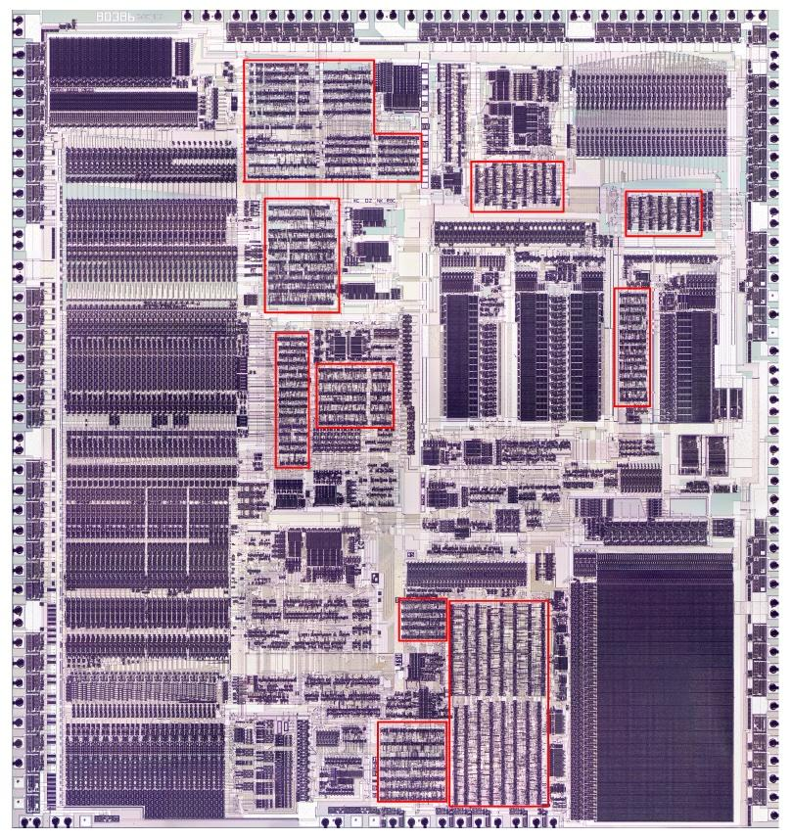
Mixing Standard Cells and Full Custom
Intel 386

Slide 74
Chip Manufacturing (Full Custom, Standard Cell)

Slide 75
[image from: https://www.kitguru.net/components/anton-shilov/tsmc-builds-first-10nm-validation-chips-with-quad-core-arm-cortex-a57/ ]

Slide 76
[image from: https://www.kitguru.net/components/anton-shilov/tsmc-builds-first-10nm-validation-chips-with-quad-core-arm-cortex-a57/ ]

Slide 77
[image from :https://community.cadence.com/cadence_blogs_8/b/breakfast-bytes/archive/2016/03/25/tsmc-manufacturing-status ]

Slide 78
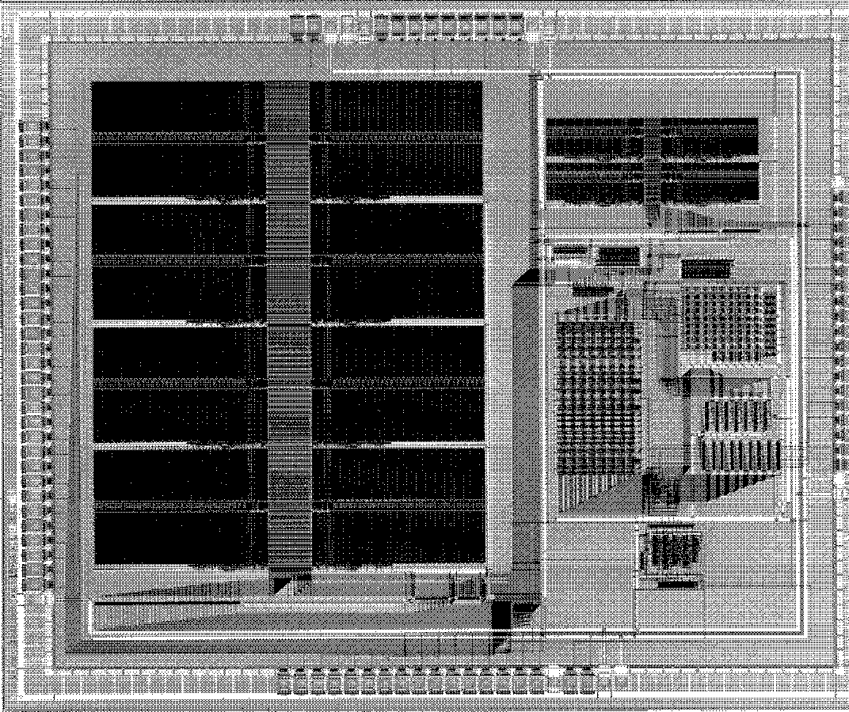
Standard Cell Design: Summary
Used for high-speed or low-power applications
Very expensive, and time consuming
(> $10M just for the mask costs)
Very high “re-spin” cost
More economic than full custom
Today standard cell often used in combination with full custom in chips that sell in large volume.

Slide 79
Serials-Parallel Networks
f = (a ∨ b) ∧ c
E.g., start car if key turned and either clutch pressed or in neutral
Text: Dally §4.1
Notes:
2

Slide 80
Analyzing Series-Parallel Networks
Determine a logic network’s function by repeatedly replacing series or parallel subnetwork with a single switch controlled by the equivalent logical expression.
CMOS majority gate -- see Dally §4.3.3
Text: Dally §4.1
Notes:
3

Slide 81
Complex gates: AND-OR-Invert (AOI)
Useful because uses fewer transistors than would need if combining distinct AND and NOR gate.
Text: Dally §4.3

Slide 82
When Complex Gates?
Typically don’t have more than 6 inputs to a single logic gate
If circuit is larger, need to decompose into multiple simpler gates (e.g., AND, OR, NOT).
Today, when companies like Intel, IBM, NVIDIA, AMD implement a large digital logic chip they use synthesis tools; these are are often given a “menu” of basic logic gates to choose from (called a “standard cell library”).

Slide 83
Summary
Learned how to convert Boolean expressions into logic gates
Two types of MOS transistors (NFET, PFET) used together to make a CMOS gate.
Noise immunity results from operation of transistors as switches with wide input range
Switch networks used to build logic functions
Tri-state inverter can either drive output to 0/1 or leave it “dangling”. Many uses.

