Slide 1
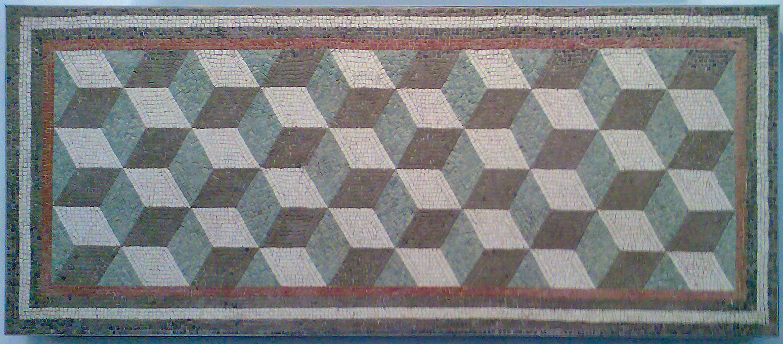
CPEN 211: Computer Systems I
Slide Set 4:
Combinational Logic Building Blocks (1)
Instructor: Tor Aamodt
[Image: Roman Geometric Mosaic. There are some hardware combinational logic designs we use repeatedly, not unlike patterns found in art and nature
Source Wikipedia, By Mbellaccini - Own work, CC BY-SA 4.0, https://commons.wikimedia.org/w/index.php?curid=38150120]
Notes:
1

Slide 2
Learning Objectives
After this slide set you should be able to:
Explain what a one-hot code is
Explain the operation of the following combinational building blocks and use them in your own hardware designs :
  Decoder (binary to one-hot)
  Encoder (one-hot to binary)
  Multiplexer (select one of N)
Notes:
2

Slide 3
Combinational Building Blocks
There are some combinational circuits that appear very frequently. Makes sense to design these “once” and then reuse them.
Learning these is also a great way to practice translating from a logic diagram to Verilog and vis versa.
Text: Dally §8
Notes:
0.5

Slide 4
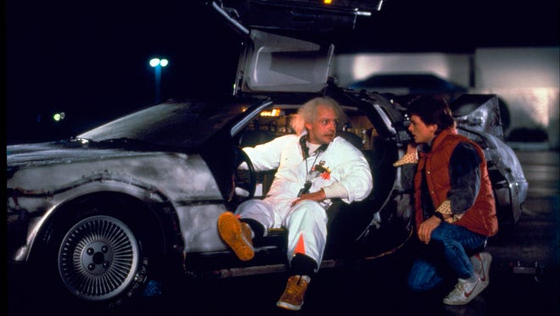
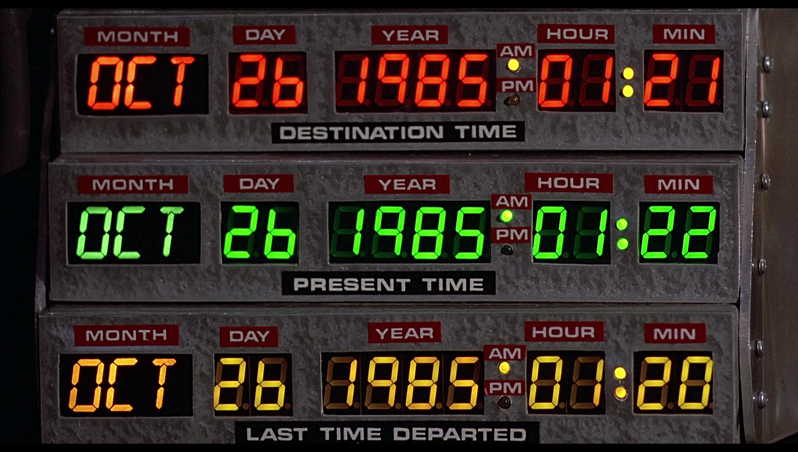
[image source: https://www.partsnotincluded.com/researching-time-circuit-led-displays/]

Slide 5
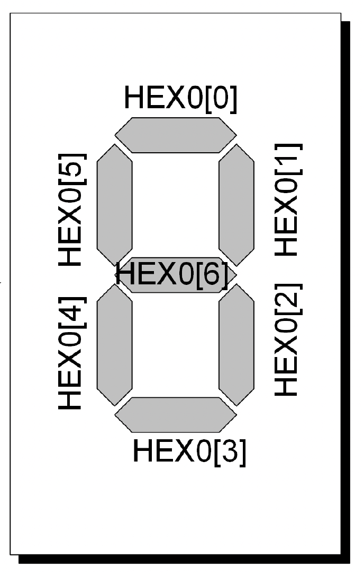
Example: Seven-Segment Decoder
?
0000 (“0”)
0001 (“1”)
0010 (“2”)
…
0111111
0000110
1011011
…

Slide 6
One-hot representation
Represent a set of N elements with N bits
Exactly one bit is set to 1 (all other bits are 0)
Example – encode numbers 0-7:
Binary One-hot
000 00000001
001 00000010
010 00000100
… …
110 01000000
111 10000000
Text: Dally §8.2
Notes:
3

Slide 7
Suppose we are given a number in binary and want to build a circuit that converts this to the corresponding one-hot code.
How might you design such a circuit?
Write out the truth table then, for each output bit draw a KMAP.
However, this is such a common circuit, it has a name…

Slide 8
Decoder
A decoder converts symbols from one code to another.
A binary to one-hot decoder converts a symbol from binary code to a one-hot code.
Used to construct memory (return to see how later)
Binary input a to one-hot output b
b[i] = 1 if a = i
(or b = 1<<a)
Decoder
a
b
n
m
m
2
n
≤
Text: Dally §8.2
Notes:
3

Slide 9
Example of a Decoder
2 4 Decoder
a1 | a0 | b3 | b2 | b1 | b0
0 | 0 | 0 | 0 | 0 | 1
0 | 1 | 0 | 0 | 1 | 0
1 | 0 | 0 | 1 | 0 | 0
1 | 1 | 1 | 0 | 0 | 0
a1 | a0 | b0
0 | 0 | 1
0 | 1 | 0
1 | 0 | 0
1 | 1 | 0
a1 | a0 | b1
0 | 0 | 0
0 | 1 | 1
1 | 0 | 0
1 | 1 | 0
Text: Dally §8.2
Notes:
2

Slide 10
Example of a Decoder
2 4 Decoder
a1 | a0 | b3 | b2 | b1 | b0
0 | 0 | 0 | 0 | 0 | 1
0 | 1 | 0 | 0 | 1 | 0
1 | 0 | 0 | 1 | 0 | 0
1 | 1 | 1 | 0 | 0 | 0
1
1
0
0
1
1
1
1
0
0
0
1
0
0
0
0
Text: Dally §8.2
Notes:
2

Slide 11
3:8 decoder
a2 | a1 | a0 | b7 | b6 | b5 | b4 | b3 | b2 | b1 | b0
0 | 0 | 0 | 0 | 0 | 0 | 0 | 0 | 0 | 0 | 1
0 | 0 | 1 | 0 | 0 | 0 | 0 | 0 | 0 | 1 | 0
0 | 1 | 0 | 0 | 0 | 0 | 0 | 0 | 1 | 0 | 0
0 | 1 | 1 | 0 | 0 | 0 | 0 | 1 | 0 | 0 | 0
⁞ |  |  | ⁞
1 | 1 | 1 | 1 | 0 | 0 | 0 | 0 | 0 | 0 | 0

Slide 12
Encoder
An encoder is an inverse of a decoder.
Encoder is a logic module that converts a one-hot input signal to a binary-encoded output signal.
Example: a 4 2 encoder.
a3 | a2 | a1 | a0 | b1 | b0
0 | 0 | 0 | 1 | 0 | 0
0 | 0 | 1 | 0 | 0 | 1
0 | 1 | 0 | 0 | 1 | 0
1 | 0 | 0 | 0 | 1 | 1
b0 = a3 ∨ a1
b1 = a3 ∨ a2
Text: Dally §8.4
Notes:
3

Slide 13
How to choose one of two different inputs in a digital circuit?

Slide 14
Multiplexer
Often want to select one thing out of many possibilities.
Example: Pick either A0 or A1 as input to module.
Solution: Use a combinational logic block with three inputs select, A0 and A1 where the value of select says whether the output is equal to A0 or A1.
So common, this circuit is given a name, “multiplexer” (or “mux” for short):
0
1
Operation: If select is zero then b = A0 otherwise b = A1
0
1
Text: Dally §8.3
Notes:
3.5

Slide 15
Multiplexer Select Encoding
What is best encoding for “select”?
Two common encodings:
Binary: select=0 means b=A0,
select=1 means b=A1
One hot: select=01 means b=A0
select=10 means b=A1
Text: Dally §8.3
Notes:
3.5

Slide 16
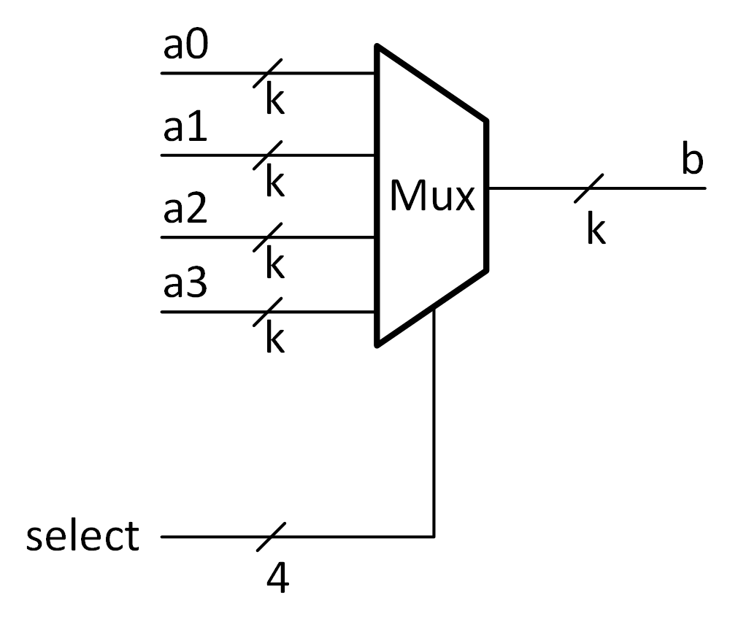
Example: k-bit, 4 to 1 multiplexer with one-hot select
If select = 0001, then b = a0
If select = 0010, then b = a1
If select = 0100, then b = a2
If select = 1000, then b = a3

Slide 17
Multiplexer
Multiplexer:
  n k-bit inputs
  n-bit one-hot select signal s
  Multiplexers are commonly used as data selectors
Selects one of n k-bit inputs
s must be one-hot
b=a[i] if s [i] = 1
Text: Dally §8.3
Notes:
3.5

Slide 18
Multiplexer (n=2,k=1)
s1 | s0 | A0 | A1 | b
0 | 1 | 0 | 0 | 0
0 | 1 | 0 | 1 | 0
0 | 1 | 1 | 0 | 1
0 | 1 | 1 | 1 | 1
1 | 0 | 0 | 0 | 0
1 | 0 | 0 | 1 | 1
1 | 0 | 1 | 0 | 0
1 | 0 | 1 | 1 | 1
0
1
1
1
1
Question: How to build this circuit out of gates?

Slide 19
Let’s design this multiplexer…
s1 | s0 | A0 | A1 | b
0 | 0 | 0 | 0
0 | 0 | 0 | 1
0 | 0 | 1 | 0
0 | 0 | 1 | 1
0 | 1 | 0 | 0 | 0
0 | 1 | 0 | 1 | 0
0 | 1 | 1 | 0 | 1
0 | 1 | 1 | 1 | 1
1 | 0 | 0 | 0 | 0
1 | 0 | 0 | 1 | 1
1 | 0 | 1 | 0 | 0
1 | 0 | 1 | 1 | 1
1 | 1 | 0 | 0
1 | 1 | 0 | 1
1 | 1 | 1 | 0
1 | 1 | 1 | 1

Slide 20
Multiplexer Implementation
k=1, n=4
1
0
0
1
0
0
1
1
1
1
0
0
0
Text: Dally §8.3
Notes:
3

Slide 21
1-bit, 2-input One-Hot Select Mux
Symbol:
Implementation with
AND and OR gates:

Slide 22
2-bit, 3-input Mux

Slide 23
k-bit Binary-Select Multiplexer
Start with one hot select mux:
Selects one of n k-bit inputs
s must be one-hot
b=a[i] if s [i] = 1
Text: Dally §8.3
Notes:
3

Slide 24
1-bit, 4-input: Binary-Select Multiplexer
Add decoder:
k=1, m=2, n=4
3-input AND gates result from combining two 2-input AND gates: one from decoder and one from one-hot select Mux.
Text: Dally §8.3
Notes:
1.5

Slide 25
Recall: Tri-state inverter
e=0, a=1
e | a | x
0 | 0 | Z
0 | 1 | Z
1 | 0 | 1
1 | 1 | 0

Slide 26
Multiplexer Implementation
k=1, n=4
1
0
0
1
0
0
1
1
1
1
0
0
0
Tri-State Buffer
Text: Dally §8.3
Notes:
3

Slide 27

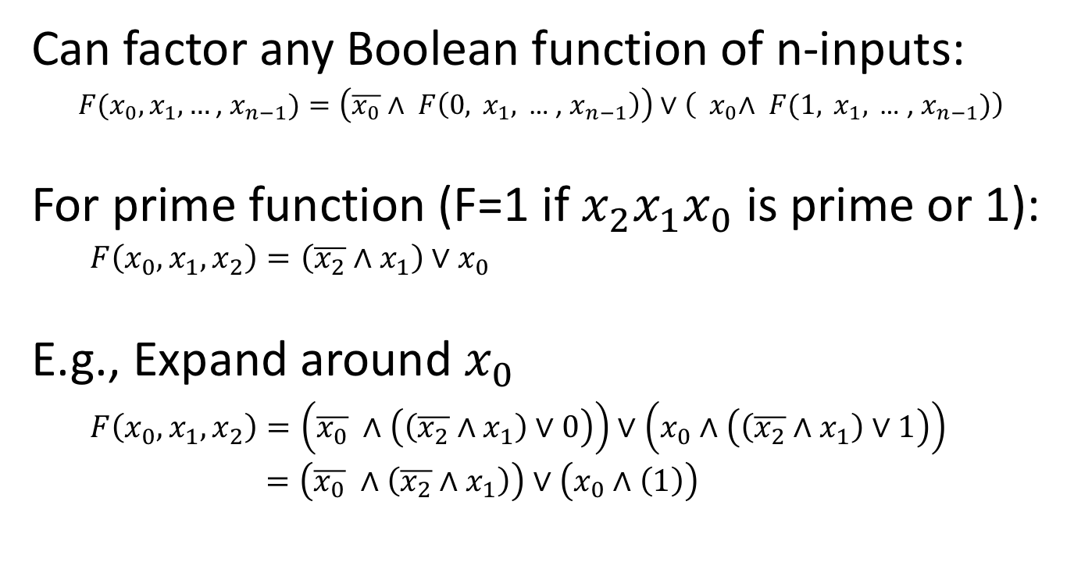

Recall: Shannon Expansion
Can factor any Boolean function of n-inputs:
$F(x_{0},x_{1},…\text{, }x_{n−1})=\left(\overline{x_{0}}∧ F\left(0, x_{1},\text{ … , }x_{n−1}\right)\right)∨\left({ x}_{0}∧ F(1, x_{1},\text{ … , }x_{n−1})\right)$
For prime function (F=1 if ${x_{2}x}_{1}x_{0}$ is prime or 1):
$F\left(x_{0},x_{1},x_{2}\right)=\left(\overline{x_{2}}∧x_{1}\right)∨x_{0}$
E.g., Expand around $x_{0}$
$F\left(x_{0},x_{1},x_{2}\right)=\left(\overline{x_{0}} ∧\left(\left(\overline{x_{2}}∧x_{1}\right)∨0\right)\right)∨\left(x_{0}∧\left(\left(\overline{x_{2}}∧x_{1}\right)∨1\right)\right)$
$=\left(\overline{x_{0}} ∧\left(\overline{x_{2}}∧x_{1}\right)\right)∨\left(x_{0}∧\left(1\right)\right)$
$$\left(\overline{x_{2}}∧x_{1}\right)$$
0
i
s
p
r
i
m
e
1
1
1
$$x_{0}$$

Slide 28

Next, expand around $x_{1}$:
$F\left(x_{0},x_{1},x_{2}\right)=\left(\overline{x_{0}} ∧\left(\overline{x_{2}}∧x_{1}\right)\right)∨\left(x_{0}∧\left(1\right)\right)$
$=\left(\overline{x_{1}} ∧\left(\left(\overline{x_{0}} ∧\left(\overline{x_{2}}∧0\right)\right)∨\left(x_{0}∧\left(1\right)\right)\right)\right)∨\left(x_{1}∧\left(\left(\overline{x_{0}} ∧\left(\overline{x_{2}}∧1\right)\right)∨\left(x_{0}∧\left(1\right)\right)\right)\right)$
$=\left(\overline{x_{1}} ∧\overline{x_{0}} ∧\left(0\right) \right)∨\left({\overline{x_{1}} ∧x}_{0}∧\left(1\right)\right)∨\left(x_{1}∧\overline{x_{0}} ∧\left(\overline{x_{2}}\right)\right)∨\left(x_{1}∧x_{0}∧\left(1\right)\right)$
0
0
1
1
i
s
p
r
i
m
e
x₂
2
1
3
2
x₁
x₀

Slide 29
Logic with Muxes
0
1
1
0
0
1
1
1
i
s
p
r
i
m
e
i
s
p
r
i
m
e
0
Muxb
x₂
2
1
1
3
0
2
1
3
x₁
x₀
x₂
x₁
x₀
Text: Dally §8.3

Slide 30
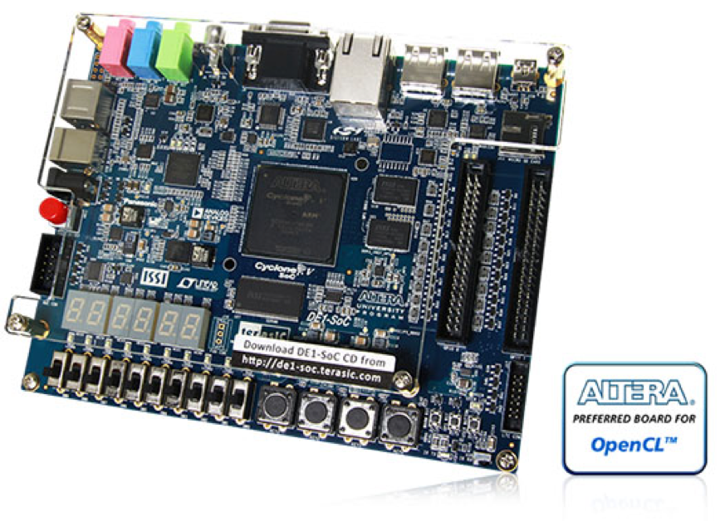
What’s Inside an FPGA?

Slide 31
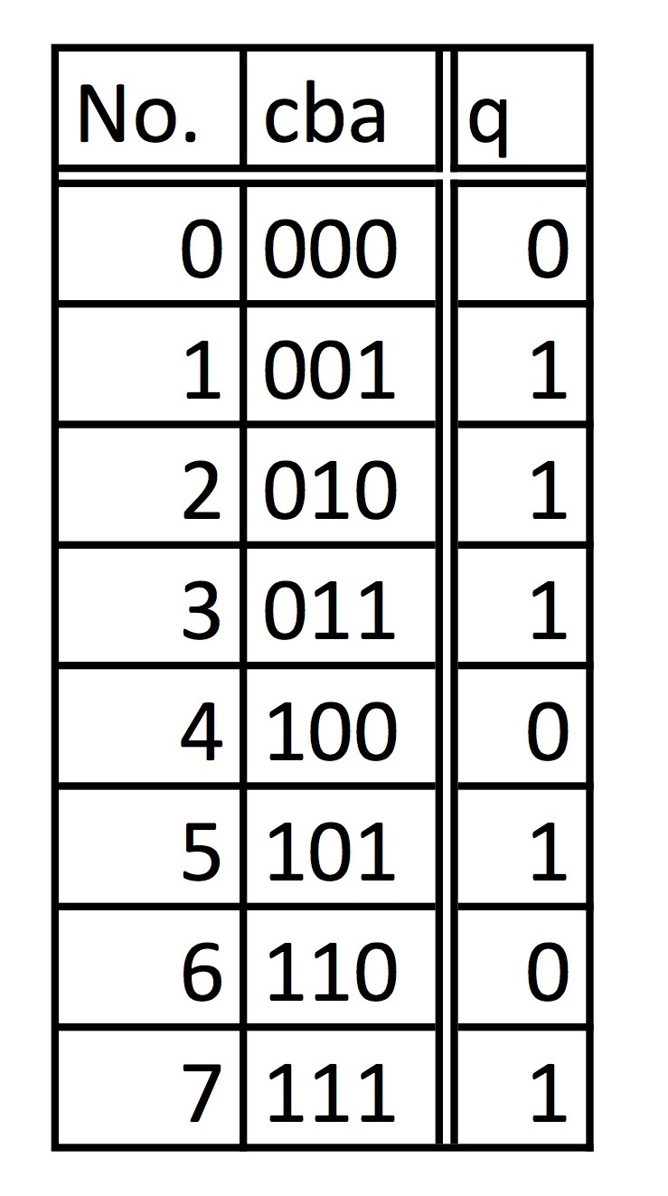
What’s Inside an FPGA?
Basic Logic Gate: Lookup-Table
Function of each lookup table can be configured by shifting in bit-stream. Lookup table is basically a hardware implementation of a “truth table” storing the output for each different input in one of the rows.
3
Inputs
Truth table for isprime:
0
1
Bit-Stream (.sof file)
1
1
Muxb
0
1
0
1

Slide 32
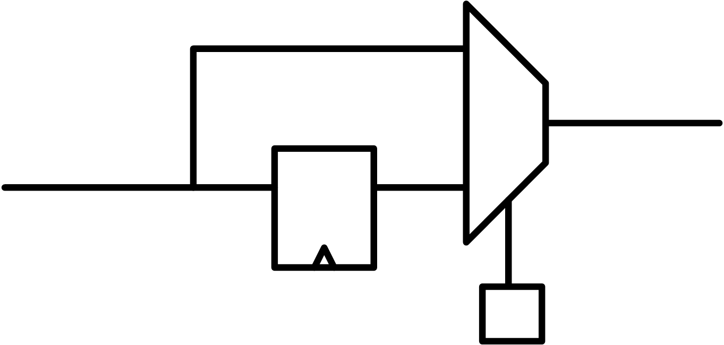
FPGA Logic Block:
Lookup Table
3
Inputs
Mux selects between output of lookup table, or flip-flop
that connects to output of lookup table. Mux select input is programmed by configuration bit-stream as well.
Muxb

Slide 33
What’s Inside an FPGA?

Slide 34
Reconfigurable Logic:
Connect Logic Blocks using Fixed Metal Tracks and Programmable Switches

Slide 35
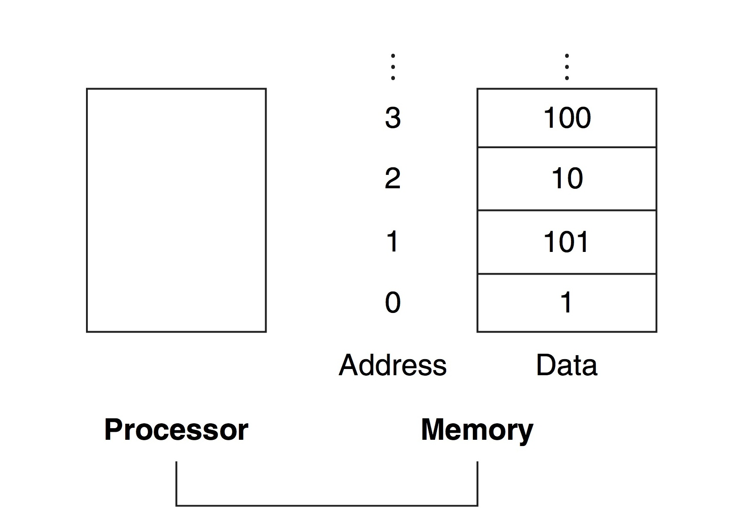
Memory
Notes:
This figure shows an abstracted view of main memory in a computer. The main memory is on the right and is connected to the processor on the left…
… using a bus…

Slide 36
Memory
Memory is one of the most important structures inside a computer (or any digital system)
Memory is composed of large number of locations that can be uniquely identified and can store a value
“8 gigabytes (8GB)” means 8 billion memory locations*, each containing 1 byte (8-bits) of information.
Each location is uniquely identified by its “address”
Total number of locations is called the “address space”
Number of bits stored in each location is “addressability”
Let’s look at a special type of memory called read-only memory (ROM) – values cannot be modified
* Actually, 8 x 1024 x 1024 x 1024 = 8,589,934,592 locations

Slide 37
Read-only memory (ROM)
Above ROM contains 2^{n} (read-only) memory locations each storing m-bits of data
Text: Dally §8.8
Notes:
2

Slide 38
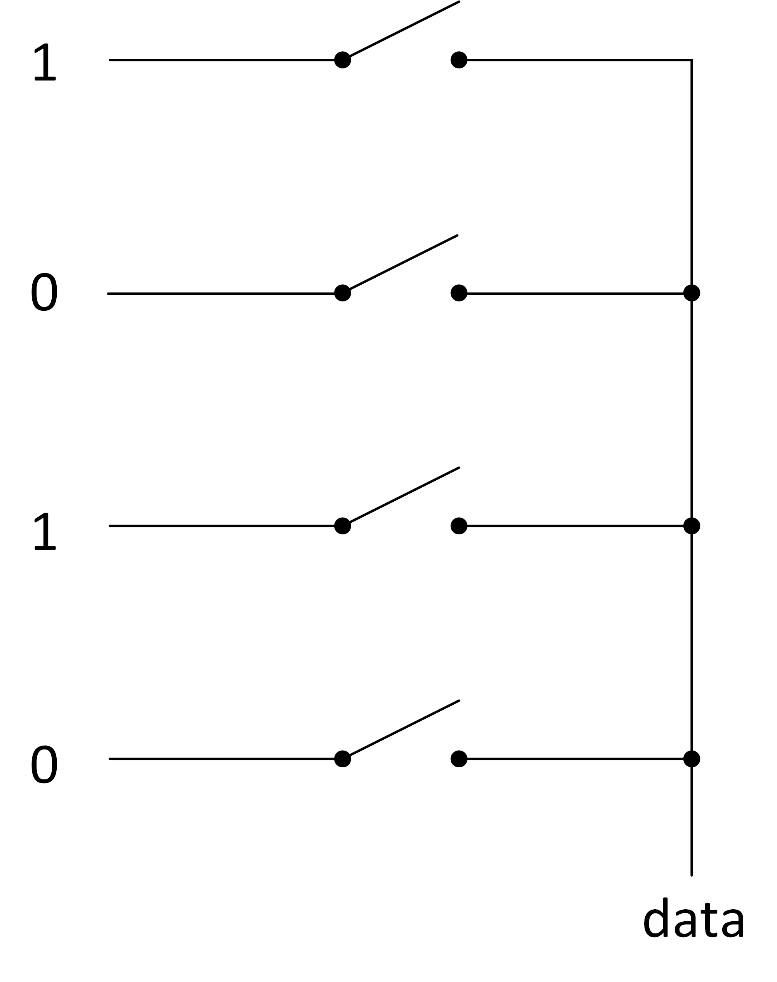
Example Read Only Memory (n=2, m=1)
Switch
Stored Data:
2² x 1-bit words
Simplified view (e.g., omits logic for controlling switches)
This memory stores 2² = 4 “words” where each word is 1-bit
Each address is 2-bits long.
Address space contains 4 locations.
Addressability is 1-bit.

Slide 39
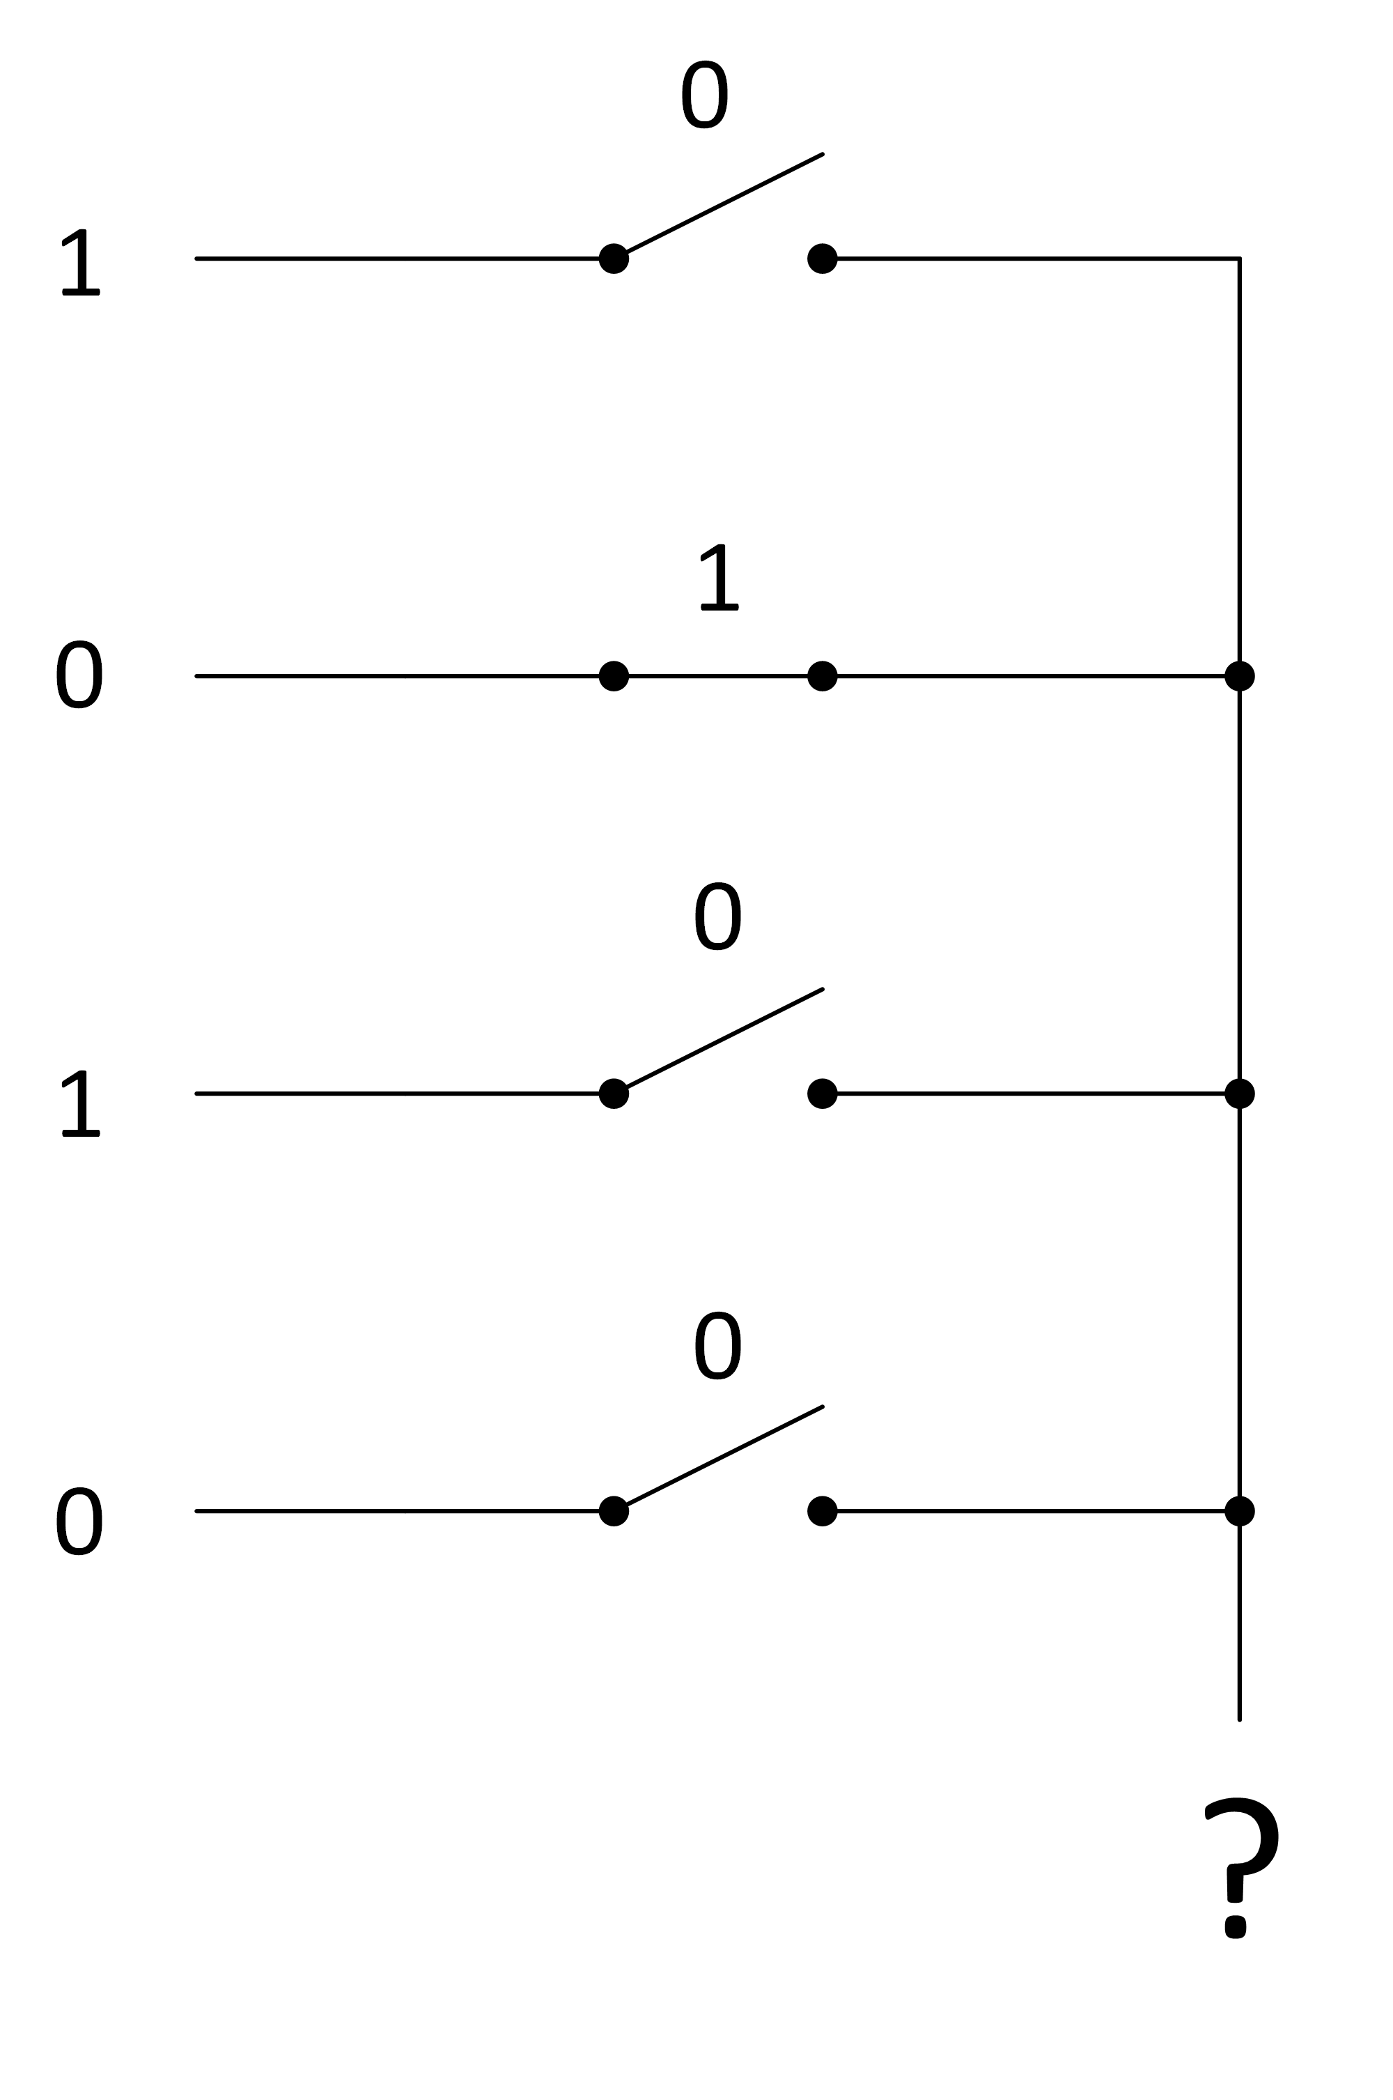
Example: n=2, m=1
“0” on “control input”
means switch “open”
“1” on “control input”
means switch “open”

Slide 40
Read-only memory (ROM) – internal structure
“Tri-state driver” – acts
Like a switch where input
on side of triangle is
“control input”.
Text: Dally §8.8
Notes:
2

Slide 41
2-D array implementation
Text: Dally §8.8
Notes:
3

Slide 42
What’s Inside an FPGA? Continued…
FPGA vendors embed fixed blocks to improve speed and density:
Embedded Memories (blocks of 2K-18K)
To use these memory blocks we
Need to follow the coding
Style in the Quartus manual

Slide 43
What’s Inside an FPGA?
FPGA vendors embed fixed blocks to improve speed and density:
Embedded Memories (blocks of 2K-18K)
Multiplier Blocks

Slide 44
What’s Inside an FPGA?
FPGA vendors embed fixed blocks to improve speed and density:
Embedded Memories (blocks of 2K-18K)
Multiplier Blocks
High-Speed I/Os
Dedicated Clock Circuitry
CPU (eg. ARM Cortex-A9
in Cyclone V on DE1-SoC)

Slide 45
Factoring
Many combinational blocks can be built up out of multiple smaller versions of the same block

Slide 46
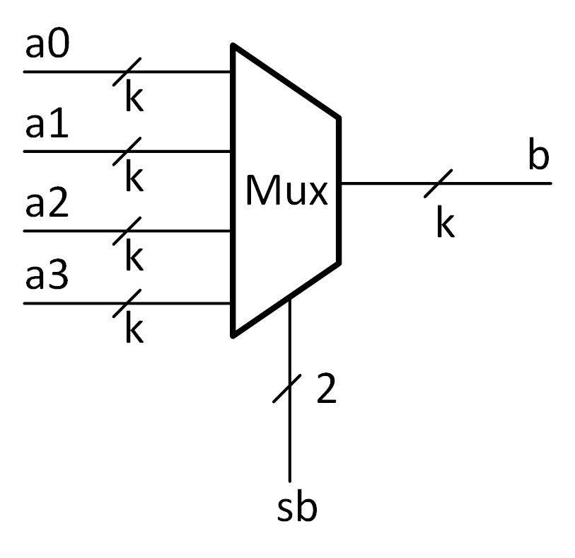
Example: 4-Input Binary Select Multiplexer
Text: Dally §8.3

Slide 47
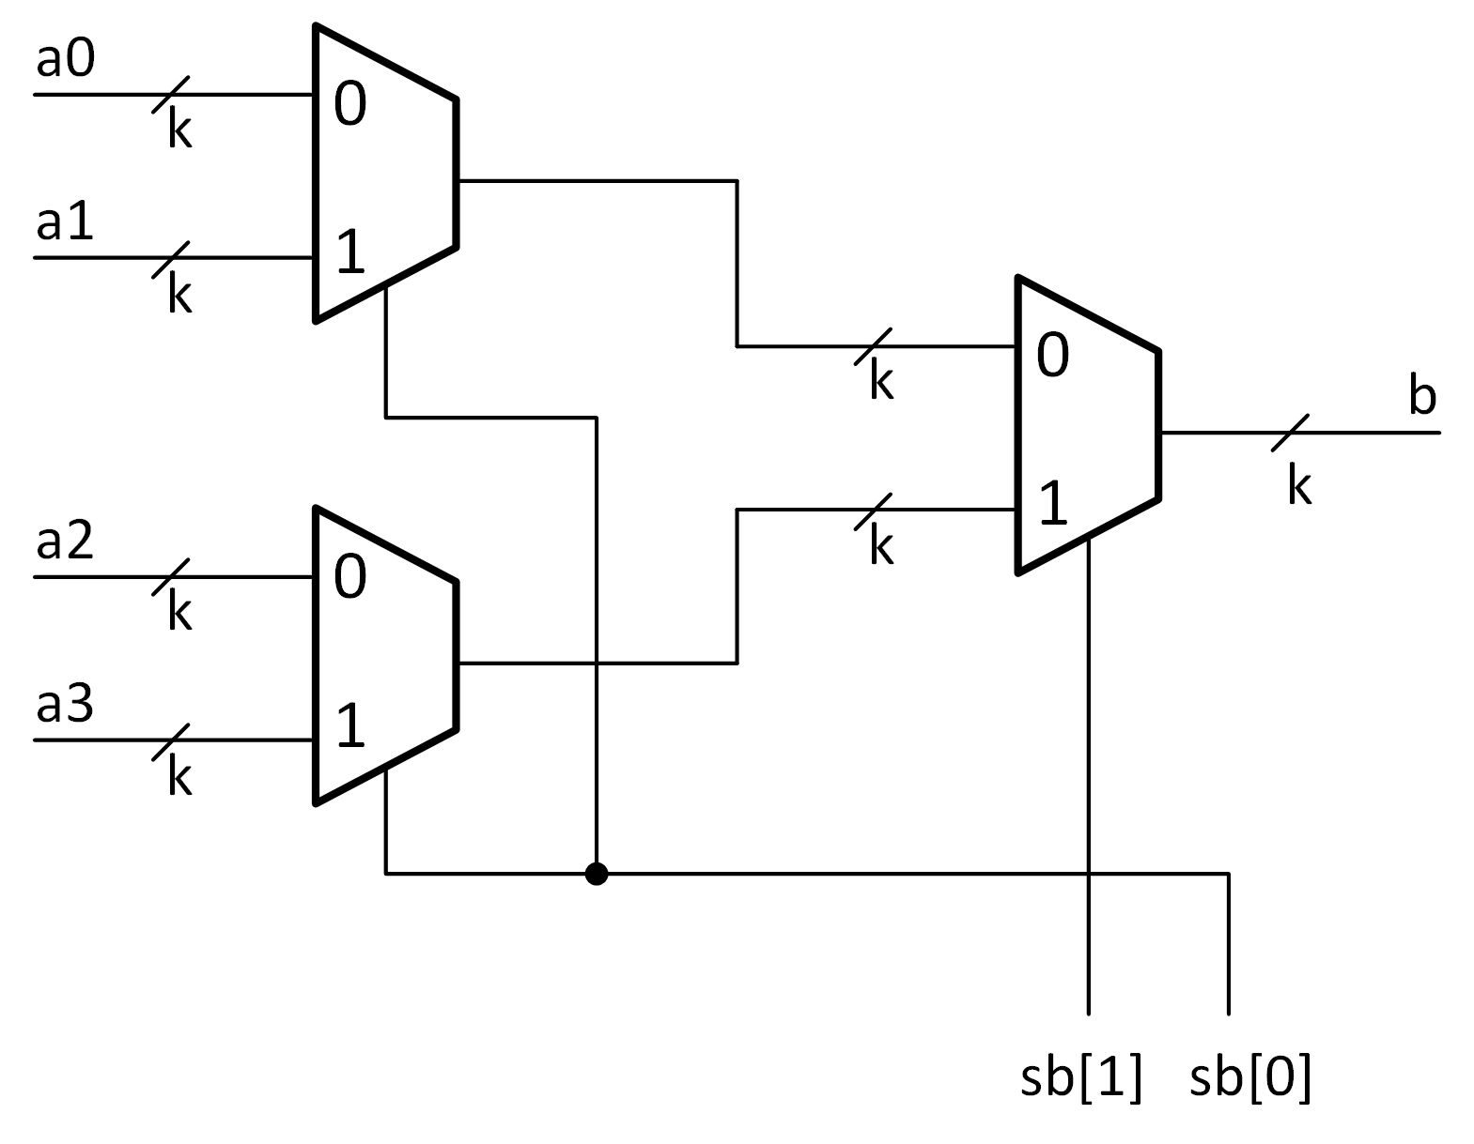
Example: 4-Input Binary Select Multiplexer
Text: Dally §8.3

Slide 48
Designing A Large Encoder – 16→4 from five 4→2s
First, encode lower 2 bits.
Next, want to encode upper 2 bits. Can do that with an encoder where input is one hot vector summarizing which encoder has a one on input.
0
High bits
0000
a
[
1
5
:
1
2
]
4:2
2
Low bits
15 14 13 12
4
00
0
0
0000
a
[
1
1
:
8
]
4:2
2
0
4:2
b
[
3
:
2
]
11 10 9 8
4
00
1
2
01
One hot
input
0
1
0010
a
[
7
:
4
]
4:2
2
7 6 5 4
4
01
0
0000
4:2
b
[
1
:
0
]
a
[
3
:
0
]
2
01
3 2 1 0
4
00
2
Text: Dally §8.4
Notes:
3

Slide 49
Example: Larger Decoders
Decoders used for constructing memory are LARGE (e.g., 6:64, 7:128, etc…)
Building large decoder using same approach as for 2:4 and 3:8 is inefficient
Want to build a large decoder using fewer transistors

Slide 50
Don’t freak out if you don’t understand the next ~15 slides. You will do fine in this course even if you don’t get this example.
It is however a useful and “interesting” example

Slide 51
Reconsider 2:4 Decoder
yb
Truth Table
y1
y0
yb | y1 | y0
0 | 0 | 1
1 | 1 | 0
A 1:2 decoder!
Text: Dally §8.2

Slide 52
Reconsider 2:4 Decoder
2:4 decoder can be built out of two 1:2 decoders combined using four AND gates.
One AND gate for each output.
How to extend to larger decoders?
Hard part: Knowing which small decoder outputs to AND together.
xb
yb
x1
x0
y1
y0
Text: Dally §8.2

Slide 53
Geometric Interpretation: Big picture
Divide input bus into N smaller busses such that every input wire is part of just one of the smaller buses
Any input bus value has a corresponding set of values assigned to each of the N smaller busses.
Let the smaller busses specify positions in an N-dimensional space. Notice: Each point in this space corresponds to just one input value.
Let each decoder output be represented by one of these positions.
Use AND gate to verify each of the N smaller busses has the value that corresponds to this output.
Simplify AND gate inputs by using one-hot code.

Slide 54
2:4 Decoder Geometric Interpretation
(xb,yb) specify coordinate in Euclidean space:
The 2:4 decoder output that has value of 1 indicates which point (xb,yb) corresponds to.
1
yb
0
0
1
xb
Text: Dally §8.2

Slide 55
2:4 Decoder Geometric Interpretation
(xb,yb) specify coordinate in Euclidean space:
The 2:4 decoder output that has value of 1 indicates which point (xb,yb) corresponds to.
0
1
0
{xb,yb}=00₂
Decoder
a
b
0
yb
1
0
0
1
xb
Text: Dally §8.2

Slide 56
2:4 Decoder Geometric Interpretation
(xb,yb) specify coordinate in Euclidean space:
The 2:4 decoder output that has value of 1 indicates which point (xb,yb) corresponds to.
0
1
0
{xb,yb}=01₂
Decoder
a
b
1
yb
0
0
0
1
xb
Text: Dally §8.2

Slide 57
2:4 Decoder Geometric Interpretation
(xb,yb) specify coordinate in Euclidean space:
The 2:4 decoder output that has value of 1 indicates which point (xb,yb) corresponds to.
0
1
1
{xb,yb}=10₂
Decoder
a
b
0
yb
0
0
0
1
xb
Text: Dally §8.2

Slide 58
2:4 Decoder Geometric Interpretation
(xb,yb) specify coordinate in Euclidean space:
The 2:4 decoder output that has value of 1 indicates which point (xb,yb) corresponds to.
1
1
0
{xb,yb}=11₂
Decoder
a
b
0
yb
0
0
0
1
xb
Text: Dally §8.2

Slide 59
2:4 Decoder Geometric Interpretation
(x1,x0) is one-hot code indicating x value
(y1,y0) is one-hot code indicating y value
y1=1
yb
y0=1
x0=1
x1=1
xb
Text: Dally §8.2

Slide 60
2:4 Decoder Geometric Interpretation
(x1,x0) is one-hot code indicating x-dimension
(y1,y0) is one-hot code indicating y-dimension
b[0] is 1 when x0 = 1 AND y0 = 1
Same as “b0 = x0 ⋀ y0”
0
0
{xb,yb}=00₂
Decoder
a
b
0
yb
1
y0=1
x0=1
xb
0₁₀
00₂
Text: Dally §8.2

Slide 61
2:4 Decoder Geometric Interpretation
(x1,x0) is one-hot code indicating x-dimension
(y1,y0) is one-hot code indicating y-dimension
b[1] is 1 when x0 = 1 AND y1 = 1
Same as “b1 = x0 ⋀ y1;”
0
y1=1
0
{xb,yb}=01₂
Decoder
a
b
1
yb
0
x0=1
xb
1₁₀
01₂
Text: Dally §8.2

Slide 62
2:4 Decoder Geometric Interpretation
(x1,x0) is one-hot code indicating x-dimension
(y1,y0) is one-hot code indicating y-dimension
b[2] is 1 when x1 = 1 AND y0 = 1
Same as “b2 = x1 ⋀ y0;”
0
1
{xb,yb}=10₂
Decoder
a
b
0
yb
0
y0=1
x1=1
xb
2₁₀
10₂
Text: Dally §8.2

Slide 63
2:4 Decoder Geometric Interpretation
(x1,x0) is one-hot code indicating x-dimension
(y1,y0) is one-hot code indicating y-dimension
b[3] is 1 when x1 = 1 AND y1 = 1
Same as “b3 = x1 ⋀ y1;”
1
y1=1
0
{xb,yb}=11₂
Decoder
a
b
0
yb
0
x1=1
xb
3₁₀
11₂
Text: Dally §8.2

Slide 64
6:64 Decoder Geometric Interpretation
Build 6 → 64 decoder from three 2 → 4 decoders
  Think of each bit of output as one point in a cube
Each 2→4 decodes 2 bits of input “a”
  a[5:4]→x[3:0]
  a[3:2]→y[3:0]
  a[1:0]→z[3:0]
Example: input a = 011010
a5 | a4 | x3 | x2 | x1 | x0
0 | 0 | 0 | 0 | 0 | 1
0 | 1 | 0 | 0 | 1 | 0
1 | 0 | 0 | 1 | 0 | 0
1 | 1 | 1 | 0 | 0 | 0
a3 | a2 | y3 | y2 | y1 | y0
0 | 0 | 0 | 0 | 0 | 1
0 | 1 | 0 | 0 | 1 | 0
1 | 0 | 0 | 1 | 0 | 0
1 | 1 | 1 | 0 | 0 | 0
a1 | a0 | z3 | z2 | z1 | z0
0 | 0 | 0 | 0 | 0 | 1
0 | 1 | 0 | 0 | 1 | 0
1 | 0 | 0 | 1 | 0 | 0
1 | 1 | 1 | 0 | 0 | 0
Text: Dally §8.2
Notes:
3

Slide 65
2-Stage decoder
Text: Dally §8.2
Notes:
2

Slide 66
Advantage Of Dividing Large Decoder
6->64 decoder requires:
  64 6-input AND gates (384 inputs)
6->64 decoder using 2->4 decoders requires:
  12 2-input AND gates (24 inputs)
  64 3-input AND gates (192 inputs)
Faster, smaller, lower power
Text: Dally §8.2
Notes:
1.5

Slide 67
Summary
We learned about three combinational logic building blocks: decoder, encoder, mux
We saw how to design them using truth tables and optimize them using Boolean algebra
Learned how an FPGA works
Saw how a read-only-memory works.
Saw how to build larger building blocks out of smaller building blocks.

