Slide 1
CPEN 211: Introduction to Microcomputers
Slide Set 5: Sequential Logic
WARNING: Be sure to complete the online portion of Flipped Lecture #2
before the start of lecture on Tue 24 Sep 2024 or you will lose marks.
Instructor: Prof. Tor Aamodt
Notes:
1

Slide 2


Slide 3
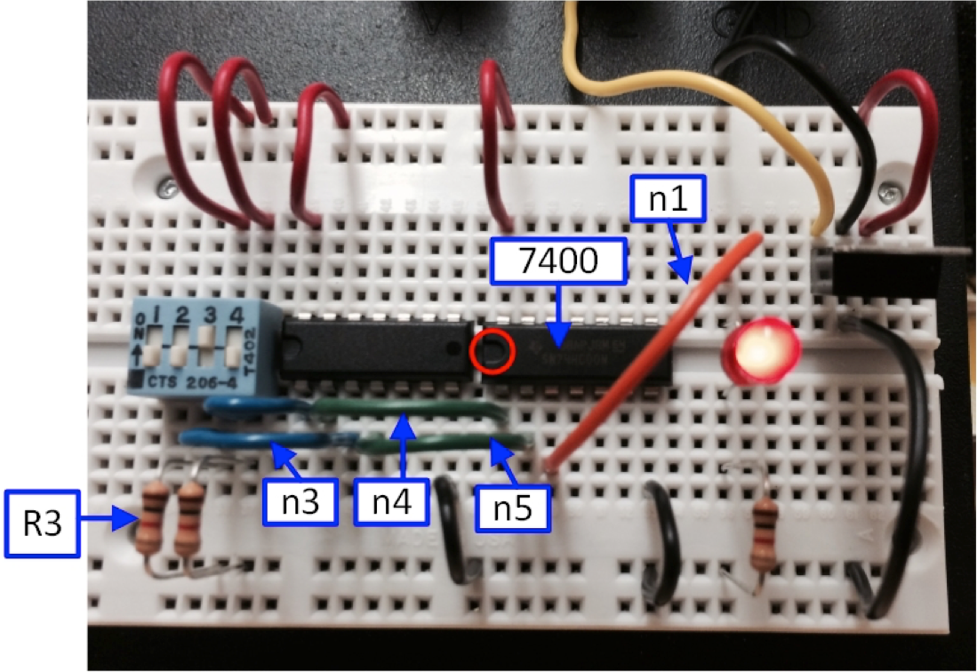

Slide 5





Slide 6
Sensor
Trigger
Design
This
Block
On
/
Off
Alarm
Reset
Specification:
Alarm goes on as soon as sensor pulse on “Trigger” is detected and then stays on until “Reset” is asserted.

Slide 7
d
q
D
Q
^
clk

Slide 9
Sequential logic has state
Combinational Logic
Sequential Logic
Text: Dally §14.1

Slide 10
Text: Dally §14.1

Slide 11
DeMorgan Graphically
=
=
Notes:
1.5

Slide 12



$$q_{new}=¬r ∧ (s∨ q_{old})$$
$$=¬1 ∧ (s∨ q_{old})$$
$$=0 ∧ (s∨ q_{old})$$
Text: Dally §14.1

Slide 13
Axioms of Boolean Algebra
Axioms: a set of mathematical statements that we assert to be true.
Identity:
  0 ∧ x = 0
  1 ∨ x = 1
Idempotence:
  1 ∧ x = x
  0 ∨ x = x
Negation:
  ¬0 = 1
  ¬1 = 0
Text: Dally §3.1
Notes:
2

Slide 14


a | b | AND
0 | 0 | 0
0 | 1 | 0
1 | 0 | 0
1 | 1 | 1
$$q_{new}=¬r ∧ (s∨ q_{old})$$
$$=¬1 ∧ (s∨ q_{old})$$
$$=0 ∧ (s∨ q_{old})$$
$$=0$$
Text: Dally §14.1

Slide 15
r | s | q_{old} | q_{new}
1 | 0 | 1
r | s | q_{old} | q_{new}
1 | 0 | 1 | 0
r | s | q_{old} | q_{new}
1 | 0 | 1 | 0
1 | 0 | 0
r | s | q_{old} | q_{new}
1 | 0 | 1 | 0
1 | 0 | 0 | 0
r | s | q_{old} | q_{new}
1
r | s | q_{old} | q_{new}
$$q_{new}=¬r ∧ (s∨ q_{old})$$
Text: Dally §14.1

Slide 16




r | s | q_{old} | q_{new}
1 | 0 | 1 | 0
1 | 0 | 0 | 0
0 | 0 | 0
r | s | q_{old} | q_{new}
1 | 0 | 1 | 0
1 | 0 | 0 | 0
0 | 0 | 0 | 0
$$q_{new}=¬r ∧ (s∨ q_{old})$$
$$=¬0 ∧ (0∨0)$$
$$=1 ∧0$$
$$=0$$
Text: Dally §14.1

Slide 17

$$q_{new}=¬r ∧ (s∨ q_{old})$$
$$=¬0 ∧ (1∨ q_{old})$$
Text: Dally §14.1

Slide 18
Axioms of Boolean Algebra
Axioms: a set of mathematical statements that we assert to be true.
Identity:
  0 ∧ x = 0
  1 ∨ x = 1
Idempotence:
  1 ∧ x = x
  0 ∨ x = x
Negation:
  ¬0 = 1
  ¬1 = 0
Text: Dally §3.1
Notes:
2

Slide 19


r | s | q_{old} | q_{new}
1 | 0 | 1 | 0
1 | 0 | 0 | 0
0 | 0 | 0 | 0
0 | 1 | 0
$$q_{new}=¬r ∧ (s∨ q_{old})$$
$$=¬0 ∧ (1∨ q_{old})$$
$$=1 ∧1$$
$$=1$$
Text: Dally §14.1

Slide 20
$$q_{new}=¬r ∧ (s∨ q_{old})$$
Text: Dally §14.1

Slide 21
Reset-Set (RS) Latch
q=0 if r=1
q=1 if s=1 and r=0
and q holds last value if r=0 and s=0
What happens if s=1 and r=1?
Normally, we do not use an RS-latch this way.
Text: Dally §14.1

Slide 22
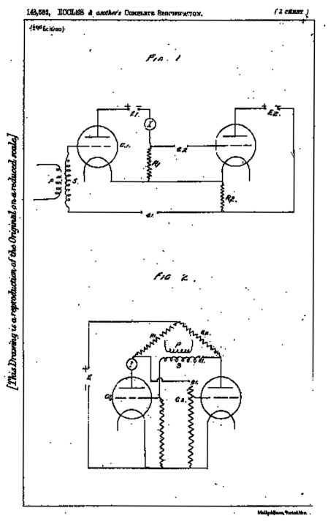

Slide 23
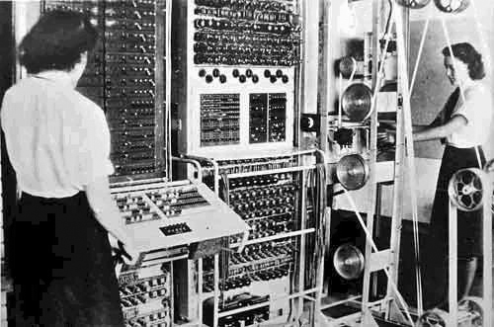

Slide 24
Reset-Set (RS) Latch
q=0 if r=1
q=1 if s=1 and r=0
and q holds last value if r=0 and s=0
What happens if s=1 and r=1?
Normally, we do not use an RS-latch this way.
Text: Dally §14.1

Slide 25

Reset-Set (RS) Latch
$$q_{new}=¬r ∧ (s∨ q_{old})$$
Text: Dally §14.1

Slide 26
Reset-Set (RS) Latch
This is the more common way an RS-Latch is drawn (does not follow bubble rule).
Text: Dally §14.1

Slide 27
Gated RS Latch
1
1
1
0
1
0
a | b | AND
0 | 0 | 0
0 | 1 | 0
1 | 0 | 0
1 | 1 | 1
q=0 if rg=1
q=1 if sg=1 and rg=0
and q holds last value if rg=0 and sg=0

Slide 28
Gated RS Latch
1
→ 0
1
1
→ 0
0
1
0
a | b | AND
0 | 0 | 0
0 | 1 | 0
1 | 0 | 0
1 | 1 | 1
q=0 if rg=1
q=1 if sg=1 and rg=0
and q holds last value if rg=0 and sg=0

Slide 29
Gated RS Latch
When clk is high, operates like a normal RS latch
When clk is low, maintains value, regardless of r and s

Slide 30
This is called level-sensitive, since the operation depends on the level of the CLK signal.

Slide 31
Gated RS Latch

Slide 32
Gated RS Latch
Equivalent circuit:
Notes:
Cost of a CMOS transistor in today’s digital electronics is “cheaper than a printed character in the Sunday NY Times” [Moore].
20-16 = 4 transistors. If transistors are so cheap do 4 matter?
Multiply by billions used in your gadgets. Pay 20/16 = 1.25 => 25% more for your next smartphone, tablet, laptop, etc…?

Slide 33
0
0
1
1

Slide 34
0
0
0
1
1
For Gated RS-Latch:
When clk is high, operates like a normal RS latch
When clk is low, maintains value, regardless of r and s

Slide 35
1
1
1
0
0
For Gated RS-Latch:
When clk is high, operates like a normal RS latch
When clk is low, maintains value, regardless of r and s

Slide 36
0
0
1
0
1
For Gated RS-Latch:
When clk is high, operates like a normal RS latch
When clk is low, maintains value, regardless of r and s

Slide 37
D Latch
If clk is high, Q becomes equal to D
If clk is low, Q maintains its value (regardless of D)
This is also level-sensitive

Slide 38
Timing Diagram for a Level-Sensitive D-Latch
x

Slide 41
Timing Diagram for a Level-Sensitive D-Latch
x

Slide 42
Symbol for the level-sensitive D-latch:
D
Q
Clk
Q

Slide 43
Hazards
b
a
a
c
0
0
0
1
1
1
1
0
0
0
0
1
1
b
v
c
0
1
3
2
c
1
0
1
1
0
4
5
7
6
b
a
v
c
Static-1 hazard
Time:
0ns
1ns
2ns
3ns
4ns
5ns
6ns
Text: Dally §6.10
Notes:
3

Slide 44
Wanted: Edge sensitive behavior

Slide 45
Edge Triggered D Flip-Flop
This specific circuit implementation of D Flip-Flop is called a “master-slave” flip-flop
Text: Dally §27.2 (you may ignore discussion of setup/hold time)

Slide 47
D Flip-Flop
x

Slide 48
Verilog design style – for synthesizable modules
Combinational modules use only
  Assign statements
  Case or Casex statements (with default)
  If statements – only if all signals have a default assignment
  Instantiations of other combinational modules
Sequential modules use only
  Combinational logic
  Explicitly declared registers (flip-flops)
Do not use
  Loops
  Always blocks except for case, casex, or if
Do use
  Signal concatenation, e.g., {a, b} = {c, d}
  Signal subranges, e.g., a[7:1] = b[6:0] ;
Logic is organized into small modules
  Leaf modules not more than 40 lines
  If it could be made two modules, it should be
Text: Dally §Appendix

Slide 49
Verilog design style – for synthesizable modules (page 2)
Use lots of comments
  Comments themselves
  Meaningful signal names – tempHigh, not th
  Meaningful module names – DaysInMonth, not Mod3
Activation lists for case statements include ALL inputs (or use *)
Constants
  All constants are `defined if used more than once
  Width of all constants is specified 5’d31, not 31
Signals
  Buses (multi-bit signals) are numbered high to low
    e.g., wire [31:0] bus
  All signals should be high-true (except primary inputs and outputs)
Visualize the logic your Verilog will generate.
  If you can’t visualize it, the result will not be pretty
Text: Dally §Appendix

Slide 50
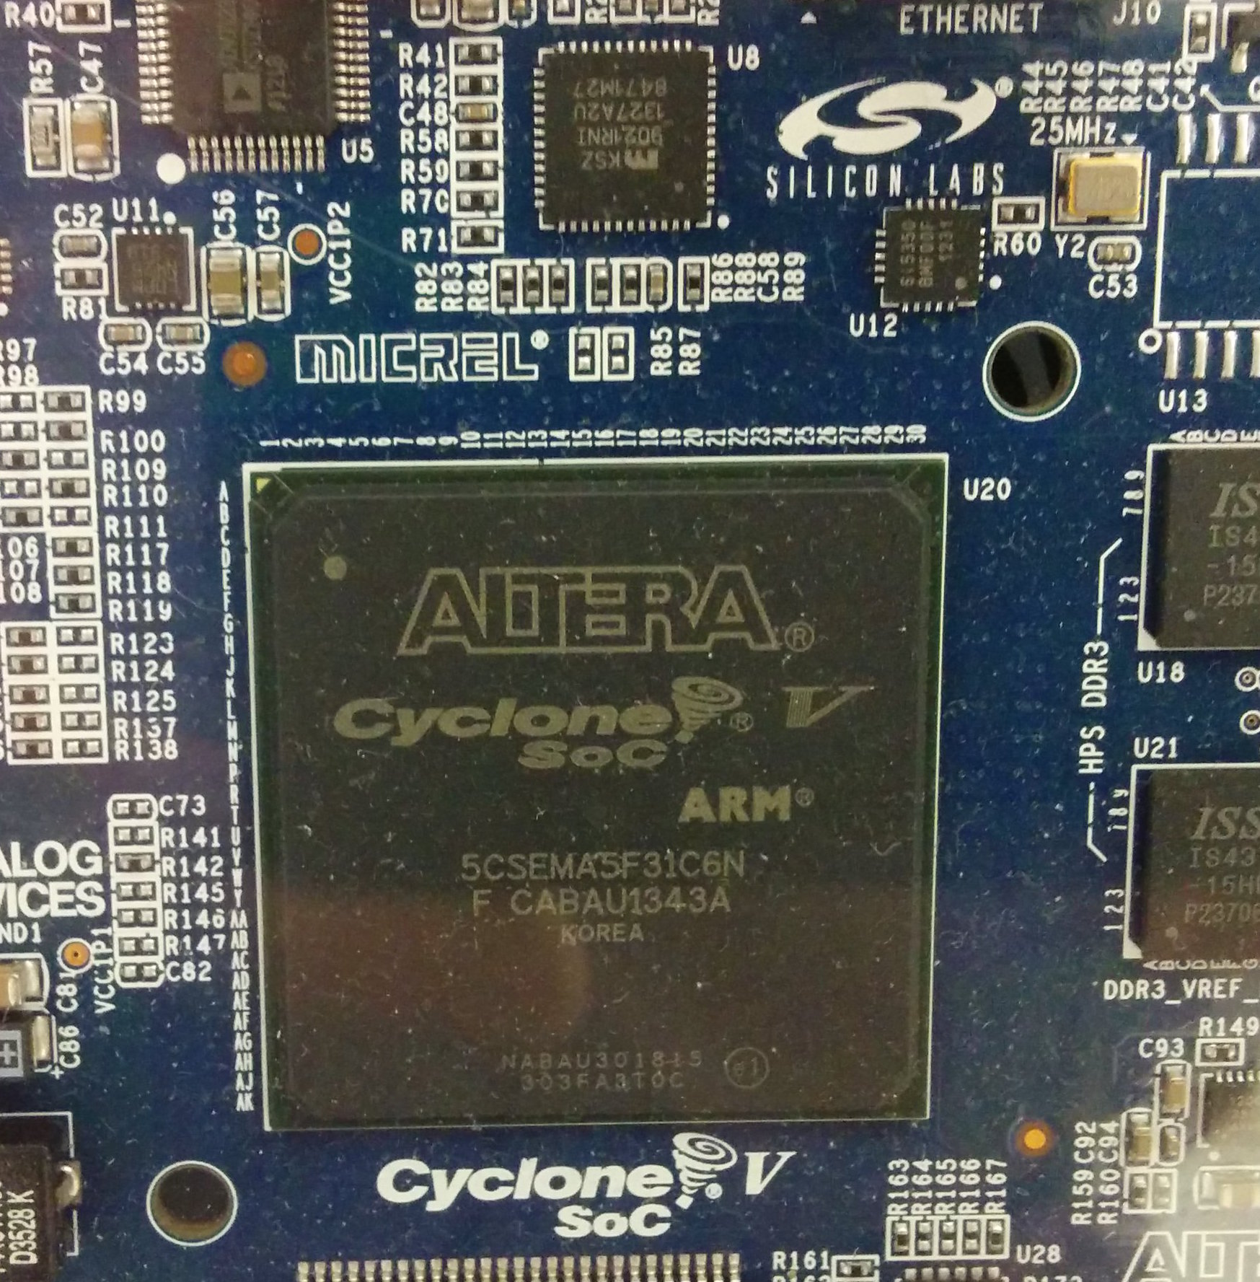

Slide 51
D Flip-Flop
x

Slide 52
D Flip-Flop
d
q
D
Q
Input: D, Clock
Output: Q
Q outputs a steady value
Edge on Clock changes Q to be D
Flip-flop stores state
Allows sequential circuits to iterate
^
clk
Text: Dally §14.2

Slide 53
Representing Information with Digital Signals
Binary Information
Light On/Off: 1/0
Element of a set
000 | White
001 | Red
010 | Blue
011 | Yellow
100 | Purple
101 | Orange
110 | Green
111 | Black
Continuous Quantities: E.g., temperature
000 | 68
001 | 70
010 | 72
011 | 74
100 | 76
101 | 78
110 | 80
111 | 82
0000000 | 68
0000001 | 70
0000011 | 72
0000111 | 74
0001111 | 76
0011111 | 78
0111111 | 80
1111111 | 82
Text: Dally §1.3

Slide 54
N-bit Register
N flip-flops, each storing an N-bit value:
d
N
N
q
D
Q
^
clk
Text: Dally §14.2

Slide 55
Example: 4-bit Register
=

Slide 56

[Patt §3.6]
Notes:
1.5

Slide 57
[Patt §3.6]
Notes:
1.5

Slide 58
Synchronous Sequential Logic
Text: Dally §14.2

Slide 59
Hazards
b
a
a
c
0
0
0
1
1
1
1
0
0
0
0
1
1
b
v
c
0
1
3
2
c
1
0
1
1
0
4
5
7
6
b
a
v
c
Static-1 hazard
Time:
0ns
1ns
2ns
3ns
4ns
5ns
6ns
Text: Dally §6.10
Notes:
3

Slide 60
Voltage
Time

Slide 61
Synchronous Sequential Logic
Text: Dally §14.2

Slide 62
Example Sequential Circuit: Increment
n
Adder
n
n
  D
  Q
1
^
clk
Text: Dally §14.2

Slide 63
Example: A Traffic-Light Controller
carew
Text: Dally §14.3

Slide 64
Traffic Light FSM
Finite state machine is specified by
  States, Inputs, Outputs
Four states
  gns: Green north-south (red east-west)
  yns: Yellow north-south (red east-west)
  gew: Green east-west (red north-south)
  yew: Yellow east-west (red north-south)
Input
  Carew: is there a car waiting on the east-west road
  Reset: return to initial state (need not go through yellow)
Output: Two 3-bit traffic light signals (1-hot) (gyr gyr)
  100 001: NS green, EW red; 001 010 NS red, EW yellow
Text: Dally §14.3

Slide 65
One-hot representation
Represent a set of N elements with N bits
Exactly one bit is set to 1 (all other bits are 0)
Example – encode numbers 0-7:
Binary One-hot
000 00000001
001 00000010
010 00000100
… …
110 01000000
111 10000000
Text: Dally §8.2
Notes:
3

Slide 66
Traffic Light FSM
Finite state machine is specified by
  States, Inputs, Outputs
Four states
  gns: Green north-south (red east-west)
  yns: Yellow north-south (red east-west)
  gew: Green east-west (red north-south)
  yew: Yellow east-west (red north-south)
Input
  Carew: is there a car waiting on the east-west road
  Reset: return to initial state (need not go through yellow)
Output: Two 3-bit traffic light signals (1-hot) (gyr gyr)
  100 001: NS green, EW red; 001 010 NS red, EW yellow
Text: Dally §14.3

Slide 67
Complete Traffic Light State machine
¬carew | rst
carew & ¬rst
¬rst
¬rst
gns
100 001
yns
010 001
gew
001 100
yew
001 010
rst
rst
*
state
output
carew = car east-west sensor active
= gyr gyr
rst = reset
ns
ew
Text: Dally §14.3

Slide 68
State Table (ignoring reset for now)
¬carew
carew
¬carew
carew
Text: Dally §14.3

Slide 69
State Assignment
Assign values to encode each state (gns, yns, gew, yew) on state and next_state signals
Text: Dally §14.4

Slide 70
One-Hot State Assignment
Text: Dally §14.4

Slide 71
Translating No-Reset FSM To One-Hot Controller
¬carew
carew
*
*
gns
100 001
yns
010 001
gew
001 100
yew
001 010
*
*
ns
ew
D
Q
D
Q
D
Q
D
Q
^
^
^
^
carew
clk
Input logic (one-hot states): OR of arrows into the corresponding state in state diagram.
Text: Dally §14.5

Slide 72
Binary State Assignment (Gray Code)
Text: Dally §14.4

Slide 73
Encoded state table and next-state K-maps
ns1
s1s0
s0
c
00
01
11
10
0
c
1
s1
ns1 = s0
Text: Dally §14.5

Slide 74
Logic Equations
¬carew
carew
Text: Dally §14.5

Slide 75
Logic Equations
¬carew
carew
Text: Dally §14.5

Slide 76
Implementation of traffic-light controller with binary state assignment
carew
Text: Dally §14.5

Slide 77
Alternative State Table Representation for Next State Logic
s1s0 | c | ns1 | ns0 | output
00 | 0 | 0 | 0 | 100001
00 | 1 | 0 | 1 | 100001
01 | 0 | 1 | 1 | 010001
01 | 1 | 1 | 1 | 010001
10 | 0 | 0 | 0 | 001010
10 | 1 | 0 | 0 | 001010
11 | 0 | 1 | 0 | 001100
11 | 1 | 1 | 0 | 001100
s1s0 | c | ns1 | ns0 | output
00 | 0 | 0 | 0
00 | 1
01 | 0
01 | 1
10 | 0
10 | 1
11 | 0
11 | 1
s1s0 | c
00 | 0
00 | 1
01 | 0
s1s0 | c | ns1 | ns0 | output
00 | 0 | 0 | 0 | 100001
00 | 1 | 0 | 1 | 100001
01 | 0 | 1 | 1
01 | 1
10 | 0
10 | 1
11 | 0
11 | 1
s1s0 | c | ns1 | ns0 | output
00 | 0
00 | 1
01 | 0
01 | 1
10 | 0
10 | 1
11 | 0
11 | 1
s1s0 | c | ns1 | ns0 | output
00 | 0 | 0 | 0 | 100001
00 | 1
01 | 0
01 | 1
10 | 0
10 | 1
11 | 0
11 | 1
s1s0 | c
00 | 0
00 | 1
s1s0 | c
00 | 0
s1s0 | c
00 | 0
00 | 1
01 | 0
01 | 1
10 | 0
10 | 1
11 | 0
11 | 1
s1s0 | c | ns1 | ns0 | output
00 | 0 | 0 | 0 | 100001
00 | 1 | 0 | 1
01 | 0
01 | 1
10 | 0
10 | 1
11 | 0
11 | 1
s1s0 | c
s1s0 | c
00 | 0
00 | 1
01 | 0
01 | 1
10 | 0
10 | 1
11 | 0
s1s0 | c
00 | 0
00 | 1
01 | 0
01 | 1
10 | 0
10 | 1
s1s0 | c
00 | 0
00 | 1
01 | 0
01 | 1
s1s0 | c
00 | 0
00 | 1
01 | 0
01 | 1
10 | 0
s1s0 | c | ns1 | ns0 | output
00 | 0 | 0 | 0 | 100001
00 | 1 | 0 | 1 | 100001
01 | 0
01 | 1
10 | 0
10 | 1
11 | 0
11 | 1
s1s0 | c | ns1 | ns0 | output
00 | 0 | 0 | 0 | 100001
00 | 1 | 0 | 1 | 100001
01 | 0 | 1 | 1 | 010001
01 | 1
10 | 0
10 | 1
11 | 0
11 | 1
s1s0 | c | ns1 | ns0 | output
00 | 0 | 0 | 0 | 100001
00 | 1 | 0 | 1 | 100001
01 | 0 | 1 | 1 | 010001
01 | 1 | 1 | 1 | 010001
10 | 0
10 | 1
11 | 0
11 | 1

Slide 78
Summary
RS-latch remembers the past
Gated RS-latch only changes its output when the clock input is high
D latch simplifies design by using a single input that represents the value we want to store
To simplify reasoning about delays in circuits we will use the edge-sensitive D flip-flop in the labs
To design a state machine we start with a state diagram, create a state table then encode the states.
To encode states use either a one-hot or grey code.

