Slide 1
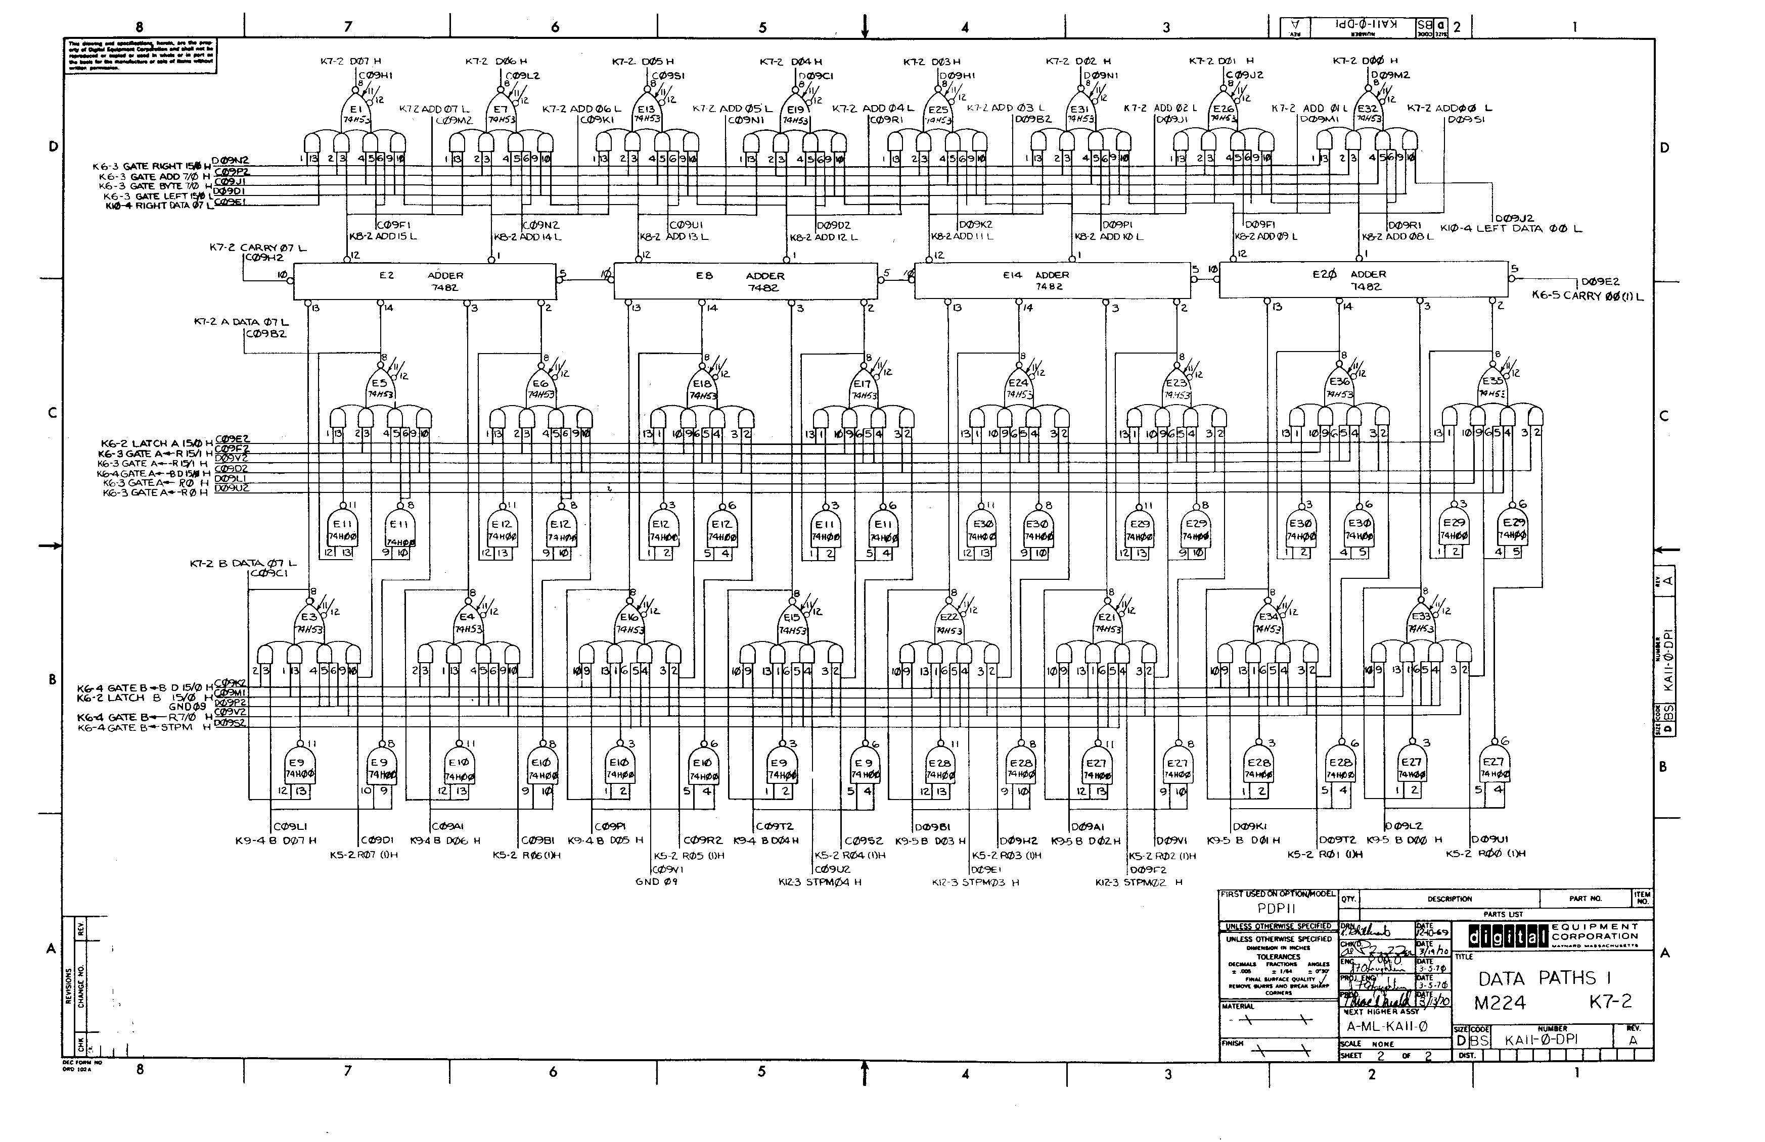
CPEN 211: Introduction to Microcomputers
Slide Set 6: Verilog for Combinational Logic
Prof. Tor Aamodt
[ Background image: Logic gate diagram for a portion of the PDP 11 data path; The PDP 11 was a famous “minicomputer” from the 1970s.
Copyright © DEC. Source: http://www.psych.usyd.edu.au/pdp-11/Images/11_20_dp.gif ]
Notes:
0.5

Slide 2

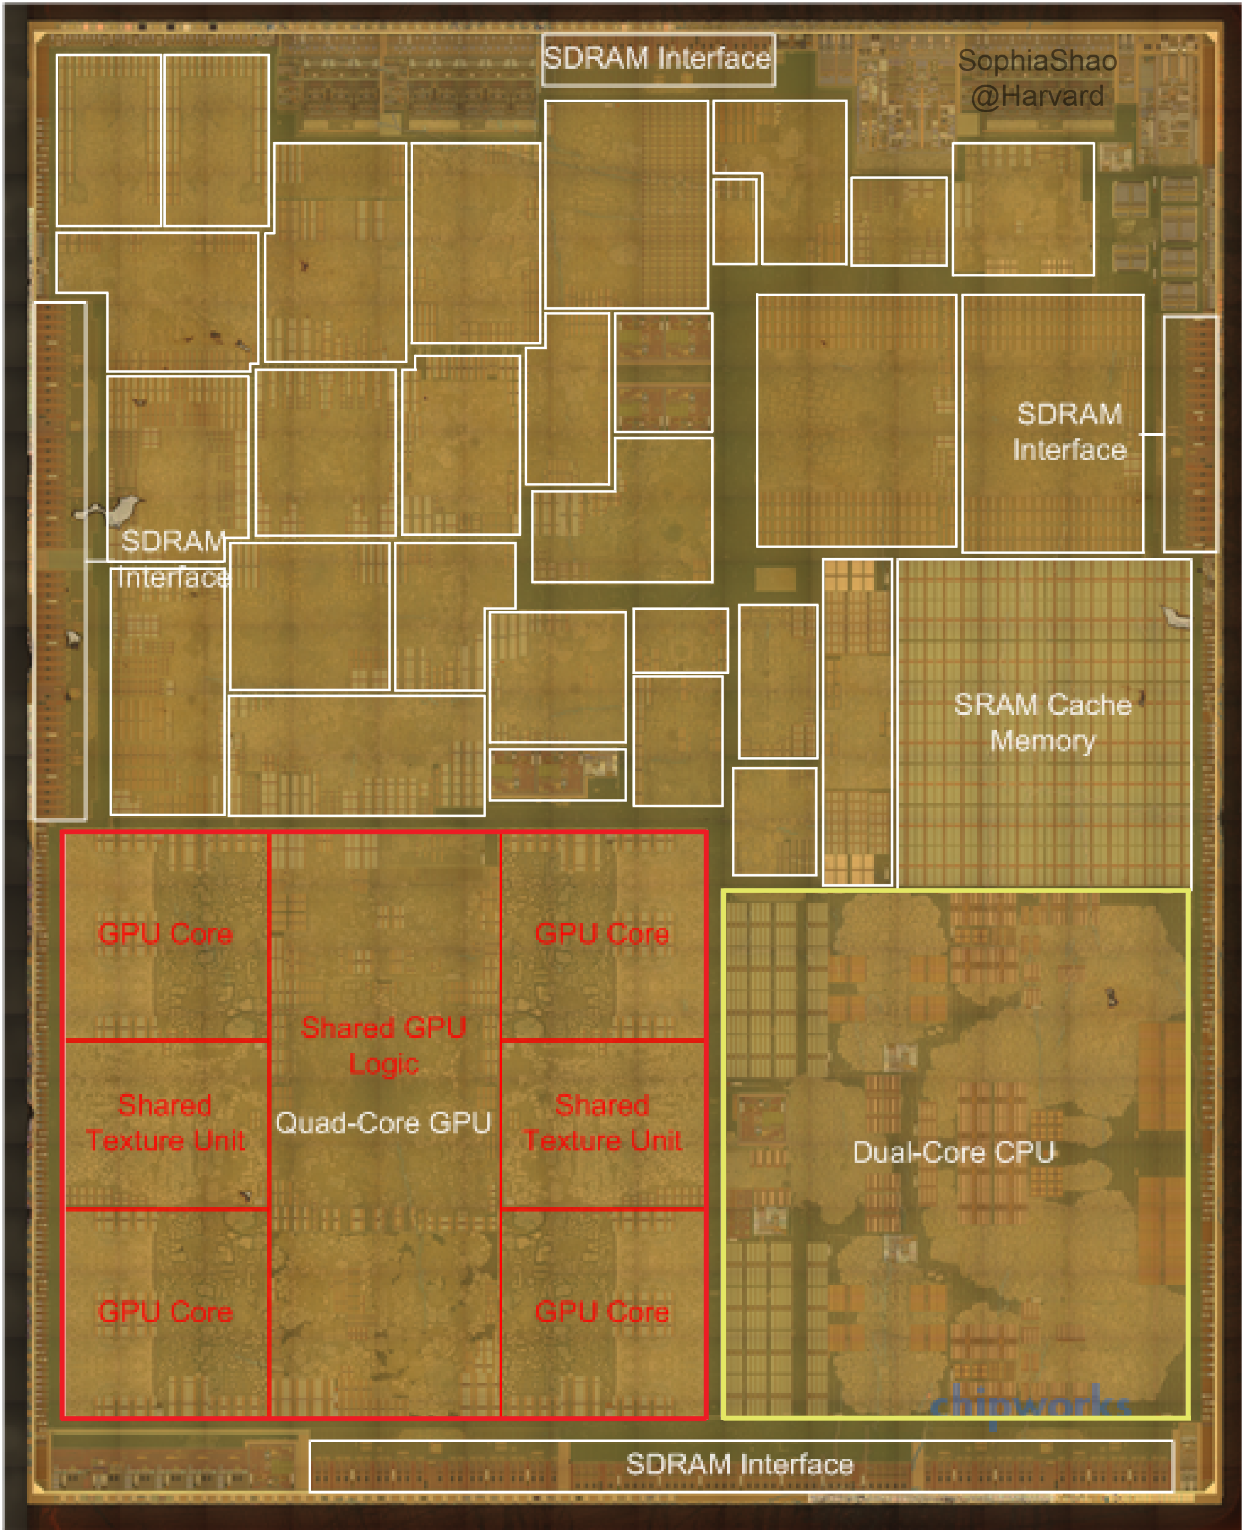

Apple A8 die photo
(application processor
used in iPhone 6)
[http://vlsiarch.eecs.harvard.edu/accelerators/die-photo-analysis]
Notes:
Verilog is used as an input to synthesis tools to create chips like these.

Slide 3
Learning Objectives
After this slide set you should be able to:
Write Verilog for combinational logic
Write Verilog for comb. logic testbenches
List important style guidelines that help avoid common errors when working with combinational logic
Notes:
2

Slide 4
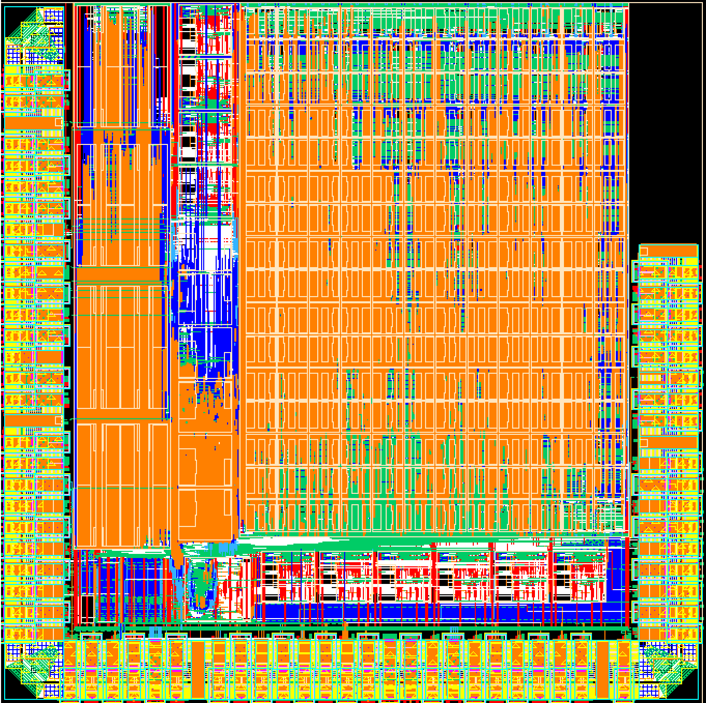
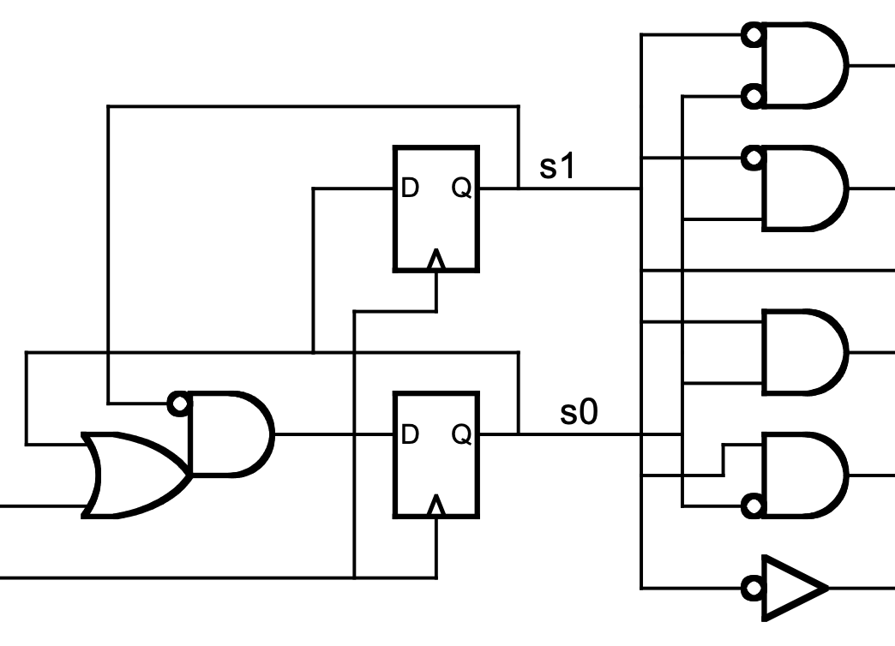
Scaling logic design
~1M logic gates and 742 SRAMs
How to scale to more complex designs?

Slide 5


Hardware design languages to the rescue
designing hardware with KMAPs
designing hardware with an HDL

Slide 6
Why Use Verilog?
Verilog can be used as an input to:
  Synthesis – implement hardware with gates, cells, or FPGAs
  Simulation – see what your hardware will do before you build it
Text: Dally §1.5
Notes:
In this course, we use Verilog to describe hardware.
Before talking about syntax I want to give you some context on how Verilog is used.
Not software: Reading novel vs. describing how to build a house not with a blue print but words.
Same code used in two ways
Simulation => ModelSim – this is very close to running the Verilog code as if it where a program.
Synthesis => Quartus – this is different. Here the tool tries to figure out which hardware behaves the same as your description. In general, synthesis is a very hard problem and that means we need to be careful about how we write Verilog.

Slide 7
What is Verilog?
It is NOT a programming language!
It is a hardware description language (HDL)
Why do we need a new method to describe hardware?
  What is wrong with schematics?
With Verilog, you can specify hardware in two ways:
  Structurally: what the hardware looks like (like schematics)
  Behaviourally: what the hardware does
But the real power of Verilog is that it lets you combine structural and behavioural descriptions in the same design!
Notes:
In this course, we use Verilog to describe hardware.
Before talking about syntax I want to give you some context on how Verilog is used.
Not software: Reading novel vs. describing how to build a house not with a blue print but words.
Same code used in two ways
Simulation => ModelSim – this is very close to running the Verilog code as if it where a program.
Synthesis => Quartus – this is different. Here the tool tries to figure out which hardware behaves the same as your description. In general, synthesis is a very hard problem and that means we need to be careful about how we write Verilog.

Slide 8
Tools and design flow
RTL description
(e.g., RTL Verilog)
testbench
(e.g., Verilog, C, etc.)
synthesis
(Quartus tech mapper)
compilation
(Modelsim vlog)
gate-level netlist
place & route
(Quartus fitter)
simulator
binary
FPGA config
(bitstream)
simulation
(Modelsim vsim)
FPGA programming
(Quartus programmer)
signal traces
(waveforms)
circuit on FPGA

Slide 9
Verilog infelicities
full Verilog
(testbenches)
designed for simulation,
not hardware design (!)
only small subset
is “synthesizable”
you need to learn
hardware → RTL description
patterns and stick to them
but also (some of) the rest
to write testbenches
synthesizable
Verilog
(hardware)

Slide 10
The most important thing to remember:
There are many things that we can describe, but can not build
Therefore, we should not expect all Verilog code to be “synthesizable”

Slide 11
Verilog Modules
The basic construct for modeling a digital system in Verilog is called a module. Each hardware block is described in one module.
Modules have
  Module declaration
  Input and output declarations
  Internal signal declarations
  Logic definition; describes either what the block does and/or what it is composed of
    Assign statements
    Case statements
    Module instantiations
Notes:
Module describe a block of hardware. It is different from a function in a software programming language.

Slide 12
Running example…
Input: 3 bits
Output: 1 if more inputs are 1 than are 0
abc | out
000 | 0
001 | 0
010 | 0
011 | 1
100 | 0
101 | 1
110 | 1
111 | 1
b
a
a
c
0
0
0
1
1
1
1
0
0
0
0
1
0
0
1
3
2
b
v
c
c
1
0
1
1
1
out
4
5
7
6
b
a
v
c
a
v
b

Slide 13
Structure
module name
ports
module Majority(input a, input b, input c, output out);
endmodule
n1
n2
out
ports specify direction
n3
module Majority( input [2:0] val, output out ) ;
endmodule
bus width (here 3 bits: 2, 1, 0)
important: modules are not functions

Slide 14
Structure
module Majority(input a, input b, input c, output out);
wire n1, n2, n3 ;
and foo(n1, a, b) ;
and bar(n2, a, c) ;
and baz(n3, b, c) ;
or glurph(out, n1, n2, n3) ;
endmodule
n1
n2
out
n3
instance name
modules to
instantiate*
*actually, not and and are Verilog primitives, but you can instantiate them like modules
Text: Dally §3.6
Notes:
If time, write code manually. Point out by default out is “wire”.

Slide 15
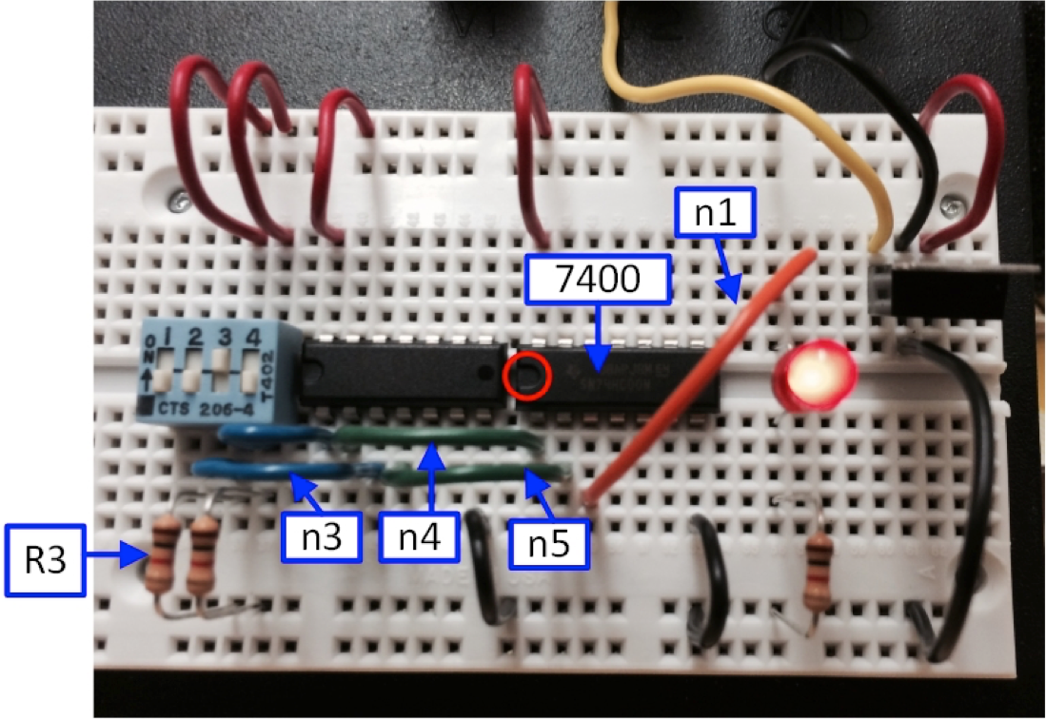
Modules + instance hierarchy = structure
instance of
a 7404 module
instance of
a 7400 module
instance of a 1kΩ resistor module
two more instances of a 1kΩ resistor module
again: modules are not functions
Think about module instances as chips on a breadboard. Think about input/output ports as pins on chips. We use wires to get value from one chip output to another chip input.

Slide 16
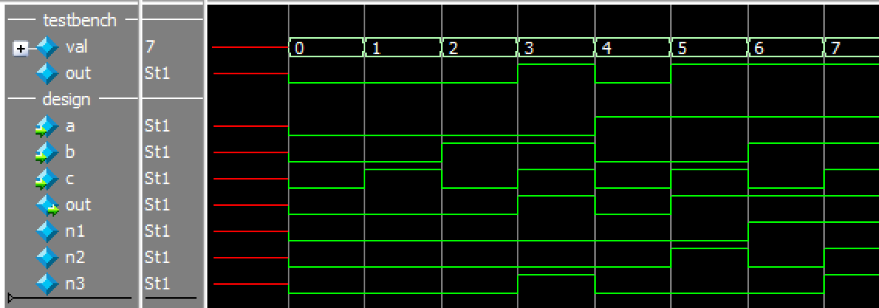
Okay, but when does “stuff happen”?
module Majority(input a, input b, input c, output out);
wire n1, n2, n3 ;
and foo(n1, a, b) ;
and bar(n2, a, c) ;
and baz(n3, b, c) ;
or glurph(out, n1, n2, n3) ;
endmodule
n1
n2
out
n3
test inputs
and outputs
wires inside
our design
time
Text: Dally §3.6
Notes:
If time, write code manually. Point out by default out is “wire”.

Slide 17
Primer on Verilog Syntax

Slide 18
File types
.v is extension for Verilog
.sv is extension for SystemVerilog <- use this
SystemVerilog is a superset of Verilog and as we will learn a few helpful keywords that are only supported by SystemVerilog, it will make your life easier if you use .sv for your files.

Slide 19
Boolean Expressions in Verilog
Verilog uses &, |, and ~ to represent AND, OR, and NOT, respectively.
Verilog uses ^ for exclusive-OR.
Avoid using ! for NOT (we’ll see why later).
Text: Dally §3.6
Notes:
1

Slide 20
Continuous assignment
We can instantiate logic and connect it together with a type of statement called a continuous assignment. As the name suggests, it is always active (always happening):
assign <wire> = <expression (with wires or regs)>;

Slide 21
Example: Verilog description of an AND gate (older K&R style):
Module declaration
I/O list
module AND_GATE(a, b, c);
input a, b;
output c;
assign c = a & b;
endmodule
Declare I/Os
An assign statement defines a signal with an equation

Slide 22
Same thing, but with the ANSI style I/O declaration syntax we saw earlier:
module AND_GATE(input a, input b, output c);
assign c = a & b;
endmodule

Slide 23
Majority Circuit in Verilog
n1
n2
out
n3
Note: all assignments performed concurrently.
module Majority(a, b, c, out) ;
input a, b, c ;
output out ;
wire n1, n2, n3 ;
assign out = n1 | n2 | n3 ;
assign n1 = a & b ;
assign n2 = a & c ;
assign n3 = b & c ;
endmodule
module Majority(a, b, c, out) ;
input a, b, c ;
output out ;
wire n1, n2, n3 ;
assign n1 = a & b ;
assign n2 = a & c ;
assign n3 = b & c ;
assign out = n1 | n2 | n3 ;
endmodule
Text: Dally §3.6
Notes:
If time, write code manually. Point out by default out is “wire”.

Slide 24
Majority Circuit in Verilog
n1
n2
out
n3
We can combine a wire declaration and assign statement…
module Majority(a, b, c, out) ;
input a, b, c ;
output out ;
wire n1 = a & b ;
wire n2 = a & c ;
wire n3 = b & c ;
assign out = n1 | n2 | n3 ;
endmodule
Text: Dally §3.6
Notes:
If time, write code manually. Point out by default out is “wire”.

Slide 25
Majority Circuit in Verilog
out
A single assign statement can include multiple Boolean operators….
module Majority(a, b, c, out) ;
input a, b, c ;
output out ;
assign out = (a & b)|(a & c)|(b & c) ;
endmodule
Text: Dally §3.6
Notes:
If time, write code manually. Point out by default out is “wire”.

Slide 26
So a recipe for specifying combinational logic in VHDL:
1. Write a boolean expression for each output
2. Include each boolean expression as a signal assignment
within a module.
This will work, and you can use it. But, there are more
efficient and easier ways to do it.

Slide 27
Verilog Literal Numbers
Verilog numbers can be expressed using:
<size>’[<signed>]<radix>value
<size> Number of bits.
<signed> Signed: s (if omitted unsigned)
<radix> Radix of the number:
b – binary
d – decimal
o – octal
h – hexidecimal
value Digits depend upon radix; Underscores ignored.
Examples: 8’b0001_1101 (8-bits, value is 29 in decimal)
8’d29 (same value)

Slide 28
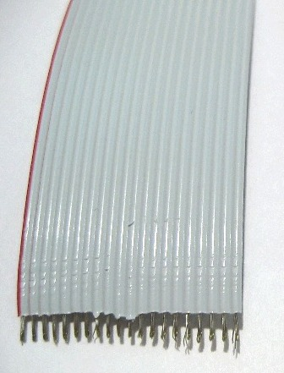
Describing Buses in Verilog
In the prior example all signals were a
single bit. This maps nicely to one wire.
We can also have a signal that represents a set of parallel wires:
wire [2:0] X;
This defines X as a bus with 3 parallel wires. This is like an array in a programming language. Each element of the array is a single bit.
Busses can also be used as input/output signals of design entities.

Slide 29
Describing Buses in Verilog
The size of a bus and the element numbers are assigned when the signal is defined:
[0:7] // 8 elements addressable with indices 0 to 7
[3:11] // 8 elements addressable with indices 3 to 11
[33:23] // 11 elements addressable with indices 33 to 23
You can do lots of cool things with busses:
  You can assign values to all elements in the array at once
assign x = 8’b00011101;
2. You can copy one bus to another:
assign out_bus = in_bus;

Slide 30
Cool things™, continued…
You can access individual elements (“wires”):
wire STATUS;
wire [15:0] MAIN_BUS;
…
assign STATUS = MAIN_BUS[15];
You can access subranges of busses:
wire [31:0] MAIN_BUS;
wire [3:0] OPCODE;
…
assign OPCODE = MAIN_BUS[31:28];

Slide 31

Examples of Copying Busses
// Example 1
wire [7:0] out_bus;
wire [7:0] in_bus;
…
assign out_bus = in_bus;
// Example 2
wire [7:0] out_bus;
wire [15:8] in_bus;
…
assign out_bus = in_bus; // OK: out_bus(7) connected to in_bus(15)
// Example 3
wire [7:0] out_bus;
wire [0:7] in_bus;
…
assign out_bus = in_bus; // OK: out_bus(7) connected to in_bus(0)
// Example 4
wire [7:0] out_bus;
wire [15:0] in_bus;
…
assign out_bus = in_bus; // Same as assign out_bus[7:0] = in_bus[7:0];

Slide 32

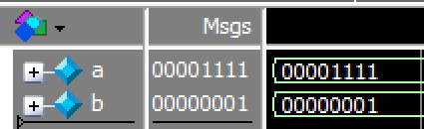
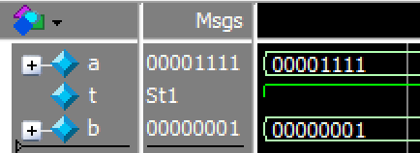
Examples of Copying Busses
// Example 5
module bus_test(a,b);
input [7:0] a;
output [7:0] b;
assign t = a;
assign b = t;
endmodule
Moral? Verilog does not consider it an error if you use a signal without declaring it first! (Verilog treats signals without declarations like a wire).

Slide 33
Cool things™, continued…
Concatenate short vectors to produce longer ones using { }
Example: if the following two signals are defined
wire [3:0] ERROR_CODE;
wire [7:0] MAIN_BUS;
Then the following assignments are legal:
assign MAIN_BUS = {4'b0000, 4'b1111};
assign MAIN_BUS = {4'b0000, ERROR_CODE};
assign MAIN_BUS = {1'b1, 7'b0000000};
assign MAIN_BUS = {1'b1, 1'b0, 1'b1, 1'b0, 1'b1, 1'b0, 1'b1, 1'b0};
assign MAIN_BUS = {1'b0, ERROR_CODE, 3b'111};
assign {ERROR_CODE,MAIN_BUS} = 12b’111110101010;

Slide 34
Cool things™, continued…
You can make copies of one or more bits using the replication operator, {k{n}}
wire [1:0] x = 2’b10;
wire [7:0] y = {4{x}}; // y = 8’b10101010; {k{n}} makes k copies of n
wire [8:0] z = {3{x,1’b0}}; // z = 9’b100100100; combined w/ concat.
7. You can make two-dimensional arrays:
reg [3:0] data [7:0]; // data contains 8 elements of 4-bits each
We could have used “wire” instead of “reg” – but we will use reg because assignments to memory are made in an “always” block. Inside an always block you could write:
data [7] = 4’b0011;
You can write bitwise Boolean expressions:
wire [3:0] result = A & B;
// result[0] = A[0] & B[0]; result[1] = A[1] & B[1]; …

Slide 35
Boolean Expressions Revisited
When applied to two operands &, |, ^ are “bit-wise”
Bitwise means the operators operate individually on each bit in a bus.
Also ~ is bitwise.
Text: Dally §3.6
Notes:
1

Slide 36
Busses and Booleans
wire [3:0] result = A & B;
A[0]
B[0]
result[0]
A[1]
B[1]
result[1]
A
B
result
A[2]
B[2]
result[2]
A[3]
B[3]
result[3]

Slide 37
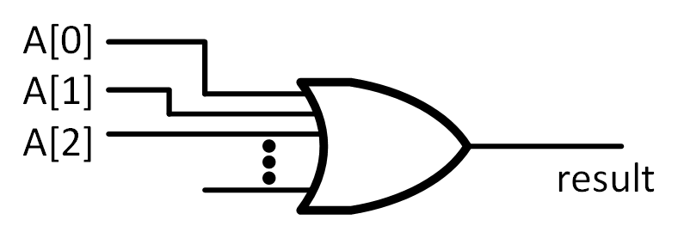
Cool things™, continued…
9. You can OR or AND together bits using:
wire result = |A; // result = (A[0] | A[1] | A[2] | … A[n-1])
wire foo = &A; // foo = (A[0] & A[1} & A[2] & …. A[n-1])

Slide 38



Thermostat Revisited
[http://www.clipartpanda.com/categories/cute-house-clipart]
[http://blogs.plos.org/obesitypanacea/2011/02/25/turn-down-your-thermostat-to-lose-weight-suggests-new-study-dripping-with-sarcasm/]

Slide 39
Design Step
presetTemp
Thermostat
fanOn
currentTemp

Slide 40
Example, Verilog for Thermostat
module Thermostat(presetTemp, currentTemp, fanOn) ;
input [2:0] presetTemp, currentTemp ; // temperature inputs, 3 bits each
output fanOn ; // true when current > preset
wire fanOn ; // don’t really need this line as outputs are “wire” by default
assign fanOn = (currentTemp > presetTemp) ;
endmodule
Text: Dally §1.5

Slide 41
Example: Majority Gate
module Majority( input [2:0] val, output out ) ;
assign out = (val==3'b111) | (val==3'b110) | (val==3’b101) | (val==3'b011);
endmodule

Slide 42
Verilog “define”
Very similar to “#define” in C:
`define <macro_name> <macro_text>
Example:
`define Sa 2'b00
means “Sa” has the value 2'b00
To use a define value you put backtick ` before it: `Sa
No Semicolon!

Slide 43
Verilog Conditional Operator
<cond_expr> ? <true_expr> : <false_expr>
Meaning: If <cond_expr> is true, then the value of entire expression is the value given by <true_expr> otherwise the value is given by <false_expr>.
Examples:
If “in” is 1, then value of (in ? `Sb : `Sa) is `Sb If “in” is 0, then value of (in ? `Sb : `Sa) is `Sa

Slide 44
Verilog Description of a Multiplexer
A0
b
A1
select
wire [1:0] b = select ? A0 : A1;
NOTE: This is combinational logic.

Slide 45
Example: Majority Gate
`define Unanimous 3'b111
module Majority( input [2:0] val, output out ) ;
assign out = (val==`Unanimous) ? 1'b1 :
(val==3'b110) ? 1'b1 :
(val==3’b101) ? 1'b1 :
(val==3'b011) ? 1'b1 : 1'b0 ;
endmodule

Slide 46
The Always Block
Two important things to know:
What an always block is (syntax and meaning)
Rules to ensure your always block Verilog code is synthesizable by CAD tools.
We will also talk about SystemVerilog variants that can help avoiding bugs: always_comb, always_ff

Slide 47
The always block allows us to describe the function or behaviour of a circuit or subcircuit without describing the actual hardware
We have already seen some sorts of behavioural descriptions:
assign fanOn = (currentTemp > presetTemp) ;
This describes the behaviour of the circuit driving “fanOn” without necessarily specifying the actual hardware implementation
But we are going to take this MUCH further and describe circuits
at a much higher level.

Slide 48
How can we describe behaviour?
If we could write an English description, that would be nice
- but English gives too much room for ambiguity
A better way: describe the behaviour using something that has a notion of order between statements – somewhat like software
- writing software is easy
- no room for ambiguity
Verilog provides always block syntax which makes describing behavior easier.

Slide 49
Always Block Syntax and Semantics
always @(<sensitivity_list>) begin
<sequence of statements in which order matters>
end
- Each always block describes the function of one block of hardware.
- When a signal in the sensitivity list changes, statements inside the always
block are immediately & instantaneously evaluated one after the other in
order starting from the beginning of the always block.
- Sensitivity list is a list of signals separated by commas (“,”) or “or” or an
asterisk (“*”), which means the list of all signals read inside the always block.
Individual signals may include event “posedge” or “negedge” modifier.
- The sensitivity list is NOT the same thing as the input parameters to
a function (in a language like “C” or Java, or C++). It does NOT pass
values into the always block. The sensitivity list determines when the
sequence of statements inside the always block will be evaluated.
- If only one statement inside always block, we can omit “begin” and “end”
NOTE: The “description” inside the always block may have little resemblance to the actual hardware implementation. However, provided you follow certain rules (described later) the hardware will implement the same behavior.

Slide 50


A Great (But Silly) Harry Potter Analogy
Hardware
Software
[Source: http://www.davidbordwell.net/blog/wp-content/uploads/HPatPoA-paintings.jpg]
[Source: http://ichef.bbci.co.uk/news/640/cpsprodpb/EDED/production/_83890906_83890905.jpg]

Slide 51
What goes inside an Always Block?
For CPEN 211: “if”, “case”, “casex” statements! DO NOT USE LOOPS IN ALWAYS BLOCKS.
Use “begin” and “end” to group statements (like {} in C)
Signals modified in an always block MUST be declared as “reg” instead of “wire”. (This is a syntax rule, says nothing about the hardware that will be synthesized.)
Always block outputs modified using “=” or “<=” (will talk about difference a bit later).
Can read either “wire” or “reg” inside an always block
Do NOT use assign statements inside an always block.

Slide 52
If Statement
if (<condition expression>)
<statement>
[ else <statement> ]
NOTES:
Need to wrap <statement> in begin/end if you want multiple statements.
When describing combinational logic using if statement need to include “else” (Why? See synthesis rules later in slide set).

Slide 53
Case Statement
case (<selector>)
{ <label list> : <statement> }+
[ default: <statement> ]
endcase
NOTES:
Need to wrap <statement> part in begin/end pair if you want multiple statements.
When describing combinational logic with case statement need to include default (Why? See synthesis rules later in slide set).

Slide 54
Example: Days in Month Function
DaysInMonth
month
days

Slide 55
Example, Days in Month Function

Slide 56
Example: Days in Month Function
module DaysInMonth(month, days) ;
input [3:0] month ; // month of the year 1 = Jan, 12 = Dec
output [4:0] days ; // number of days in month
reg [4:0] days ;
always @(month) begin // evaluate whenever month changes
case(month)
2: days = 5'd28 ; // February has 28
4,6,9,11: days = 5'd30 ; // 30 days have September ...
default: days = 5'd31 ; // all the rest have 31...
endcase
end
endmodule
Reg defines a signal set in an always block. It does NOT define a register.
Always block evaluates each time activity list changes. In this case each time month changes
Case statement selects statement depending on value of argument. Like a truth table.
Can have multiple values per statement
Default covers values not listed.
Text: Dally §7.1.2, 9.2

Slide 57
Some Common Syntax Errors
** Error: <file name>(<line number>): LHS in procedural continuous assignment may not be a net: t.
Error (10043): Verilog HDL unsupported feature error at <file name>(<line number>): Procedural Continuous Assignment to register is not supported
Do NOT use “assign” inside of an always block.
** Error: <file name>(<line number>): (vlog-2110) Illegal reference to net ”<name>".
Do NOT update a “wire” inside an always block (output of always block must be reg)

Slide 58
Writing a truth table in Verilog
Example: Prime number function
Truth table:
Text: Dally §7.1.2
Notes:
1

Slide 59
4-bit Prime Number Function in Verilog Code – Using case
module prime(in, isprime) ;
input [3:0] in ; // 4-bit input
output isprime ; // true if input is prime
reg isprime ;
always @(in) begin
case(in)
1,2,3,5,7,11,13: isprime = 1'b1 ;
default: isprime = 1'b0 ;
endcase
end
endmodule
Text: Dally §7.1.2
Notes:
0.5

Slide 60
Q: When do you need begin / end?
If you want more than one statement to be “evaluated” based upon same condition, then you group those statements in ”begin” and “end”:
always @(sel or A or B)
if (sel == 1'b0)
begin
Y = A;
Z = B;
end
else
begin
Y = B;
Z = A;
end
We do NOT need “begin” here because “if/else” is a single statement
We DO need “begin/end” here because we want two statements “Y=A;” and “Z=B;” to be evaluated if sel == 1’b0.

Slide 61
Q: When do you need begin / end?
Example of using begin/end inside case to allow multiple statements for a given case label:
always @(*)
case(in)
4’b0000: begin
out1 = 1'b1;
out2 = |in2;
end
4'b0001: begin
out1 = 1'b0;
out2 = 1'bx;
end
…

Slide 62
always_comb
Using sensitivity list or @(*) is error prone as “always” is too powerful (too general).
SystemVerilog introduced versions that specify design intent: always_comb, always_ff
For combinational logic use “always_comb”
always_comb
case(month)
2: days = 5'd28 ;
4,6,9,11: days = 5'd30 ;
default: days = 5'd31 ;
endcase

Slide 63
Multiple updates
always_comb begin
Y = 2'b11;
if (A == 1'b1) begin
Y = 2'b00;
end
end

Slide 64
Beware the Ambiguous ELSE!
always_comb begin
Y = 2'b00;
if (A == 1'b0)
if (B == 1'b1)
Y = 2'b01;
else
Y = 2'b10;
end
always_comb begin
Y = 2'b00;
if (A == 1'b0)
if (B == 1'b1)
Y = 2'b01;
else
Y = 2'b10;
end
Source of confusion? Without more information it is ambiguous which of the two if statements the “else” belongs to. ModelSim and Quartus pick the “closest if” -- indentation does NOT matter!

Slide 65
Use begin/end to get intended behavior
always_comb begin
Y = 2'b11;
if (A == 1'b1) begin
if (B == 1'b1)
Y = 2'b00;
end else
Y = 2'b01;
end

Slide 66
Combinational Logic Building Blocks in Verilog

Slide 67
Verilog implementation of a 2:4 decoder
a1 | a0 | b3 | b2 | b1 | b0
0 | 0 | 0 | 0 | 0 | 1
0 | 1 | 0 | 0 | 1 | 0
1 | 0 | 0 | 1 | 0 | 0
1 | 1 | 1 | 0 | 0 | 0
Decoder
a
b
n
m
2
4
m
2
n
≤
“X << Y“ means shift X to the left by Y bit positions.
module Dec24(a, b) ;
input [1:0] a ;
output [3:0] b ;
wire [3:0] b = 1 << a ;
endmodule
Text: Dally §8.2
Notes:
0.5

Slide 68
Encoder
a3 | a2 | a1 | a0 | b1 | b0
0 | 0 | 0 | 1 | 0 | 0
0 | 0 | 1 | 0 | 0 | 1
0 | 1 | 0 | 0 | 1 | 0
1 | 0 | 0 | 0 | 1 | 1
b0 = a3 ∨ a1
b1 = a3 ∨ a2
// 4:2 encoder
module Enc42(a, b) ;
input [3:0] a ;
output [1:0] b ;
assign b = {a[3] | a[2], a[3] | a[1]} ;
endmodule
// 4:2 encoder
module Enc42(a, b) ;
input [3:0] a ;
output [1:0] b ;
Text: Dally §8.4
Notes:
3

Slide 69
1-bit, 2-input One-Hot Select Mux
Symbol:
Implementation with
AND and OR gates:
// 1-bit 2-input mux with one-hot select
module Mux2a(a1, a0, s, b) ;
input a0, a1; // inputs
input [1:0] s; // one-hot select
output b ;
// 1-bit 2-input mux with one-hot select
module Mux2a(a1, a0, s, b) ;
input a0, a1; // inputs
input [1:0] s; // one-hot select
output b ;
assign b = (s[0] & a0) | (s[1] & a1);
endmodule

Slide 70
2-bit, 3-input Mux
// 2-bit, 3-input mux with one-hot select
module Mux3_2(a2, a1, a0, s, b) ;
input [1:0] a0, a1, a2; // inputs
input [2:0] s ; // one-hot select
output[1:0] b ;
// 2-bit, 3-input mux with one-hot select
module Mux3_2(a2, a1, a0, s, b) ;
input [1:0] a0, a1, a2; // inputs
input [2:0] s ; // one-hot select
output[1:0] b ;
assign b = ({s[0],s[0]} & a0) |
({s[1],s[1]} & a1) |
({s[2],s[2]} & a2) ;
endmodule

Slide 71
module Mux3a(a2, a1, a0, s, b) ;
input [7:0] a0, a1, a2 ; // inputs
input [2:0] s ; // one-hot select
output[7:0] b ;
reg [7:0] b ;
always @(*) begin
case(s)
3'b001: b = a0 ;
3'b010: b = a1 ;
3'b100: b = a2 ;
default: b = {8{1'bx}} ;
endcase
end
endmodule
This makes 8 copies of 1’bx. Here ‘x’ means “don’t care”. So, the default statement says we “don’t care” what any of the bits of b are if s does not match 3’b001, 3’b010 or 3’b100. Quartus can use these don’t cares to optimize the implementation. Just like you did with a KMAP.

Slide 72
Verilog Syntax Module Instantiation

Slide 73
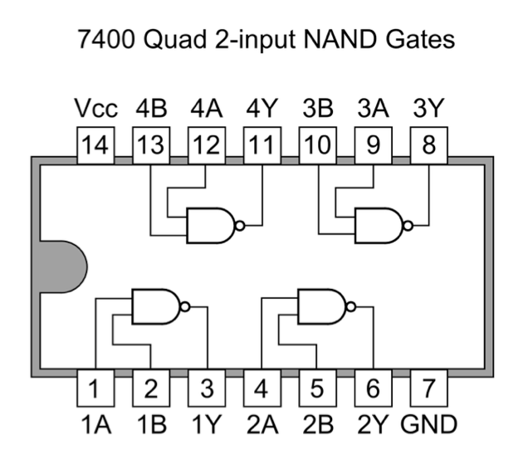
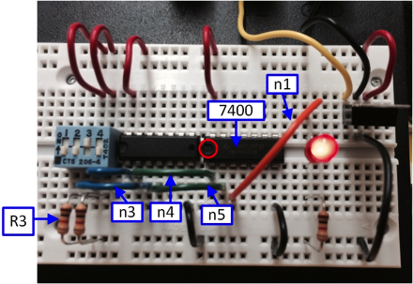
Module Instantiation
Instantiate
Tic-tac-toe example (Dally §9.4)…
//Figure 9.13
module TwoInArray(ain, bin, cout) ;
input [8:0] ain, bin ;
output [8:0] cout ;
…
2x
module TicTacToe(xin, oin, oout) ;
…
TwoInArray winx(oin, xin, win) ;
TwoInArray blockx(xin, oin, block) ;

Slide 74

Consider a REALLY simple example
Consider the following example:
We can express each gate as a module:
module NAND_GATE(A,B,Z);
input A, B ;
output Z ;
assign Z = ~(A & B);
endmodule
module INV_GATE(A,Z );
input A;
output Z;
assign Z = ~A;
endmodule

Slide 75
Instantiation Syntax
<module name> <instance name>(<port list>) ;
<module name> name of the module.
<instance name> name of this instance of the module.
<port list> list of signals connected to inputs and outputs of module.
Module output ports must be connected to wire where instantiated.
Module input ports can be connected to either a reg or wire.

Slide 76
module NAND_GATE(A,B,Z);
input A, B ;
output Z ;
assign Z = ~(A & B);
endmodule
A
B
Z
A
Z
NAND_GATE
INV_GATE
module INV_GATE(A,Z);
input A;
output Z;
assign Z = ~A;
endmodule
Modules can be in separate “.v” files
(compiled in any order)
module AND_GATE (IN1, IN2, OUT1);
input IN1, IN2;
output OUT1;
wire X;
NAND_GATE U0 (IN1, IN2, X);
INV_GATE U1 (X, OUT1);
endmodule
Module instantiation is NOT the same as a function call in a programming language like C/C++/Java. A closer “analogy” is plugging chips into a breadboard and connecting wires to the pins on the chip, which is something you do BEFORE powering up and using circuit (instantiate before power is “on”).

Slide 77
module AND_GATE (IN1, IN2, OUT1);
input IN1, IN2;
output OUT1;
wire X;
NAND_GATE U0 (IN1, IN2, X);
INV_GATE U1 (X, OUT1);
endmodule
Module instantiations
Verilog syntax for module instantiation:
<module name> <instance name>(<port list>) ;
IMPORTANT! Semantics of module instantiation is NOT same
as for function call in a programming language like C/C++/Java.
Module outputs must be connected to “wire” where instantiated.
(Module inputs can be either “reg” or “wire” where instantiated.)
Notes:
If NAND_GATE used “always block” to define it’s behavior would X need to be a reg?

Slide 78
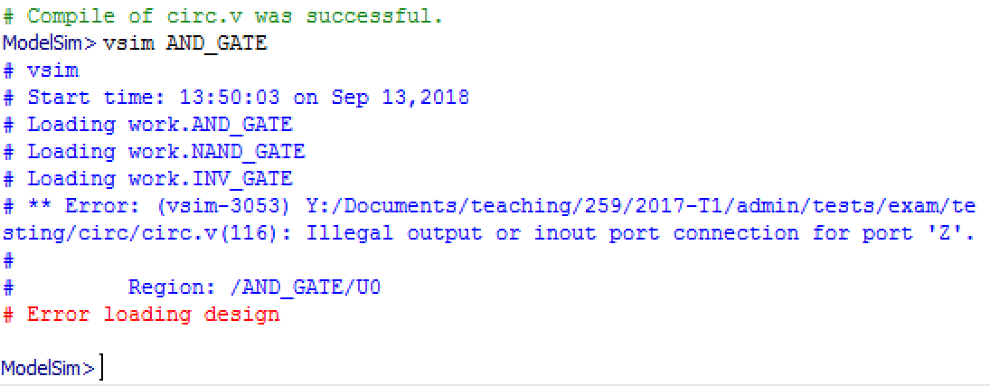
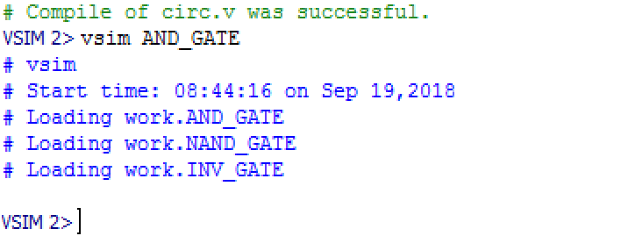
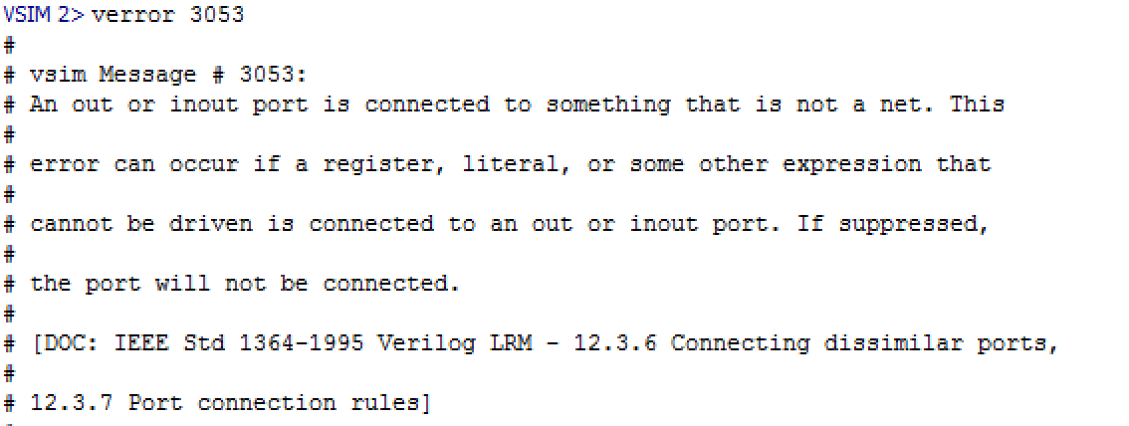
Module outputs must be connected to “wire” where instantiated
Suppose we want to use “always” to define Z inside NAND_GATE…
112:
113:
114:
115:
116:
117:
118:
module AND_GATE (IN1, IN2, OUT1);
input IN1, IN2;
output OUT1;
reg X;
NAND_GATE U0 (IN1, IN2, X);
INV_GATE U1 (X, OUT1);
endmodule
module NAND_GATE(A,B,Z);
input A, B ;
output reg Z ;
always @(A, B)
Z = ~(A & B);
endmodule
module AND_GATE (IN1, IN2, OUT1);
input IN1, IN2;
output OUT1;
wire X;
NAND_GATE U0 (IN1, IN2, X);
INV_GATE U1 (X, OUT1);
endmodule
Moral: Use “wire” for outputs where module is instantiated.
Again, module inputs can be connected to either reg or wire at the location where the module is instantiated.

Slide 79
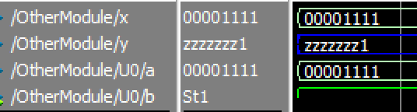
Very Common Instantiation Bug
Mismatch in input/output port width between declaration and instantiation:
module Bad(a,b);
input [7:0] a;
output [7:0] b;
reg b; // bug: should be “reg [7:0] b;”
always @*
b = a;
endmodule
module OtherModule;
wire [7:0] x;
wire [7:0] y;
Bad U0(x,y);
In ModelSim, no compile error, but you do get a warning when starting simulation:
** Warning: (vsim-3015) <file1>(<line1>): [PCDPC] - Port size (1) does not match connection size (8) for port 'b'. The port definition is at: <filename2>(<line2>).

Slide 80
Module Instantiation “LEGO Analogy”
Verilog can be viewed as a description for how to build hardware. You may want to think of module instantiation, assign statements, always blocks in Verilog as instructions saying how to build a LEGO toy (picture above).
After you build a LEGO toy, you can play with it, which is similar in this analogy to changing slide switches and/or pressing push buttons on your DE1-SoC after downloading compiled design (e.g., LEGO wheels turning).
[figure source: http://lego.brickinstructions.com/lego_instructions/set/9324/Micro_Building_Set]

Slide 81
Implicit vs. Named Port Association
In the NAND+NOT gate example, order to connect wires was implicit
NAND_GATE U0 (IN1, IN2, X);
means that IN1 is connected to the first port in the module definition and IN2 is connected to the second port in the module definition, etc.
We can also use named association:
NAND_GATE U0( .A(IN1), .B(IN2), .Z(X) );
means that IN1 is connected to A in the module def’n, etc.
NOTE: When using named notation, order does not matter: Could use “NAND_GATE U0(.Z(X), .B(IN2), .A(IN1))” above instead.

Slide 82
Named Port Association: Syntax
<port list> ::= <named assoc> [, <port list> ]
<named assoc> ::= { .<port name>(<signal name>) }+
<port name> name of the input/output port in module declaration.
<signal name> name of signal connected to port in module instantiation.
module AND_GATE (IN1, IN2, OUT1);
input IN1, IN2;
output OUT1;
wire X;
NAND_GATE U0( .A(IN1), .B(IN2),.Z(X));
INV_GATE U1 (X, OUT1);
endmodule
module NAND_GATE(A,B,Z);
input A, B ;
output Z ;
assign Z = ~(A & B);
endmodule

Slide 83
Example of Named Association
module Dec24(a, b) ;
input [1:0] a ;
output [3:0] b ;
wire [3:0] b = 1 << a ;
endmodule
NO210, INV110 are modules defining NOR and NOT gates in the “technology library” or “cell library” provided by the chip manufacturing company.
Using “Synopsys” above decoder Verilog synthesizes to:
module Dec_Synthesized ( in, out );
input [1:0] in;
output [3:0] out;
wire n2, n3;
NO210 U2 ( .A(n2), .B(n3), .Y(out[3]) );
NO210 U3 ( .A(in[0]), .B(n2), .Y(out[2]) );
NO210 U4 ( .A(in[1]), .B(n3), .Y(out[1]) );
NO210 U5 ( .A(in[0]), .B(in[1]), .Y(out[0]) );
IV110 U6 ( .A(in[1]), .Y(n2) );
IV110 U7 ( .A(in[0]), .Y(n3) );
endmodule
Notes:
1.5

Slide 84


Another silly analogy…
When buying a car typically need to pick a color… color doesn’t change once you pick up your car (not without a lot of work).
Module Parameters

Slide 85
Module Parameters
Often want to change width of signals when instantiating a module in different parts of our design (or in different designs) and often the rest of the design should change in a predictable way.
Verilog parameter syntax allows us to specify properties of a module that stay fixed for any given module instance:
Syntax of module declaration with parameter(s):
module <module_name>( <port list> ) ;
{ parameter <parameter name> [ = <default value> ] ; } *
Syntax of module instantiation with default parameters overridden:
<module name> #(<parameter list>) <instance name>(<port list>) ;

Slide 86
Verilog implementation of a n:m decoder
// a - binary input (n bits wide)
// b - one hot output (m bits wide)
module Dec(a, b) ;
parameter n=2 ;
parameter m=4 ;
input [n-1:0] a ;
output [m-1:0] b ;
wire [m-1:0] b = 1 << a ;
endmodule
Decoder
a
b
n
m
m
2
n
≤
What if we want a 3->8 decoder?
Instantiate a 3->8 decoder using:
Dec #(3,8) U1(a, b) ;
Text: Dally §8.2
Notes:
0.5

Slide 87
Example: Implement an arbitrary logic function with a decoder -- e.g., prime number function
i
n
[
2
:
0
]
3:8
b
[
7
:
0
]
3
8
b
[
7
]
b
[
5
]
b
[
3
]
i
s
p
r
i
m
e
b
[
2
]
b
[
1
]
module Primed(in, isprime) ;
input [2:0] in ;
output isprime ;
wire [7:0] b ;
// compute the output as the OR of the required minterms
wire isprime = b[1] | b[2] | b[3] | b[5] | b[7] ;
// instantiate a 3->8 decoder
Dec #(3,8) d(in,b) ;
endmodule
Text: Dally §8.2
Notes:
2

Slide 88
Parameterized Multiplexer (v1)
module Mux3a(a2, a1, a0, s, b) ;
parameter k = 1 ;
input [k-1:0] a0, a1, a2 ; // inputs
input [2:0] s ; // one-hot select
output[k-1:0] b ;
reg [k-1:0] b ;
always_comb begin
case(s)
3'b001: b = a0 ;
3'b010: b = a1 ;
3'b100: b = a2 ;
default: b = {k{1'bx}} ;
endcase
end
endmodule
k
k
k
k
k

Slide 89
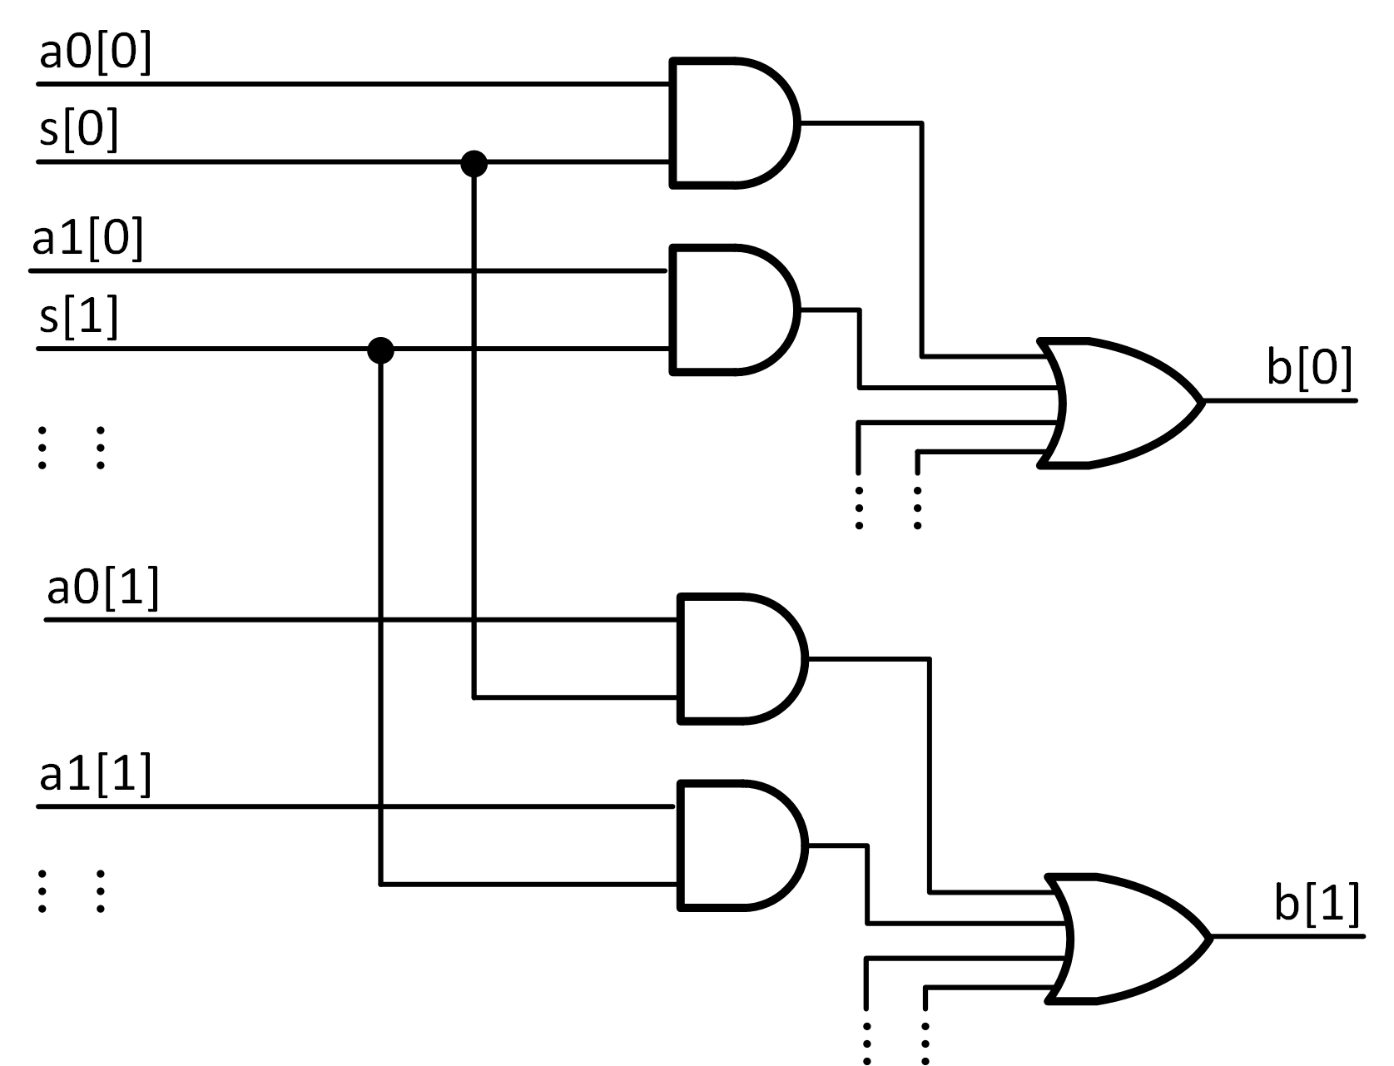
Parameterized Multiplexer (v2)
// 4-input, k-bit mux with one-hot select
module Mux4(a3, a2, a1, a0, s, b) ;
parameter k = 1 ;
input [k-1:0] a0, a1, a2, a3 ; // inputs
input [3:0] s ; // one-hot select
output[k-1:0] b ;
wire [k-1:0] b = ({k{s[0]}} & a0) |
({k{s[1]}} & a1) |
({k{s[2]}} & a2) |
({k{s[3]}} & a3) ;
endmodule
Mux4 #(2) mx(2'd3, 2'd2, 2'd1, 2'd0, f, h) ;
f h
# 0001 00
# 0010 01
# 0100 10
# 1000 11
k=1
k=2

Slide 90
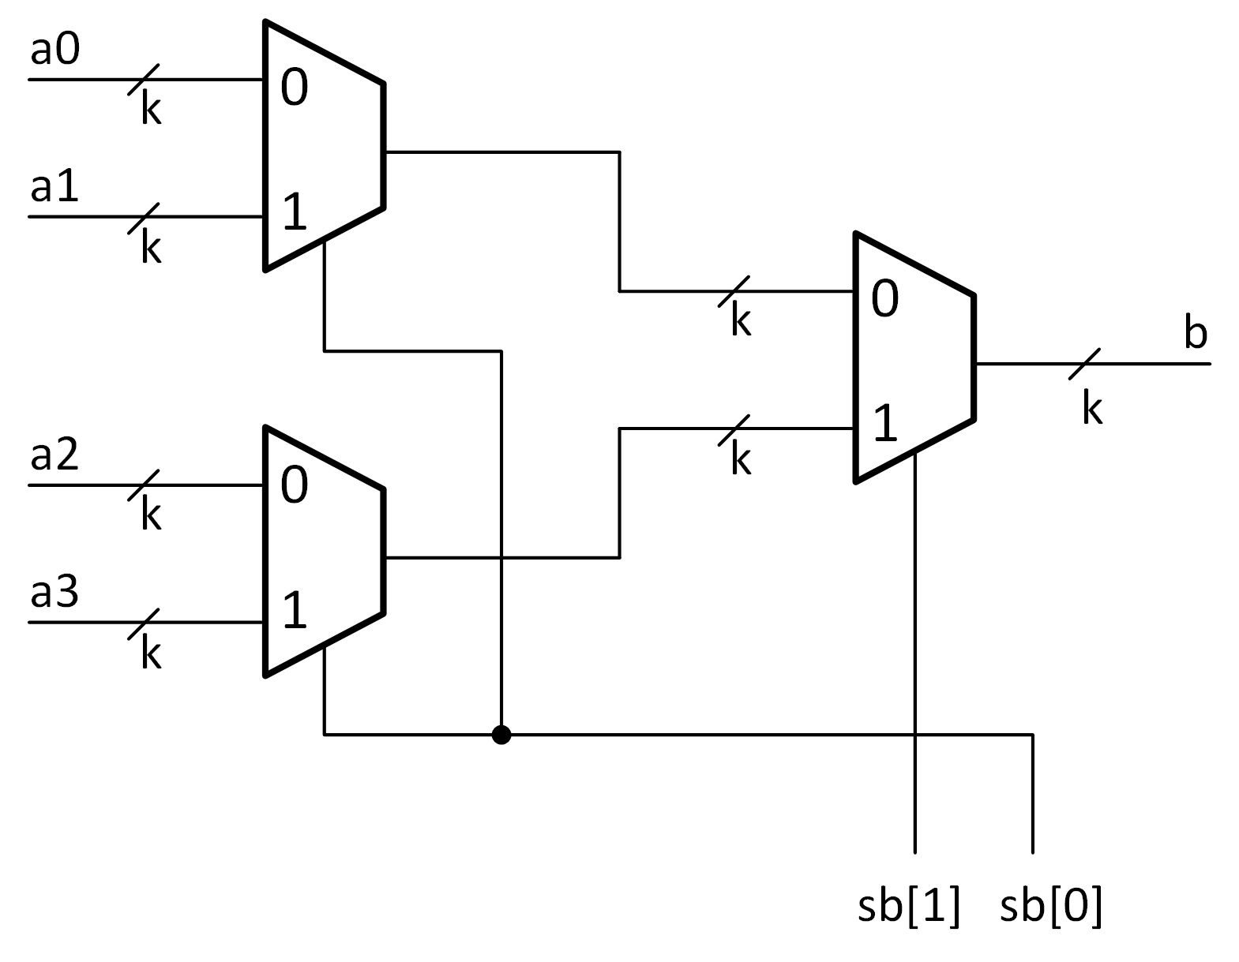
// 4:1 multiplexer with binary select (arbitrary width)
module Mux4b(a3,a2, a1, a0, sb, b) ;
parameter k = 1 ;
input [k-1:0] a0, a1, a2, a3 ; // inputs
input [1:0] sb ; // binary select
output[k-1:0] b ;
wire [k-1:0] t0, t1 ;
assign t0 = sb[0] ? a1 : a0;
assign t1 = sb[0] ? a3 : a2;
assign b = sb[1] ? t0 : t1;
endmodule
t0
t1
Text: Dally §8.3

Slide 91
Always Block Synthesis Rules for Combinational Logic

Slide 92

Most important few slides in this course!
If write all your Verilog in one big always block your code probably will not work!
Why?
Next slides will tell you and explain what you need to do to ensure your Verilog works.

Slide 93
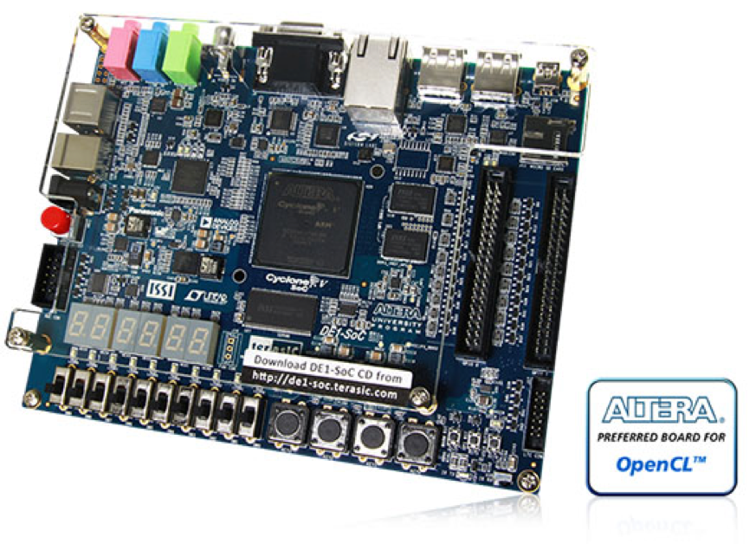
Verilog
The synthesis tool “compiles” the Verilog into gates. Makes hardware out of Verilog.

Slide 94
Verilog
What do you think happens if the synthesis tool can not make hardware for your Verilog?
The gates will not implement the behaviour you specified…
If you are lucky, you get an error message (or warning)
Your circuit won’t implement the behaviour you specified

Slide 95
“Synthesizable” Verilog
Not all Verilog code can be synthesized by current tools.
- This isn’t limited to our tools (Quartus)
Synthesizable Verilog is a subset of Verilog that can be synthesized
by current tools.
If you write Verilog that is not synthesizable:
- Tools will not be able to create hardware
- Sometimes it will try, but end up with something that is
“not quite right”
- Sometimes you get an error message, sometimes you don’t!
Moral: if you are going to synthesize, always write Synthesizable Verilog!

Slide 96
But what sort of Verilog is Synthesizable?
In general, it depends a bit on the tools.
To make sure your Verilog is synthesizable, every always block must be one of four types. The first type is “purely combinational” (we’ll see other types later).
In the next three slides, I am going to explain rules to ensure your Verilog for combinational logic is synthesizable by all tools.
RTL-level Synthesis Tools: can handle a fairly small subset. There is even an industry standard: “1364.1-2002 - IEEE Standard for Verilog Register Transfer Level Synthesis”
Behavioural Synthesis Tools: larger subset

Slide 97
Type 1: Purely Combinational: All outputs are a function only of the present inputs (outputs do not depend upon previous inputs).
always @(sel or A or B) begin
if (sel == 1'b0)
Y = A;
else
Y = B;
end
always_comb begin
if (sel == 1'b0)
Y = A;
else
Y = B;
end
always @(*) begin
if (sel == 1'b0)
Y = A;
else
Y = B;
end

Slide 98
For purely combinational always blocks:
Rule 1: Every input that can affect the output(s) must be
in the sensitivity list or use the wildcard @(*) or use
SystemVerilog “always_comb” instead of “always”
Rule 2: Every output must be assigned a value for every
possible combination of the inputs
WARNING: Everyone remembers Rule 1 but many forget Rule 2.
Forgetting Rule 2 will cost you HOURS or even DAYS of extra debugging due to “inferred latches” (see HDL Tools Tutorial). If you use always_comb, you’ll get an error if you forget Rule 2.

Slide 99
This would not be synthesizable
(violates Rule 1):
This would not be synthesizable
(violates Rule 2):
always @(A or B) begin
if (SEL == 1'b0)
Y = A;
else
Y = B;
end
always @(SEL or A)
if (SEL == 1'b0)
Y = A;
Warning (10235): Verilog HDL Always Construct warning at ss6.v(152): variable "SEL" is read inside the Always Construct but isn't in the Always Construct's Event Control
Warning (10240): Verilog HDL Always Construct warning at ss6.v(164): inferring latch(es) for variable "Y", which holds its previous value in one or more paths through the always construct

Slide 100
Check Synthesis results using
“RTL Viewer” in Quartus
Use RTL viewer for labs and while studying for midterm. Helps you develop better intuition for Verilog; catch design errors.

Slide 101
IMPORTANT: If you write Verilog that connects output of combinational logic back to input (possibly through some other combinational logic block) you’ll get warnings in Quartus about “combinational loops” and/or inferred latches. ModelSim will not give you any warnings and may (or may not) hit an “iteration limit” error. Synthesize with Quartus and check warnings!
Check synthesis warnings for warnings about combinational loops. Almost always a bug.
always @(*) begin
if (sel == 1'b0)
Y = Y; // DO NOT DO THIS!!!
else
Y = B;
end
Notes:
1

Slide 102
Synthesis Rules – Summary (for now)
We just introduced our first ”synthesis rule”. Use it when you want to design combinational logic with an always block.
After we talk about sequential logic we will introduce a few more synthesis rules.
However we will see the final and most important rule will be: Every use of an always block must match one of the synthesis rules.

Slide 103

Preview: Flip-flops and registers?
Verilog has no built-in way to describe flip-flops
  because it’s secretly a simulator construction language
  but has syntax that looks like it does, presumably to confuse everyone
registers are inferred from
  declaration syntax, and
  how you use them
example: reg [3:0] ← maybe a four-bit register, maybe not
(yes, this is as insane as it sounds)

Slide 104
A flip-flop: the simulator view
D-flip-flop rules:
  at the rising edge of clk, D copied to Q
  Q retains value until next rising edge of clk
variable to retain value
(you can think of this as the reg)
module dff(input clk, input D, output Q);
reg r;
assign Q = r;
always_ff @(posedge clk) begin
r <= D;
end
endmodule: dff
rising edge of clk
block executed whenever
event posedge clk happens
nonblocking assignment
for register updates
(more on this a bit later)
Advice: don’t think about the simulator view

Slide 105
Synthesis rules for inferring flip-flops
remember: reg may or may not create a register
synthesis tools infer a register when:
  a variable is declared as reg
  variable is written in exactly one always_ff @(posedge somesignal) block
    somesignal becomes the register’s clock
  and is not written or assigned elsewhere in any way
this pattern ensures DFF behaves the same way
in simulation and in real hardware

Slide 106
A flip-flop: the synthesis tool view
module dff(input clk, input D, output reg Q);
always_ff @(posedge clk) begin
Q <= D;
end
endmodule: dff
pattern matches
infer flip-flop
Advice: just memorize the patterns and don’t think about it

Slide 107

source: Disney

Slide 108
Testing and Testbenches

Slide 110
Testbench Scripts in Verilog
Goal: Test if our design works before building hardware.
If design does not work (as it frequently won’t, at least initially) our testbench makes it easier to identify bugs during simulation.
Important: Test script Verilog is not meant to be synthesized into hardware (i.e., gates). Test script Verilog is only used for simulation. In example we will identify syntax/styles that should NOT be used in synthesizable Verilog.
Text: Dally §3.6
Notes:
1.5

Slide 111
ModelSim vs Quartus
ModelSim: Used for simulation. Why simulate? To verify our design is correct BEFORE either building custom hardware (expensive) or “programming” FPGA (harder to debug). Does NOT perform synthesis.
Quartus: Used for implementation. Performs synthesis (use algorithms like KMAP to determine which gates implement the same behavior you seen in simulation).

Slide 112

Terminology
“Test Script”
Q1. Draw a logic diagram for an XOR
gate using only NAND and NOT gates.
“Device Under Test”
Output from “DUT”

Slide 113
The Initial Block (used in testbenches ONLY)
initial begin
<sequence of statements in which order matters; delays allowed>
end
- Initial blocks are not synthesizable – use ONLY for test bench ”scripts”
- Each initial block describes a sequence of operations
- Delays allowed
Syntax: #<number of time units> ;
Example:
#10;
The line above means the enclosing initial block should wait
10 “time units” before executing the next statement.

Slide 114
Test benches use a very different style of Verilog
Initial statements
$display
Repeat and other looping constructs
#delay
Don’t use these constructs in synthesizable modules

Slide 115

Test Bench (test_maj)
Test Script
(process)
in
DUT
(majority)
out
[http://www.servicenoodle.com/lighthouse-auto-sales-and-repair-p-552966]
module Majority(a, b, c, out) ;
input a, b, c ;
output out ;
assign out = (a & b)|(a & c)|(b & c) ;
endmodule
Text: Dally §3.6
Notes:
2

Slide 116
We must use wire for ”out” because it is driven by the module instantiation for Majority.
Testbenches have NO inputs or outputs! This test_maj is used as the top level module when simulating design under test Majority.
module test_maj ;
reg [2:0] in ; // input - three bit counter
wire out ; // output of majority
// instantiate the gate
Majority m(in[0],in[1],in[2],out) ;
// generate all eight input patterns
initial begin
in = 3'b000 ;
repeat (8) begin
#100 ;
$display("in = %b, out = %b",in,out) ;
in = in + 3'b001 ;
end
end
endmodule
We must use reg here because “count” is driven (i.e., written to) from inside the “initial” block.
Repeat the block of code 8 times.
#100 means wait 100 time steps before going to the next line.
Instantiate an instance of Majority to use as a “design under test” (DUT).
$display is similar to “printf” in C.
The initial block operates in parallel with the module instance “m” of Majority. Starts at time=0.
This Verilog is NOT synthesizable. It is a testbench used ONLY for testing and debugging.
Text: Dally §3.6

Slide 117
Testbench Output (ModelSim)
in = 000, out = 0
in = 001, out = 0
in = 010, out = 0
in = 011, out = 1
in = 100, out = 0
in = 101, out = 1
in = 110, out = 1
in = 111, out = 1
Text: Dally §3.6
Notes:
1

Slide 118
How to write test scripts?
First: Think of waveform you want as input. How? Consider “corner cases” – ask yourself “what might break?”
Second: Write the script.
Example: Suppose want inputs “A” and “B” to look like this:

Slide 119
module AB_test ;
reg A, B; // input
wire out ; // output of DUT
// instantiate design under test
Foo DUT(A,B,out);
// generate input patterns here
initial begin
// t=0 (time elapsed so far)
A = 1'b0; B = 1'b0;
#10 ;
// t=10
A = 1'b1;
#5 ;
// t=15
B = 1'b1;
#5 ;
// t=20
A = 1'b0;
#20 ;
// t=40
B = 1'b0;
#10 ;
// t=50
$stop(0);
end
endmodule

Slide 120
What to test?
If feasible: everything! Only smaller designs.
For larger designs testing “everything” is not feasible. In that case, you focus on “corner cases” and things “that could go wrong”.
At a minimum, each line of your synthesizable Verilog code should be “exercised” by at least one test in your testbench. That means that line does something for that test. This is not a guarantee you are testing everything, but a good start.
No complete algorithm / recipe. “Formal verification” is one approach but currently “blows up” for large designs. One can speculate machine learning could be used to lower human effort—likely won’t be foolproof.

Slide 121
Strategies for Designing Tests
Start simple and built up:
  Test functionality of single blocks (unit testing).
  Test combinations of blocks (full system testing).
Test both what should happen does happen AND what should NOT happen does NOT happen.
  If an output should be 0 for this input, is it?
Use regularity to cut down the number of tests:
  If 32-bit adder correctly adds 0+0, 0+1, ... 19+19, and 23244501+7984, it very likely works for all positive integers.

Slide 122
Debugging
Two issues students face:
  Syntax errors
  Simulation (design) errors
Video walk through of debugging techniques using HDL tutorial as an example. https://youtu.be/2c3CZouKJKs

Slide 123
Simulation (Design) Errors
?
Hardware defined by Verilog statement (e.g., always block)
?
Inputs
Outputs
✗
Use ModelSim waveform viewer to identify error symptom.
Trace to cause by finding the block that is the signal’s driver.
First check inputs to block in waveform viewer to verify they look OK.
If (a) all inputs to this block look OK, then problem is the Verilog for that block (examine Verilog for THIS BLOCK ONLY, until you understand why output is different than expected when inputs look OK). If (b) an input to this block is not OK trace backward to source block and go to 3.
lab1_top DUT (
.not_LEFT_pushbutton(~sim_LEFT_button),
.not_RIGHT_pushbutton(~sim_RIGHT_button),
.A(sim_A),
.B(sim_B),
.result(sim_result)
);

Slide 124
Possibility (a) Input Looks Correct
Inputs
✔
Hardware defined by Verilog statement (e.g., always block)
✔
Outputs
✗
✔
Examine Verilog for THIS block carefully
(most likely THIS is where the root cause of the bug is)
  Video with more details: https://youtu.be/2c3CZouKJKs

Slide 125
Example
pb_top DUT (
.not_LEFT_pushbutton(~sim_LEFT_button),
.not_RIGHT_pushbutton(~sim_RIGHT_button),
.A(sim_A),
.B(sim_B),
.result(sim_result)
);
module pb_top (
input not_LEFT_pushbutton,
input not_RIGHT_pushbutton,
input [3:0] A,
input [3:0] B,
output reg [3:0] result );
...
always @* begin
case( {LEFT_pushbutton, RIGHT_pushbutton} )
2’b01: result = ADDed_result;
2’b10: result = ANDed_result;
2’b11: result = ADDed_result; // Right push button takes precedence
endcase
end

Slide 126
Possibility (b) Input Looks Wrong
Inputs
✔
Hardware defined by Verilog statement (e.g., always block)
✗
Outputs
✗
✔
“Garbage In, Garbage Out”

Slide 127
Hardware defined by “2nd” Verilog statement (e.g., always block)
✗
✔
Hardware defined by “1st” Verilog statement (e.g., always block)
✗
✔
Repeat process starting from this block

Slide 128
Example
module NAND_GATE(A,B,Z);
input A, B ;
output Z ;
assign Z = (A & B);
endmodule
A
B
Z
A
Z
NAND_GATE
INV_GATE
module INV_GATE(A,Z);
input A;
output Z;
assign Z = ~A;
endmodule
module AND_GATE (IN1, IN2, OUT1);
input IN1, IN2;
output OUT1;
wire X;
NAND_GATE U0 (IN1, IN2, X);
INV_GATE U1 (X, OUT1);
endmodule

Slide 129
Add Internal Signals to ModelSim Waveform Viewer
A
B
Z
A
Z
NAND_GATE
INV_GATE

Slide 130
9 Rules of Debugging (D. Agans) https://goo.gl/MgvFRc
Debugging: The 9 Indispensable Rules for Finding Even the Most Elusive Software and Hardware Problems
Understand the system
Make it fail
Quit thinking and look
Divide and conquer
Change one thing at a time
Keep an audit trail
Check the plug
Get a fresh view
If you didn’t fix it, it ain’t fixed

Slide 131
The “Top Level” Module
In “C” a program starts with “main()”.
What is the equivalent to “main()” in Verilog?
In Verilog you must specify a “top level module”. It can be called anything you want, and it can instantiate other modules. The name of the top level module does NOT need to match the file name, etc…
You specify the top level module to use when starting a simulation in ModelSim transcript window as follows:
  vsim <top_level_module_name>
In Quartus you specify the top level module when setting up the project and can change it by going to: Assignments >Settings… > General > Top-level entity.

Slide 132
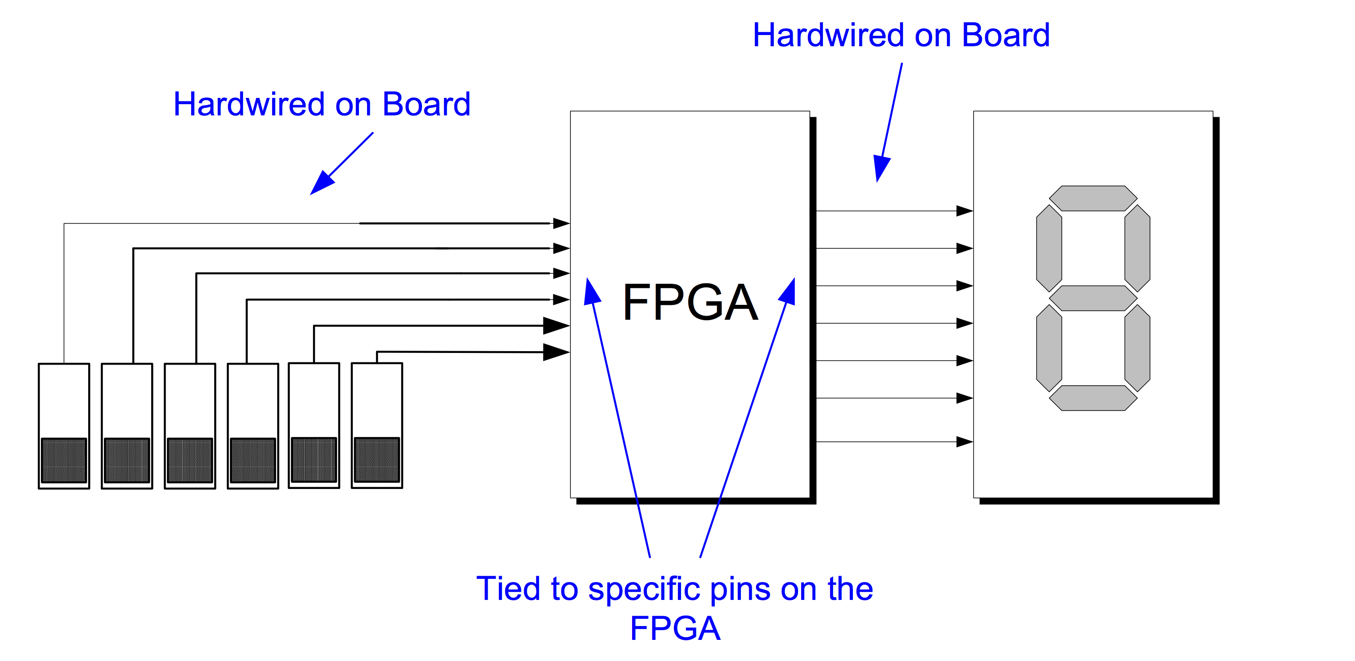
Top Level Module vs. Pin Assignments
Only the top-level module connects to pins on the FPGA inside your DE1-SoC.
The mapping between I/O names in the top level module and pins on the FPGA is specified using the pin assignments file.

Slide 133
Relevant CPEN 211 Style Guidelines
Combinational modules use only
  Assign statements
  Case or Casex statements (with default)
  If statements – only if all signals have a default assignment
  Instantiations of other combinational modules
Do not use
  Loops
  Always blocks except for case, casex, or if
Logic is organized into small modules
  Leaf modules not more than 40 lines
  If it could be made two modules, it should be
Activation lists (sensitivity list) for case statements include ALL inputs (or use *)

Slide 134
Summary
Learned how to convert Boolean expressions into logic gates
Learned some Synthesizable Verilog
  Module instantiation (implicit vs. named)
  Bus notation
  Module parameters
  Arbiter example combining above
  Always block: syntax, semantics and rules for describing combinational logic behavior
Learned how to write simple Verilog testbenches
  How to write a test script
  Strategies for designing tests
  Recommended “debugging strategy” to isolate simulation (i.e., design) errors in Verilog

