Slide 1

CPEN 211: Introduction to Microcomputers
Slide Set 7:
Verilog for Finite State Machines
Non-blocking assignments
More Synthesis Rules
Prof. Tor Aamodt
[background: Facebook social network visualization; software finite state machines are extensively in networking protocols]
Notes:
1

Slide 2
Learning Objectives
After completing this slide set you should be able to:
Write finite state machine descriptions in Verilog using edge sensitive always blocks.
Avoid common mistakes in the timing of updates to signals.
Write finite state machine descriptions using a less error prone style (following the style guidelines)

Slide 3
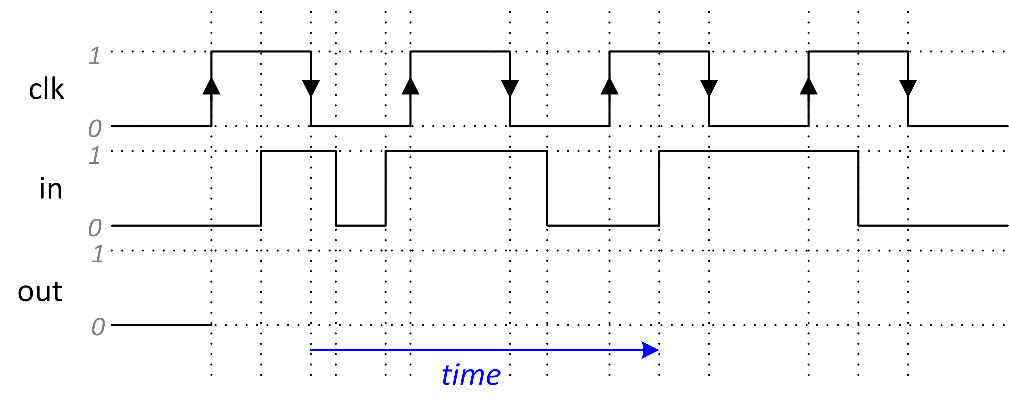
Recall (from Slide Set 6):
always @(<sensitivity_list>) begin
<sequence of statements in which order matters>
end
“posedge <expr>” is true only at times when there is a change from 0 to 1 on <expr>
always @(posedge clk)
out = in ;
In class we will complete the waveform for “out” below:

Slide 4
Warning: When you are writing Verilog you are describing hardware behavior. The “description” in an always block will have little resemblance to the actual hardware implementation. However, provided you follow the synthesis rules your hardware will implement the same behavior.
In Slide Set #6 we learned the synthesis rule for combinational logic; in this slide set we add a rule for describing synchronous sequential logic.

Slide 5
D Flip-flop
always_ff @(posedge clk)
out = in ;
in
out
D
Q
^
clk

Slide 6
Finite State Machines
Next, let’s write a Verilog module describing the following FSM’s behavior:
reset
IMPORTANT: This example is much simpler than most real FSMs because the output is different in each state. Do NOT use this example for your labs.

Slide 7
WARNINGS: 1. Since the output in each state is different we can write simplified code. 2. This code does not follow the style guidelines (we will see a “better” way to code a finite state machine later in the slide set).
module FSM(clk,reset,out);
input clk, reset;
output [1:0] out;
reg [1:0] out;
reg [1:0] present_state;
always_ff @(posedge clk) begin
if (reset)
present_state = 2'b00;
else begin
case (present_state)
2'b00: present_state = 2'b01;
2'b01: present_state = 2'b10;
2'b10: present_state = 2'b11;
2'b11: present_state = 2'b00;
default: present_state = 2'bxx;
endcase
end
out = present_state;
end
endmodule
reset
Always include a
default statement in
your case statements.
Use “don’t care” to
make it easier to find bugs.

Slide 8
Let’s walk through this code in more detail:
always_ff @(posedge clk) begin
This defines the start of an always block that contains a sequence of code where order matters.
Statements that are evaluated whenever clk changes from 0 to 1 (the “positive” edge).
There is no “delay” between statements!
Once end of always block is reached, wait until clk goes from 0 to 1 again.
if (reset)
present_state = 2'b00;
We reset present state if reset is true. Note this reset occurs at a rising edge of clock “clk”. This is called a “synchronous reset”. The MR input to the DFF in Lab #2 is an “asynchronous reset” as it does not wait for a clock edge.

Slide 9
else begin
If reset is not true we will do the else part
case (present_state)
2'b00: present_state = 2'b01;
2'b01: present_state = 2'b10;
2'b10: present_state = 2'b11;
2'b11: present_state = 2'b00;
default: present_state = 2'bxx;
endcase
We use a case statement to update the state to the next state.
out = present_state;
In this very simple example, we assign out to be equal to the updated value of present_state WARNING! Using output for state encoding (as in this example) only works if every state has a different output.

Slide 10
always_ff @(posedge clk) begin
if (reset)
present_state = 2'b00;
else begin
case (present_state)
2'b00: present_state = 2'b01;
2'b01: present_state = 2'b10;
2'b10: present_state = 2'b11;
2'b11: present_state = 2'b00;
default: present_state = 2'bxx;
endcase
end
out = present_state;
end
reset

Slide 11
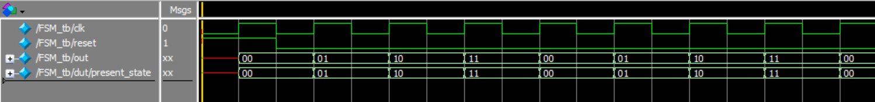
ModelSim Simulation
always_ff @(posedge clk) begin
if (reset)
present_state = 2'b00;
else begin
case (present_state)
2'b00: present_state = 2'b01;

Slide 12
Reset Notes
When power turns on (at time 0), flip-flops end up with either a 0 or a 1 but we cannot reliably predict which one for any given flip-flop.
Any given flip-flop may tend to power on to 0 or 1. Value may depend upon many factors (e.g., process variation, temperature, wear out, EMI, etc…)
ModelSim represents the uncertainty with “Unknown” value “x” (i.e., a red line).

Slide 13
Reset Notes
Circuit with a synchronous reset will have unknown state and outputs before the first rising edge when reset is asserted.
Recall Rule 1 of debugging is “Understand the system”. This red line is expected and not a “bug”!
In your electronic gadgets there is a power on reset circuit that applies a reset (so you don’t have to).

Slide 14
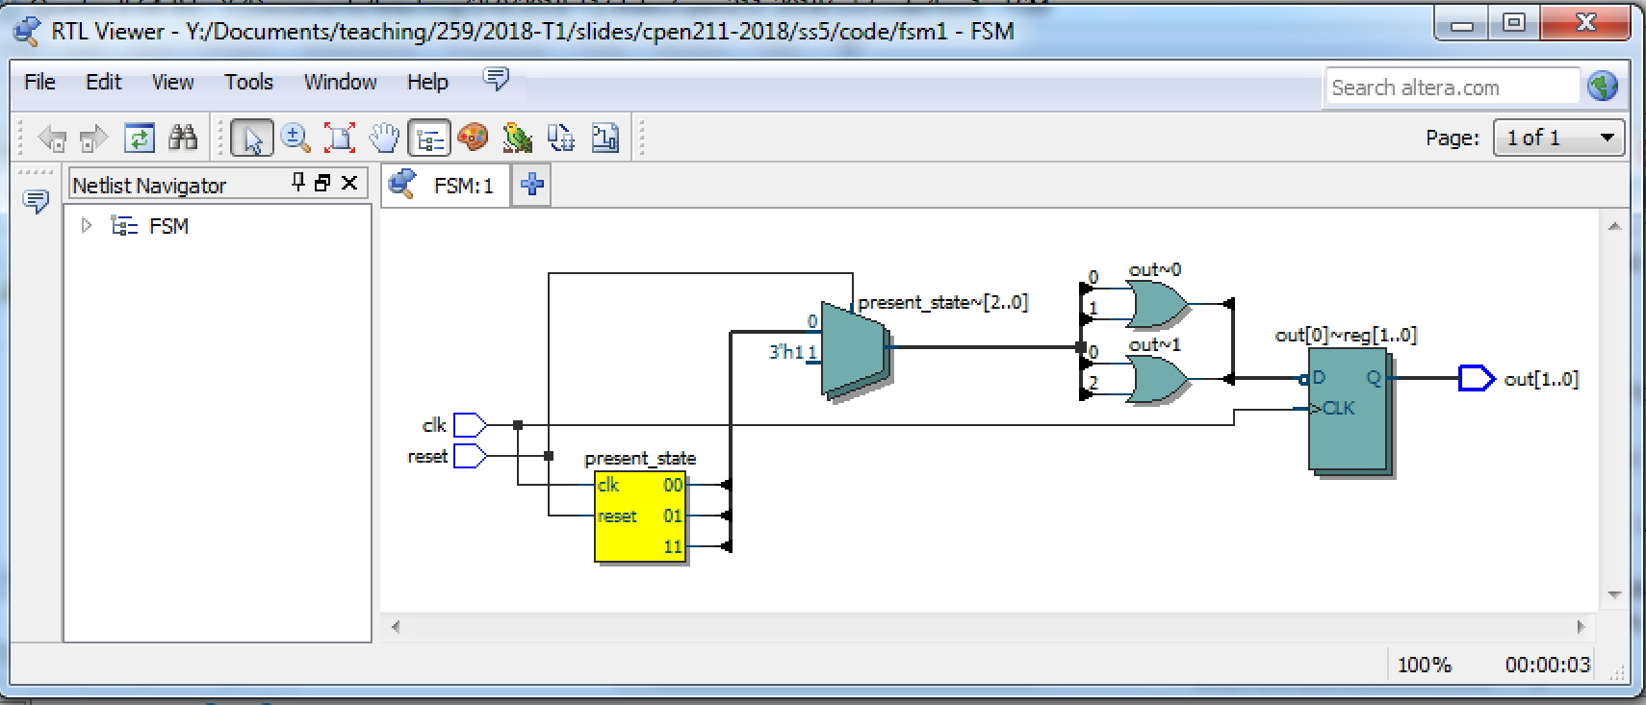
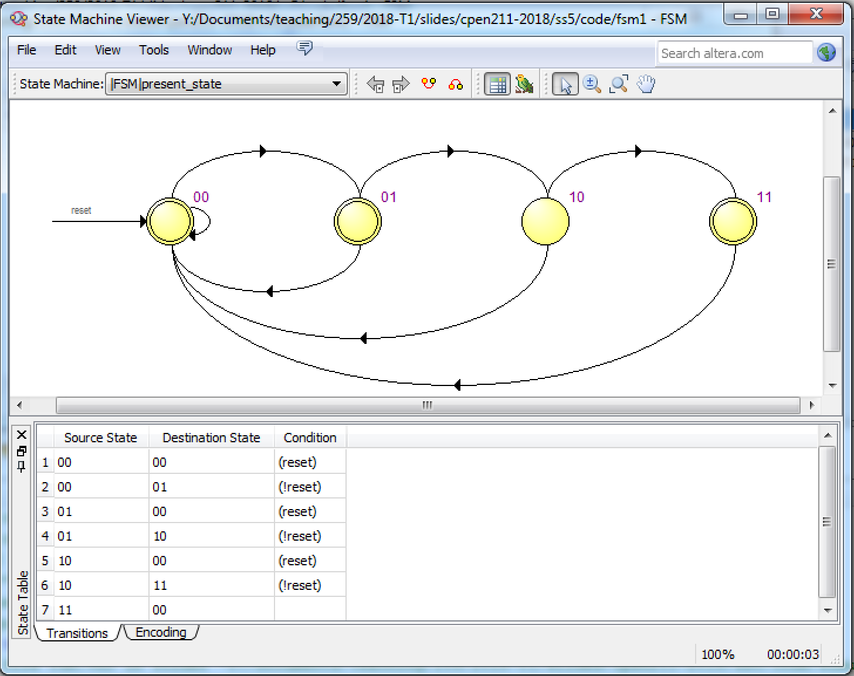
reset

Slide 15
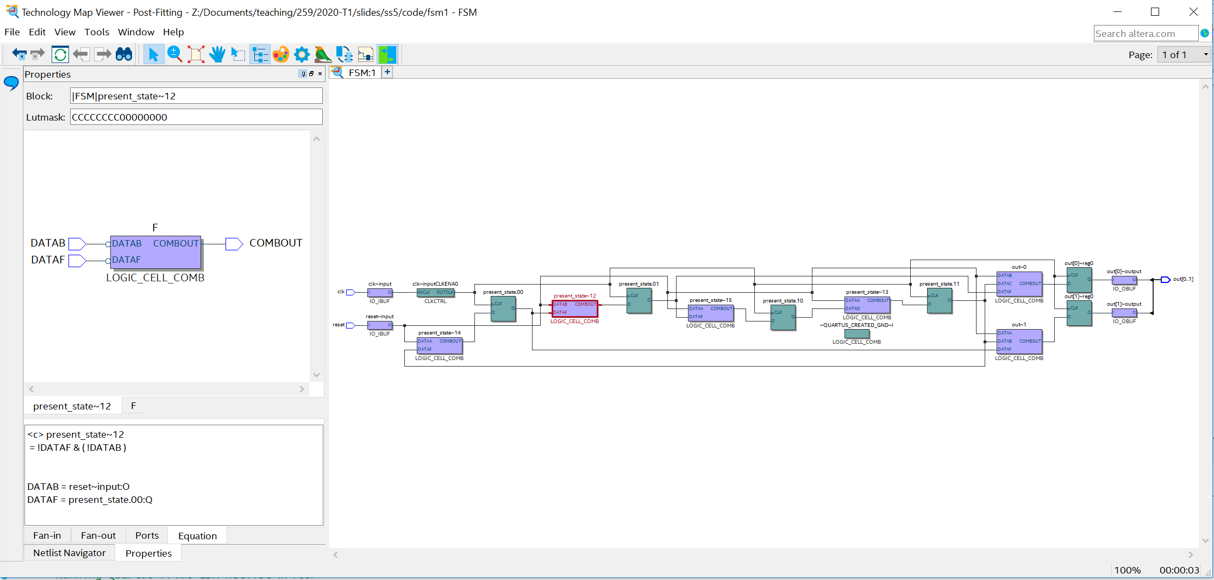
Technology Map Viewer
Tools > Netlist Viewers > Technology Map Viewer
Flip-flop to represent state “S0”
Quartus used 6-flip-flops in the implementation of our FSM. One flip-flop per state
(Quartus used a one-hot coded representation) and one for each output bit.

Slide 16
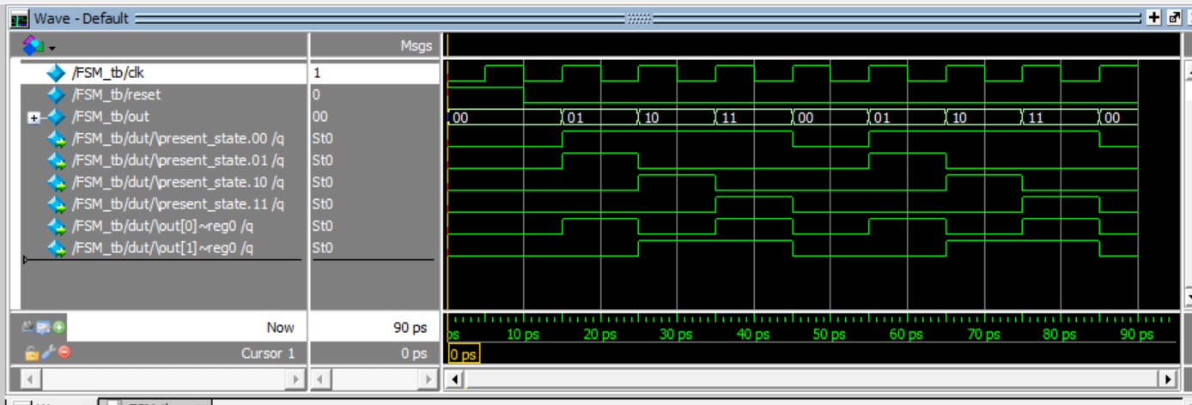
Gate-Level Simulation in ModelSim
Quartus inverted reset state encoding. E.g., “0” for present_state.00 means we are in
state 00 but other states follow usual one hot encoding we saw in flipped lecture.

Slide 17
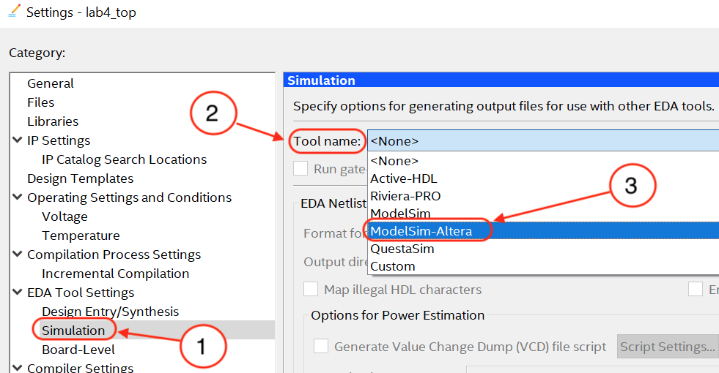
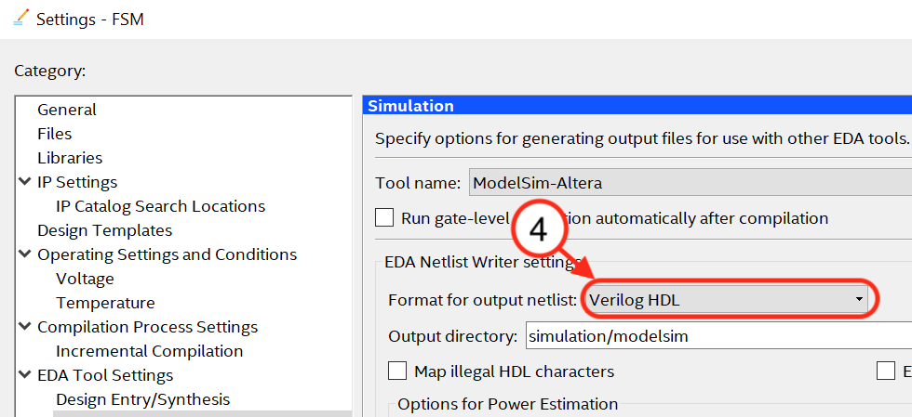
Gate-Level Simulation: How?
Adjust settings in Quartus. Do this before compiling.
Assignments > Settings > EDA Tools Settings > Simulation
Set “Tool name” to “Model-Sim Altera” and “Format for output netlist” to Verilog.
In ModelSim use transcript window to start simulation specifying libraries that model
FPGA internal blocks:
vsim -t 1ps -L cyclonev_ver -L altera_ver -L altera_mf_ver \
-L 220model_ver -L sgate_ver -L altera_lnsim_ver FSM_tb
NOTE: Replace “FSM_tb” with the module name of your testbench.

Slide 18
Different States with Same Output
In general, multiple states may have the SAME Output value
What if S1 outputs “00” (instead of “01”)?
reset
[00]

Slide 19
module FSM(clk,reset,out);
input clk, reset;
output [1:0] out;
reg [1:0] out;
reg [1:0] present_state;
always_ff @(posedge clk) begin
if (reset)
present_state = 2'b00;
else begin
case (present_state)
2'b00: present_state = 2'b10;
2'b10: present_state = 2'b11;
2'b11: present_state = 2'b00;
default: present_state = 2'bxx;
endcase
end
out = present_state;
end
endmodule
reset
[00]
This Verilog is WRONG. It does not implement the state machine with four states in the figure. It implements a state machine with three states. The two state machines are NOT the same.

Slide 20
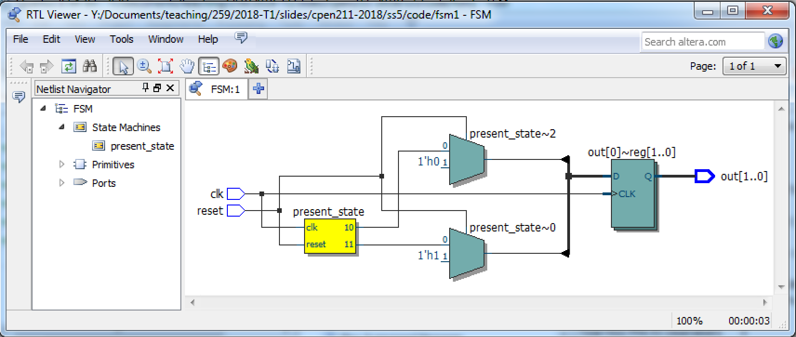
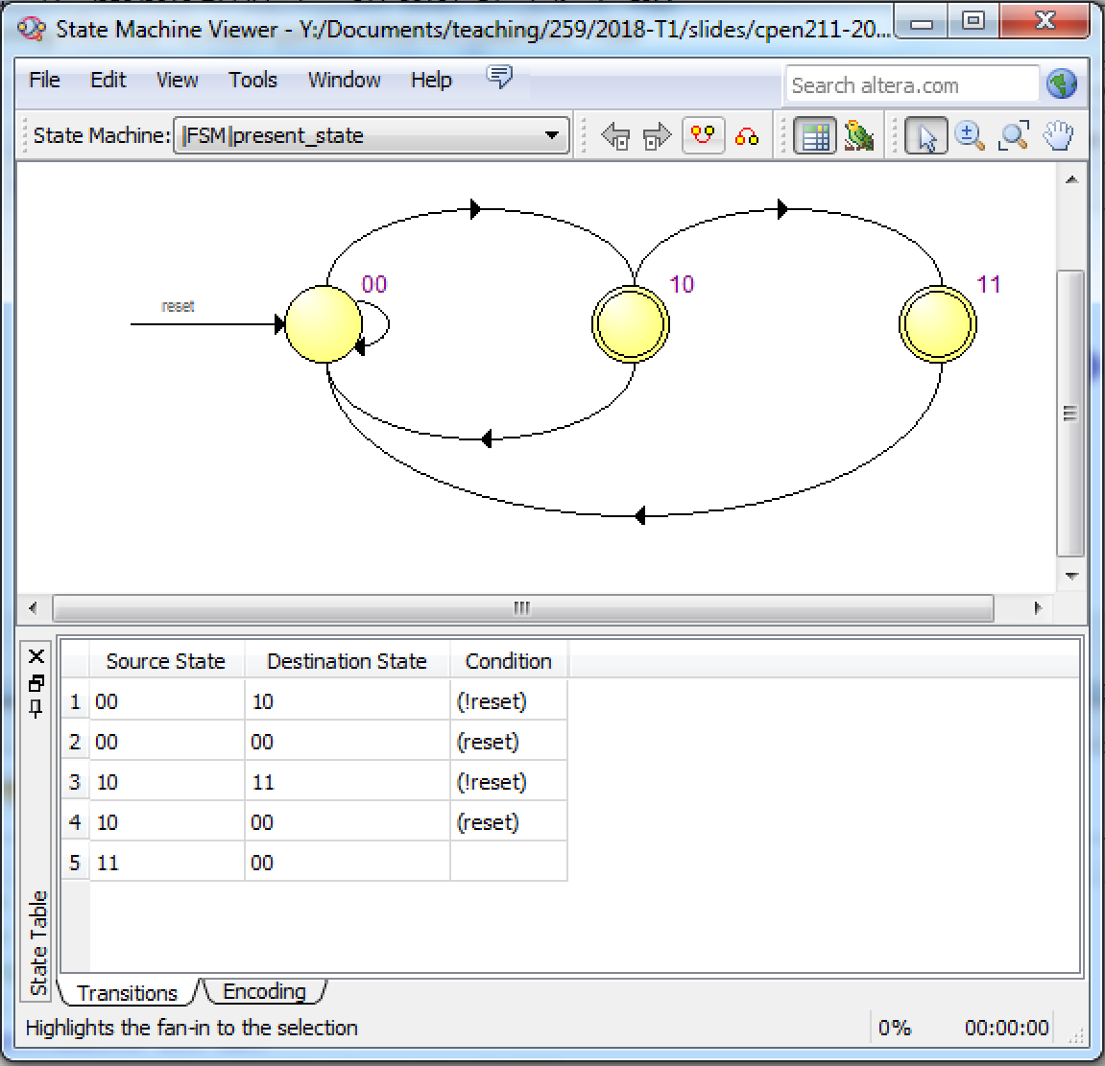
[00]

Slide 21
A more realistic example:
reset
NOTE: output for State “Sa” is same as output for State “Sd”.

Slide 22
Let’s Complete the waveform for this state machine
reset
present_state

Slide 23
`define SW 2
`define Sa 2'b00
`define Sb 2'b01
`define Sc 2'b10
`define Sd 2'b11
module FSM2(clk, reset, in, out);
input clk, reset, in;
output out;
reg out;
reg [`SW-1:0] present_state;
always_ff @(posedge clk) begin
if (reset) begin
present_state = `Sa;
out = 1'b0;
end else begin
case (present_state)
`Sa: if (in == 1'b0)
present_state = `Sa;
else
present_state = `Sb;
… continued on next slide...
WARNING: You may encounter
syntax errors if you cut & paste
this code for Lab 3.
reset

Slide 24
`Sb: if (in == 1'b0)
present_state = `Sb;
else
present_state = `Sc;
`Sc: if (in == 1'b1)
present_state = `Sc;
else
present_state = `Sd;
`Sd: if (in == 1'b1)
present_state = `Sd;
else
present_state = `Sc;
default: present_state = 2'bxx;
endcase
case (present_state)
`Sa: out = 1'b0;
`Sb: out = 1'b1;
`Sc: out = 1'b1;
`Sd: out = 1’b0;
default: out = 1'bx;
endcase
end
end
endmodule
reset
This case statement replaces:
out = present_state;
from prior example. This extra case is required because we need to know the new “present_state” we will be in after the rising edge of clk.

Slide 25
Can we combine case statements?
always_ff @(posedge clk) begin
… check for reset …
case (present_state)
`Sa: begin
if (in == 1’b0) begin
present_state = `Sa;
end else begin
present_state = `Sb;
end
out = 1'b0;
end
`Sb: begin
if (in == 1’b0) begin
present_state = `Sb;
end else begin
present_state = `Sc;
end
out = 1'b1;
end
… cases for `Sc and `Sd …
default: begin present_state = 2'bxx; out = 1'bx; end
endcase
reset

Slide 26
reset
`define Sa 2'b00
`define Sb 2'b01
`define Sc 2'b10
`define Sd 2'b11
Two case statements:
Sa
Sb
Sc
Sd
One case statement:
Sa
Sb
Sc
Sd

Slide 27
Moral?
Use two separate case statements when coding an FSM using the style in the above example:
The first to select the new state.
The second to select the output in that state.

Slide 28
Does one cycle delay really matter? Yes!
Complex designs (e.g., Lab 6 and 7) have many state machines that interact together.
Example (each rectangle is a separate state machine):
Each block is an FSM that operates in parallel (at same time).
Signals go in both direction.

Slide 29
Summary: FSM Using 1 Always Block with 2 Case Statements
Need to use two case statements because output should correspond to the state after clock edge: first case changes the state, second case updates output to match that state.
Using a single always block to design an FSM requires you to think carefully about when things happen.
Later in this slide we we will see how to code the same state machine following the style guidelines in the textbook Appendix.
Which should you use? You need to be able to read code in either style as you may see either in industry. If you have a choice, I recommend writing your own code using the style later in this slide set.

Slide 30
Testbenches for State Machines (1)
Testing is VERY important for state machines!
You will save lots of time in Lab 6 and 7 if you learn how to write really good test benches for state machines.
Testing is very important for lab proficiency test.
Even a single error (one character) is enough to fail proficiency test…. BUT you can find most errors with a good testbench and avoid all others by following style guidelines (next FSM example).

Slide 31
Testbenches for State Machines (2)
Use two initial blocks: one for clock and another for other DUT inputs.
Use a “self checking” test bench, which tests for expected present state (not in gate level simulation) and output after each input (and a rising edge of clk).
Test each transition between states that should be in state machine. Test for transitions that should NOT be in the state machine. Test outputs.
Print out messages using $display and use “task” to avoid repetitive code in you testbench.
Record presence of errors using signal (“err”) so can report whether all checks pass at end.
Look at results in waveform.

Slide 32
Hierarchical Signal Names
Verilog allows “hierarchical names”
Helps you easily check internal signals of DUT.
NOT synthesizable. Use only in testbenches. Does NOT work with gate level simulation.
Syntax (full path):
<top_level_module> { . <indentifier> } +
Example: tb.DUT.present_state
Syntax (relative path):
<instance label> { . <indentifier> } +
Example: DUT.present_state

Slide 33
Testbench: Input waveform
Goal: Inputs should test every transition, including self loops, in the state machine.
If number of edges is too many given your time constraints (e.g., during LPT-1) then test as many as you can.
IMPORTANT: Inputs (including reset) should not change when there is a rising edge on clk. (Besides being very confusing to interpret, you may get mismatches between RTL and gate level simulations if you do not ensure this.)
reset

Slide 34
Example Testbench for FSM
module FSM2_tb;
reg clk, reset, in, err;
wire out;
FSM2 dut(clk,reset,in,out);
initial begin
clk = 0; #5;
forever begin
clk = 1; #5;
clk = 0; #5;
end
end
These signals need to be declared as “reg” because
they will be assigned inside one of the initial blocks.
We use “err” to record if an error occurred. Will initial
be zero, then set to one when an error occurs. Note
that “err’ is not an input or output of dut. You can
add “err” to waveform viewer to make it easy to find
when an error occurs. Can then focus on values of
signals at that time.

Slide 35
Example Testbench for FSM
module FSM2_tb;
reg clk, reset, in, err;
wire out;
FSM2 dut(clk,reset,in,out);
initial begin
clk = 0; #5;
forever begin
clk = 1; #5;
clk = 0; #5;
end
end
Recall we use a wire for outputs of module instantiations.
This initial block generates the clock input (clk) to the FSM. NOTE: The first rising edge of clk is at time=5, the second rising edge is at time=15.

Slide 36
Example Testbench for FSM
module FSM2_tb;
reg clk, reset, in, err;
wire out;
FSM2 dut(clk,reset,in,out);
initial begin
clk = 0; #5;
forever begin
clk = 1; #5;
clk = 0; #5;
end
end
initial begin
reset = 1'b1;
in = 1’b0;
err = 1'b0;
#10; // wait until after rising edge of clock at time 5, before rising edge at time 15
Initialize “err” to zero.

Slide 37
Example Testbench for FSM
module FSM2_tb;
reg clk, reset, in, err;
wire out;
FSM2 dut(clk,reset,in,out);
initial begin
clk = 0; #5;
forever begin
clk = 1; #5;
clk = 0; #5;
end
end
initial begin
reset = 1'b1;
in = 1'b0;
err = 1'b0;
#10; // wait until after rising edge of clock at time 5, before rising edge at time 15
// check whether in expected state (you should also look at waveforms)
if( FSM2_tb.dut.present_state !== `Sa ) begin
$display("ERROR ** state is %b, expected %b",
FSM2_tb.dut.present_state, `Sa );
err = 1'b1;
end
reset

Slide 38
Example Testbench for FSM
module FSM2_tb;
reg clk, reset, in, err;
wire out;
FSM2 dut(clk,reset,in,out);
initial begin
clk = 0; #5;
forever begin
clk = 1; #5;
clk = 0; #5;
end
end
initial begin
reset = 1'b1;
in = 1’b0;
err = 1'b0;
#10; // wait until after rising edge of clock at time 5, before rising edge at time 15
// check whether in expected state (you should also look at waveforms)
if( FSM2_tb.dut.present_state !== `Sa ) begin
$display("ERROR ** state is %b, expected %b",
FSM2_tb.dut.present_state, `Sa );
err = 1'b1;
end
… continued on next slide...
a !== b treats a and b as having four possible values:
0, 1, x and z.
What’s wrong with “a != b”? If a or b is x (unknown) or z (high impedance) then result of “a != b” is x (unknown). Unknown x is treated as false by “if” (so we don’t catch the error).
Set “err” to one to record that error occurred.

Slide 39
// also check whether output is correct
if( out !== 1'b0 ) begin
$display("ERROR ** output is %b, expected %b", out, 1'b0 );
err = 1'b1;
end
reset

Slide 40
// also check whether output is correct
if( out !== 1'b0 ) begin
$display("ERROR ** output is %b, expected %b", out, 1'b0 );
err = 1'b1;
end
reset = 1'b0; // remember to de-assert reset (otherwise get stuck in Sa)

Slide 41
// also check whether output is correct
if( out !== 1'b0 ) begin
$display("ERROR ** output is %b, expected %b", out, 1'b0 );
err = 1'b1;
end
reset = 0'b0; // remember to de-assert reset (otherwise get stuck in Sa)
$display("checking Sa->Sa");
in = 1'b0; // when in Sa should stay in state Sa if input is 0
#10; // wait for rising edge of clock before checking states and output
if( FSM2_tb.dut.present_state !== `Sa ) begin
$display("ERROR ** state is %b, expected %b",
FSM2_tb.dut.present_state, `Sa );
err = 1'b1;
end
if( out !== 1'b0 ) begin
$display("ERROR ** output is %b, expected %b", out, 1'b0 );
err = 1'b1;
end

Slide 42
// also check whether output is correct
if( out !== 1'b0 ) begin
$display("ERROR ** output is %b, expected %b", out, 1'b0 );
err = 1'b1;
end
reset = 0'b0; // remember to de-assert reset (otherwise get stuck in Sa)
$display("checking Sa->Sa");
in = 1'b0; // when in Sa should stay in state Sa if input is 0
#10; // wait for rising edge of clock before checking states and output
if( FSM2_tb.dut.present_state !== `Sa ) begin
$display("ERROR ** state is %b, expected %b",
FSM2_tb.dut.present_state, `Sa );
err = 1'b1;
end
if( out !== 1'b0 ) begin
$display("ERROR ** output is %b, expected %b", out, 1'b0 );
err = 1'b1;
end
// other inputs + state and output checks ...
if( ~err ) $display("PASSED");
$stop;
end
endmodule
Print a message at end so you know all the tests completed.

Slide 43
Using “task” (testbench only)
Verilog has syntax construct called a “task”. Similar to a function but can include time delay. Can be helpful for repetitive checking code. Declared inside module where used. Use ONLY in your testbench code.
  task <identifer> ;
  { <input or output declaration> }
  begin
  { <Verilog statement> }+
  end
  endtask

Slide 44
Self-checking Testbench using task
module FSM2_tb2;
reg clk, reset, in, err;
wire out;
FSM2 dut(clk,reset,in,out);
// declare a task for checking state and outputs
task my_checker;
input [`SW-1:0] expected_state;
input [`SW-1:0] expected_output;
begin
if( FSM2_tb2.dut.present_state !== expected_state ) begin
$display("ERROR ** state is %b, expected %b",
FSM2_tb2.dut.present_state, expected_state );
err = 1'b1;
end
if( out !== expected_output ) begin
$display("ERROR ** output is %b, expected %b", out, expected_output );
err = 1'b1;
end
end
endtask
… continued on next slide...

Slide 45
initial begin
clk = 0; #5;
forever begin
clk = 1; #5;
clk = 0; #5;
end
end
initial begin
reset = 1'b1; in = 1'b0; err = 1'b0; #10;
my_checker(`Sa, 1'b0);
reset = 1'b0; // remember to de-assert reset
$display("checking Sa->Sa");
in = 1'b0; #10;
my_checker(`Sa, 1'b0);
$display("checking Sa->Sb");
in = 1'b1; #10;
my_checker(`Sb, 1'b1);
$display("checking Sb->Sb");
in = 1'b0; #10;
my_checker(`Sb, 1'b1);
//… checks for other state transitions ...
if( ~err ) $display("PASSED");
else $display("FAILED");
$stop;
end
endmodule
reset
# checking Sa->Sa
# checking Sa->Sb
# checking Sb->Sb
# PASSED
# ** Note: $stop

Slide 46
Less Error Prone Coding Style for FSMs
Use the following style for your state machines in Lab 6 and 7.

Slide 47
Finite State Machine: Implementation
Question: How do we get “state” to the reset state?
Text: Dally §14.4
Notes:
The first is to use a one-hot code for each state. The advantage of this encoding is it simplifies the logic enough that you can likely avoid using a KMAP.
For our example, since there are four states a one-hot code requires a 4-bit register. We assign gns the one-hot code 1000 and so on for the other three states.

Slide 48
Finite State Machine with
“Synchronous” Reset: Implementation
`Sa
Question: How do we describe n-bit D-flip-flop in Verilog?

Slide 49
Verilog for n-bit D Flip Flop (“Register”)
//---------------------------------------------
// define flip-flop
//---------------------------------------------
module vDFF(clk, in, out) ;
parameter n = 1; // width
input clk ;
input [n-1:0] in ;
output [n-1:0] out ;
reg [n-1:0] out ;
always_ff @(posedge clk)
out = in ;
endmodule
in
n
n
out
D
Q
^
clk

Slide 50
Verilog for Mux and DFF:
`Sa
present_state
vDFF #(`SW) STATE(clk,next_state_reset,present_state);
assign next_state_reset = reset ? `Sa : next_state;

Slide 51
module FSM2Good(clk, reset, in, out);
input clk, reset, in;
output out;
reg out;
`define SW 2
`define Sa 2'b00
`define Sb 2'b01
`define Sc 2'b10
`define Sd 2'b11
wire [`SW-1:0] present_state, next_state_reset;
reg [`SW-1:0] next_state;
vDFF #(`SW) STATE(clk,next_state_reset,present_state);
// reset logic
assign next_state_reset = reset ? `Sa : next_state;
// next state and output logic
always @(*) begin
case (present_state)
`Sa: {next_state,out} = { (in ? `Sb : `Sa), 1'b0 };
`Sb: {next_state,out} = { (in ? `Sc : `Sb), 1'b1 };
`Sc: {next_state,out} = { (in ? `Sc : `Sd), 1'b1 };
`Sd: {next_state,out} = { (in ? `Sd : `Sc), 1'b0 };
default: {next_state,out} = { {`SW{1’bx}}, 1'bx };
endcase
end
endmodule
present_state
`Sa
reset

Slide 52
`define Sa 2'b00
`define Sb 2'b01
`define Sc 2'b10
`define Sd 2'b11
Two case statements in one always block:
FSM code using style guidelines:

Slide 53
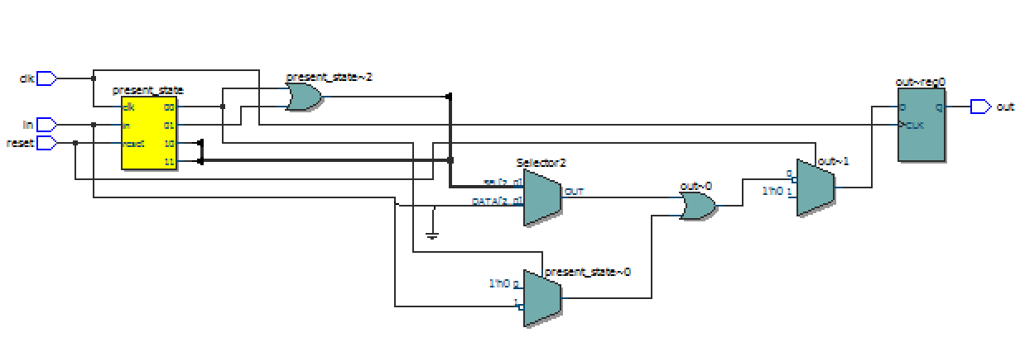
Two case statements in one always block:
FSM code using style guidelines:

Slide 54
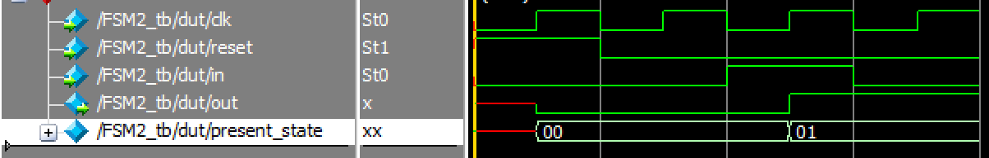

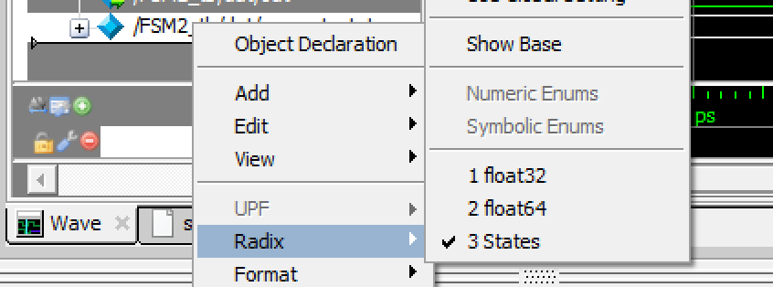
Displaying States in ModelSim
By default states show up in ModelSim waveform in their binary encoding.
You can define a custom ‘radix’ to plot states helps with debugging using the “radix define” command in the ModelSim Transcript window:
VSIM 7> radix define States { 2'b00 "Sa", 2'b01 "Sb", 2'b10 "Sc", 2'b11 "Sd", -default hex }

Slide 55
Non-Blocking Assignments

Slide 56
A normal assignment “=” takes effect “immediately”.
The “=” assignment is also called a blocking assignment.
Verilog also has a non-blocking assignment: “<=”.
The difference? Non-blocking assignments do not take effect until the end of an always block.

Slide 57
Verilog’s Non-Blocking Assignment “<=”
always @(x or y) begin
z <= x & y;
w <= x | y;
end
Signals z and w get updated at the same time, at the end of the always block. This is because they were assigned using “<=”.

Slide 58
Non-blocking assignment (<=)
always @(x or y) begin
z <= x & y;
w <= z | y;
end
This is strange: The assignment to w uses the old value of z, not the new value! That is because z is not updated until the end of the always block.

Slide 59
If z was a blocking-assignment…
always @(x or y) begin
z = x & y;
w <= z | y;
end
In this case, w would use the “new” value of z.
This is because the assignment to z used a blocking assignment “=”. The next statement is “blocked” until the update to z takes effect.

Slide 60
“Blocking” assignment
“Non-Blocking” assignment
always_ff @(posedge clk) begin
b = a;
c = b;
end
always_ff @(posedge clk) begin
b <= a;
c <= b;
end
Synthesizes to:
Synthesizes to:

Slide 61
Which circuit does the following Verilog describe?
always_ff @(posedge clk)
q1 = d1;
always_ff @(posedge clk)
q2 = q1;
A:
B:

Slide 62
Simulation errors w/ blocking assignments and “@(posedge clk)”:
// following style guidelines – OK
vDFF #(1) dff1(clk, d1, q1);
vDFF #(1) dff2(clk, q1, q2);
// non-blocking - OK
always_ff @(posedge clk)
q1 <= d1;
always_ff @(posedge clk)
q2 <= q1;
// blocking – BAD: simulation differs from synthesis!
always_ff @(posedge clk)
q1 = d1;
always_ff @(posedge clk)
q2 = q1;
Quartus synthesizes:
ModelSim simulates:
More on this: http://www.informit.com/articles/article.aspx?p=392278&seqNum=6
NOTE: Strictly speaking, we should probably use <= inside vDFF but ModelSim does “right thing” with ”=”.

Slide 63
Moral?
If you follow style guidelines and use vDFF for registers you can use normal assignments “everywhere”.
If you do not use vDFF for all your state then make sure to use non-blocking assignment “<=” for the outputs of your “always_ff @(posedge clk)” blocks!

Slide 64
We saw this rule in Slide Set 6….
For purely combinational processes (Type 1):
Rule 1: Every input (that can affect the output(s)) must be
in the sensitivity list or use the wildcard @(*)
Rule 2: Every output must be assigned a value for every
possible combination of the inputs
always @(sel or A or B) begin
if (sel == 1'b0)
Y = A;
else
Y = B;
end
always @(*) begin
if (sel == 1'b0)
Y = A;
else
Y = B;
end

Slide 65
Type 2: Purely Synchronous: Each output changes only on the rising or falling edge of a single clock
always_ff @(posedge CLK)
Z <= A & B;

Slide 66
For a purely synchronous always block (Type 2):
Rule 1: Only the clock should be in the sensitivity list and should
be put after one of the keywords “posedge” or “negedge”
Rule 2: Only signals that change on the same edge of the same
clock should be assigned to in the same always block
Rule 3: Clock should not be not read/written inside of the always
block
Rule 4: The always block can only describe what happens in one clock cycle.
Rule 5: Only one purely synchronous always block per module
or you must use non-blocking assignment “<=” for always block outputs.

Slide 67
Type 3: Purely level sensitive. Output changes only when clock is high.
always_latch
if (CLK == 1'b1)
Z = A & B;
NOTE: You will see the inferred latch warning for this code, but that is OK because here we *wanted* a latch.
Warning (10240): Verilog HDL Always Construct warning at ss6.v(295): inferring latch(es) for variable "Z", which holds its previous value in one or more paths through the always construct

Slide 68
For a purely level sensitive always block (Type 3):
Rule 1: Use always_latch (can also use “always @(*)”)
Rule 2: Clock should be in only one “if condition”.
Rule 3: Only signals that change on the same level of the same
clock should be assigned to in the same always block
Rule 4: Clock should not be not read/written inside of the always
block

Slide 69
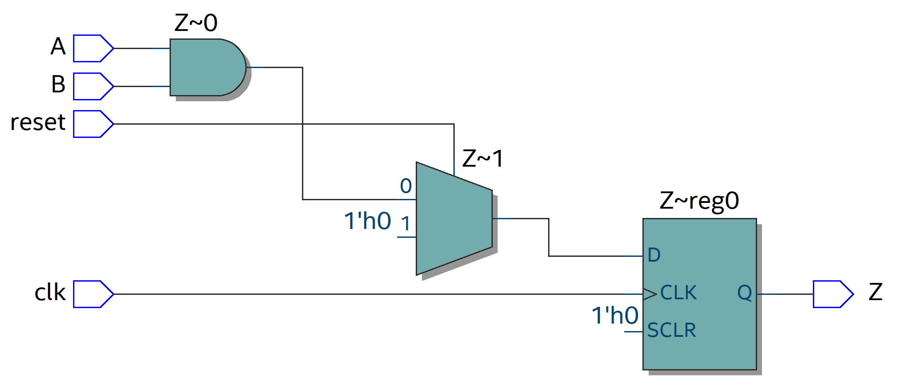
Reset, revisited
Recall a synchronous reset can be specified using an if inside a synchronous (Type 2) always block (this is what we did for our FSM example in the first style).
always_ff @(posedge clk)
if (reset)
Z = 1'b0;
else
Z = A & B;
In Lab 2, the reset behaved differently: The Q outputs of the DFFs were reset to zero immediately when MR was set to 1. How do we specify such behavior in Verilog in a way that CAD tools can recognize it and synthesize it?

Slide 70
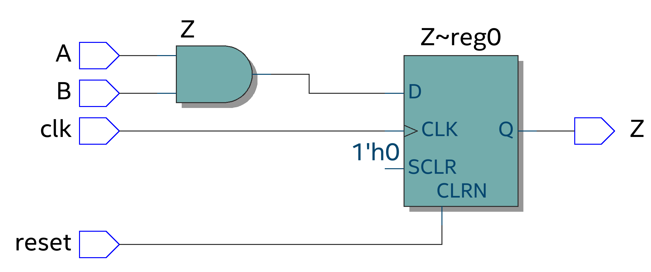
Type 4: Synchronous with asynchronous reset.
always_ff @(posedge clk, posedge reset)
if (reset)
Z = 1'b0;
else
Z = A & B;

Slide 71
For a synchronous with asynchronous reset always block (Type 4):
Rule 1: Only the clock and reset should be in the sensitivity list and both should
be put after one of the keywords “posedge” or “negedge”
Rule 2: All code must be “nested” within a single if statement that first checks if reset is asserted;
if reset is asserted, must set outputs to a constant value.
Rule 3: Only signals that change on the same edge of the same
clock should be assigned to in the same always block
Rule 4: Clock and reset should not be not read/written inside of the always
block
Rule 5: The always block can only describe what happens in one clock cycle.
Rule 6: Only one purely synchronous always block per module
or you must use non-blocking assignment “<=” for always block outputs.

Slide 72
Final Rule (the most important rule of all):
If you want to synthesize your circuit, every always block must fall exactly into one of these categories. Every always block. Every single one. No exceptions.
If one of your always blocks doesn’t, you need to break it up into blocks, where each block does fit into one of these categories.
NOTE: I am being a little bit conservative here… some synthesizers may handle a few patterns not described here. But don’t count on it.

Slide 73
module FSM2Good(clk, reset, in, out);
input clk, reset, in;
output out;
reg out;
`define SW 2
`define Sa 2'b00
`define Sb 2'b01
`define Sc 2'b10
`define Sd 2'b11
wire [1:0] present_state, next_state_reset;
reg [1:0] next_state;
vDFF #(`SW) STATE(clk,next_state_reset,present_state);
// reset logic
assign next_state_reset = reset ? 2'b00 : next_state;
// next state and output logic
always_comb begin
case (present_state)
`Sa: {next_state,out} = { (in ? `Sb : `Sa), 1'b0 };
`Sb: {next_state,out} = { (in ? `Sc : `Sb), 1'b1 };
`Sc: {next_state,out} = { (in ? `Sc : `Sd), 1'b1 };
`Sd: {next_state,out} = { (in ? `Sd : `Sc), 1'b0 };
default: {next_state,out} = 3'b000;
endcase
end
endmodule
present_state
`Sa
Type 1: Purely
Combinational logic

Slide 74
Summary
Two ways to code up a finite state machine in Verilog.
Second (following style guideline) is preferable as it avoids a very common pitfall causing output to be delayed by one cycle.
“Self checking” testbenches for FSMs.
Two new rules that are important to know whenever writing synthesizable Verilog with always blocks.

