Slide 1
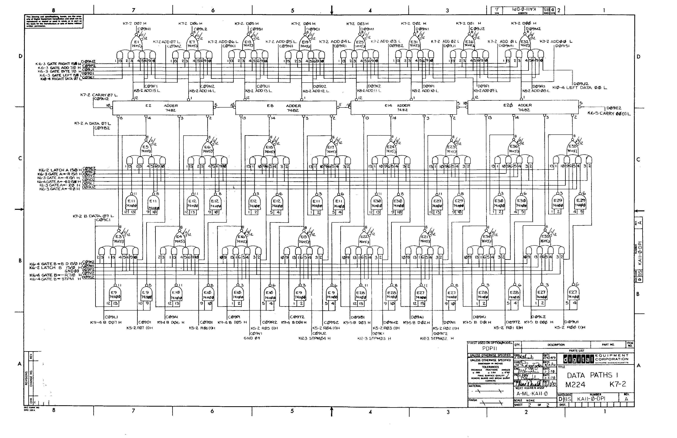
CPEN 211: Introduction to Microcomputers
Slide Set 8:
Iterative Combinational Logic
Prof. Tor Aamodt
[ Background image: Logic gate diagram for a portion of the PDP 11 data path; The PDP 11 was a famous “minicomputer” from the 1970s.
Copyright © DEC. Source: http://www.psych.usyd.edu.au/pdp-11/Images/11_20_dp.gif ]
Notes:
0.5

Slide 2
Learning Objectives
By the end of this slide set you should be able to:
Design an iterative combinational logic circuit
Describe iterative combinational logic in Verilog
Notes:
2

Slide 3
Hexadecimal numbers
Hexadecimal, ‘hex’, or base-16, number system is very convenient when working with computers.
Mainly, it is shorter and faster to write than binary.
It is far easier to convert between binary and ‘hex’ than between binary and decimal.
Four bits can represent 2⁴ = 16 different things.
We take four bits, give them the 16 labels 0, 1, 2, 3, 4, 5, 6, 7, 8, 9, A, B, C, D, E, F

Slide 4
Hexadecimal numbers
Binary | Decimal | Hexadecimal
0000 | 0 | 0
0001 | 1 | 1
0010 | 2 | 2
0011 | 3 | 3
0100 | 4 | 4
0101 | 5 | 5
0110 | 6 | 6
0111 | 7 | 7
1000 | 8 | 8
1001 | 9 | 9
1010 | 10 | A
1011 | 11 | B
1100 | 12 | C
1101 | 13 | D
1110 | 14 | E
1111 | 15 | F

Slide 5
From Decimal To Binary To Hexadecimal
Example: 1963₁₀
1963₁₀ = 0111 1010 1011₂
7
A_{hex}
B_{hex}
Text: Dally §10.1
Notes:
1963-1024=939
939-512=427
427-256=171
171-128=43
43-32=11
11-8=3
3-2=1
1-1=0

Slide 6
Example: Arbiter
Arbiter handles requests from multiple devices to use a single resource.
[https://en.wikipedia.org/wiki/All-way_stop#/media/File:4waystop.jpg]
E.g.: Single resource is road inside intersection
Text: Dally §8.5
Notes:
1.5

Slide 7
Arbiter
Arbiter handles requests from multiple devices to use a single resource. Responds to requests (r) with grants (g).
Arbiter
r
g
n
n
Finds first “1” bit in input r
g[i]=1 iff r[i]==1 and, for j<i, r[j]==0
Another way of saying this: picks lowest input set to 1 as the single winner and grants this winner’s request.
NOTE: output is one-hot code (or all zero if no requests).
Text: Dally §8.5
Notes:
3.5

Slide 8
How to build an Arbiter?

Slide 9
Iterative Circuit Design (1/4)
Any combinational logic circuit can be implemented as sum-of-products. So, could design an arbiter that way.
However, some combinational logic circuits, called “iterative circuits” have outputs that follow a pattern.
Arbiter is such an example.
We can use our knowledge of the specific pattern to help design the circuit.

Slide 10
Iterative Circuit Design (2/4)
In an iterative circuit the number of output bits depends upon number of input bits. E.g., for the arbiter r and g are both n bits.
In an iterative circuit the output in position “i” is a function of the input(s) at position “i” along with the inputs at all earlier positions.
What makes the circuit “iterative” is that we can find a way to summarize the inputs from earlier bit positions using a small number of bits (e.g., a single bit).

Slide 11
Iterative Circuit Design (3/4)
The summary is often call a carry signal.
Each bit position has a carry-in (c_{i-1}) and a carry-out (c_{i}).
x_{i}
c_{i}
c_{i+1}
y_{i}

Slide 12
Iterative Circuit Design (4/4)
We build the circuit by making many identical copies of the same circuit and connecting the carry-out of one stage to the carry-in of the next circuit. First bit position connect carry-in to a fixed value.
x₀
x₁
x_{n-1}
…
c₀
c₁
c₂
c_{n-1}
c_{n}
y₀
y₁
y_{n-1}

Slide 13
Iterative Circuit Design - Steps
Encode carry by identifying information in earlier bit positions relevant to current bit position. No recipe. Requires creativity.
Write truth table for output and carry-out at position i. The inputs in this truth table are the circuit’s input at bit position i and the carry-out generated from bit position i-1.
Write out the logic function for bit position i (perhaps using a KMAP to optimize it).
Make n copies of this circuit connecting carry-out of position i-1 to carry-in of position i.

Slide 14
For arbiter: g[i]=1 iff r[i]==1 and, for j<i, r[j]==0
Notes:
First step, finding this equation from “Finds first 1 bit in input r”. Could write out a few examples and see the equation holds.
Could write out truth table for each output bit, that would work. Would take a long time.
Instead, will recognize there is a pattern to the logic (e.g., equation). Try to build iterative circuit.
Notice condition divides into two part separated by AND.
Second part suggests need a new signal, call it ”t” and t[i] means for j<i, r[j]==0

Slide 15
Logic Diagram Of One Bit Of An Arbiter
Text: Dally §8.5
Notes:
2

Slide 16
Implementation of a 4-Bit Arbiter
Using Bit-Cell
1
0
0
1
1
1
0
0
0
0
1
0
0
g[i]=1 iff r[i]==1 and, for j<i, r[j]==0
Text: Dally §8.5
Notes:
2

Slide 17
Implementing Arbiter Using Verilog
// arbiter stage
module ArbStage(r, cin, g, cout) ;
input r, cin ;
output g, cout ;
assign cout = ~r & cin ;
assign g = r & cin ;
endmodule
cin
cout

Slide 18
Implementing Arbiter Using Verilog
1
// arbiter – version #1: hierarchical
module Arb(r, g) ;
input [3:0] r ;
output [3:0] g ;
wire [4:0] c ;
assign c[0] = 1’b1;
ArbStage stage1(r[0], c[0], g[0], c[1]);
ArbStage stage2(r[1], c[1], g[1], c[2]);
ArbStage stage3(r[2], c[2], g[2], c[3]);
ArbStage stage4(r[3], c[3], g[3], c[4]);
endmodule

Slide 19
Implementing Arbiter – Version #2
1
// arbiter – version #2: gate level
module Arb(r, g) ;
input [3:0] r ;
output [3:0] g ;
wire [3:0] c ;
assign c[0] = 1'b1;
assign c[1] = ~r[0] & c[0];
assign c[2] = ~r[1] & c[1];
assign c[3] = ~r[2] & c[2];
assign g = r & c;
endmodule
c0
c1
c2
c3
Notes:
Use this example to introduce alternative and commonly used bit-slice notation:
assign c = {~r[2] & c[2], ~r[1] & c[1], ~r[0] & c[0], 1’b1 };
assign c = {~r[2:0] & c[2:0], 1’b1 };

Slide 20
Implementing Arbiter – Version #3
1
// arbiter – version #3: bit-slice
module Arb(r, g) ;
input [3:0] r ;
output [3:0] g ;
wire [3:0] c ;
//assign c[0] = 1'b1;
//assign c[1] = ~r[0] & c[0];
//assign c[2] = ~r[1] & c[1];
//assign c[3] = ~r[2] & c[2];
assign c = {(~r[2:0] & c[2:0]),1'b1};
assign g = r & c;
endmodule
“iterative” combinational logic circuit using bit-slice style:
We use {a, b} for concatenation
We use r[2:0] and c[2:0] for index ranges

Slide 21
Example: Implementing Arbitrary Width Arbiter Using Verilog
Highlighted line is equivalent to:
assign c[0] = 1'b1;
assign c[1] = ~r[0] & c[0];
assign c[2] = ~r[1] & c[1];
…
assign c[n-1] = ~r[n-2] & c[n-2];
// arbiter (arbitrary width)
module Arb(r, g) ;
parameter n=4 ;
input [n-1:0] r ;
output [n-1:0] g ;
wire [n-1:0] c ;
wire [n-1:0] g ;
assign c = {(~r[n-2:0] & c[n-2:0]),1'b1} ;
assign g = r & c ;
endmodule
Text: Dally §8.5
Notes:
3

Slide 22
Priority Encoder
Priority Encoder:
  n-bit input signal a
  m-bit output signal b
    b indicates, in binary, the position of the first 1 bit in a (starting from least significant bit)
1010
0010
01
Arbiter
Encoder
a
r
g
ae
b
n
n
m
b
m = log₂n
Priority
Encoder
a
b
n
m
Text: Dally §8.5
Notes:
3.5

Slide 23
Verilog for Priority Encoder
// priority encoder (arbitrary width)
module PriorityEncoder83(r, b) ;
input [7:0] r ;
output [2:0] b ;
wire [7:0] g ;
Arb #(8) a(r, g) ;
Enc83 e(g, b) ;
endmodule
Text: Dally §8.5
Notes:
1.5

Slide 24
Functions built from decoders and other blocks
Example – find maximum of 256 small 4-bit numbers
  Decode each number 4→16 bits (256 times)
  OR these together w/16 256-bit ORs
    (each a 4-level tree of 4-input ORs)
  Use an Arbiter to get highest of 16
  Encode the 16→4
Need to see if this is more efficient than a tournament
Can this determine which input has the ‘winning’ number?
Decode
OR
Arbiter
Encode
Text: Dally §8.2 + 8.5
Notes:
3

Slide 25
Comparing Values
Comparing two 1-bit signals for equality:
a | b | f
0 | 0 | 1
0 | 1 | 0
1 | 0 | 0
1 | 1 | 1
XNOR gate
Text: Dally §8.6
Notes:
1.5

Slide 26
Equality Comparator
Comparing two n-bit signals for equality:
a=b
// equality comparator
module EqComp(a, b, eq) ;
parameter k=8;
input [k-1:0] a,b;
output eq;
wire eq;
assign eq = (a==b) ;
endmodule
Text: Dally §8.6
Notes:
2.5

Slide 27
Magnitude Comparator
a > b
A > B iff A[i] > B[i] and A[k] = B[k] for k > i.
A = 0 1 1 0 0 1 1 0 1 0
B = 0 1 0 1 0 1 0 1 0 0
AgtB =
1
1
1
0
1
1
1
0
1
0
Text: Dally §8.6
Notes:
2.5

Slide 28
A > B iff A[i] > B[i] and A[k] = B[k] for k > i.
Text: Dally §8.6
Notes:
2.5

Slide 29
Magnitude Comparator
A > B iff A[i] > B[i] and A[j] = B[j] for j > i.
Equivalent to writing:
assign gtb[0] = 1'b0;
assign gtb[1] = (eqi[0] & gtb[0]) | gti[0];
assign gtb[2] = (eqi[1] & gtb[1]) | gti[1];
…
// magnitude comparator
module MagComp(a, b, gt) ;
parameter k=8 ;
input [k-1:0] a, b ;
output gt ;
wire [k-1:0] eqi = a ~^ b ;
wire [k-1:0] gti = a & ~b ;
wire [k:0] gtb = {((eqi[k-1:0] & gtb[k-1:0]) | gti[k-1:0]), 1’b0} ;
wire gt = gtb[k] ;
endmodule
Text: Dally §8.6
Notes:
2.5

Slide 30
Another Implementation Of Magnitude Comparator
Text: Dally §8.6
Notes:
2

Slide 31
// Behavioral Magnitude comparator
module MagComp_b(a, b, gt) ;
parameter k=8 ;
input [k-1:0] a, b ;
output gt ;
wire gt = (a > b) ;
endmodule
Text: Dally §8.6
Notes:
1.5

Slide 32
Putting things together – Maximum unit
a
n
n
1
m
a
x
Mux
0
n
n
a
Magnitude
Comparator
a > b
gt
b
b
n
Text: Dally §9.3
Notes:
2

Slide 33
Summary
Learned about iterative combinational logic

