Slide 1
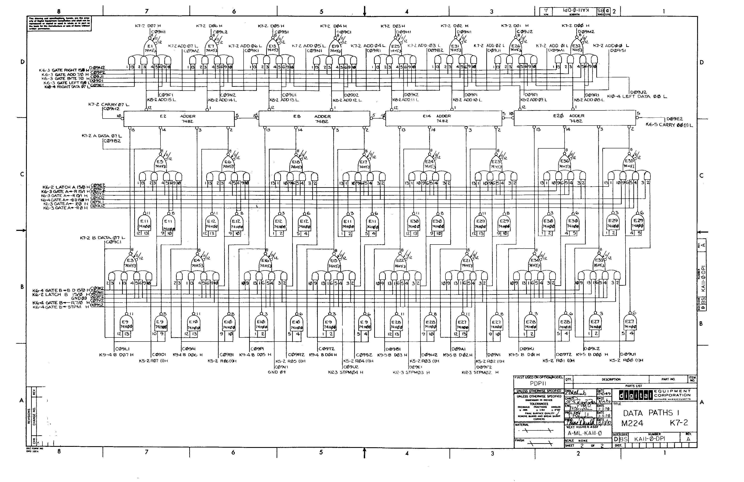
CPEN 211: Introduction to Microcomputers
Slide Set 10:
Adder Circuits, Two’s Complement
Prof. Tor Aamodt
[ Background image: Logic gate diagram for a portion of the PDP 11 data path; The PDP 11 was a famous “minicomputer” from the 1970s.
Copyright © DEC. Source: http://www.psych.usyd.edu.au/pdp-11/Images/11_20_dp.gif ]
Notes:
0.5

Slide 2
Learning Objectives
By the end of this slide set you should be able to:
Explain how addition is performed using combinational logic
Represent negative numbers in 2’s complement
Build an efficient adder/subtractor unit
Notes:
2

Slide 3
Addition
We can design an iterative combinational logic circuit to perform addition…
Inputs:
  A = (a_{n-1},a_{n-2},…,a₁,a₀)
  B = (b_{n-1},b_{n-2},…,b₁,b₀)
Output:
  Sum = (s_{n-1},s_{n-2},…,s₁,s₀)
Carry?

Slide 4
Binary addition
1-bit 0+0 = 0, 1+0 = 1, 1+1 = 10
0_
10_
110_
1_
11_
111_
  6 110
  + 3 011
  5 101
  +7 111
9
1
12
01
001
1001
0
00
100
1100
carry-in
carry-out
Text: Dally §10.2

Slide 5
One bit of an adder
Counts the number of “1” bits on its input
Outputs the result in binary
For a half-adder, 2 inputs, output can be 0, 1, or 2
For a full-adder, 3 inputs, output can be 0, 1, 2, or 3
Text: Dally §10.2

Slide 6
Half Adder
ab cs
# 00 00
# 01 01
# 10 01
# 11 10
// half adder
module HalfAdder(a,b,c,s);
input a,b ;
output c,s ; // carry and sum
wire s = a ^ b ;
wire c = a & b ;
endmodule
Text: Dally §10.2

Slide 7
Full Adder
Counts the number of “1” bits on its input
For a full-adder, 3 inputs, output can be 0, 1, 2, or 3
Full adder symbol:
Text: Dally §10.2

Slide 8
Full adder from a truth table
Text: Dally §10.2

Slide 9
Full adder from truth table
// full adder - logical
module FullAdder2(a,b,cin,cout,s) ;
input a,b,cin ;
output cout,s ; // carry and sum
wire s = a ^ b ^ cin ;
wire cout = (a & b)|(a & cin)|(b & cin) ; // majority
endmodule
Text: Dally §10.2

Slide 10
Full Adder via Factoring
Can build (smaller) full-adder out of half adders…
half adder
ab cs
# 00 00
# 01 01
# 10 01
# 11 10
Text: Dally §10.2

Slide 11
# 000 00
# 001 01
# 010 01
# 011 10
# 100 01
# 101 10
# 110 10
# 111 11
// full adder - from half adders
module FullAdder1(a,b,cin,cout,s) ;
input a,b,cin ;
output cout,s ; // carry and sum
wire g,p ; // generate and propagate
wire cp ;
HalfAdder ha1(a,b,g,p) ;
HalfAdder ha2(cin,p,cp,s) ;
assign cout = g | cp;
endmodule
Text: Dally §10.2

Slide 12
Adder in Verilog - behavioral
// multi-bit adder - behavioral
module Adder1(a,b,cin,cout,s) ;
parameter n = 8 ;
input [n-1:0] a, b ;
input cin ;
output [n-1:0] s ;
output cout ;
wire [n-1:0] s;
wire cout ;
assign {cout, s} = a + b + cin ;
endmodule
Verilog automatically zero extends “cin” to be n bits for this addition.
Text: Dally §10.2

Slide 13
Multi-bit Adder
0_
10_
110_
  6 110
  + 3 011
9
1
01
001
1001
Text: Dally §10.2

Slide 14
c[i]
a[i]
s[i]
b[i]
p
g
c[i+1]
p[i]: Propagate carry in position i if a[i] or b[i] is 1
g[i]: Generate carry in position i if both a[i] and b[i] are 1

Slide 15
Ripple-carry adder – bit-slice notation
// multi-bit adder – with vectors
module Adder2(a,b,cin,cout,s) ;
parameter n = 8 ;
input [n-1:0] a, b ;
input cin ;
output [n-1:0] s ;
output cout ;
wire [n-1:0] p = a ^ b ;
wire [n-1:0] g = a & b ;
wire [n:0] c = {g | (p & c[n-1:0]), cin} ;
wire [n-1:0] s = p ^ c[n-1:0] ;
wire cout = c[n] ;
endmodule
Text: Dally §10.2

Slide 16
Negative Integers
Thus far we have only addressed positive integers. What about negative numbers?
3 ways to represent negative integers in binary:
  Sign Magnitude
  One’s complement
  Two’s complement
Example: Consider +23 –23
  Sign Magnitude 0 10111 1 10111
  One’s complement 0 10111 1 01000
  Two’s complement 0 10111 1 01001
Text: Dally §10.3

Slide 17
Converting Positive to Negative
To convert a positive number in 2’s complement to a negative number:
invert bits and then add 1
E.g., convert 0011 to negative number:
step 1: 1100 (flip all bits)
step 2: 1100+0001 (add one)
1101 (-3 in 2’s complement)
Text: Dally §10.3

Slide 18
Converting Negative to Positive
Use same operation to convert back
E.g., convert 1101 (-3) to positive number:
step 1: 0010 (flip all bits)
step 2: 0010+0001 (add one)
0011 (3 in 2’s complement)
Text: Dally §10.3

Slide 19
Why do we use 2’s complement?
2’s complement makes subtraction easy
Represent negative number, –x as 2^{n} – x
All arithmetic is done modulo 2^{n} so no adjustments are necessary
x + (– y) = (x + (2^{n} – y)) mod 2^{n}
consider 4-bit numbers
4 – 3 = 4 + (– 3)
= (4 + (16 – 3)) mod 16 // 4+(16-3) = 17; 17 mod 16 = 1
= 4 + (15 – 3 + 1)
= 4 + (15 – 3) + 1
= 0100 + (1111 – 0011) + 0001
= 0100 + (1100) + 0001
= 0001
Text: Dally §10.3

Slide 20
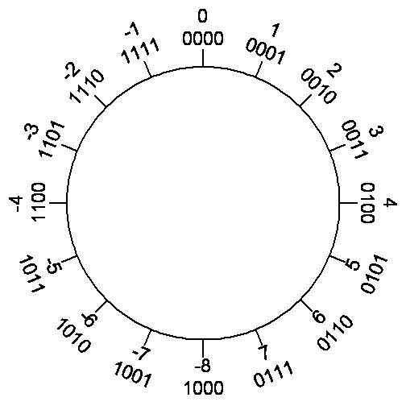
2’s Complement
1 = 0001
-1 = 1110 + 1 = 1111
7 = 0111
-7 = 1000+1 = 1001
Interesting case: -8
5-bits:
8 = 01000
-8 = 10111 + 1 = 11000
Note: Lower 4-bit same!
Want MSB to indicate
negative number, so in 4-bits:
1000 is -8
Text: Dally §10.3

Slide 21
Value Function (2’s Complement)
Assume b_{i} is value of i^{th} bit in 2’s complement representation of a number, then
Example, n=4:
-8₁₀ = 1000₂ = (-2³ • 1) + (0 • 2⁰) + (0 • 2¹) + (0 • 2⁰)
Text: Dally §10.3

Slide 22
Impact of <signed> (s) in
Verilog Bit Literals…
wire [7:0] a;
assign a = <val>;
<val>
2’b10 // a == 8’b0000_0010 (zero extended)
2’b01 // a == 8’b0000_0001
2’sb10 // a == 8’b1111_1110 (sign extended)
2’sb01 // a == 8’b0000_0001
Note: “Does not work” with “x” – use {n{x}} to get n x’s.

Slide 23
2’s Complement Adder/Subtractor
Text: Dally §10.3

Slide 24
Overflow
If using 4-bits, 4 + 4 = 8 which cannot fit into 4-bit (recall, 1000 means -8 if using 4-bit 2’s complement)
If using 4-bits, -6 + (-3) = -9 which doesn’t fit in 4-bits (lower 4-bits of 10111₂ is 0111₂ which is 7₁₀)
Observation: Inputs same sign, result different sign.
Text: Dally §10.3

Slide 25
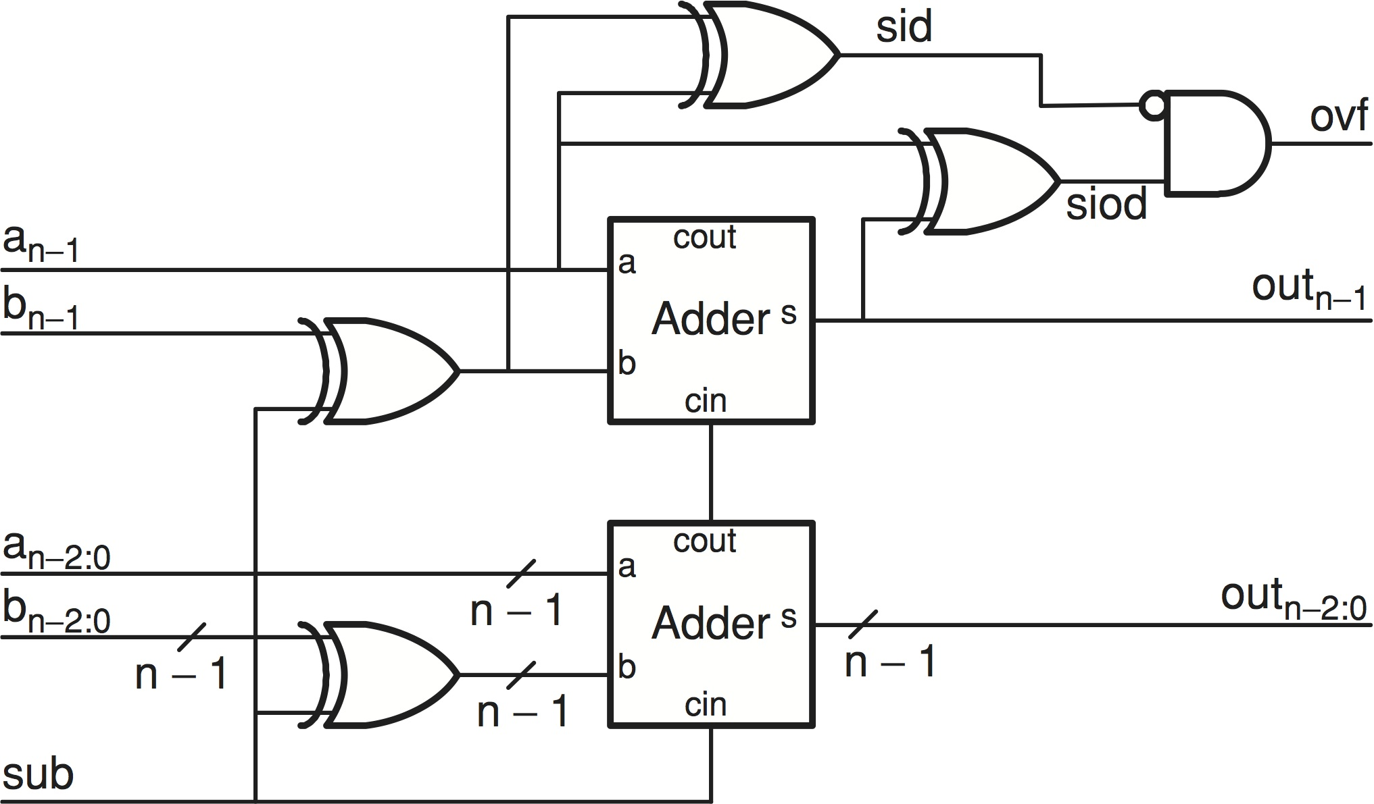
Detecting Overflow
1 here if sign of A and B differ
1 here if sign of A and result differ
This works fine, but it turns out there is a more clever implementation that uses fewer gates...
Text: Dally §10.3

Slide 26
Alternative implementation
Let’s consider inputs and outputs of full-adder used to compute sign bit:
as | bs | cis | ss | cos | ovf | comment
0 | 0 | 0 | 0 | 0 | 0 | Both inputs positive, no overflow, carry in = carry out
0 | 0 | 1 | 1 | 0 | 1 | Both inputs positive, overflow, carry in != carry out
0 | 1 | 0 | 1 | 0 | 0 | Inputs signs different, no overflow, carry in = carry out
0 | 1 | 1 | 0 | 1 | 0 | Inputs signs different, no overflow, carry in = carry out
1 | 1 | 0 | 0 | 1 | 1 | Both inputs negative, overflow, carry in != carry out
1 | 1 | 1 | 1 | 1 | 0 | Both inputs negative, no overflow, carry in = carry out
So we know there is an overflow if: carry in != carry out for the sign bit!
Text: Dally §10.3

Slide 27
Text: Dally §10.3

Slide 28
// add a+b or subtract a-b, check for overflow
module AddSub(a,b,sub,s,ovf) ;
parameter n = 8 ;
input [n-1:0] a, b ;
input sub ; // subtract if sub=1, otherwise add
output [n-1:0] s ;
output ovf ; // 1 if overflow
wire c1, c2 ; // carry out of last two bits
wire ovf = c1 ^ c2 ; // overflow if signs don't match
// add non sign bits
Adder1 #(n-1) ai(a[n-2:0],b[n-2:0]^{n-1{sub}},sub,c1,s[n-2:0]) ;
// add sign bits
Adder1 #(1) as(a[n-1],b[n-1]^sub,c1,c2,s[n-1]) ;
endmodule
// multi-bit adder – with vectors
module Adder2(a,b,cin,cout,s) ;
Text: Dally §10.3

Slide 29
Summary
Learned about addition and 2’s complement

