Slide 1
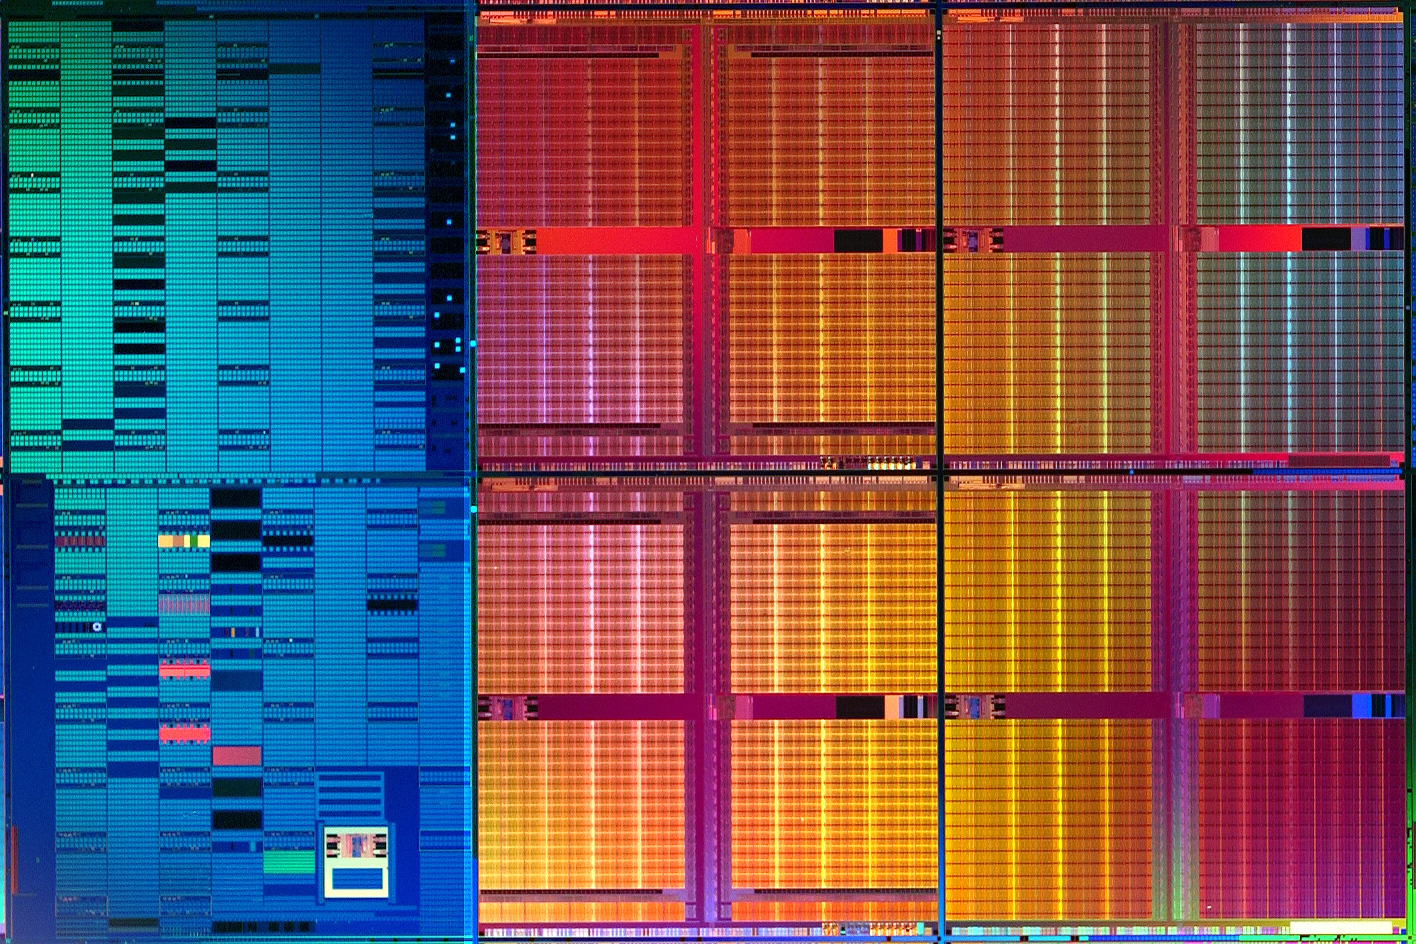
CPEN 211: Introduction to Microcomputers
Slide Set 11:
Casex;
Read-Write Memory;
Datapath State Machines
Prof. Tor Aamodt
[Background: Intel 45nm SRAM test chip;
Source: http://www.intel.com/pressroom/archive/releases/2006/20060125comp.htm]
Notes:
1

Slide 2
Learning Objectives
By the end of this slide set you should be able to:
Use Verilog casex
Design a datapath circuit
Implement a datapath circuit using Verilog
Implement any digital system by designing a FSM and corresponding datapath and writing Verilog.
Explain operation of a read-write memories and describe them in Verilog that synthesizes to use the embedded memory block on your DE1-SoC.

Slide 3
Recall: Prime Number Function
F(d,c,b,a) is true if input d,c,b,a is prime
ba
a
dc
00
01
11
10
0
1
1
1
0
1
1
0
00
01
11
10
0
1
0
0
d
0
0
1
0
b
Text: Dally §6.5
Notes:
1.5

Slide 4
Verilog “casex” Statement
module prime1(in, isprime) ;
input [3:0] in ; // 4-bit input
output isprime ; // true if input is prime
reg isprime ;
always @(*)
casex(in)
4'b0xx1: isprime = 1 ;
4'b001x: isprime = 1 ;
4'bx101: isprime = 1 ;
4'bx011: isprime = 1 ;
default: isprime = 0 ;
endcase
endmodule
casex matches either a 0 or 1 in case expression to x in corresponding bit position of item expression.
E.g., when used in casex item expression 4’b0xx1 matches when case expression (in) equals
4’b0001 or …
4’b0011 or …
4’b0101 or …
4’b0111
Text: Dally §7.1.3
Notes:
0.5

Slide 5
Verilog “casex” Statement
module prime1(in, isprime) ;
input [3:0] in ; // 4-bit input
output isprime ; // true if input is prime
reg isprime ;
always @(*)
casex(in)
4'b0xx1: isprime = 1 ;
4'b001x: isprime = 1 ;
4'bx101: isprime = 1 ;
4'bx011: isprime = 1 ;
default: isprime = 0 ;
endcase
endmodule
ba
a
dc
00
01
11
10
0
1
1
1
0
1
1
0
00
01
11
10
0
1
0
0
d
0
0
1
0
b
Text: Dally §7.1.3
Notes:
0.5

Slide 6
Verilog “casex” Statement
module prime1(in, isprime) ;
input [3:0] in ; // 4-bit input
output isprime ; // true if input is prime
reg isprime ;
always @(*)
casex(in)
4'b0xx1: isprime = 1 ;
4'b001x: isprime = 1 ;
4'bx101: isprime = 1 ;
4'bx011: isprime = 1 ;
default: isprime = 0 ;
endcase
endmodule
ba
a
dc
00
01
11
10
0
1
1
1
0
1
1
0
00
01
11
10
0
1
0
0
d
0
0
1
0
b
If multiple case items match a given case expression the first case item is used.
E.g., if in == 4’b0101 the line “4'b0xx1: isprime = 1 ;” is “executed”
and the line “4'bx101: isprime = 1 ;” is “skipped”.
Text: Dally §7.1.3
Notes:
0.5

Slide 7
Which is better?
module prime(in, isprime) ;
input [3:0] in ; // 4-bit input
output isprime ; // true if input is prime
reg isprime ;
always @(in) begin
case(in)
1,2,3,5,7,11,13: isprime = 1'b1 ;
default: isprime = 1'b0 ;
endcase
end
endmodule
Case?
Casex?
Assign?
module prime(in, isprime) ;
input [3:0] in ; // 4-bit input
output isprime ; // true if input is prime
wire isprime = (in[0] & ~in[3]) |
(in[1] & ~in[2] & ~in[3]) |
(in[0] & ~in[1] & in[2]) |
(in[0] & in[1] & ~in[2]) ;
endmodule
Text: Dally §7.1.2

Slide 8
4-bit Prime Number Function in Verilog Code –
Result of synthesizing descriptions
module prime_synthesis_output ( in, isprime );
input [3:0] in;
output isprime;
wire n1, n2, n3, n4;
OAI13 U1 ( .A1(n2), .B1(n1), .B2(in[2]), .B3(in[3]), .Y(isprime) );
INV U2 ( .A(in[1]), .Y(n1) );
INV U3 ( .A(in[3]), .Y(n3) );
XOR2 U4 ( .A(in[2]), .B(in[1]), .Y(n4) );
OAI12 U5 ( .A1(in[0]), .B1(n3), .B2(n4), .Y(n2) );
endmodule
Text: Dally §7.1.2

Slide 9
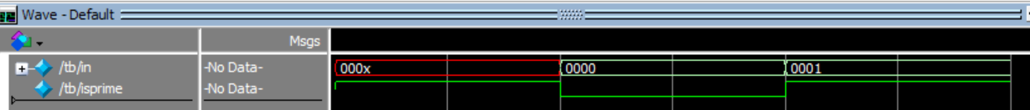
One thing to watch out for…
module prime1(in, isprime) ;
input [3:0] in ; // 4-bit input
output isprime ; // true if input is prime
reg isprime ;
always @(*)
casex(in)
4'b0xx1: isprime = 1 ;
4'b001x: isprime = 1 ;
4'bx101: isprime = 1 ;
4'bx011: isprime = 1 ;
default: isprime = 0 ;
endcase
endmodule
If the select input to casex contains unknowns they will match 0, 1 or x in case labels!

Slide 10
Datapath State Machines

Slide 11
An FSM is a state register and two functions
Text: Dally §16.1

Slide 12
A Simple Counter
Suppose you want to build an FSM with the following state diagram
Text: Dally §16.1

Slide 13
A Simple Counter
Could write out all rows of state transition table and from this table, write Verilog
State | Next State
 | ~rst | rst
0 | 1 | 0
1 | 2 | 0
2 | 3 | 0
. . .
30 | 31 | 0
31 | 0 | 0
Text: Dally §16.1

Slide 14
State | Next State
 | ~rst | rst
0 | 1 | 0
1 | 2 | 0
2 | 3 | 0
. . .
30 | 31 | 0
31 | 0 | 0
module Counter1(clk,rst,out) ;
input rst, clk ; // reset and clock
output [4:0] out ;
reg [4:0] next ;
vDFF #(5) count(clk, next, out) ;
always @(*)
casex({rst,out})
{1'b1, 5’bxxxxx}: next = 0 ;
6'd0: next = 1 ; // 6’d0 == {1’b0, 5’b00000}
6'd1: next = 2 ;
6'd2: next = 3 ;
6'd3: next = 4 ;
6'd4: next = 5 ;
…
6'd30: next = 31 ;
6'd31: next = 0 ;
default: next = 5'bxxxxx ;
endcase
endmodule
Text: Dally §16.1

Slide 15
Rule #1 for combinational logic
Concatenate 1 reset bit with
5 bits used for out
always @(*)
casex ( {rst, out} )
{1'b1, 5’bxxxxx} : next = 0 ;
We use casex to allow “x” for case label to
match 0 and 1 in case expression {rst, out}
always @(*)
if (rst == 1’b1)
next = 0;
Text: Dally §16.

Slide 16
always @(*)
casex ( {rst, out} )
{1'b1, 5’bxxxxx} : next = 0 ;
6'd0: next = 1 ;
if (rst == 1’b1)
next = 0;
else if ((rst == 0) & (out==5’b00000) )
next = 1;
Equivalent
// 6’d0 == {1’b0, 5’b00000}
Text: Dally §16.

Slide 17
State | Next State
 | ~rst | rst
0 | 1 | 0
1 | 2 | 0
2 | 3 | 0
. . .
30 | 31 | 0
31 | 0 | 0
module Counter1(clk,rst,out) ;
input rst, clk ; // reset and clock
output [4:0] out ;
reg [4:0] next ;
vDFF #(5) count(clk, next, out) ;
always @(*)
casex({rst,out})
{1'b1, 5’bxxxxx}: next = 0 ;
6'd0: next = 1 ; // 6’d0 == {1’b0, 5’b00000}
6'd1: next = 2 ;
6'd2: next = 3 ;
6'd3: next = 4 ;
6'd4: next = 5 ;
…
6'd30: next = 31 ;
6'd31: next = 0 ;
default: next = 5'bxxxxx ;
endcase
endmodule
Text: Dally §16.1

Slide 18
Make Table Symbolic
State | Next State
 | ~rst | rst
0 | 1 | 0
1 | 2 | 0
2 | 3 | 0
. . .
30 | 31 | 0
31 | 0 | 0
State | Next State
 | ~rst | rst
a | a+1 | 0
Text: Dally §16.1

Slide 19
Alternate description (symbolic table)
module Counter1(clk,rst,out) ;
input rst, clk ; // reset and clock
output [4:0] out ;
reg [4:0] next ;
vDFF #(5) count(clk, next, out) ;
always @(*) begin
casex ({rst,out})
6'b1xxxxx: next = 0 ;
6'd0: next = 1 ;
6'd1: next = 2 ;
6'd2: next = 3 ;
6'd3: next = 4 ;
6'd4: next = 5 ;
6'd5: next = 6 ;
6'd6: next = 7 ;
…
6'd30: next = 31 ;
6'd31: next = 0 ;
default: next = 0 ;
endcase
end
endmodule
module Counter1(clk,rst,out) ;
input rst, clk ; // reset and clock
output [4:0] out ;
reg [4:0] next ;
vDFF #(5) count(clk, next, out) ;
always @(*) begin
case(rst)
1'b1: next = 0 ;
1'b0: next = out + 1 ;
default: next = 5'bxxxxx;
endcase
end
endmodule
out
Text: Dally §16.1

Slide 20
module Counter1(clk,rst,out) ;
input rst, clk ; // reset and clock
output [4:0] out ;
reg [4:0] next ;
vDFF #(5) count(clk, next, out) ;
always @(*) begin
case(rst)
1'b1: next = 0 ;
1'b0: next = out + 1 ;
default: next = 5'bxxxxx;
endcase
end
endmodule
We will fill in this waveform in class….
out

Slide 21
Datapath Implementation
State | Next State
 | ~rst | rst
0 | 1 | 0
1 | 2 | 0
2 | 3 | 0
. . .
30 | 31 | 0
31 | 0 | 0
You can describe the next-state function with a table
However, it can more compactly be described by an expression:
next = rst ? 0 : count + 1 ;
This “counter” is an example of a sequential “datapath” – a sequential circuit where the next state function is generated by an expression rather than a table.
Text: Dally §16.1

Slide 22
Schematic
A simple counter
next = rst ? 0 : count + 1
Text: Dally §16.1

Slide 23
Verilog description
module Counter(clk, rst, count) ;
parameter n=5 ;
input rst, clk ; // reset and clock
output [n-1:0] count ;
wire [n-1:0] next = rst ? 0 : count + 1 ;
vDFF #(n) CNT(clk, next, count) ;
endmodule
Text: Dally §16.1

Slide 24
An Up/Down/Load (UDL) Counter
A Deluxe Counter that can:
  count up (increment)
  count down (decrement)
  be loaded with a value
Assume: up, down, and load are one-hot.
rst overrides any other input.
if (rst) next_state = 0
else if (up) next_state = state+1
else if (down) next_state = state-1
else if (load) next_state = in
else next_state = state
Text: Dally §16.2

Slide 25
Table Version
We could write out a giant truth table for the next state logic:
State | Next State
 | rst | up | down | load
0 | 0 | 1 | 31 | input
1 | 0 | 2 | 0 | input
2 | 0 | 3 | 1 | input
. . .
30 | 0 | 31 | 29 | input
31 | 0 | 0 | 30 | input
Text: Dally §16.2

Slide 26
Symbolic Table Version
Can more succinctly write out in a symbolic truth table:
State | Next State
 | rst | up | down | load | else
q | 0 | q+1 | q-1 | input | q
Let’s make the assumption about one hot (up,down,load) explicit:
State | Input | Rst | Up | Down | Load | Next
q | x | 1 | x | x | x | 0
q | x | 0 | 1 | 0 | 0 | q+1
q | x | 0 | 0 | 1 | 0 | q-1
x | y | 0 | 0 | 0 | 1 | y
q | x | 0 | 0 | 0 | 0 | q
Text: Dally §16.2

Slide 27
Schematic of UDL Counter
Here we combined +1 and -1
because CAD tools like Quartus
are unlikely to make this
optimization on their own.
Text: Dally §16.2

Slide 28
Verilog Description
module UDL_Count1(clk, rst, up, down, load, in, out) ;
parameter n = 4 ;
input clk, rst, up, down, load ;
input [n-1:0] in ;
output [n-1:0] out ;
wire [n-1:0] out ;
reg [n-1:0] next ;
vDFF #(n) count(clk, next, out) ;
always @(*) begin
casex({rst, up, down, load})
4'b1xxx: next = {n{1'b0}} ;
4'b0100: next = out + 1'b1 ;
4'b0010: next = out - 1'b1 ;
4'b0001: next = in ;
4’b0000: next = out ;
default: next = {n{1’bx}} ;
endcase
end
endmodule
Text: Dally §16.2

Slide 29
Check Using Quartus RTL Viewer

Slide 30
For example, if n=8 and down=1
{{n-1{down}},1’b1} equals 8’b11111111 (i.e., -1)
If down = 0 then
{{n-1{down}},1’b1} equals 8’b00000001 (i.e., 1)
module UDL_Count1(clk, rst, up, down, load, in, out) ;
parameter n = 4 ;
input clk, rst, up, down, load ;
input [n-1:0] in ;
output [n-1:0] out ;
wire [n-1:0] out, outpm1 ;
reg [n-1:0] next ;
vDFF #(n) count(clk, next, out) ;
assign outpm1 = out + {{n-1{down}},1'b1} ; // down ? -1 : 1
always @*
casex ({rst, up, down, load})
4'b1xxx: next = {n{1'b0}} ;
4'b01xx: next = outpm1 ;
4'b001x: next = outpm1 ;
4'b0001: next = in ;
default: next = out ;
endcase
endmodule
Text: Dally §16.2

Slide 31
Check Using Quartus RTL Viewer

Slide 32
Timer module
load – loads count from “in”
done – asserted (set to 1) when count == 0
count should decrement by 1 each cycle unless load or done is true
Text: Dally §16.2

Slide 33
module Timer(clk, rst, load, in, done) ;
parameter n=4 ;
input clk, rst, load ;
input [n-1:0] in ;
output done ;
wire [n-1:0] count, next_count ;
wire done ;
vDFF #(n) cnt(clk, next_count, count) ;
always @(*) begin
casex ({rst, load, done})
3'b1xx: next_count = 0 ; // reset
3'b001: next_count = 0 ; // done
3'b01x: next_count = in ; // load
default: next_count = count-1’b1; // count down
endcase
end
assign done = (count == 0) ;
endmodule
Text: Dally §16.2

Slide 34
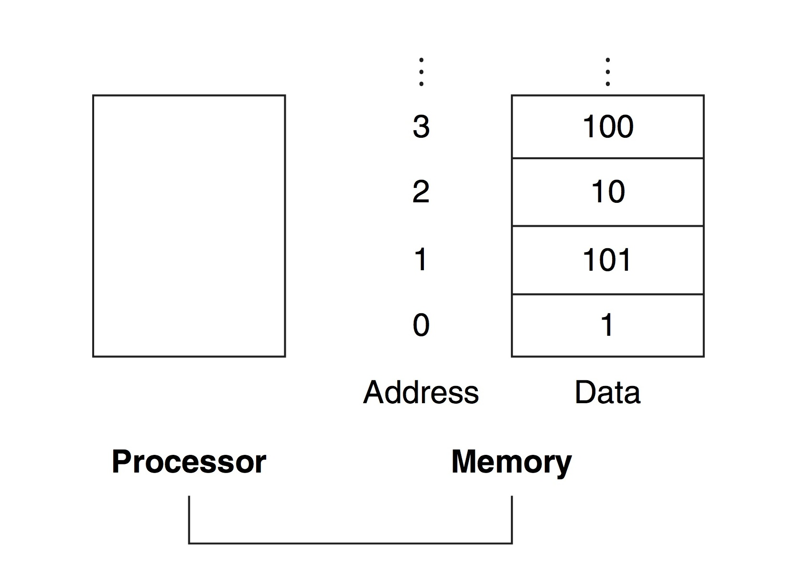
Read-Write Memory
Notes:
This figure shows an abstracted view of main memory in a computer. The main memory is on the right and is connected to the processor on the left…
… using a bus…

Slide 35
Read-Write Memory
Also called “Random Access Memory” (RAM)
Recall:
  Memory composed of large number of locations that can be uniquely identified and can store a value
  Location is uniquely identified by its “address”
  Total number of locations is called “address space”
  Number of bits in each location is “addressability”
RAM supports two operations
  Read a value from a location
  Write a value to a location

Slide 36
Read-Write Memory
Above RAM contains 2^{n} memory locations each storing m-bits of data. Can both read and write. Write by putting data on “data_in” and setting “write”.
Text: Dally §8.8
Notes:
2

Slide 37
Recall: D Latch
If clk is high, Q becomes equal to D
If clk is low, Q maintains its value (regardless of D)
This is also level-sensitive

Slide 38
Recall: Timing Diagram for a Level-Sensitive D-Latch
Output Q follows input D when CLK=1 but holds value when CLK=0.

Slide 39
2²-by-3-bit Read-Write Memory
Ref: Patt §3.5

Slide 40
2²-by-3-bit Memory: Read Operation
Read Address = 3 (11 in binary)
Write Enable = 0 (not writing)
Contents at location with address 3 = 101

Slide 41
2²-by-3-bit Memory: Write Operation
Write Address = 2 (10 in binary)
Write Enable = 1 (write)
New contents at location with address 2 = 011

Slide 42
Read-Write Memory in Verilog
(DO NOT USE FOR Lab 5 to 7 – see code two slides later)
// RAM of parameterized size and width
module ram_reg(ra, wa, write, din, dout) ;
parameter b = 32;
parameter w = 4;
input [w-1:0] ra, wa;
input write;
input [b-1:0] din;
output [b-1:0] dout;
reg [b-1:0] ram [2**w-1:0];
assign dout = ram[ra];
always @(*) begin
if(write == 1)
ram[wa] = din;
end
endmodule // ram_reg
Text: Dally §8.9

Slide 43
Inside the FPGA on your DE1-SoC
FPGA vendors embed fixed blocks to improve speed and density:
Embedded Memories (blocks of 2K-18K)
NOTE: We will learn about how FPGAs work in Slide Set 9

Slide 44
// To ensure Quartus uses the embedded MLAB memory blocks inside the Cyclone
// V on your DE1-SoC we follow the coding style from in Altera's Quartus II
// Handbook (QII5V1 2015.05.04) in Chapter 12, “Recommended HDL Coding Style”
//
// 1. "Example 12-11: Verilog Single Clock Simple Dual-Port Synchronous RAM
// with Old Data Read-During-Write Behavior"
// 2. "Example 12-29: Verilog HDL RAM Initialized with the readmemb Command"
module RAM(clk,read_address,write_address,write,din,dout);
parameter data_width = 32;
parameter addr_width = 4;
parameter filename = "data.txt";
input clk;
input [addr_width-1:0] read_address, write_address;
input write;
input [data_width-1:0] din;
output [data_width-1:0] dout;
reg [data_width-1:0] dout;
reg [data_width-1:0] mem [2**addr_width-1:0];
initial $readmemb(filename, mem);
always @ (posedge clk) begin
if (write)
mem[write_address] <= din;
dout <= mem[read_address]; // dout doesn't get din in this clock cycle
// (this is due to Verilog non-blocking assignment "<=")
end
endmodule
Use ONLY for Instruction+Data Memory added in Lab 7.
DO NOT USE FOR REGISTER FILE in Lab 5 or you WILL lose marks!
Initializes memory to
contents of file
Writes on rising edge of clock
Read data “delayed” 1 cycle

Slide 45
Summary
Verilog casex syntax
Some state machines operate on data and it makes sense to use a symbolic state table for these.
Common datapath elements and examples
Read/Write memory

