Slide 1
Slide Set 13: Timing

Slide 2
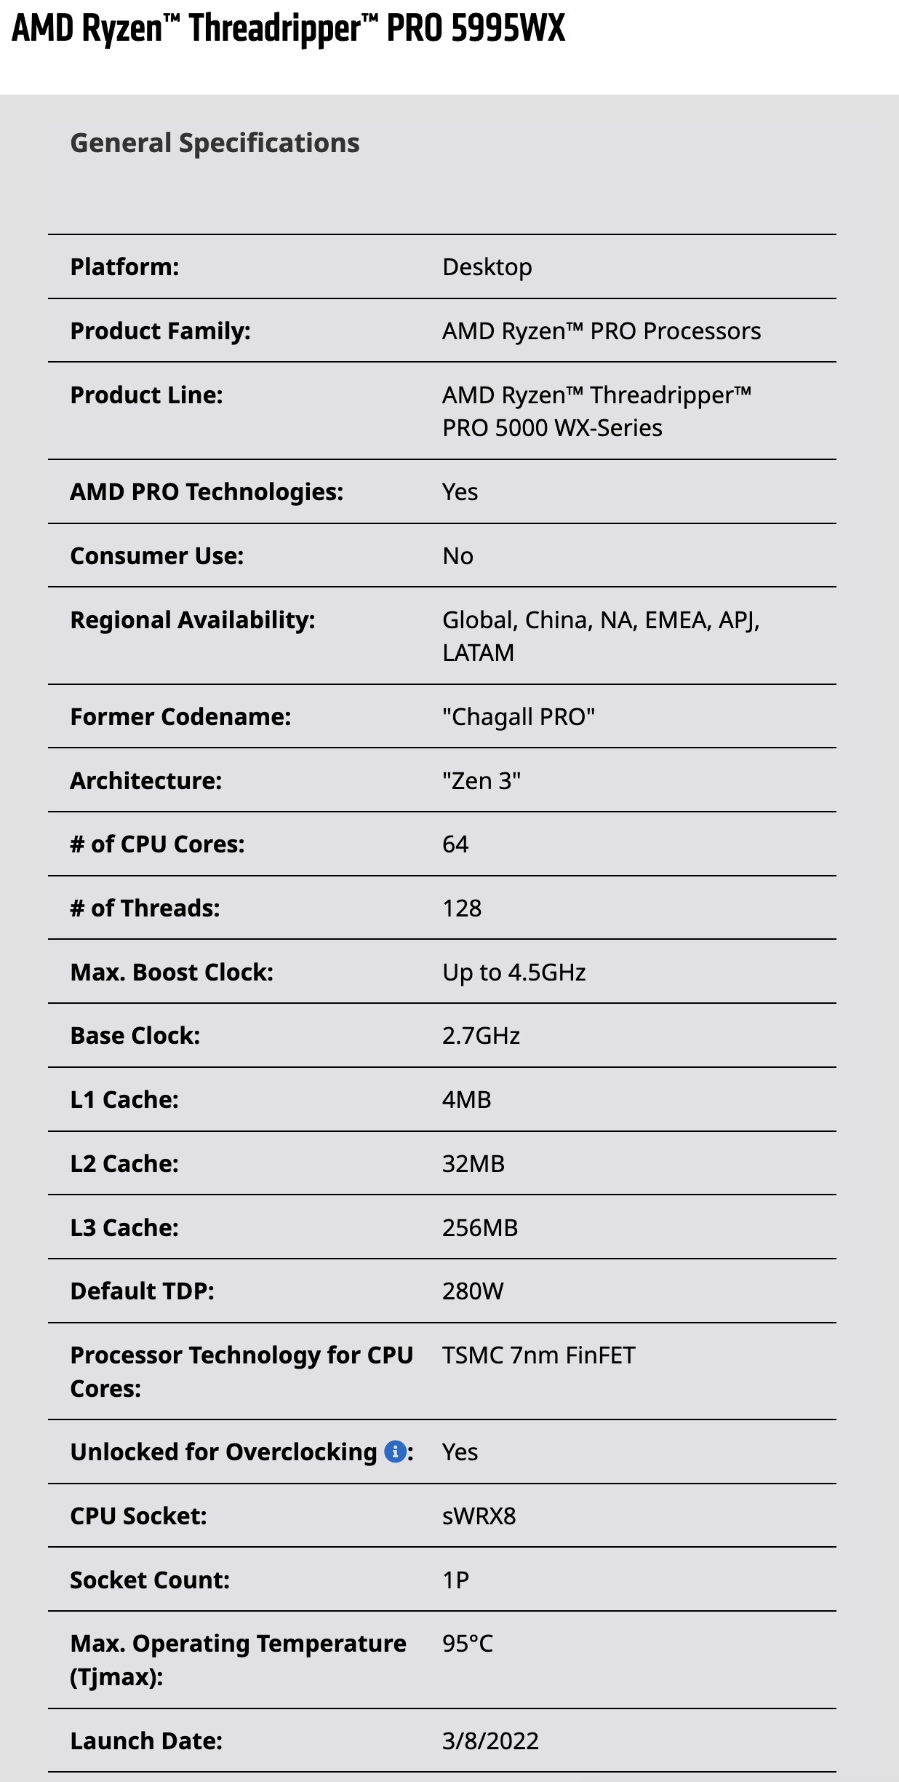
Q: what are
these numbers?
⋮
⋮
source: AMD

Slide 3
Learning Objectives
By the end of this slide set you should be able to:
Define propagation delay, setup time, hold time, and clk-to-Q time
Explain how they arise from the transistor RC model
Finding the critical path given circuit (longest delay between flip-flops)
Perform timing analysis in Quartus
Explain how to fixing violations of setup time and hold time

Slide 4
TL;DR: timing in a digital circuit
digital circuit = combinational logic in between flip-flop registers
gates have some propagation delay t_{prop}
  ➔ how long it takes for gate output to stabilize after inputs change
slowest path between regs: critical path
  determines maximum clock frequency
combinational
logic
critical path
t_{prop}

Slide 5
Okay, but why is there a gate delay?
MOSFETs can be modelled as an RC circuit
  source/drain resistance R_{s}
  gate parasitic capacitance C_{g}
gate
gate oxide
source
drain
substrate
R_{s}
R_{s}
C_{g}
C_{g}

Slide 6
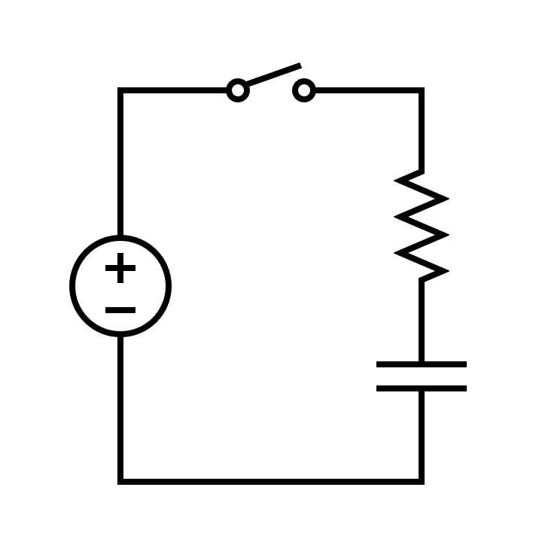

$$V_{C}=V_{S}(1−e^{\frac{−t}{RC}})$$
voltage at gate
time

Slide 7
Gate delays TL;DR
propagation delay across gates
delay longer if fanout is higher
(b/c parallel capacitance adds)
connected gate delays accumulate
t_{prop}
longer t_{prop}
t_{prop1} + t_{prop2}

Slide 8
Timing analysis
(incomplete)
A
I1
I2
B
I1 prop delay
I2 prop delay
Q: is this the
fastest clock?
problem: we didn’t account for flip-flop delays

Slide 9
Review: D flip-flops
D flip-flop = two latches in series
first captures input when clk is low
second takes over from the first when clk goes high
D
Q
D
Q
D
Q
G
G
clk
clk
what about timing? we need to look inside a latch

Slide 10
Inside a latch: setup time and hold time
latches capture input in feedback loops
change only one input at a time, or else loop can go metastable*
to capture stable signal, D must be stable before and after G falls
these constraints are called setup time (t_{S}) and hold time (t_{H})
G
G
Q
Q
Q
D
D
*details beyond the scope of 211, but it’s a bad thing™
Notes:
setup time is because D changes have to propagate into the feedback loop
hold time is because G has to propagate to the feedback loop
actually the Earle latch and the SR latch need different analysis to figure out setup and hold times

Slide 11
What about flip-flop propagation time?
clk
clk
Q
D
D→Q propagation time not well-defined — Q changes when clk rises
so actually we care about clock-to-Q time (t_{CQ})
Notes:
the analysis here depends on clk going from low to high

Slide 12
D flip-flop timing constraints redux
t_{S}: setup time — D input steady before posedge clk
  time to stabilize the first latch feedback loop before the gate (clock) changes
t_{H}: hold time — D input steady after posedge clk
  time for the latch gate (clk) to propagate to isolate the first latch feedback loop
t_{CQ}: clock-to-Q time — when output appears on Q after posedge clk
  time for the clock to propagate to the second latch output

Slide 13


Flip-flop timing waveforms: setup and hold
setup time
clk
hold time
input arrives before clk – t_{S}
input changes before clk + t_{H}
D
input arrives too late
setup time violation
D
signal changes too early
hold time violation
D
TL;DR: D input can’t change in the forbidden zone™

Slide 14
Flip-flop timing waveforms: clock-to-Q
clk
clk-to-Q propagation time
D
DFF captures D input at rising clock edge*
Q
output reflects DFF contents later,
at clk + t_{CQ}
*assuming the FF’s setup time and hold time are respected

Slide 15
Timing constraints redux
propagation delay (gates)*
  how soon the output changes after an input change
setup time (flip-flops)
  how early before posedge clk the input has to become stable
hold time (flip-flops)
  how long after posedge clk the input must remain stable
clk-to-Q time (flip-flops)
  how soon after posedge clk the DFF’s contents appear on Q
*wires also have a tiny resistance and capacitance so also a tiny propagation delay, but we will ignore this in CPEN211

Slide 16
Timing analysis: gate and flip-flop constraints
A
I1
I2
B
A’s
t_{CQ}
I1 prop delay
I2 prop delay
B’s
t_{S}
“slack”
minimum clk period =
t_{CQ}
+ t_{prop,I1}
+ t_{prop,I2}
+ t_{S}

Slide 17
Timing analysis example
A
I1
I2
I3
B
parameters: t_{S} = 0.5ns t_{H} = 0.6ns t_{CQ} = 0.3ns t_{prop,INV} = 1ns
Q. min clk period [ns]?
t_{CQ} + 3×t_{prop,INV} + t_{S} = 0.3 + 3 + 0.5 = 3.8ns
Q. max frequency?
1 / 3.8ns = 263.2 MHz
Q. slack at 100 MHz?
100MHz → 10ns; 10 – 3.8 = 6.2ns
Q. met timing at 100MHz?
slack is positive → YES

Slide 18
Fixing setup time violations
lower target clock frequency*
combinational logic optimization (e.g., replicate to reduce fanout)
pipelining (later lecture)
retiming (later lecture)
typically tools like Quartus do logic optimization and maybe retiming
*and hope for partial marks

Slide 19
What about hold time?
A
B
parameters: t_{S} = 0.5ns t_{H} = 0.6ns t_{CQ} = 0.3ns t_{prop,INV} = 1ns
suppose A’s input changes 0 → 1
A’s new output (1) will appear at clk + tCQ = clk + 0.3ns
no gate delays and ideal wires → output 1 gets to B at clk + 0.3ns
but B needed previous input (0) stable until clk + t_{H} = clk + 0.6ns!
hold time violation
*usually minimum clk-to-Q time < maximum clk-to-Q time; this example assumes they are equal

Slide 20
Fixing hold time violations
A
B
parameters: t_{S} = 0.5ns t_{H} = 0.6ns t_{CQ} = 0.3ns t_{prop,INV} = 1ns
problem: path too fast: A’s changes arrive at B’s inputs too early
  arrive at clk + t_{CQ} = clk + 0.3ns, but needed to hold stable until clk + t_{H} = 0.6ns
independent of clock frequency, so can’t fix with slower clock
how to make paths slower? add some gates on the path
  now arrive at clk + t_{CQ} = clk + 0.3ns + 2ns = clk + 2.3ns ≥ clk + 0.6ns

Slide 21



Hold Violations Cont.
A
B
t_{s}
t_{h}
clk
$$D_{A}$$
t_{CQ}
$$Q_{A}$$
$$D_{B}$$
signal changes too early
hold time violation

Slide 22



Hold Violations Cont.
A
B
t_{s}
t_{h}
clk
$$D_{A}$$
t_{CQ}
t_{prop}
$$Q_{A}$$
$$Q_{A}$$
$$D_{B}$$
$$D_{B}$$

Slide 23
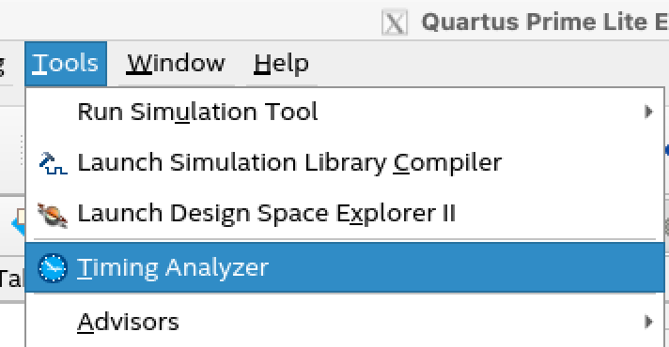
Timing closure in practice
specify target frequency, I/O constraints, etc. in .sdc file
  create_clock -period 10 -name clk [get_ports clk]
  set_input_delay -clock clk 1 [all_inputs]
  set_output_delay -clock clk 1 [all_outputs]
Static Timing Analysis (STA) tools do
the math we covered (+ more details)
  Quartus has one built-in
Quartus tries its best to meet timing
  logic optimization, retiming, buffers, …

Slide 24
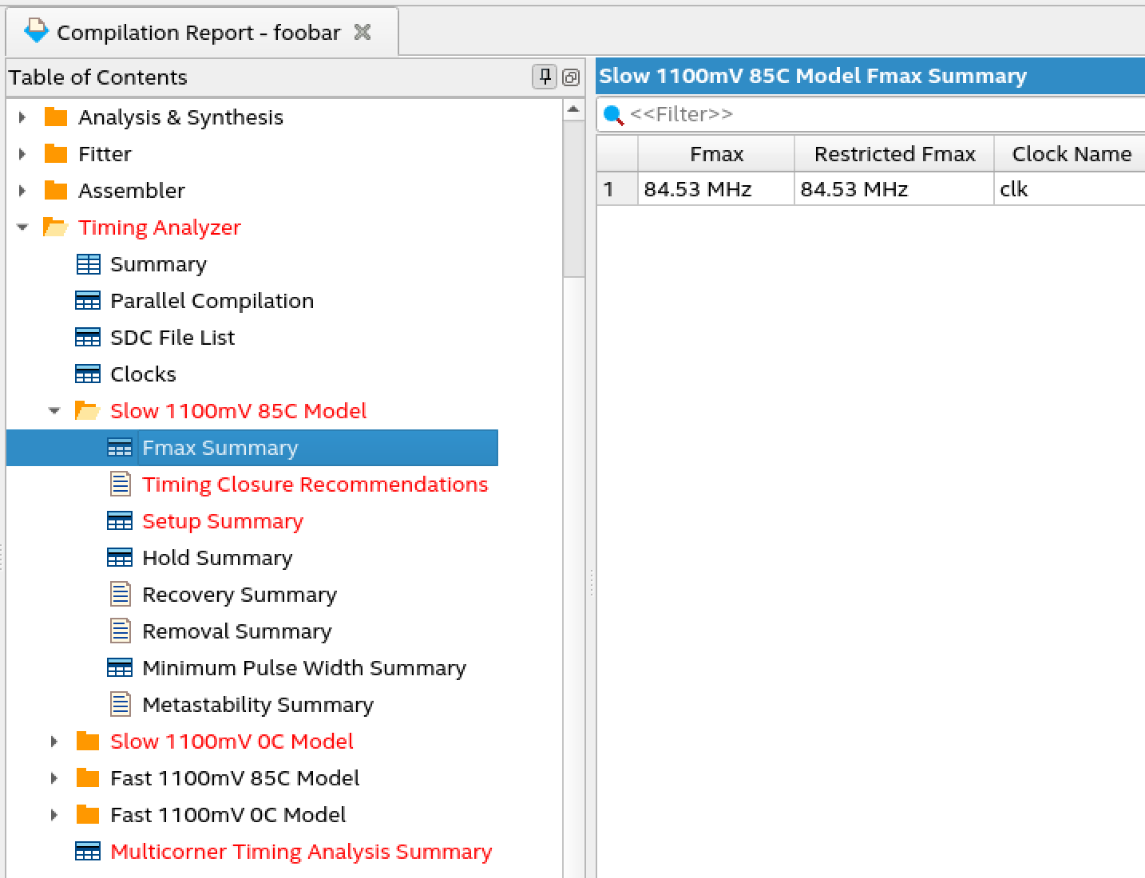
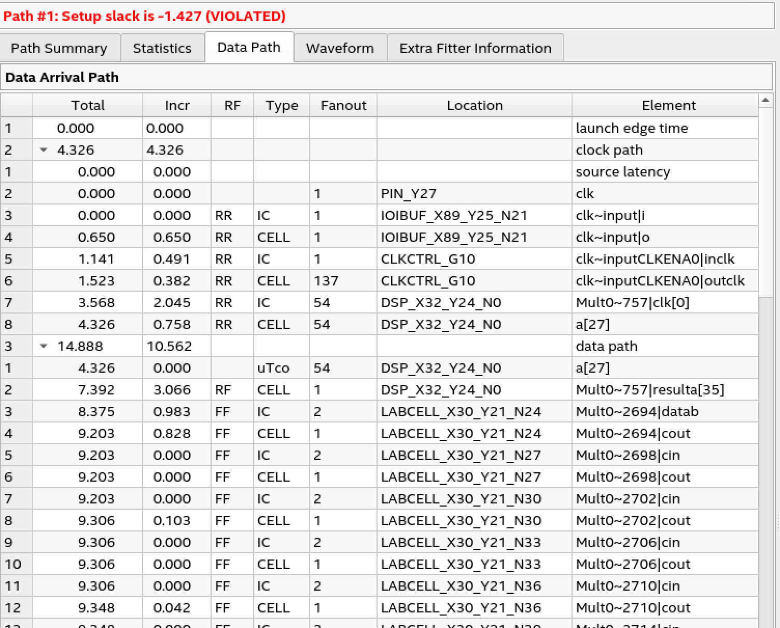
fastest clock Quartus could get
(not the 100MHz we wanted)
failed
critical
path
delay
details
analyzes fast/slow, hot/cold “corners”
– manufacturing variation
– external temp
– chip temp variations when running

Slide 25
Summary
what propagation delay, setup time, hold time, and clk-to-Q time are
how they arise from the transistor RC model
finding the critical path given circuit (longest delay between flip-flops)
timing analysis from constraints (max frequency, min period, slack, etc.)
ways of fixing violations of setup time and hold time

