Slide 1
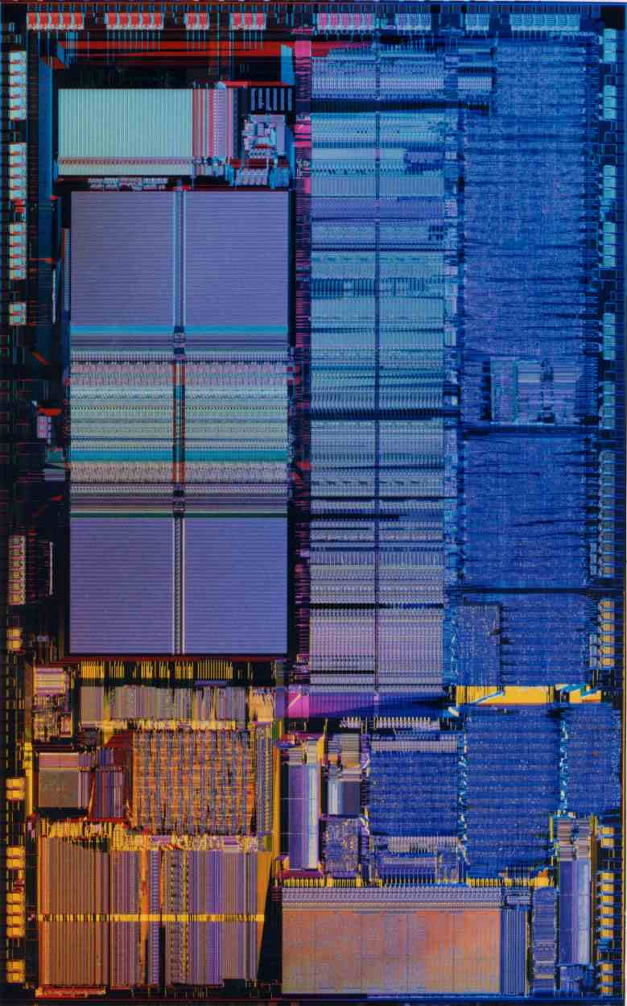
CPEN 211: Computer Systems I
Slide Set 14: Instruction Pipelining
Prof. Tor Aamodt
Slide background: Die photo of the Intel 486 (first pipelined x86 processor)
Notes:
1

Slide 2
Learning Objectives
After this lecture you should be able to…
Evaluate performance tradeoffs using the “processor performance equation”
Describe instruction pipelining
Describe pipelining hazards
Describe what is meant by forwarding
Evaluate timing of a short instruction sequence on a pipelined processor
Implement a pipelined Simple RISC Machine

Slide 3
Microarchitecture
The instruction set architecture (ISA) defines the interface between software and hardware.
Many hardware designs can implement a given ISA. Which is “best”?
“Best” depends upon what you care about (often performance or performance/power)

Slide 4

Performance
Performance is in units of things per sec
  bigger is better
If we are primarily concerned with response time
Performance(X) $=\frac{1}{Execution Time(X)}$
  " X is n times faster than Y" means
Performance(X) Execution_time(Y)
n = =
Performance(Y) Execution_time(X)
Another way of saying this: “Speedup of X compared to Y is n”.
Text: COD ARM Edition §1.6

Slide 5
What is a “Clock Cycle”?
vDFF
vDFF
combinational
logic
Maximum clock frequency is impacted by delay through combinational logic.
Text: COD ARM Edition §4.2

Slide 6
Processor Performance Equation
Cycles Per Instruction (CPI)
i₀
i₁
i_{n}
time
Total Execution Time
clock cycle
Text: COD ARM Edition §1.6

Slide 7
Computing Cycles Per Instruction
CPI in processor performance equation is average cycles per instruction:
CPI = Cycles / Instruction Count
= (CPU Time * Clock Rate) / Instruction Count (1)
If different instructions take a different number of cycles:
(2)
Where: I_{j} = Instruction count for instruction of type “j”
CPI_{j} = cycles per instruction for instruction of type j
Substituting (2) into (1) and noting that Cycle Time x Clock Rate =1 we get:
Here F_{j} is the normalized instruction frequency for instructions of type j
Text: COD ARM Edition §1.6

Slide 8
Example CPI Calculation
During co-op at a small startup company you are asked to create a “system-on-chip” that will be implemented on an FPGA. You are using the NIOS II processor along with the QSYS SoC developer tool (part of Quartus) and wondering whether to select a “NIOS II/e” that uses the minimum resources or a “NIOS II/f” that includes 4KB instruction cache, 4KB data cache, branch prediction, hardware multiply and hardware divide.
For a matrix multiply program we find
Question: Which processor is faster and by how much?
NOTE: cycle time = 1 / clock frequency
 | Nios II/e | Nios II/f
IC | 208M | 92.4M
CPI | 13.9 | 2.69
Clock Frequency | 111 MHz | 88.7 MHz

Slide 9
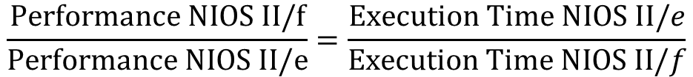
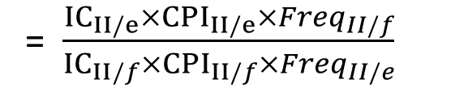
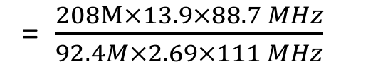
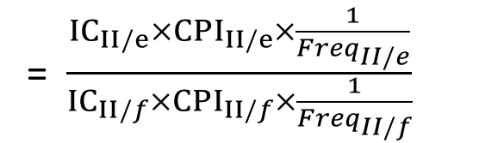
Example CPI Calculation: Solution
$$\frac{Performance NIOS II/f}{Performance NIOS II/e}=\frac{Execution Time NIOS II/e}{Execution Time NIOS II/f}$$
= $\frac{{IC}_{II/e}×{CPI}_{II/e}×\frac{1}{{Freq}_{II/e}}}{{IC}_{II/f}×{CPI}_{II/f}×\frac{1}{{Freq}_{II/f}}}$
= $\frac{{IC}_{II/e}×{CPI}_{II/e}×{Freq}_{II/f}}{{IC}_{II/f}×{CPI}_{II/f}×{Freq}_{II/e}}$
= $\frac{208M×13.9×88.7 MHz}{92.4M×2.69×111 MHz}$
= 9.3
For matrix multiplication, the NIOS II/f is 9.3 times faster.
FPGA Resources?
Nios II/f (4KB I$ 4KB D$): 290 LABs and 26 block RAMs – max 4 per FPGA
Nios II/e: 159 LABs and 6 block RAMs – max 10 per FPGA

Slide 10
RISC Instruction Processing Steps
Instruction fetch cycle (IF)
  Send PC to memory and fetch the current instruction from memory. Update the PC to next sequential PC by adding 4
Instruction Decode/Register fetch cycle (ID)
  decode instruction (what does it do?)
  read source registers
Execute/effective address cycle (EX)
  Compute branch target and condition
  memory reference: ALU computes effective address from base register and offset.
  register-register ALU instruction: ALU performs operation
  register-immediate ALU instruction: ALU performs operation
Text: COD ARM Edition §4.1

Slide 11
A Simple RISC Implementation
Memory access (MEM)
  load: read memory @ effective address
  store: write value from register to effective address
Write-back cycle (WB)
  Register-Register/Register Immediate/Load: Write the result into the register file.

Slide 12
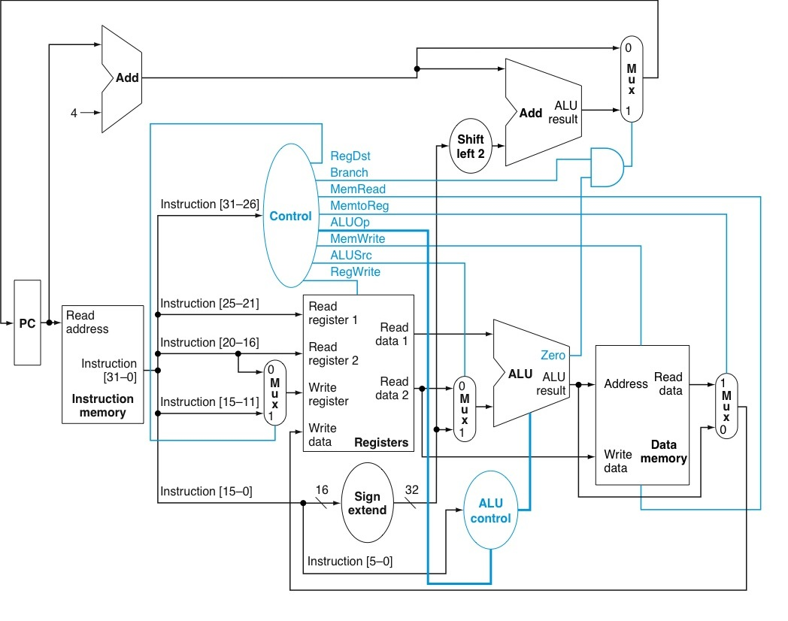
Single Cycle Processor?
Start by looking at each component one at a time.
This is just ONE way to build a processor that implements a given ISA.
“How was this design created?”
Note: this figure is for MIPS which is similar to but different from ARM
Current Logical State
of the Machine
Next Logical State
of the Machine
Latch
or
register
combinational
logic
Text: COD ARM Edition §4.3-4.4

Slide 13
Internal organization of Register File
Write Port
Read Port
Read Port
You designed the register file above in Lab 5
The above design has one write port and one read port
Text: COD ARM Edition §4.3

Slide 14
One Write Port and Two Read Ports
Write Port
Read Port 1
Read Port 1
Read Port 2
Read Port 2
Text: COD ARM Edition §4.3

Slide 15
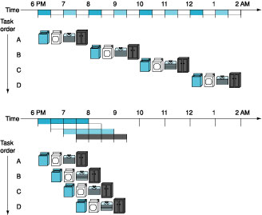
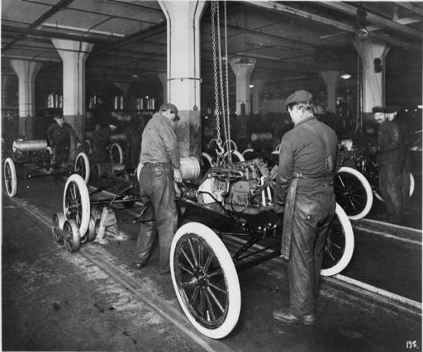
Pipelining: Analogy
Early in Time
Later in Time
1st task
Last task
Simultaneous activity
From 7:30 to 8:00 pm
Text: COD ARM Edition §4.5

Slide 16
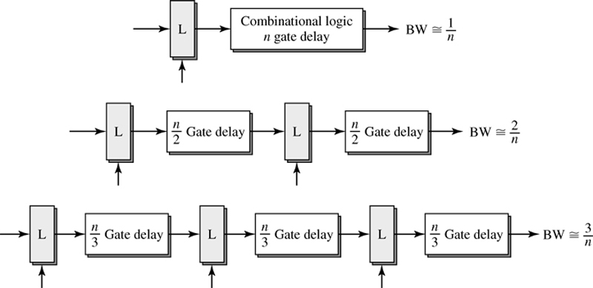
Pipelining Combination Logic
Figure 2.1: Shen & Lipasti

Slide 17
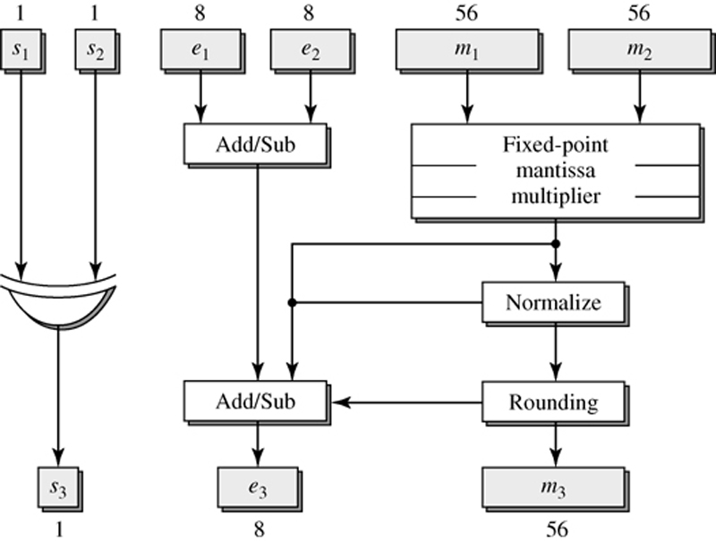
Example: Floating-Point Multiplier
Module | Chip Count | Delay, ns
Partial Product generation | 34 | 125
Partial Product reduction | 72 | 150
Final reduction | 21 | 55
Normalization | 2 | 20
Rounding | 15 | 50
Exponent section | 4
Input latches | 17
Output latches | 10
Total | 175 | 400

Slide 18
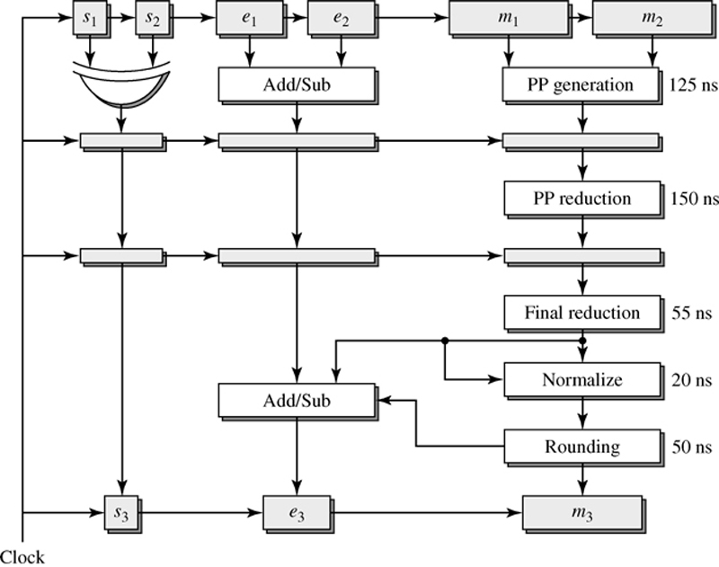
Pipelined Floating-Point Multiplier
[Waser and Flynn, 1982]
82 ICs
setup time = 5 ns
clock to output = 17 ns
Clock Period = 150+5+17 = 172 ns
Cost = 175+82=257 => 45% increase
Figure 2.5: Shen & Lipasti

Slide 19
Pipelining Idealism/Challenges
Uniform Subcomputations
  Goal: Each stage has same delay
  Achieve by balancing pipeline stages
Identical Computations
  Goal: Each computation uses same number of stages
Independent Computations
  Goal: start new computation each cycle

Slide 20
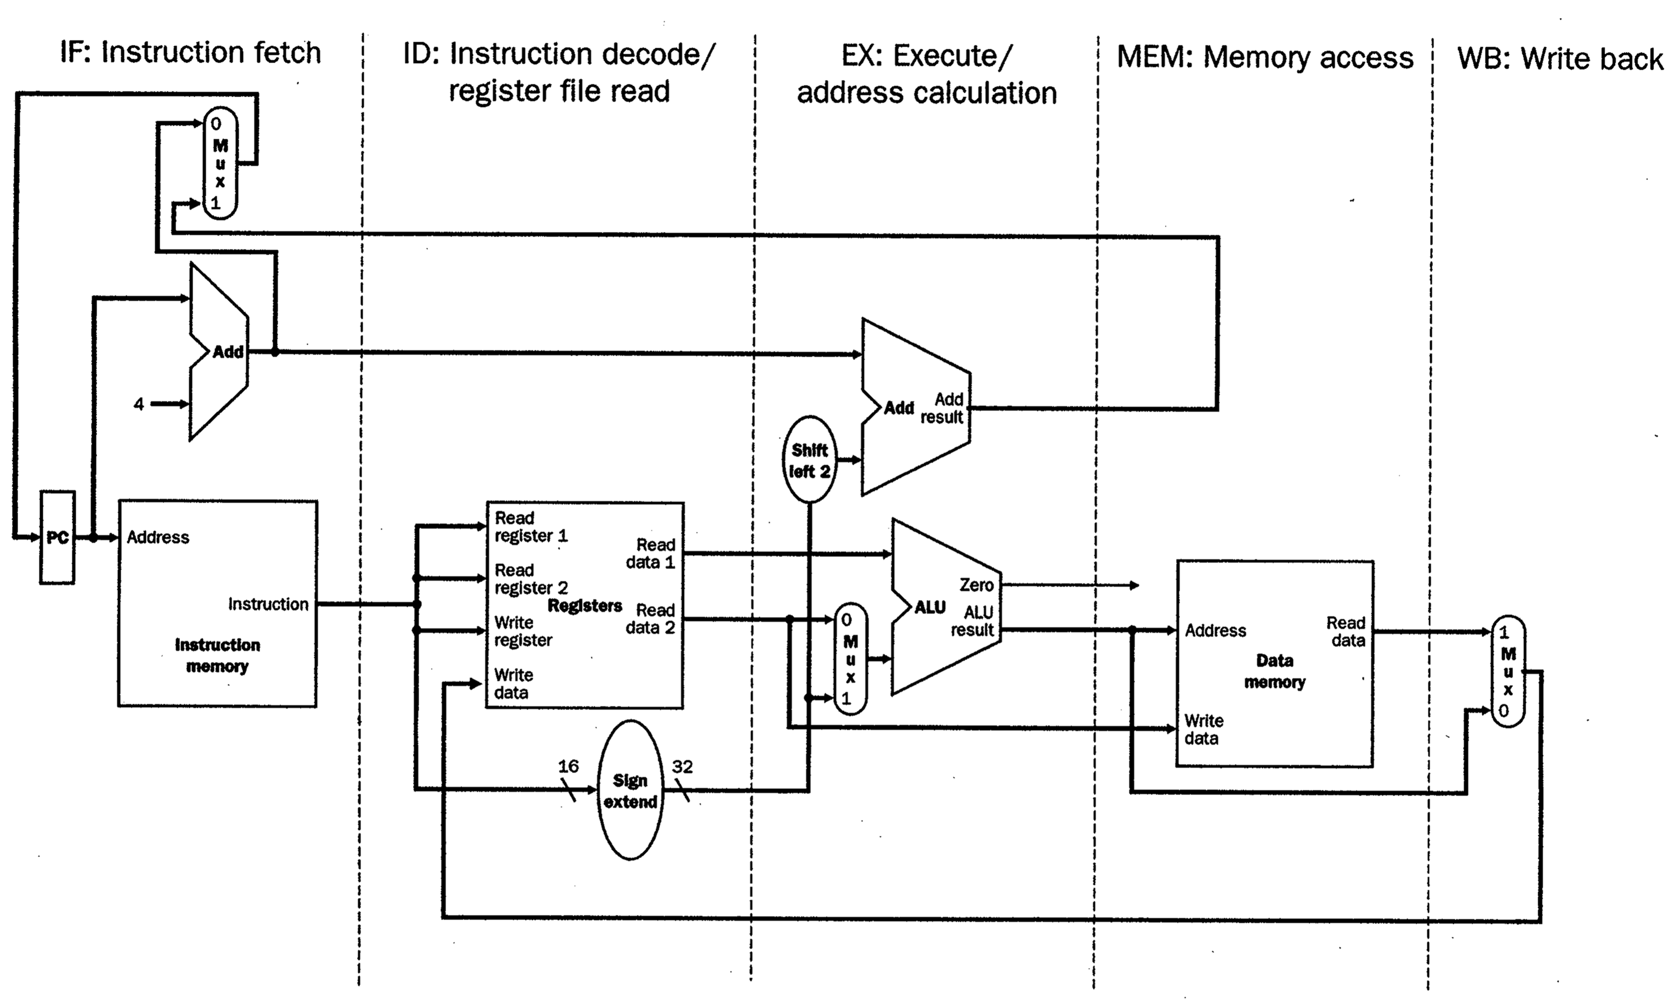
Instruction Pipelining…
Start with Single Cycle Processor
Text: COD ARM Edition §4.6

Slide 21
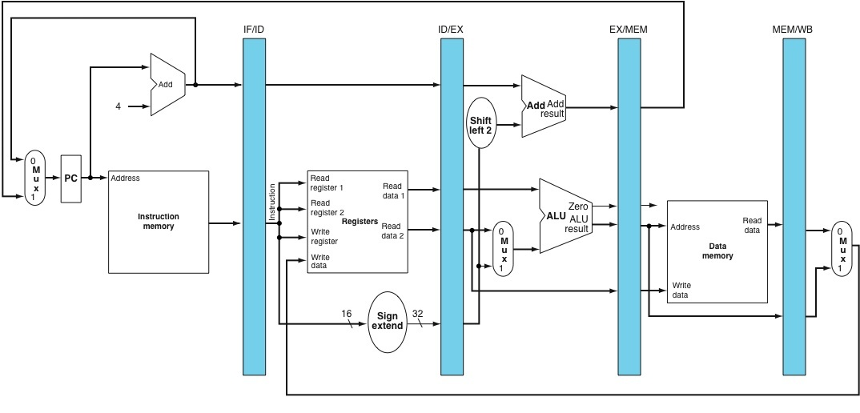
Add registers between stages of instruction pipeline
IF/ID
ID/EX
EX/MEM
MEM/WB
IF ID EX MEM WB
Instruction Fetch Instruction decode / Execute / Memory Access Write back
Register file read address calc.
“Pipeline Registers” keep value after rising edge of clock. Identify pipeline register by stage before and after it.
NOT visible to programmer.
Text: COD ARM Edition §4.6

Slide 22
Instruction Pipelining Example
Let’s look at how a single instruction flows through a 5-stage pipeline:
LDR R1, [R2, #100]
Text: COD ARM Edition §4.6

Slide 23
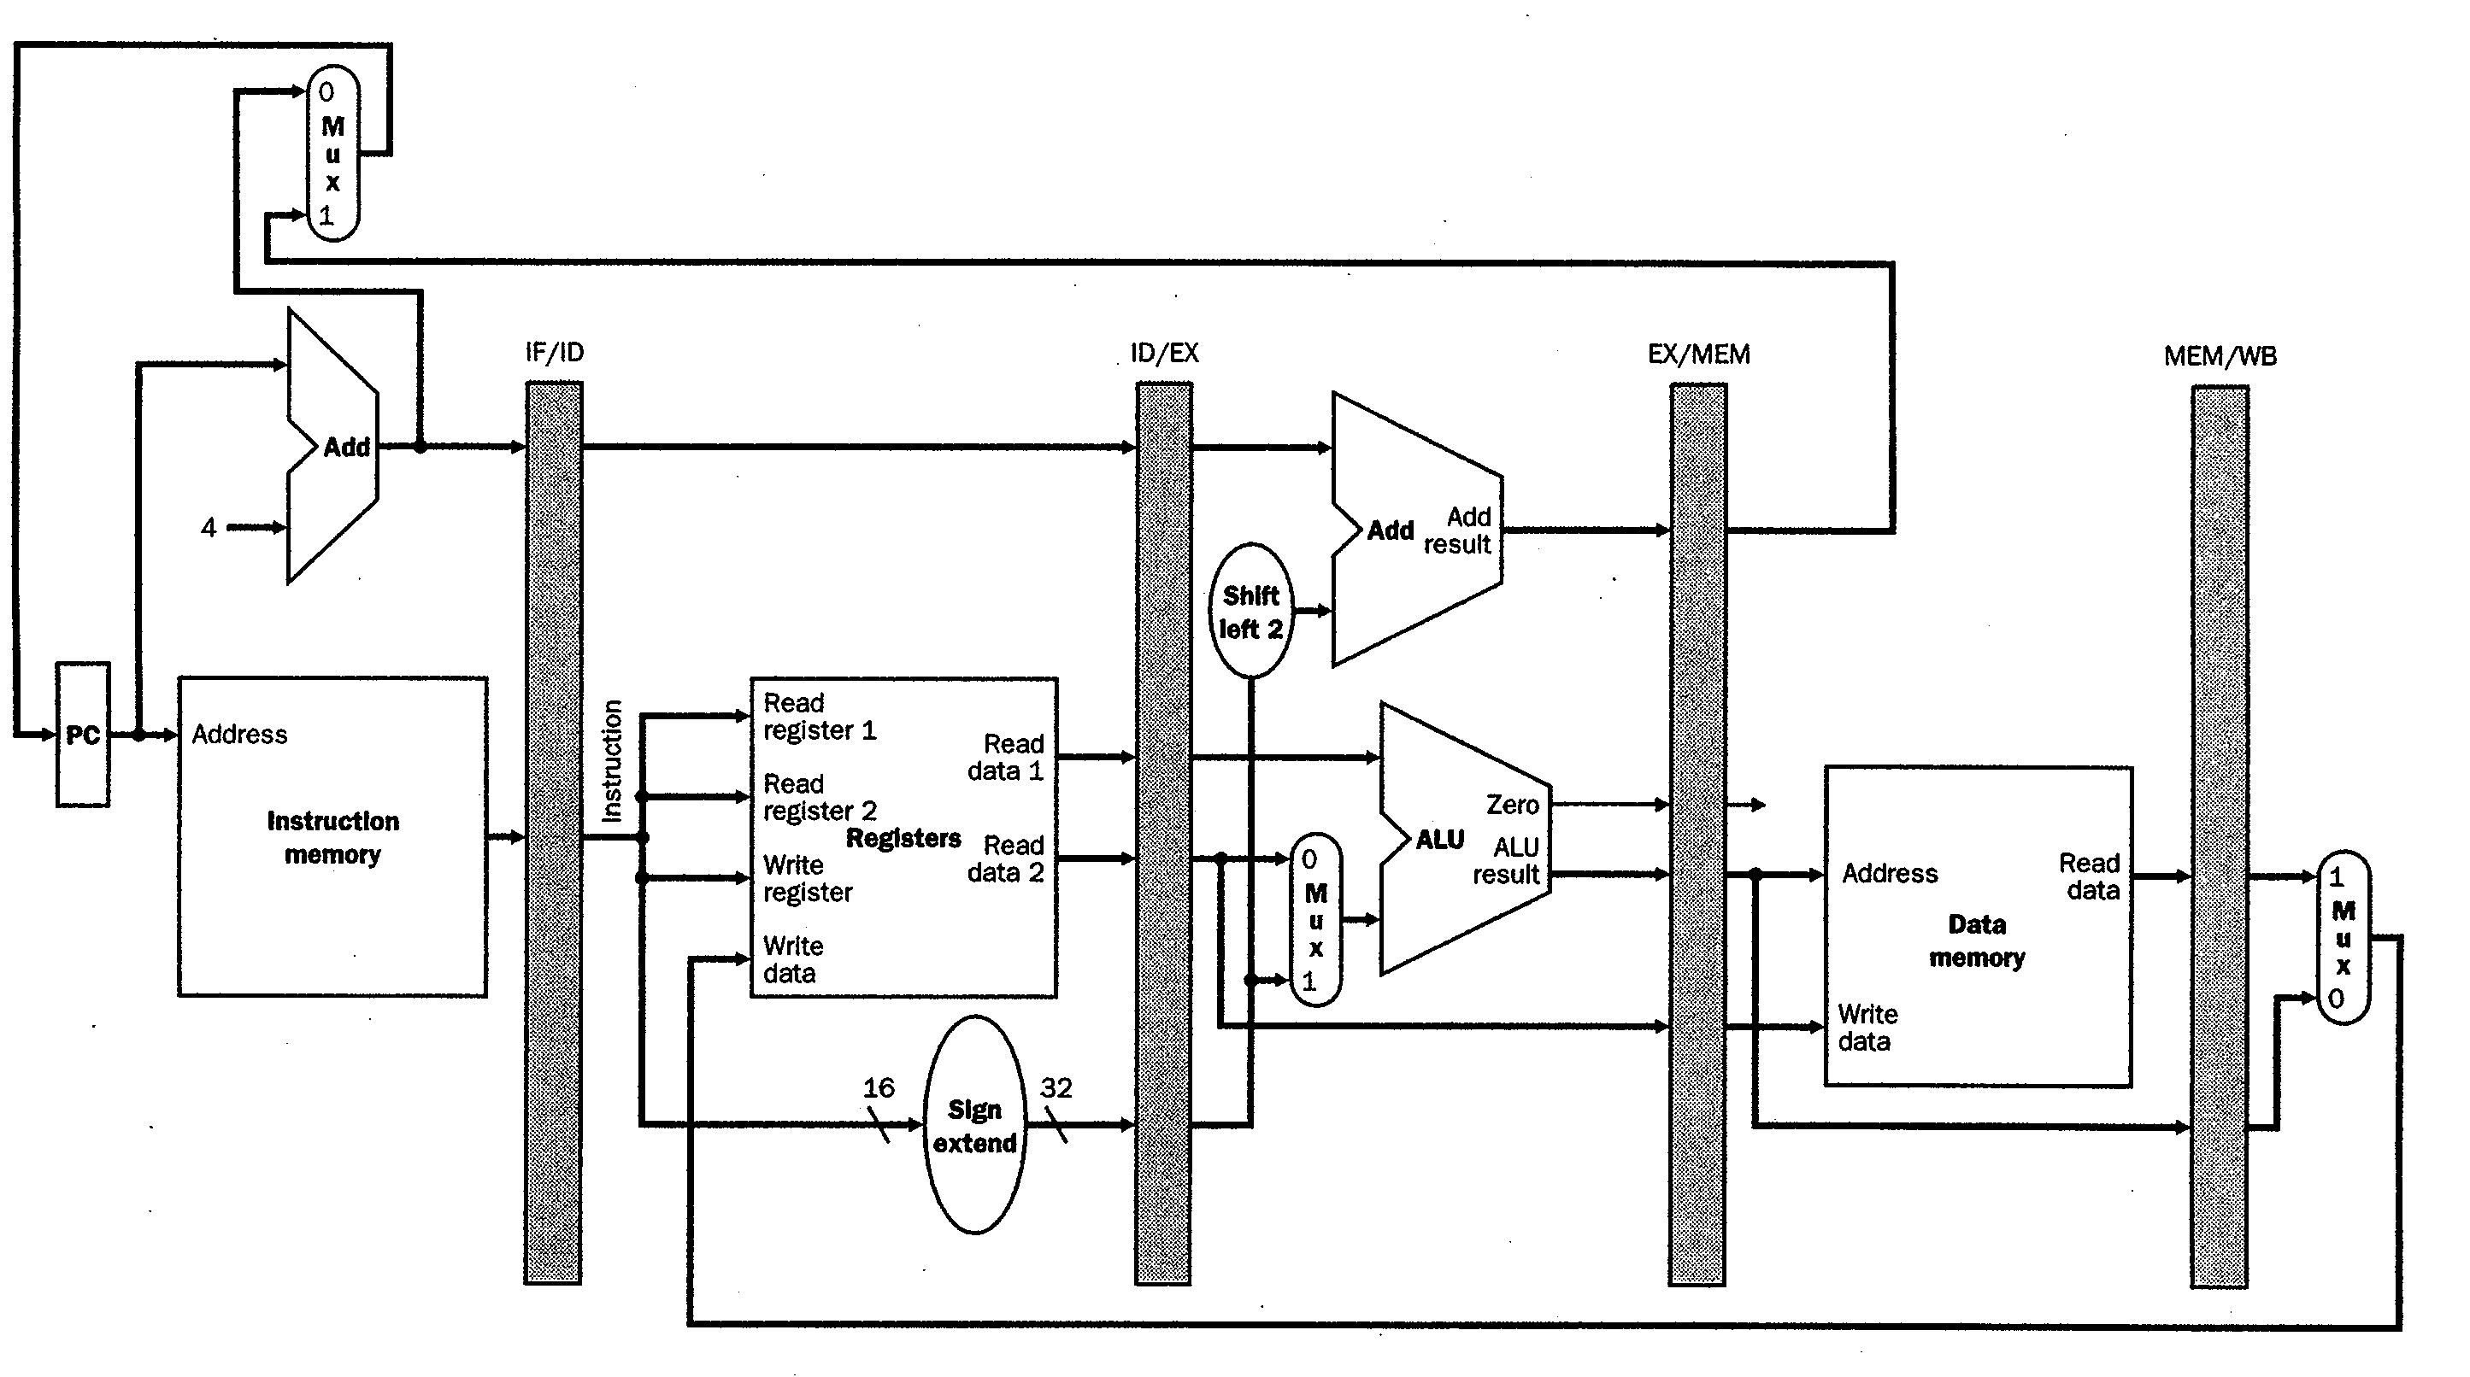
Pipelined “LDR R1, [R2, #100]”
Add registers between stages of execution
Pipeline Register Stores bits encoding the instruction “LDR R1, [R2, #100]”
Send PC, fetch
“LDR” instruction
Text: COD ARM Edition §4.6

Slide 24
Pipelined “LDR R1, [R2, #100]”
Pipeline Register Stores Regs[Rn], Regs[Rm], SgnExt(100)
Text: COD ARM Edition §4.6

Slide 25
Pipelined “LDR R1, [R2, #100]”
Pipeline Register Stores ALU outputs
Text: COD ARM Edition §4.6

Slide 26
Pipelined “LDR R1, [R2, #100]”
Pipeline Register Stores Output of Data Memory
Text: COD ARM Edition §4.6

Slide 27
Pipelined “LDR R1, [R2, #100]”
Register File Stores Data Memory output to R1
=> RegisterFile acts like final pipeline register
Text: COD ARM Edition §4.6

Slide 28
Question
Something was wrong in the last example – did you see it? Not something missing. Something just wrong.
  Load writes to destination register of instruction in IF/ID stage and doing so is wrong.
  Why?
    Look at source of “Write Register” in previous slide.
  Write to destination register of instruction that comes 3 instructions later:
    LDR R1,[R2, #100] ; instruction in MEM/WB
    ADD R3,R4,R5 ; instruction in EX/MEM
    ADD R6,R7,R8 ; instruction in ID/EX
    ADD R10,R11,R12 ; instruction in IF/ID
  So, which register gets written to? => R10 (i.e., not R1)
  Let’s fix this...
Text: COD ARM Edition §4.6

Slide 29
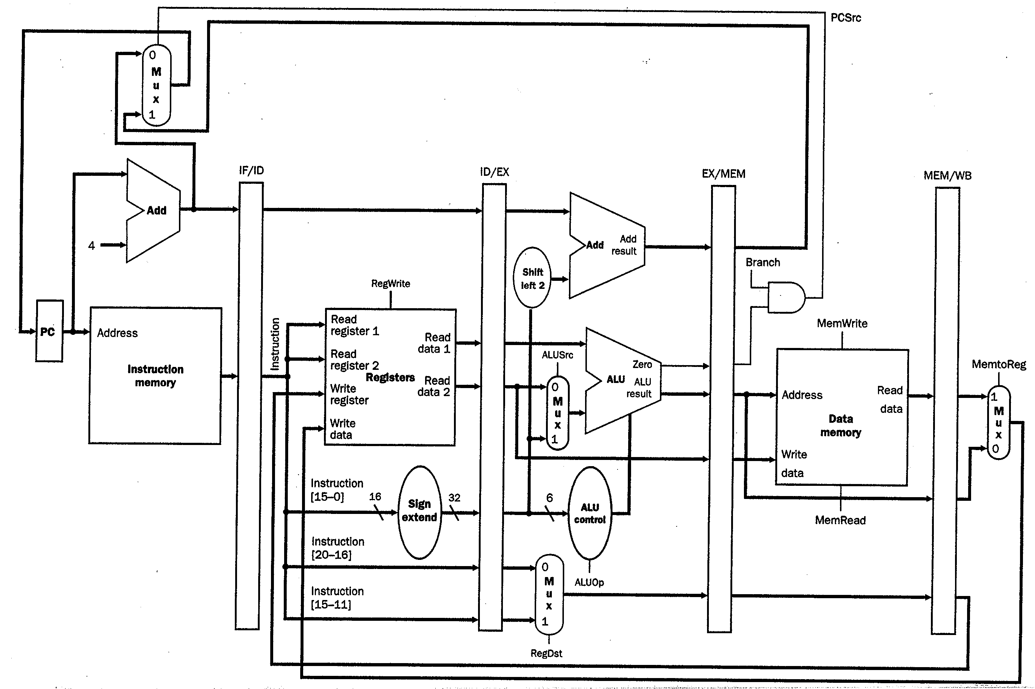
Pipeline Control Signals (1)
LDR R1,[R2,#100]
LDR R1,[R2,#100]
LDR R1,[R2,#100]
LDR R1,[R2,#100]
Text: COD ARM Edition §4.6

Slide 30

Pipelining ARM
Different ARM processors have different microarchitectures.
Cortex-A9 (used in many smartphones and your DE1-SoC) has very different microarchitecture from Cortex-M3 (used in Fitbit One).
Cortex-A9: 8 pipeline stages
Cortex-M3: 3 pipeline stages

Slide 31
Basic ARM pipeline (e.g., Cortex-M3)
Branch instruction evaluated in execute. Recall:
PC_{target} = PC_{branch} + 8 + 4 x “Target address”
PC = PC_{branch}+8
Fetch
PC_{branch}+4
Decode
PC_{branch}
Execute

Slide 32
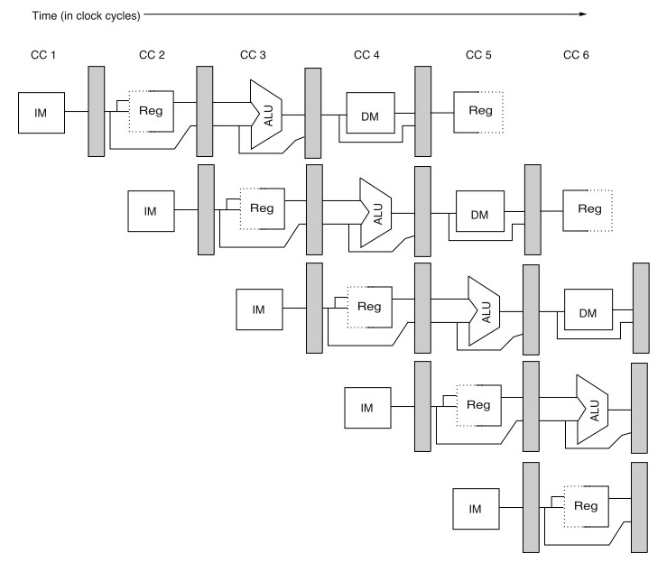
Analysis of Instruction Pipelining
Early in Time
Later in Time
1st Inst.
Last Instruction
Text: COD ARM Edition §4.7

Slide 33
Pipelining introduces potential “hazards”
 | Clock Number
 | 1 | 2 | 3 | 4 | 5 | 6 | 7 | 8 | 9
ADD R1,R2,R3 | IF | ID | EX | MEM | WB
SUB R4,R1,R5 |  | IF | ID | EX | MEM | WB
AND R6,R1,R7 |  |  | IF | ID | EX | MEM | WB
ORR R8,R1,R9 |  |  |  | IF | ID | EX | MEM | WB
EOR R10,R1,R11 |  |  |  |  | IF | ID | EX | MEM | WB
How do instructions after ADD get the correct value for R1?
Text: COD ARM Edition §4.7

Slide 34
Pipeline Hazards
Structural Hazards
Data Hazards
Control Hazards
We will discuss each type in turn. For each one consider:
  How is the hazard caused?
  What are the solutions to “resolve” the hazard?
  How do different solutions differ in their impact on performance?
Text: COD ARM Edition §4.7

Slide 35
Structural Hazards
Caused by resource conflicts
  Two or more instructions want to use the same hardware at the same time.
Two ways to resolve structural hazards:
  Solution 1: Stall
    Later instruction waits until earlier instruction is finished using resource… BUT this can lead to reduction in performance
  Solution 2: Replicate hardware
    Often we can eliminate need for stalling by replicating hardware or building hardware capable of servicing multiple instructions at the same time.
Text: COD ARM Edition §4.7

Slide 36
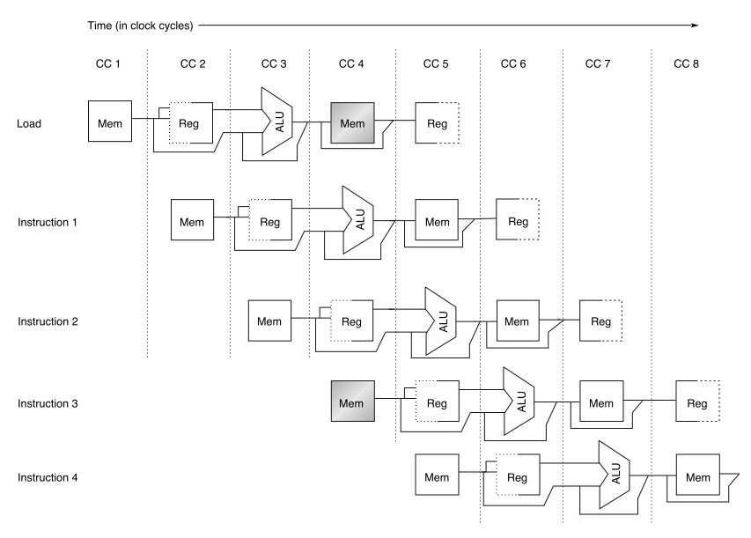
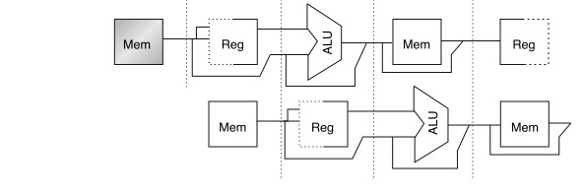
Structural Hazard Example
What if data and instructions are placed in same memory (at different locations)?
Problem: In this example, in clock cycle 4 (CC4) “Instruction 3” needs to be fetched from “Mem” in same cycle as the earlier Load instruction wants to read data from “Mem”.
Solutions?
stall

Slide 37
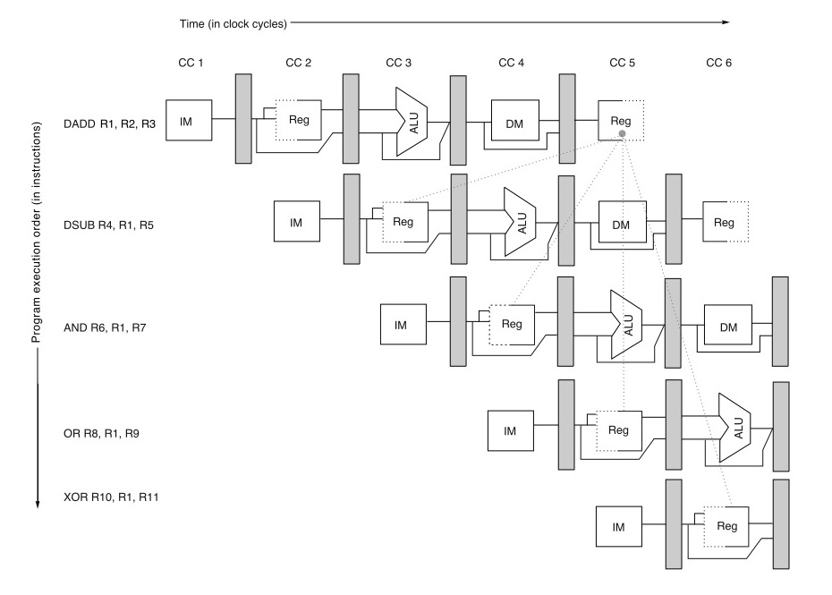
Problem: Data Hazards
“RAW hazards”
(read after write
hazard)
Note data dependencies
Red/dotted: Impossible to send information “back in time”.
Green/solid: Can potentially send information to other part of pipeline in same cycle or to a later cycle… requires hardware support and consideration of what can happen in a single clock cycle.
Text: COD ARM Edition §4.7

Slide 38

Forwarding
Note: forwarding always occurs within a single clock cycle.
Text: COD ARM Edition §4.7

Slide 39
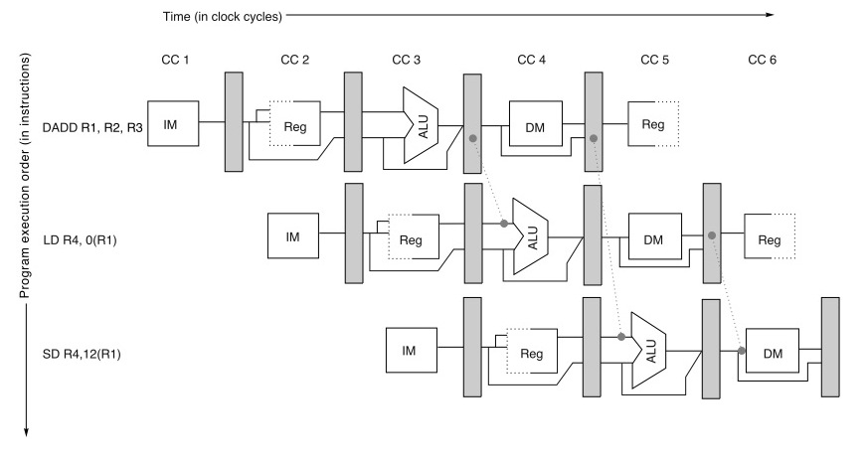
Forwarding Example #2
Questions:
1. How do we know a forwarding path is helpful?
2. How do we control the forwarding path?
Text: COD ARM Edition §4.7

Slide 40
Pipeline Control Signals (2)
Challenge: Control signals appear in each pipeline stage
Review: Control strategies for non-pipelined processor:
  Combinational Control (single-cycle CPU)
    Cannot apply to pipelined processor since there are many instructions in pipeline
  Sequential Control (FSM for multi-cycle CPU)
    Cannot apply to pipelined processor since there are many instructions in pipeline
New strategy
  Start with combinational control
  Pipeline it!
    Make proper control signals flow alongside with each instruction

Slide 41
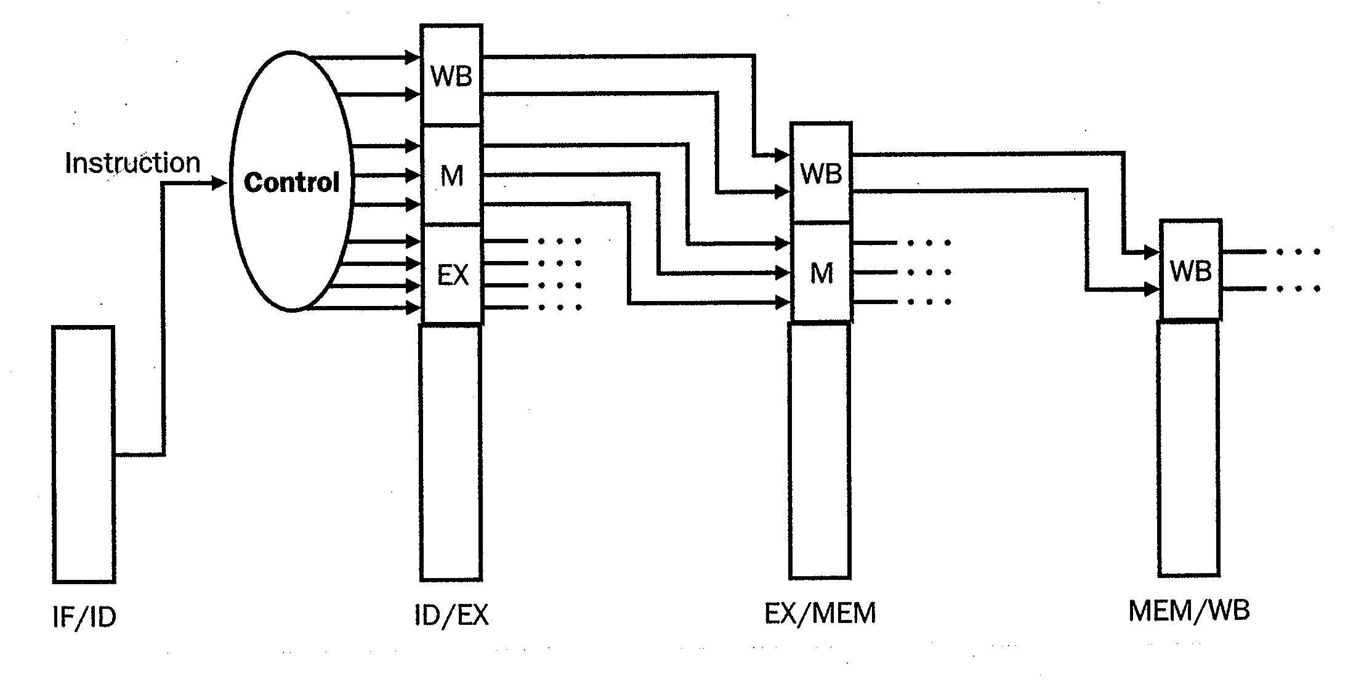
Pipeline Control Signals (2)
Separate signals into groups (one per stage)
  Each group contains all control signals for that stage
Add pipeline registers
IF ID EX MEM WB
Instruction Fetch Instruction decode / Execute / Memory Access Write back
Register file read address calc.

Slide 42
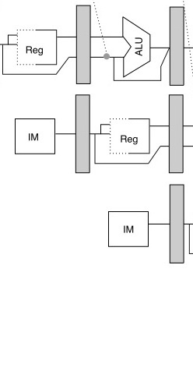
Solution #2: Forwarding
Solution #1: Stall
Time (in clock cycles)
a
b
c
Program execution order
(in instructions)
How do we implement the hardware for forwarding paths “a”, “b” and “c”?
NOTE: Forwarding begins and ends within a single clock cycle
Notes:
- If we do nothing, DADD writes R1 in CC5, but DSUB reads R1 in C3 and hence DSUB sees the wrong value
- Key point: forwarding begins and ends in a single clock cycle

Slide 43
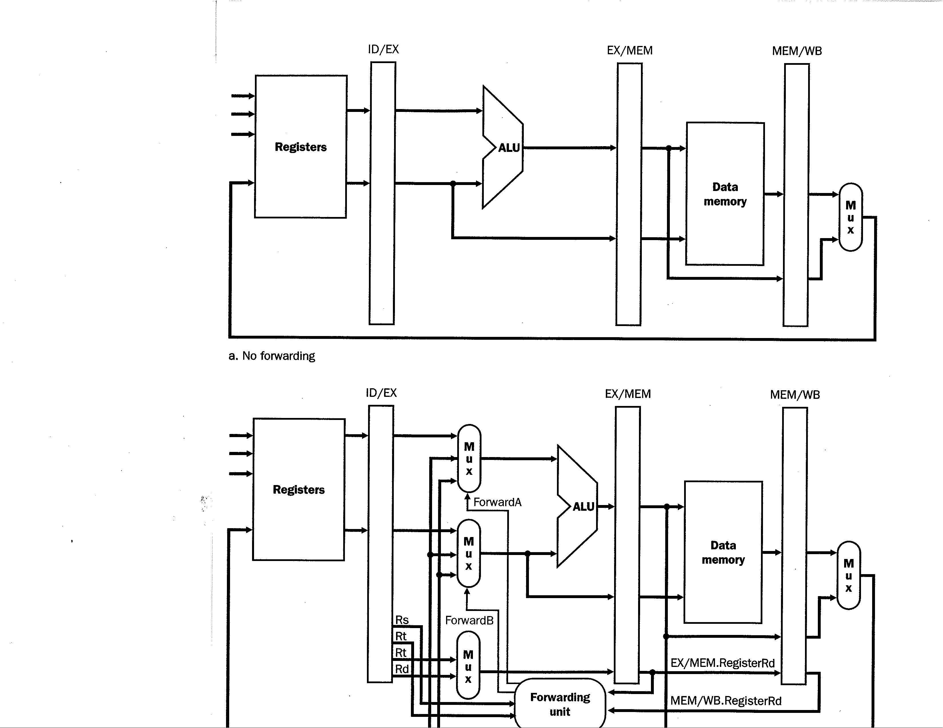
Implementing Forwarding
The figure below shows a basic pipelined processor (focusing on data flow) but with no forwarding

Slide 44
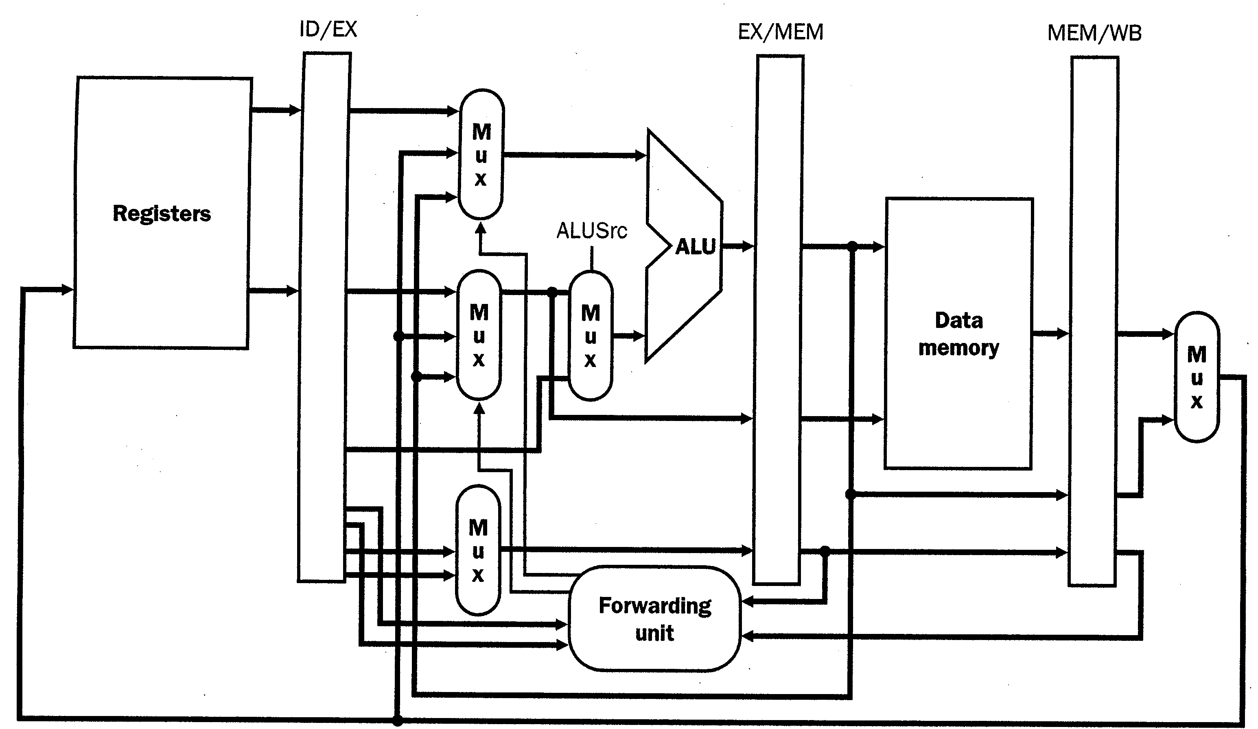
Implementing Forwarding
SgnExt(Imm16)
Rm
Rn
Rn
Rd
a
b
Forwarding paths often begin at output of pipeline register
(values forwarded at beginning of clock cycle)

Slide 45
Forwarding Example
ADD R1,R2,R3
Regs[R2]
Regs[R3]
Rm = 2
Rn = 3
Rn = 3
Rd = 1

Slide 46
Forwarding Example
SUB R4,R1,R5
ADD R1,R2,R3
Regs[R1]
Regs[R2]
Regs[R5]
Regs[R3]
Rm = 1
2
Rn = 5
3
Rd = 1
Rn = 5
3
Rd = 4
1

Slide 47
Forwarding Example
AND R6,R7,R1
SUB R4,R1,R5
ADD R1,R2,R3
Rm = 1
1
Rn = 7
5
4
1
Rn = 7
5
Rd = 6
4
1
1
5
Above: Forwarding unit compares the destination register specifier of DADD
instruction in EX/MEM to both source register specifiers of DSUB instruction
in ID/EX. Finds a match (Rs == Rd == 1), and thus enables forwarding mux.
Notes:
Some questions one might ask at this point:
1. What are all the possible combinations of instructions we need to consider? For example, what if DADD R1,R2,R3 were LD R1,0(R3)??
2. What other forwarding paths are required to reduce or minimize stalling due to RAW hazards for the classic 5-stage MIPS pipeline
3. How would you go about deciding where to put forwarding paths in a new design?

Slide 48
Forwarding Example
ORR R8,R1,R9
AND R6,R7,R1
SUB R4,R1,R5
ADD R1,...
Rm = 1
7
Rn = 9
1
6
4
1
Rn = 9
1
Rd = 8
6
4
7
1
1

Slide 49
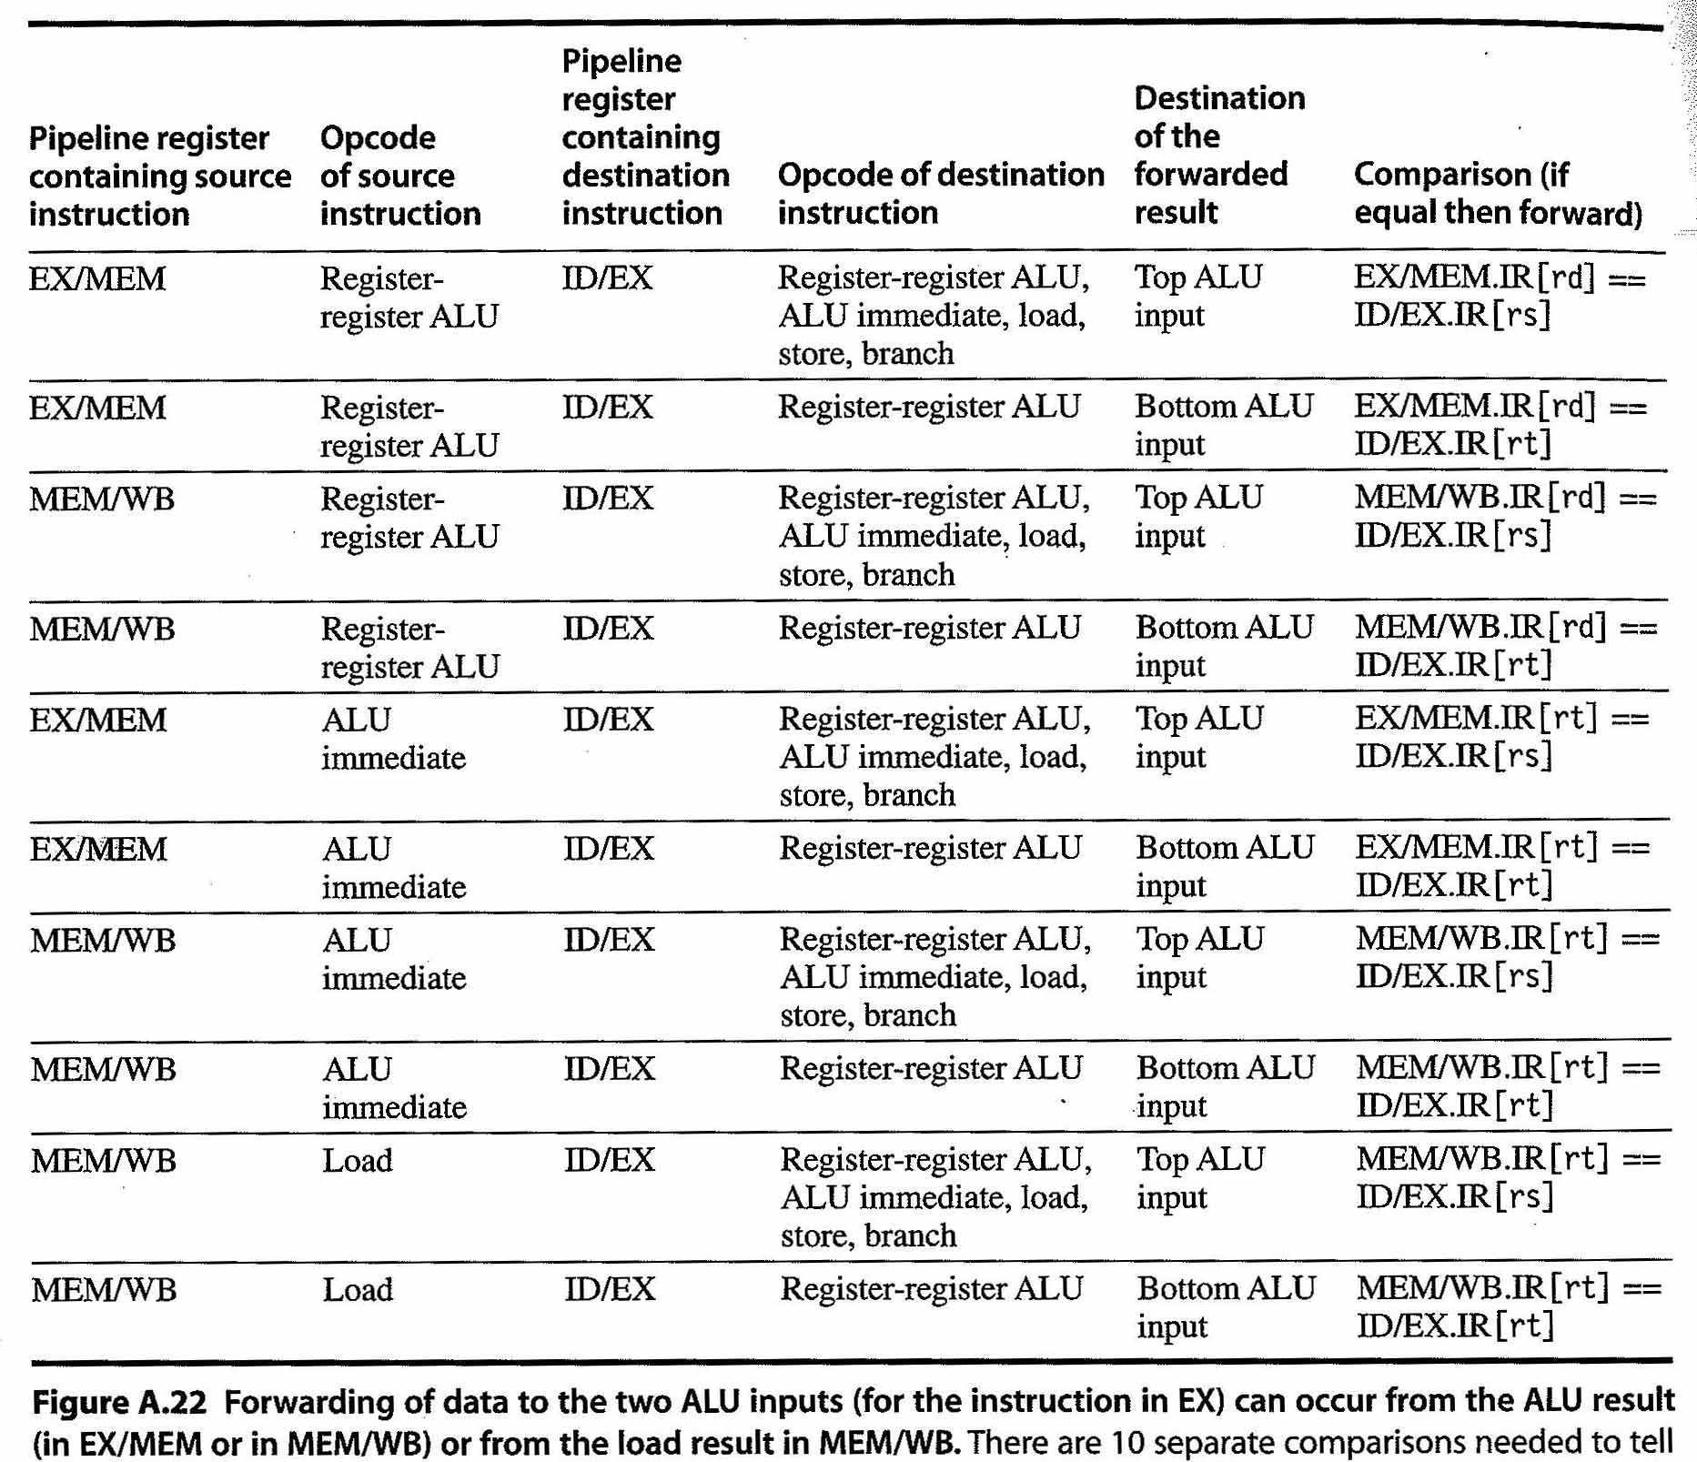
Forwarding Unit Logic
Let’s briefly consider the forwarding unit in a bit more detail.
This unit needs to check for data hazards between instructions in different stages of the pipeline and enable the forwarding muxes.
Figure below lists all the combinations a hardware designer would need to consider for controlling multiplexers for “a” and “b” (rt=Rn and rs=Rm)

Slide 50
Where do Forwarding Paths go?
PC
To fully reduce or eliminate need for stalling: Add forwarding paths starting from “producer” stages (and later stages) to earlier “consumer” stages.
IF/ID
ID forwarding paths
(used if branches resolved in decode)
ID/EX
EX/MEM
ALU
forwarding
paths
MEM forwarding paths
MEM/WB
Example: “All forwarding paths required to reduce or eliminate stalls” if branches are resolved in decode

Slide 51
Forwarding through register file?
Recall EECE 353 Lab 3:
  Write: On rising edge of clock
  Read: “Output bus” changes whenever “readnum” changes or when contents of register changes.
  To forward through register file, want to write in first half of clock cycle.
  We can achieve this effect by inverting clock input to registers so that flip-flops capture write data on falling clock edge.

Slide 52
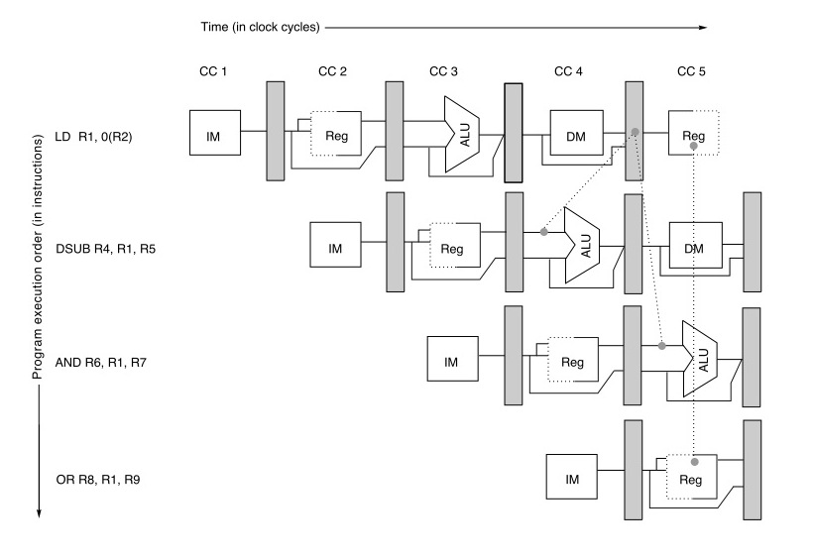
Unavoidable Stalls
Can’t do this. Why?
Forwarding cannot
eliminate stall for this
data hazard
Text: COD ARM Edition §4.7

Slide 53
Pipeline Stalls
Stalled instruction and subsequent instructions held in pipeline registers.
We insert “no op” instruction(s) in place of stalled instruction.
Unavoidable stalls occur when the stage producing the forwarded value is “later” in pipeline than stage consuming the value and there are “not enough” instructions separating these two instructions.

Slide 54
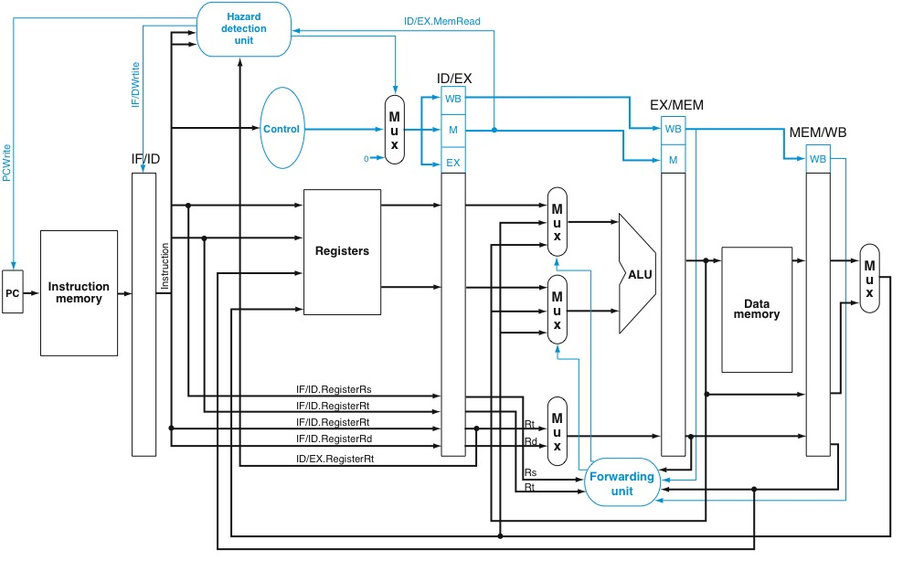
Stall Hardware: Hazard Detection Unit
NOP

Slide 55
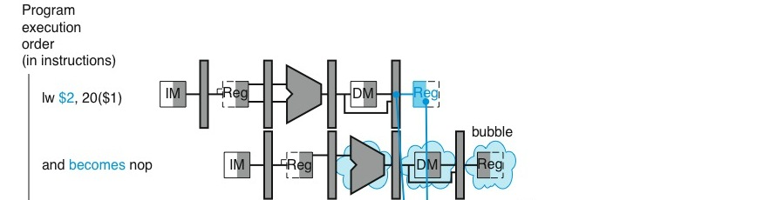
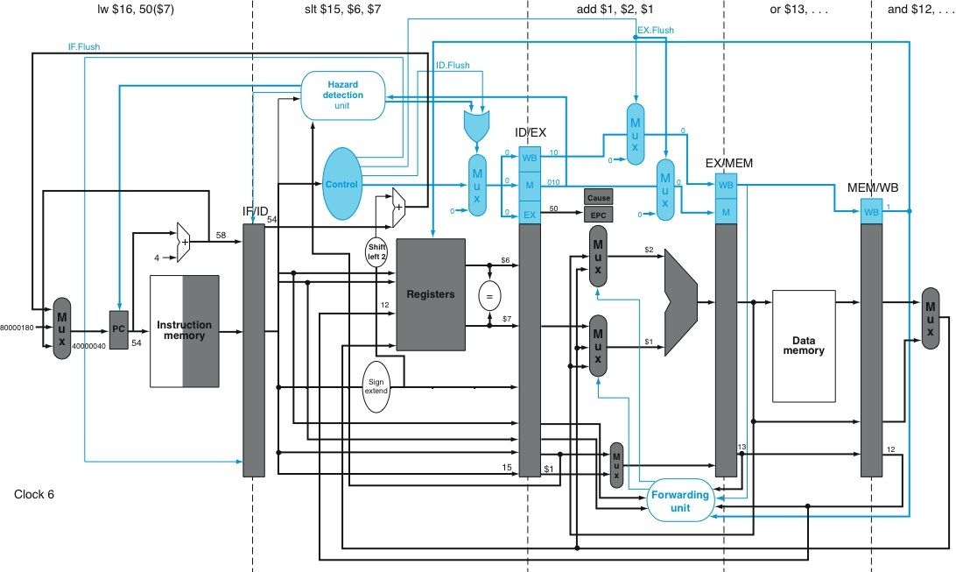

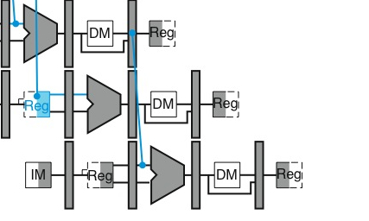
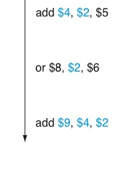




Hazard Detection Location Options
Hazard detection in decode:
“and” instruction stalled in IF/ID during CC3
F
D
X
M
W
Hazard detection in execute:
“and” instruction stalled in ID/EX during CC4
May lower clock frequency (need to send stall signal farther).

Slide 56
Control Hazards
Branch may or may not change program counter (PC).
Therefore, which instruction should follow a branch depends upon the result of executing the branch instruction.
Recall: Result of branch typically known by end of EX (or ID).
Text: COD ARM Edition §4.8

Slide 57
Option 1: Stall
First, let’s define some terminology:
BNE Label ; branch instruction
ADD R1,R2,R3 ; branch successor for “not taken” branch
LD R1,0(R2)
…
Label: SUB R1,R2,R3 ; branch successor for “taken” branch
Text: COD ARM Edition §4.8

Slide 58
Option 1: Stall
 | Clock Number
 | 1 | 2 | 3 | 4 | 5 | 6 | 7 | 8
branch instruction | F | D | X | M | W
branch successor |  |  |  | F | D | X | M | W
branch succ. + 1 |  |  |  |  | F | D | X | M
branch succ. + 2 |  |  |  |  |  | F | D | X
Decode branch and
stall fetch on cycle 2
Fetch successor on cycle 4.
(cannot do this on cycle 3)
“Resolve branch” during cycle 3.
(hardware determines successor
at end of cycle 3)
Text: COD ARM Edition §4.8

Slide 59
Option 2: Predict “Not Taken”
Many “forward” branches are “weakly biased” meaning they are taken and not-taken roughly the same number of times.
This means that about half the time, if we had just guessed that the branch was not taken, we would have been right.
What happens if we are wrong? If we are wrong, we need a way to correct our mistake.
Text: COD ARM Edition §4.8

Slide 60
Predict “Not Taken”
(correct prediction)
 | Clock Number
 | 1 | 2 | 3 | 4 | 5 | 6 | 7 | 8
Not taken branch | F | D | X | M | W
branch instr. + 1 |  | F | D | X | M | W
branch instr. + 2 |  |  | F | D | X | M | W
branch instr. + 3 |  |  |  | F | D | X | M | W
“Resolve branch” during cycle 3.
Hardware determines successor
at end of cycle 3. In this case, the prediction turns out to be correct since the branch was not taken. We did not know this until end of cycle 3.
On cycle 2, hardware
predicts next instruction
is “branch instr. + 1”
Text: COD ARM Edition §4.8

Slide 61
Predict “Not Taken”
(incorrect/wrong prediction)
 | Clock Number
 | 1 | 2 | 3 | 4 | 5 | 6 | 7 | 8
TAKEN branch | F | D | X | M | W
branch instr. +1 |  | F | D | X | M | W
branch instr. +2 |  |  | F | D | X | M | W
branch target |  |  |  | F | D | X | M | W
Next cycle (clock cycle 4), fix incorrect prediction.
Two things happen:
Squash incorrectly fetched instructions (turn into “no ops” or “bubbles”)
Start fetching correct instruction
Resolve branch
on cycle 3. Find out prediction was wrong.
Text: COD ARM Edition §4.8

Slide 62

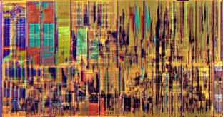
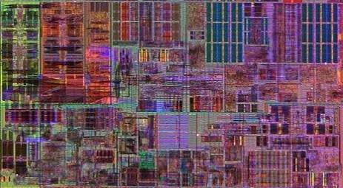
Intel Core i7
Execution
Units
L1 Data Cache
L2 Cache
& Interrupt
Servicing
Memory Ordering
& Execution
Paging
Out-of-Order
Scheduling &
Retirement
Instruction
Decode &
Microcode
Branch Prediction
Instruction Fetch
& L1 Cache
Highlighted above: Significant investment of silicon area to “predict branches”.

Slide 63
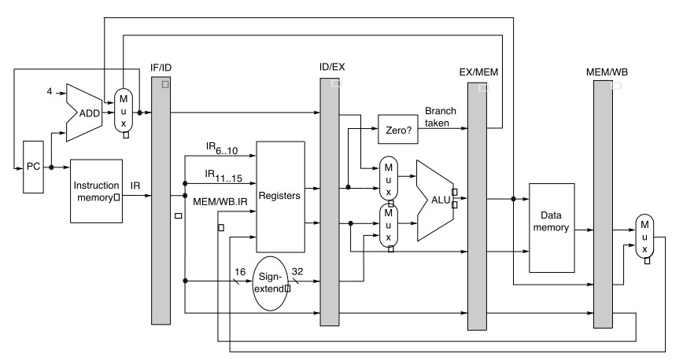
Resolving a Branch in Execute (EX)
EX
Check branch condition and compute target in execute stage. Update PC with correct target by end of cycle that branch enters execute stage. Fetch correct target following cycle.

Slide 64
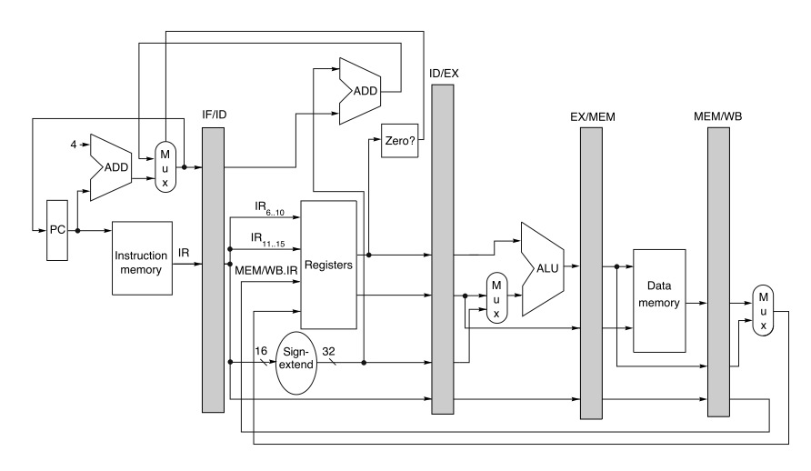
Resolving a Branch in Decode (ID)
ID
Check branch condition and compute target in decode stage. Update PC with correct target by end of cycle that branch enters decode stage. Fetch correct target following cycle.

Slide 65
Pipeline Diagrams Formats
A=B=C
(all mean same thing)
Abstract
away
detail
A
 | Clock Number
 | 1 | 2 | 3 | 4 | 5 | 6 | 7 | 8 | 9 | 10
lw $2,20($1) | F | D | X | M | W
add $4,$2,$5 |  | F | D | X | X | M | W
or $8,$2,$6 |  |  | F | D | D | X | M | W
add $9,$4,$2 |  |  |  |  | F | D | X | M | W
B
 | Clock Number
 | 1 | 2 | 3 | 4 | 5 | 6 | 7 | 8 | 9 | 10
lw $2,20($1) | F | D | X | M | W
add $4,$2,$5 |  | F | D | s | X | M | W
or $8,$2,$6 |  |  | F | s | D | X | M | W
add $9,$4,$2 |  |  |  |  | F | D | X | M | W
C

Slide 66
Drawing Pipeline Timing Diagrams
Step 1: Identify data hazards, draw arrow from destination register of instruction producing value to source register of instruction consuming value. Note branch instructions that are “taken” (e.g., you might mark them with a star “*”)
Step 2: Consider each instruction “T” in the order it is executed by the program. Starting from fetch, determine on which clock cycle “T” reaches each pipeline stage using the following “rules”:
  Does “T” follow a taken branch? If so, consider when that branch is “resolved” – fetch for “T” (e.g., “IF” stage) occurs cycle after branch is “resolved”.
  Consider any structural hazards involving “T” and an earlier instruction in the pipeline. Stall instruction “T” on cycles for which there is a structural hazard.
  Consider any “data hazards” identified in Step 1 and identify any instruction “S” that produces a value consumed by instruction “T”. For each such instruction “S”, consider which pipeline stage for “S” produces the value and which stage for “T” consumes the value.
  Ensure the consuming stage for “T” occurs at least one cycle later than the producing stage for “S” inserting stalls for “T” if necessary – e.g., at the decode stage if hazard detection is in decode. Here you may need to consider whether forwarding is allowed (based upon the question you are trying to answer).
  Draw arrow from stage forwarding to consumer stage for “T”. This arrow should not cross more than one clock cycle.

Slide 67
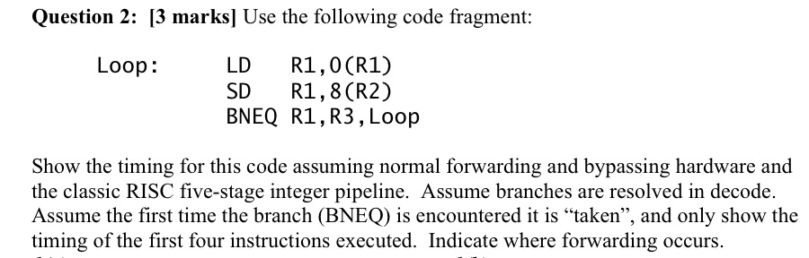
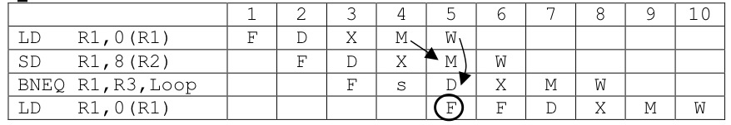
Example 1
Loop: LDR R1, [R1]
STR R1, [R1, #8]
CMP R1, R3
BNE Loop
(BNE)
five
Solution:
*

Slide 68
Summary
Learned about the processor performance equation
Learned about pipelining
  What it is; why improves performance
  Challenges of implementing pipelining (Hazards)
  Forwarding and how to implement it
  Pipeline timing diagrams

