Slide 1
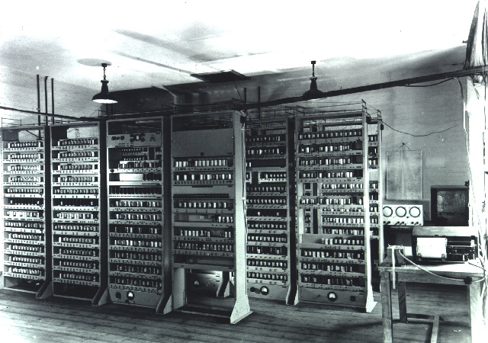
CPEN 211: Introduction to Microcomputers Slide Set 15: Function Calls
Instructor: Prof. Tor Aamodt
Background: The Electronic delay storage automatic computer (EDSAC) – became operation 6 May 1949 - subroutines were invented on this machine
[CC BY 2.0, https://commons.wikimedia.org/w/index.php?curid=432935]
Notes:
1

Slide 2
Learning Objectives
After this slide set you should be able to:
Explain how function calls work at the ARM assembly level.
Explain how the stack is used to support nested function calls and recursion.
Write assembly code for a function call using the ARM calling conventions.

Slide 3
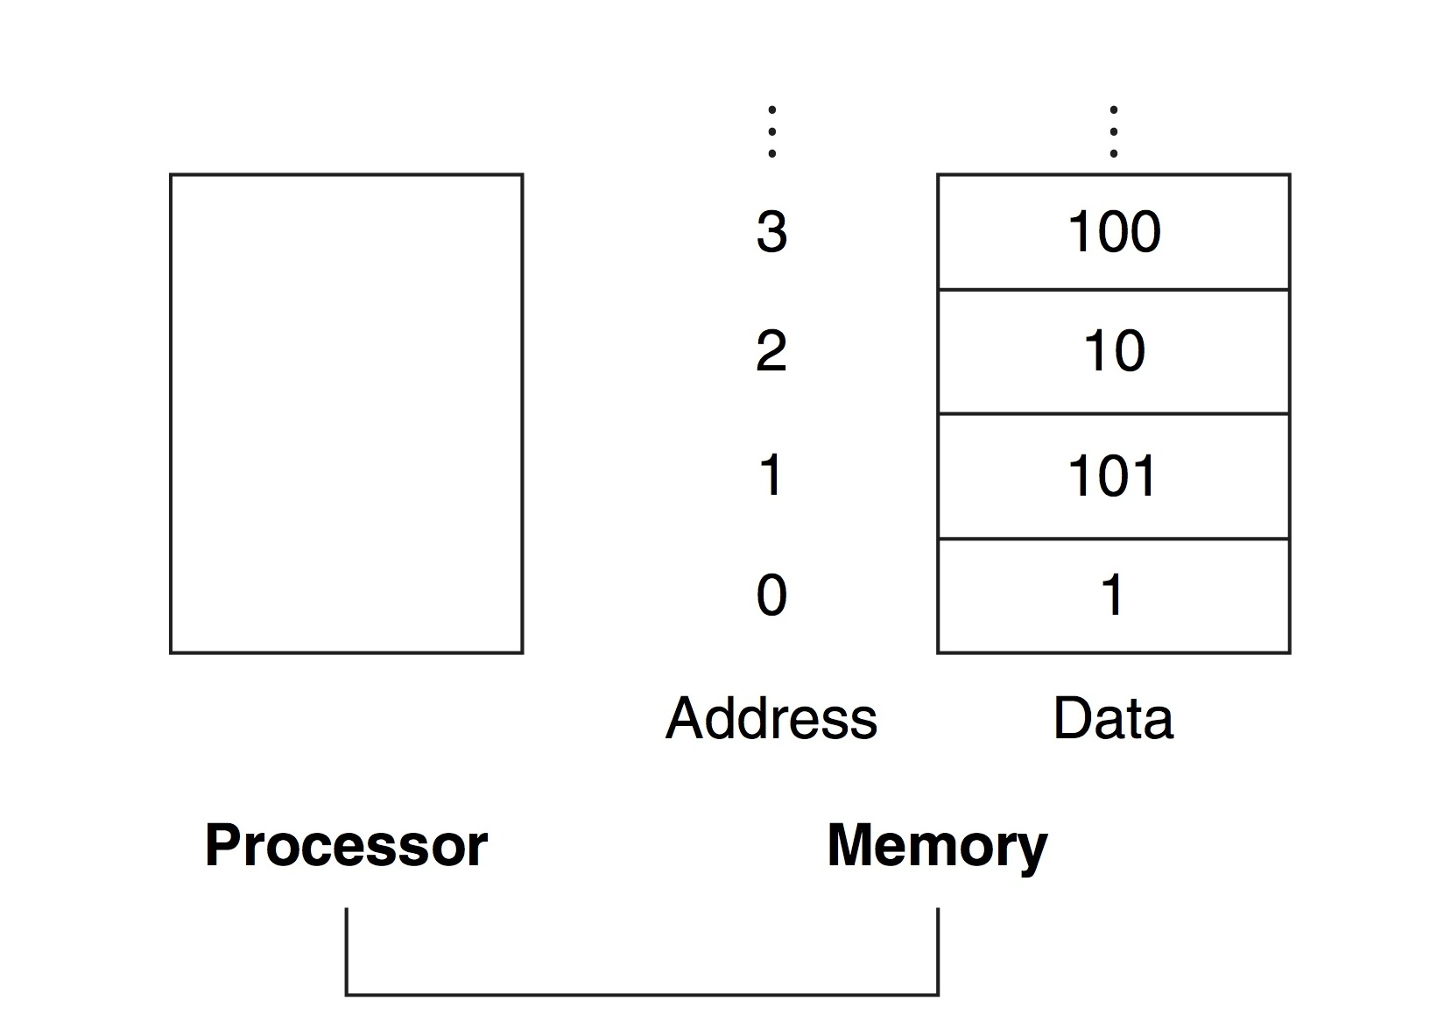
Memory vs Registers
R0
R1
R2
…
R15
Von Neumann architecture: Processor (CPU) accesses instructions and data from external Memory.
Registers (e.g., Register File in Lab 5) inside Processor.

Slide 4
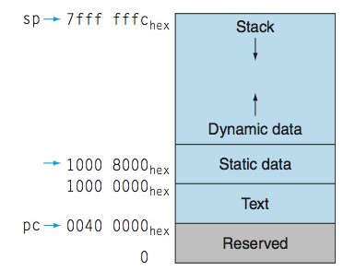
Memory Spaces
All memory locations in a memory are implemented the same way. E.g., 1-bit stored by a 1 Transistor, 1 Capacitor (1T1C) DRAM cell.
However, software (operating system, compiler) typically use different locations in memory for different purposes (figure above):
Reserved area (for operating system),
Text = instructions for program,
Static data for global variables,
Dynamic data for large data structures used by multiple functions
Stack used for implementing function calls (main focus of this slide set)

Slide 5
Function call standards
In general, how function calls are implemented is part of a system’s “Application Binary Interface” (ABI)
In this lecture we will look at basic details of how function calls work in ARM.
More details on function calls in “Procedure Call Standard for the ARM Architecture” https://static.docs.arm.com/ihi0042/g/aapcs32.pdf (You do NOT need to read this document)

Slide 6
“extern” vs. “static” linkage
extern int foo(int a, int b);
The “extern” keyword says the function should be compiled so it can be called by a function using the standard ABI.
By default, all functions in C have “extern” linkage even if the keywork “extern” is left out.
Alternative: “static”
means function can only be called by a function in the current file. This means compiler does not need to follow standard (can be clever to improve function call performance).
static int foo(int a, int b);

Slide 7
How to implement this C code in ARM?
/* file: main.c */
extern int leaf_example(int,int,int,int);
void main() {
int result = leaf_example(1,5,9,20);
if (result > 10) ...
}
/* file: leaf.c */
int leaf_example(int g, int h, int i, int j)
{
int f;
f = (g + h) – (i + j);
return f;
}

Slide 8
BAD Solution #1: Use ARM unconditional branch (B) to call subroutine code!
main:
MOV r0, #1
MOV r1, #5
MOV r2, #9
MOV r3, #20
B leaf_example
return:
MOV r7, #10 ;
CMP r4, r7
BLE label
...
leaf_example:
ADD r5, r0, r1 ; r5 = g + h
ADD r6, r2, r3 ; r6 = i + j
SUB r4, r5, r6 ; f = (g+h)-(i+j)
B return
What’s wrong with this approach?

Slide 9
Call leaf_example() more than once?
/* file: main.c */
extern int leaf_example(int,int,int,int);
void main() {
int y1 = leaf_example(1,5,9,20);
int y2 = leaf_example(20,5,9,1);
if (y1 > y2) ...
}
/* file: leaf.c */
int leaf_example(int g, int h, int i, int j)
{
int f;
f = (g + h) – (i + j);
return f;
}

Slide 10
BAD Solution #2: Inline subroutine code!
main:
MOV r0, #1
MOV r1, #5
MOV r2, #9
MOV r3, #20
; y1 = leaf_example(1,5,9,20);
ADD r5, r0, r1
ADD r6, r2, r3
SUB r4, r5, r6
; y2 = leaf_example(20,5,9,1);
ADD r8, r3, r1
ADD r9, r2, r0
SUB r7, r8, r9
; if ( y1 > y2 )
CMP r4, r7
BLE label
This works sometimes -- when doesn’t it work? Compilers apply this as “optimization” but increases # of instructions.

Slide 11
Inlining Challenge #1: Libraries
How to support “libraries”?
How to use “qsort()” which sorts arrays and is defined in “#include <stdlib.h>”?
Problems?
How to transfer control back from qsort(), which was compiled before we wrote our program?
Which registers used to pass arguments?
What happens to our registers while qsort() runs?
For library functions that return a result: how do we get the result?

Slide 13
[https://arxiv.org/abs/1509.09308 - Submitted on 30 Sep 2015 (v1), last revised 10 Nov 2015 (this version, v2)]

Slide 14
Inlining Challenge #2: Recursion
/****************************************************
* The “Ackermann function” was discovered in 1928 *
* https://en.wikipedia.org/wiki/Ackermann_function *
****************************************************/
unsigned A(unsigned m, unsigned n)
{
if(m==0)
return n+1;
else if(m>0 && n==0)
return A(m-1,1); // NOTE: recursive call!
else
return A(m-1, A(m,n-1) ); // NOTE: recursive calls!
}

Slide 15
Good (General) Solution?
Functions are also sometimes called “subroutines” or “procedures”
Functions are key to enabling “modularity” in software (e.g., enable libraries)
We want a general solution
Textbook explains general solution using analogy: “Spy” given some instructions, goes off and completes a mission to get information and covers up their tracks so nobody knows they were there.
Text: COD4e §2.8

Slide 16
Operation of a Function Call
Basic operation:
Put parameters where function can find them
Transfer control to the function
Acquire storage for function
Perform task
Put result where calling program can access it
Return control to the point of origin (noting function can be called from many places)
Text: COD4e §2.8

Slide 17
How to implement this C code in ARM?
/* file: main.c */
extern int leaf_example(int,int,int,int);
void main() {
int result = leaf_example(1,5,9,20);
if (result > 10) ...
}
/* file: leaf.c */
int leaf_example(int g, int h, int i, int j)
{
int f;
f = (g + h) – (i + j);
return f;
}

Slide 18
Step 1: Put parameters somewhere
Fastest “location” is registers
By convention ARM uses R0 to R3 for first four inputs to function:
Example:
main:
MOV r0, #1
MOV r1, #5
MOV r2, #9
MOV r3, #20
Text: COD4e §2.8

Slide 19
Aside (Step 2 & 6): Hansel and Gretel
If you have heard story you may recall Hansel and Gretel drop breadcrumbs on ground while walking into forest so they can find their way back home.
[By http://www.mythfolklore.net/3043mythfolklore/reading/grimm/images/rackham_hansel.htm and
http://www.surlalunefairytales.com/illustrations/hanselgretel/rackhamhansel.html, Public Domain,
https://commons.wikimedia.org/w/index.php?curid=1057110]

Slide 20
Step 2: Transfer control to the function
ARM uses branch and link instruction, BL, to transfer control to subroutine.
BL ProcedureAddress
Sets: R14=PC+4; PC=ProcedureAddress;
I.e., in addition to transferring control to function, BL places program counter of instruction to return to in “link register” or “LR” (R14).
Text: COD4e §2.8

Slide 21
Step 2: Example of branch and link (BL)
main:
; leaf_example(1,5,9,20);
MOV r0, #1
MOV r1, #5
MOV r2, #9
MOV r3, #20
BL leaf_function

Slide 22
00001000: main:
00001000: MOV r0, #1
00001004: MOV r1, #5
00001008: MOV r2, #9
0000100C: MOV r3, #20
00001010: BL leaf_function
00001014: ...
...
00001024: leaf_function:

Slide 23
Skip Step 3 & 4 (will discuss shortly)
Basic operation:
Put parameters where function can find them
Transfer control to the function
Acquire storage for function
Perform task
Put result where calling program can access it
Return control to the point of origin (noting function can be called from many places)
Text: COD4e §2.8

Slide 24
Step 5: Put result where calling program can access it
By convention, ARM returns results by putting them in register R0 (or R0 and R1 if result is 64-bits) then returning control to calling program.
Text: COD4e §2.8

Slide 25
Step 5: Put result where calling program can access it
leaf_example:
…
ADD r5, r0, r1 ; r5 = g + h
ADD r6, r2, r3 ; r6 = i + j
SUB r4, r5, r6 ; f = (g+h)-(i+j)
MOV r0, r4 ; Step 5: put result in R0
…

Slide 26
Step 5: Put result where calling program can access it
00001000: main:
; int result = leaf_example(1,5,9,20);
00001000: MOV r0, #1
00001004: MOV r1, #5
00001008: MOV r2, #9
0000100C: MOV r3, #20
00001010: BL leaf_function
; if (result > 10) ...
00001014: MOV r4, #10
00001018: CMP r0, r4 ; result in r0
0000101C: BLE label

Slide 27
Step 6: Return control
Return address is in LR (i.e., R14). All we need to do is copy LR to PC (PC is R15 in ARM):
MOV pc, lr
Value in LR is PC address of BL instruction + 4
Text: COD4e §2.8

Slide 28
00001000: main:
; int result = leaf_example(1,5,9,20);
00001000: MOV r0, #1
00001004: MOV r1, #5
00001008: MOV r2, #9
0000100C: MOV r3, #20
00001010: BL leaf_function
; if (result > 10) ...
00001014: MOV r4, #10
00001018: CMP r0, r4
0000101C: BLE label
...
00001024: leaf_function:
...
00001054: MOV pc, lr

Slide 29
BAD Solution #3: Ad hoc register usage
leaf_example:
ADD r4, r0, r1 ; r4 = g + h
ADD r5, r2, r3 ; r5 = i + j
SUB r0, r4, r5 ; f = (g+h)-(i+j)
MOV pc, lr
When will this code cause problems?

Slide 30
Example: What if we modify main.c...?
/* file: main.c */
extern int leaf_example(int,int,int,int);
void main() {
int maxval = 40;
int result = leaf_example(1,5,9,20);
if (result > maxval) ...
}
main:
; int maxval = 40
MOV r4, #40
; int result = leaf_example(1,5,9,20);
MOV r0, #1
MOV r1, #5
MOV r2, #9
MOV r3, #20
BL leaf_function
; if (result > maxval) ...
CMP r0, r4
BLE label

Slide 31
Step 3: Acquire storage
What if function needs more than the four registers (R0 to R3) we already used to pass values into the function?
Solution is to save “backup copy” of values in registers in memory.
Text: COD4e §2.8

Slide 32
Terminology
Caller – function that makes a call
Callee – function being called
Text: COD4e §2.8

Slide 33
When to save backup copies?
Option 1: “caller save” save registers at caller before BL.
MOV r4, #40
...
BL leaf_function
...
leaf_example:
...
ADD r4, r0, r1 ; r4 = g + h
ADD r5, r2, r3 ; r5 = i + j
SUB r6, r4, r5 ; f = (g+h)-(i+j)
...
Option 2: “callee save” save registers at callee after BL.
Which option above is “better” in this case and why?
What if leaf_example was in a library (already compiled)?
How/where to save registers?

Slide 34
Step 3: Where to save - Stack
A stack is a data structure which grows as we add things to it.
Add new data to “top of stack”.
Remove data from “top of stack”
By convention in computers, stack usually grows “down”.
Text: COD4e §2.8

Slide 35
Where is the Stack? Memory
Text: COD4e §2.3
Notes:
This figure shows an abstracted view of main memory in a computer. The main memory is on the right and is connected to the processor on the left…
… using a bus…

Slide 36
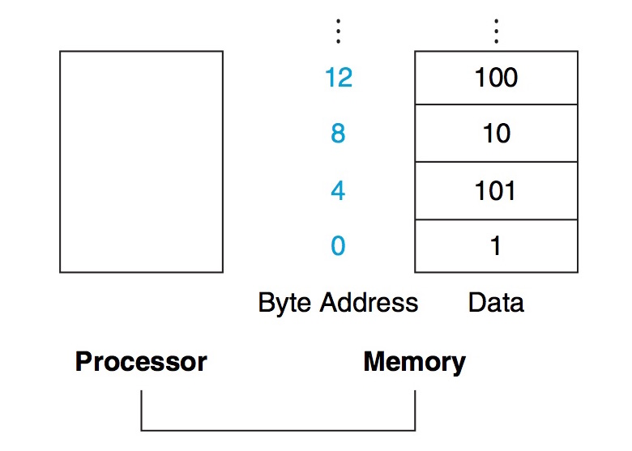
Memory: Words vs. Bytes
Text: COD4e §2.3
Notes:
This figure shows an abstracted view of main memory in a computer. The main memory is on the right and is connected to the processor on the left…
… using a bus…

Slide 37
Step 3: Where to save - Stack
By convention in computers, stack usually grows “down”. Push onto stack; Pop off of stack.
“bottom” of stack -- address in
memory high, e.g., 0x7FFFFFFF
⇐ “top” of stack, e.g., 0x7FFFF000
Text: COD4e §2.8

Slide 38
Step 3: Where to save - Stack
Address of “top of stack” saved in register called the “stack pointer” – ARM uses SP (R13)
ARM: Callee initially “pushes” (or “spills”) registers to stack and decrements stack pointer address
ARM: Callee later “pops” (or “fills”) registers from stack and increments stack pointer address
Text: COD4e §2.8

Slide 39
“spill” registers by “pushing” them onto stack:
leaf_example:
SUB sp, sp, #12 // adjust stack to make room for 3 items
STR r6, [sp,#8] // save register r6 for use afterwards
STR r5, [sp,#4] // save register r5 for use afterwards
STR r4, [sp,#0] // save register r4 for use afterwards
Recall: “STR” instruction (store) writes a value to memory.
Text: COD4e §2.8

Slide 40
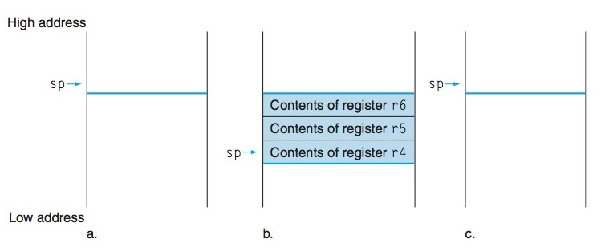
Spilling Registers to Stack
Before Call During Call After Call
Text: COD4e §2.8

Slide 41
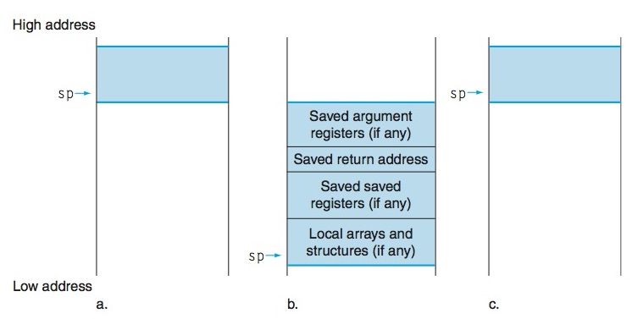
What else can go on the stack?
Each function call allocates space on stack called an “activation record”
Text: COD4e §2.8

Slide 42
ARMSim / Altera Monitor Program
Before Call
Want to return to this instruction at address 0x1018
memory location at address (0x5400) given by stack pointer (R13) before function call

Slide 43
Effect of BL instruction
During Call
Both link register (R14) and PC (R15) updated by BL instruction. NOTE: Instruction at 0x1018 is “CMP r0, r4” which is the instruction after BL.

Slide 44
What spilling looks like: ARMSim
During Call
During Call
Memory location at address (0x53f4) given by stack pointer (R13) after “SUB sp, sp, #12”

Slide 45
STR Instruction Execution Steps
Compute “effective address” by reading base address register and adding offset to it.
Read contents of register containing value to place in memory.
Write the value into memory at the location specified by the effective address.
effective address = REGS[sp] + 8
STR r6, [sp, #8]

Slide 46
What spilling looks like: ARMSim
During Call
1. effective address = 0x53f4 + 8 = 0x53fc
STR r6, [sp, #8]

Slide 47
What spilling looks like: ARMSim
During Call
STR r5, [sp, #4] ; 0x53f4 + 4 = 0x53f8

Slide 48
What spilling looks like: ARMSim
During Call
STR r4, [sp, #0] ; 0x53f4 + 0 = 0x53f4

Slide 49
Step 4: Perform Task
ADD r5,r0,r1 // register r5 contains g + h
ADD r6,r2,r3 // register r6 contains i + j
SUB r4,r5,r6 // f gets r5 – r6, which is (g + h) – (i + j)
Text: COD4e §2.8

Slide 50
Step 5: Put result where calling program can access it
MOV r0,r4 // returns f (r0 = r4)
Text: COD4e §2.8

Slide 51
LDR Instruction Execution Steps
Compute “effective address” by reading base address register and adding offset to it.
Read value in memory at the location specified by the effective address.
Write contents of register containing value to place in memory.
effective address = REGS[sp] + 4
LDR r5, [sp, #4]

Slide 52
“fill” registers by “popping” them from stack:
LDR r4, [sp,#0] // restore register r4 for caller
LDR r5, [sp,#4] // restore register r5 for caller
LDR r6, [sp,#8] // restore register r6 for caller
ADD sp, sp, #12 // adjust stack to “delete” 3 items
Text: COD4e §2.8

Slide 53
What filling looks like: ARMSim
During Call

Slide 54
What filling looks like: ARMSim
During Call
LDR r4, [sp,#0] // restore register r4 for caller

Slide 55
What filling looks like: ARMSim
During Call
LDR r5, [sp,#4] // restore register r5 for caller

Slide 56
What filling looks like: ARMSim
During Call
LDR r6, [sp,#8] // restore register r5 for caller

Slide 57
“Call Stack”
Before Call During Call After Call
Text: COD4e §2.8

Slide 58
What filling looks like: ARMSim
sp
sp

Slide 59
Return to caller
MOV pc, lr // jump back to calling routine
Text: COD4e §2.8

Slide 60
What return looks like: ARMSim

Slide 61
What return looks like: ARMSim
This is where we wanted to go!

Slide 62
Putting it all together – C code
int leaf_example (int g, int h, int i, int j)
{
int f;
f = (g + h) – (i + j);
return f;
}
Text: COD4e §2.8

Slide 63
Putting it all together – ARM assembly
leaf_example:
SUB sp, sp, #12 // adjust stack to make room for 3 items
STR r6, [sp,#8] // save register r6 for use afterwards
STR r5, [sp,#4] // save register r5 for use afterwards
STR r4, [sp,#0] // save register r4 for use afterwards
ADD r5,r0,r1 // register r5 contains g + h
ADD r6,r2,r3 // register r6 contains i + j
SUB r4,r5,r6 // f gets r5 – r6, which is (g + h) – (i + j)
MOV r0,r4 // returns f (r0 = r4)
LDR r4, [sp,#0] // restore register r4 for caller
LDR r5, [sp,#4] // restore register r5 for caller
LDR r6, [sp,#8] // restore register r6 for caller
ADD sp,sp,#12 // adjust stack to delete 3 items
MOV pc, lr // jump back to calling routine
Text: COD4e §2.8

Slide 64
ARM Calling conventions
Must return result in r0 (overwriting 1st argument)
Stack point is r13; link register is r14.
r0−r3, r12: argument or scratch registers are not preserved by the callee (called procedure) on a procedure call.
First argument in r0, second argument in r1, third argument in r2, fourth argument in r3.
r4−r11: eight variable registers that must be preserved on a procedure call (if used, the callee saves and restores them)
Similarly, callee must ensure r13 (sp) and r14 (lr) are restored (if modified, callee saves and restores them)
Can re-write last example to use r12 and reuse one of r0 through r3 can avoid two stores and two loads
Text: COD4e §2.8

Slide 65
How to implement foo() in ARM?
/* file: main.c */
extern int foo(int);
void main() {
int result = foo(2);
if (result > 10) ...
}
/* file: foo.c */
extern int bar(int);
int foo(int i)
{
return bar(i) + 2;
}

Slide 66
int foo(int i)
{
return bar(i) + 2;
}
foo:
BL bar
ADD r0, r0, #2
MOV pc, lr
What is wrong with this code for foo()?

Slide 67
int foo(int i)
{
return bar(i) + 2;
}
foo:
SUB sp, sp, #4
STR lr, [sp, #0] ; save return address!
BL bar ; BL overwrites lr!
ADD r0, r0, #2
LDR lr, [sp, #0] ; restore return address!
ADD sp, sp, #4
MOV pc, lr

Slide 68
Summary
In this slide set you learned how to implement function calls in ARM assembly. Key parts are the program stack and use of the link register.

