Slide 1
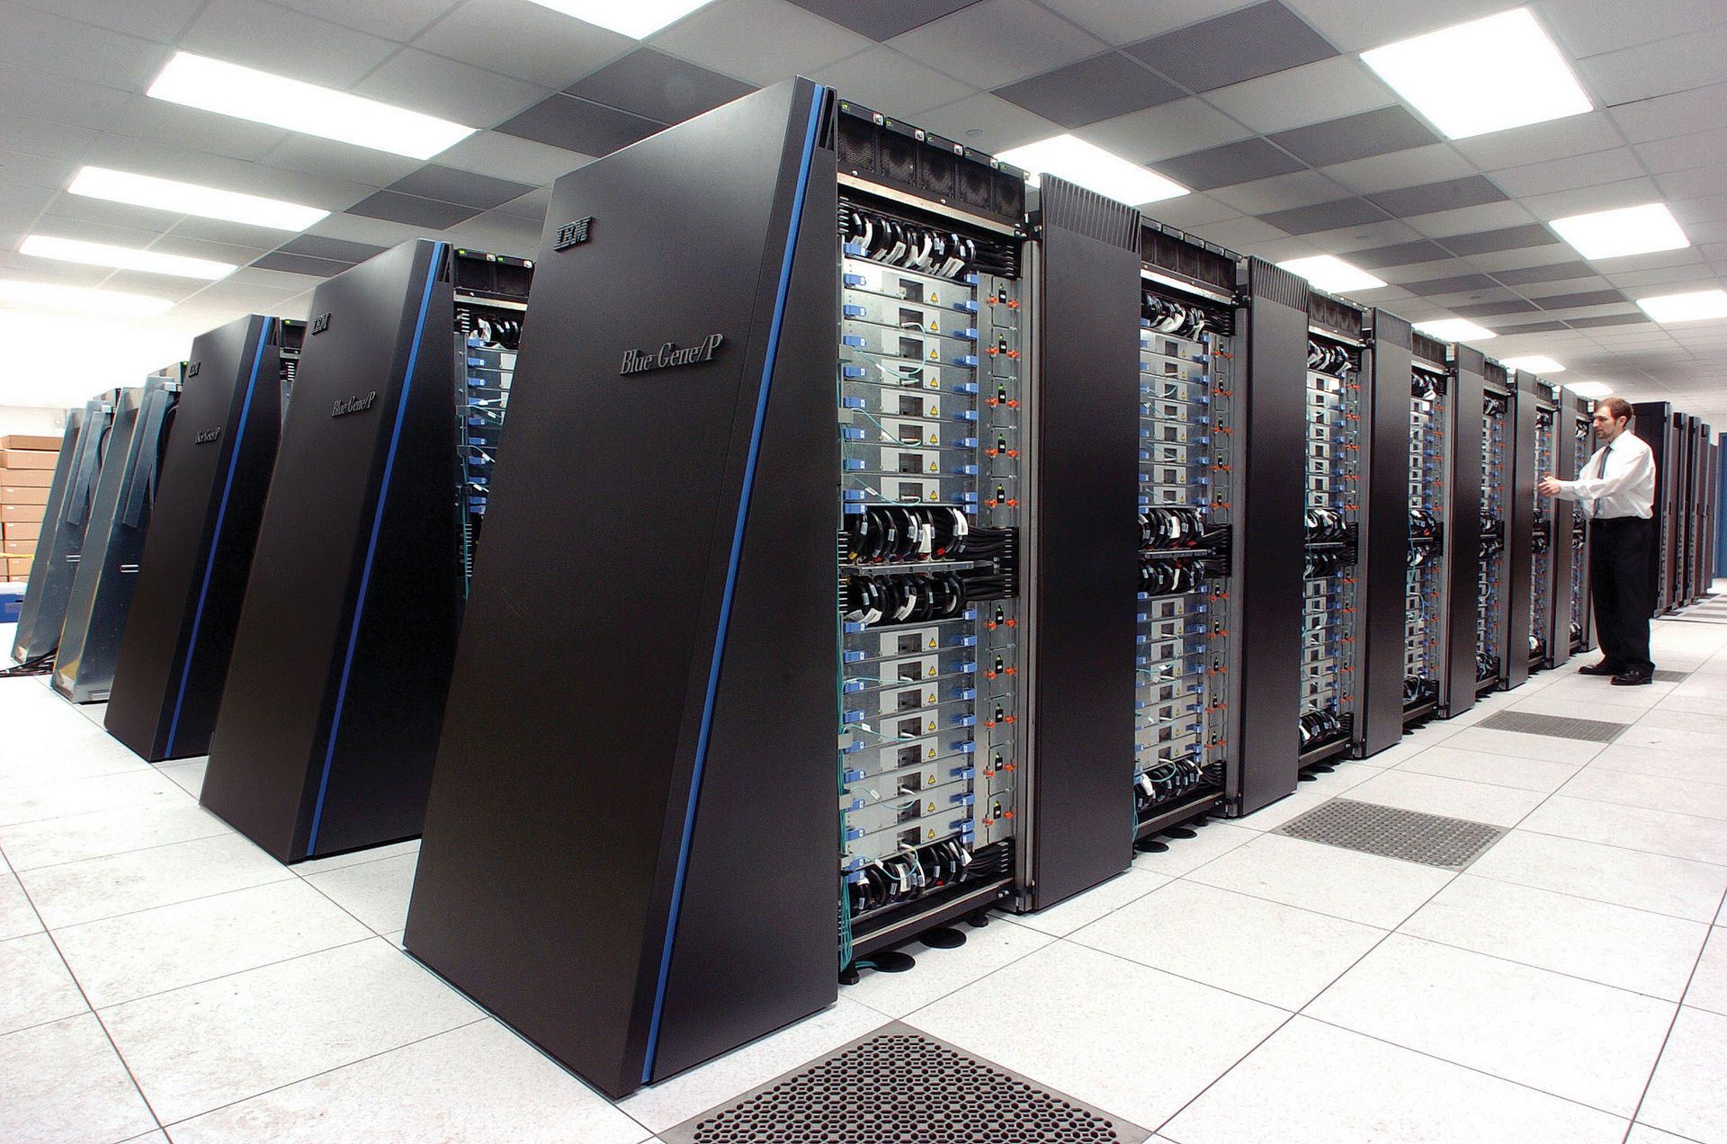
CPEN 211: Introduction to Microcomputers Slide Set 16: Fixed vs. Floating-Point
Instructor: Prof. Tor Aamodt
By Argonne National Laboratory's Flickr page - originally posted to Flickr as Blue Gene / P
From Argonne National LaboratoryUploaded using F2ComButton, CC BY-SA 2.0, https://commons.wikimedia.org/w/index.php?curid=6412306
Notes:
1

Slide 2
Learning Objectives
After this slide set you should be able to:
Explain how floating-point differs from fixed-point
Encode numbers in 32- and 64-bit IEEE floating-point.
Use floating-point with the DE1-SoC
Define error, resolution and accuracy and evaluate them for floating-point and fixed-point representations

Slide 3
Dealing with Fractional Values
Not all numbers in the real world are integers:
Two ways to deal with this:
1. Fixed point Representation
2. Floating point Representation
Fixed point leads to smaller hardware but floating point can
represent a larger range.
In the following, we will quickly look at each of these approaches
Text: Dally §11

Slide 4
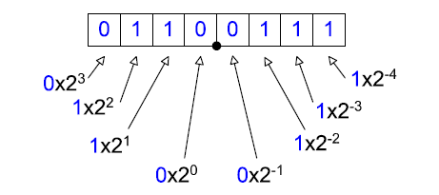
Fixed Point Representation
Some bits of the word represent digits before the decimal point, and
some bits represent digits after the decimal point.
This number represents 6.4375
The location of the decimal point determines: range vs. precision
Text: Dally §11.2.1

Slide 5
Fixed Point Representation
Shorthand: p.f format means p integer bits and f fraction bits: $v=2^{p}\sum_{i=0}^{n−1}{a_{i}2^{i−n}}$
sp.f for signed (1+p+f bits)
E.g., 4.4 format:
Text: Dally §11.2.1

Slide 6
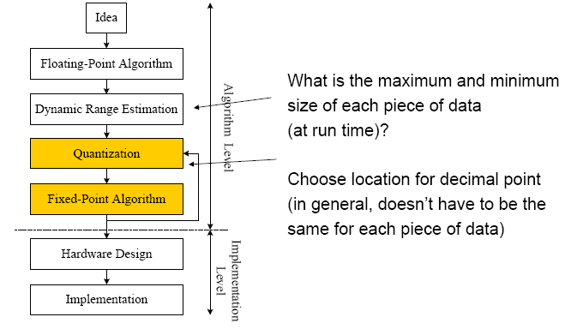
Range Estimation and Quantization

Slide 7
Arithmetic with Fixed Point Numbers:
c
c
(lose
Text: Dally §11.2.2

Slide 8
Error
Resolution
Accuracy
Text: Dally §11.1

Slide 9
Absolute and Relative Error
It is not possible to exactly represent all real numbers in a finite number of bits (or digits)… pi, sqrt(2), 1/3.
Define representation function R(x) as binary number used to represent real number x.
Define value function V(b) as value of binary number b
Absolute error: e_{a}= |V(R(x)) - x|
Relative error: e_{r} = |(V(R(x)) - x)/x|
NOTE: Typically try to choose R(x) as the binary representation that minimizes the absolute error.
Text: Dally §11.1

Slide 10
Example
Determine absolute and relative error of 6.4 represented in 4.4 fixed-point format assuming rounding to nearest.
R(x) = 01100110
V(R(x)) = 6.375
Absolute error = |6.375-6.4| = 0.025
Relative error = |(6.375-6.4)/6.4| = 0.4%
NOTE: V(01100111) = 6.4375 (absolute error = 0.0375)
0
0
Text: Dally §11.2.1

Slide 11
Resolution
The resolution is the smallest difference that can be represented in a number system
Example:
Resolution:
1x2⁻⁴ = 0.0625
Text: Dally §11.1, §11.2.1

Slide 12
Accuracy
Accuracy is maximum error over input range
Absolution accuracy: maximum absolute error
a_{a}= max |V(R(x)) - x|
Relative accuracy: maximum relative error
a_{r} = max |(V(R(x)) - x)/x|
x
x
Text: Dally §11.1

Slide 13
Floating-Point
To represent numbers with constant relative error over a very large range you learned scientific notation: E.g. 6.022 ×10²³
To represent numbers we can use a binary version of scientific notation called floating-point:
$$v=m×2^{e−x}$$
m is called the mantissa
e is called the exponent
x is called the bias
With a-bits of mantissa and b-bits of exponent say we have “aEb” floating-point representation
Text: Dally §11.3

Slide 14
Example
Suppose you need to represent temperatures from 0 to 100C with error less than 0.1C
What representation would you use?
What is the resolution of this representation?
What is its maximum absolute error?
126
127
Text: Dally §11.1

Slide 15
What about Floating-Point?
Suppose you need to represent temperatures from 0 to 100C with error less than 0.1C
Relative error must be less than 0.1C/100C, which is 0.1%, hence need 10-bits mantissa
Exponent:
Smallest number to represent: 1 x 2⁻⁴ (0.0625 C)
Largest number to represent: 1 x 2⁷ (127 C)
Range is 7 to -4; this range includes 7-(-4)+1 = 12 distinct exponent values; can encode with 4-bits, so 4-bits for exponent
Format would be 10E4 with bias of -4 (14-bits)

Slide 16
Example
Suppose you need to represent distances from 1mm to 1m with an accuracy of 0.1%
How many bits are required to do this with a binary fixed-point number?
0 | 0 | 0 | 0 |  | 0 | 0 | 1
1 x 2⁻¹
1 x 2⁻¹⁹
Resolution: 1x2⁻¹⁹ = 0.00191 mm
Error (round to nearest): 1x2⁻²⁰= 0.00095 mm
Text: Dally §11.1

Slide 17
Example
Suppose you need to represent distances from 1mm to 1m with an accuracy of 0.1%
How many bits are needed with binary floating point?
What floating-point representation is needed?
Text: Dally §11.1

Slide 18
Example
Suppose you need to represent distances from 1mm to 1m with an accuracy of 0.1%. How many bits are needed with binary floating point? What is FP representation?
Mantissa needs 10 bits to get 0.1% accuracy (2⁻¹⁰ = 0.00098)
Exponent:
Smallest number to represent: 1 x 2⁻¹⁰ (0.9765 mm)
Largest number to represent: 1 x 2⁰ (1 m)
Range is 0 to -10, so need 4-bits for exponent.
Representation: 10E4 (no sign bit)
Text: Dally §11.1

Slide 19
Fixed-Point vs. 6.4 FP Error
V(R(x)) = 0.9296875 x 2⁽¹⁴⁻⁵⁾ = 476
477
48
V(R(x)) = 0.765625 x 2⁽¹⁻⁵⁾ = 0.0478515625
Text: Dally §11.1

Slide 20
Text: Dally §11.1

Slide 21
Text: Dally §11.1

Slide 22
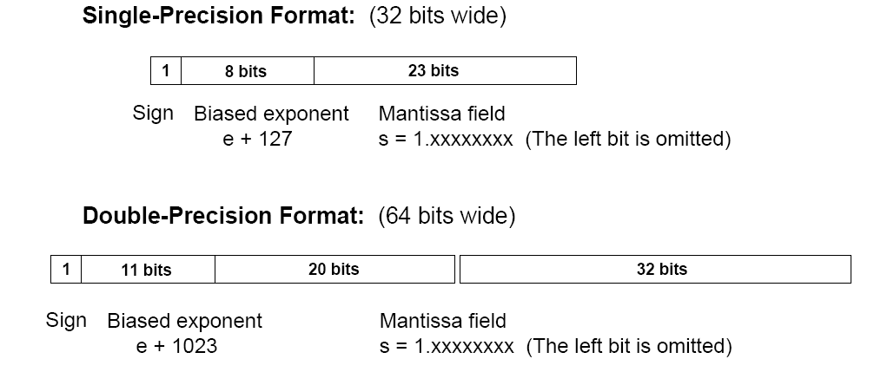
IEEE Floating-Point Format
C type: “float”
C type: “double”
Text: COD4e §3.5

Slide 23
Floating-point in C
32-bit IEEE type: “float”
E.g., “float a;” declares “a” to be of type float which means “a” is 32-bits (4 bytes).
64-bit IEEE type: “double”
E.g., “double b;” declares “b” to be of type double which means “b” is 64-bits (8 bytes).
Can use normal arithmetic operators: +, -, /, *.

Slide 24
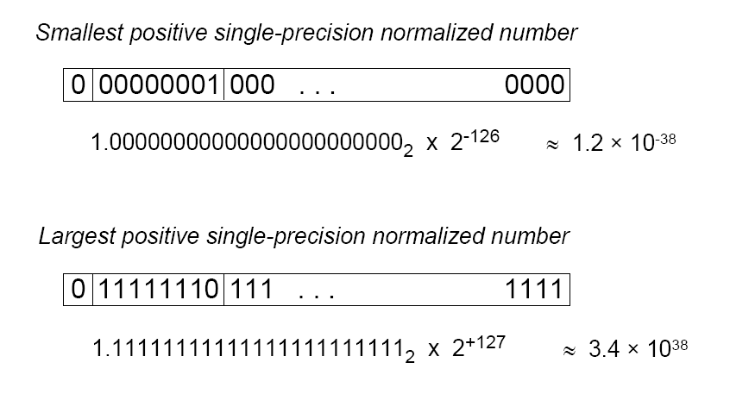
Text: COD4e §3.5

Slide 25
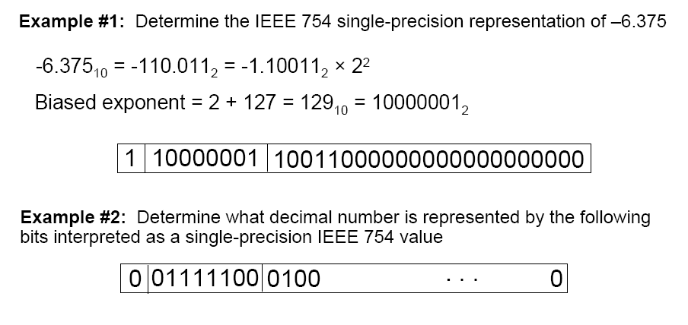
Text: COD4e §3.5

Slide 26
Other Floating-point formats
GPUs support 16-bit floating-point
[image source: https://en.wikichip.org/wiki/brain_floating-point_format]
Text: COD4e §3.5

Slide 27
Other Floating-point formats
Becoming popular to explore shorter floating-point formats -- especially for machine learning (also used in graphics).
bfloat16:
[image source: https://en.wikichip.org/wiki/brain_floating-point_format]
msfp8:
[image source: https://en.wikichip.org/wiki/microsoft/msfp8 ]

Slide 28
Algorithm for Floating Point Addition
Step 1: Normalize so each operand has the same exponent.
Step 2: Perform the operation
Step 3: Denormalize: shift so that you have a leading 1 at the front of your mantissa
Text: Dally §11.3.4; COD4e §3.5

Slide 29
We can implement floating-point either in hardware OR software. ARM provides a “coprocessor” extension for supporting floating-point in hardware on Cortex-A9.
Floating point hardware is larger than fixed point hardware
Double-precision is bigger than single-precision

Slide 30
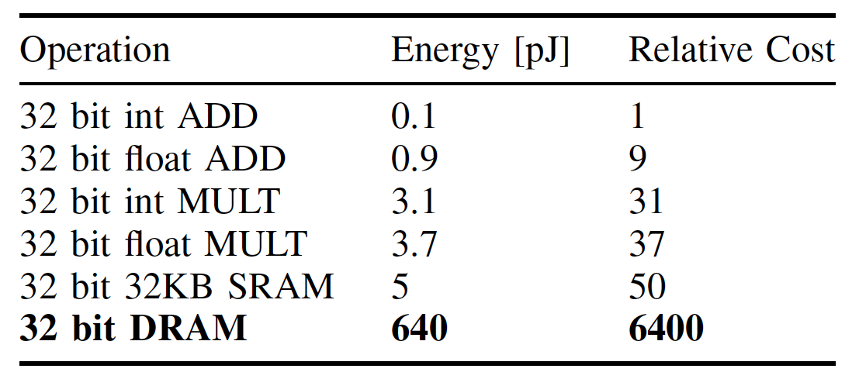
Energy Cost per Operation [45nm]
Source: Table 1 from Han et al., EIE: efficient inference engine on compressed deep neural network, ISCA 2016.

Slide 31
Special IEEE 754 Numbers
Zero:
All zeros in the exponent and matissa
Ignore sign bit
Positive Infinity
0 in sign bit, all 1’s in exponent, all 0’s in mantissa
Results when you divide a positive number by 0
Negative Infinity
- Similar to above, but 1 in sign bit
Not-a-Number (NaN)
- All 1’s in exponent, non-zero in mantissa
- For example, square root of 0
Subnormal (Denormal)
- Numbers between the smallest normalized number and 0
Note: To be strictly IEEE Standard, your arithmetic would have to implement all of this. For many applications, this is not required.
Text: Dally §11.3.2

Slide 32
Floating-Point in ARM
Floating-point operations performed by a “coprocessor” extension on some ARM processors.
ARM provides support for 100’s of coprocessor instructions through five generic coprocessor instructions: CDP, LDC, MCR, MRC, and STC (see Appendix B1)
CDP - Coprocessor data processing operation
CDP<cond> <copro>, <op1>, Cd, Cn, Cm, <op2>
LDC - Load to coprocessor
MCR - Move to coprocessor from an ARM register
MRC - Move to ARM register from a coprocessor
STC - Store from coprocessor
Text: COD4e §3.5 (pp. 247-253)

Slide 33
Floating-Point Registers
In addition to R0 – R15 the FP coprocessor provides additional registers for holding floating-point values
S0-S31 are 32-bit registers used to hold 32-bit floating-point values on ARM Processors supporting coprocessor 10 and 11 (single and double precession floating-point)
S2i-S2i+1 can be referenced as 64-bit register Di (e.g., D1 is S2 and S3 read or written together).
Text: COD4e §3.5 (pp. 247-253)

Slide 34
Floating-Point Instructions
Load: FLDS (32-bit FP load)
FLDD (64-bit FP load)
Store: FSTS (32-bit FP store)
32-bit FP Addition: FADDS 64-bit FP Addition: FADDD
32-bit FP Subtraction: FSUBS
32-bit FP Multiply: FMULS
32-bit FP Divide: FDIVS
NOTE: On DE1-SoC using Altera Monitor Program you need to encode these instructions manually (the compiler will not recognize them). You will see details of how to do this in Lab 11.
Text: COD4e §3.5 (pp. 247-253)

Slide 35
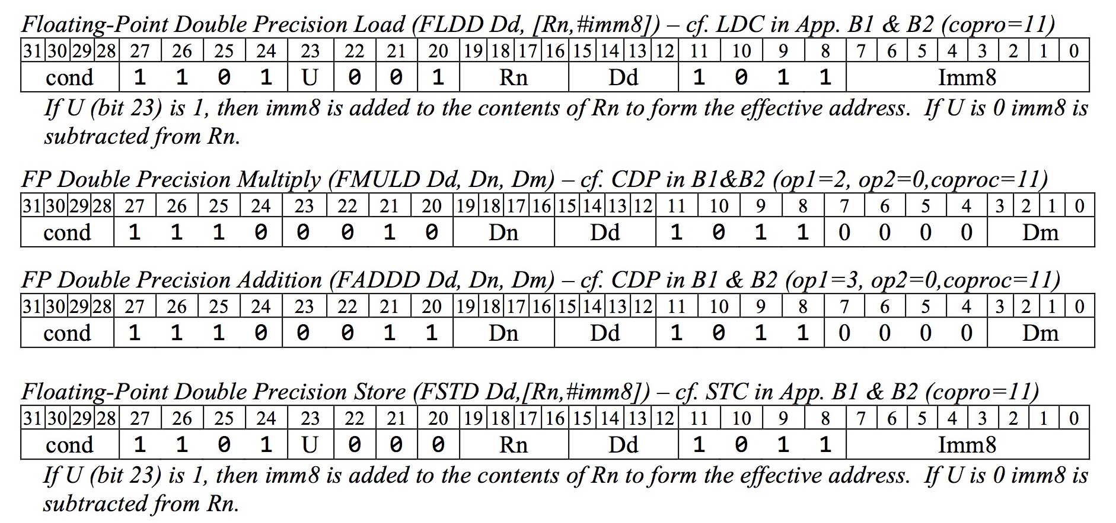
Encoding Floating-Point Instructions
Text: COD4e §Appendix B2

Slide 36
Using Floating-Point with DE1-SoC
Encode the instruction “FLDD D0, [R8]”
14₁₀, 1101, 1001, Rn, Dd, 1011, 0000, 0000
.word 0xED980B00

Slide 37
Using Floating-Point with DE1-SoC
To execute this code on your DE1-SoC:
CMP R0,R1
BNE label
FLDD D0, [R8]
label: ADD R2,R3,R4
You instead you need to write:
CMP R0,R1
BNE label
.word 0xED980B00
label: ADD R2,R3,R4

Slide 38
How to see FP results on DE1-SoC?
CPEN 211 used to have a Lab 11 where students would use floating-point on their DE1-SoC. If you want to try out some floating-point programming on your DE1-SoC:
Altera Monitor Program only shows R0-R15, CPSR. It does not show S0-S31.
You could use “MRC - Move to ARM register from a coprocessor” instructions (see encoding in Appendix B2)
Alternative use FLSD to write FP value to memory and look in memory tab of Monitor Program.
You need to understand floating point representation to interpret values -- Monitor Program does not understand IEEE floating-point!
ARM Development Studio enables access to S0-S31.

Slide 39
Summary
Fixed and floating point representations
Using floating-point with ARM.
Accuracy and resolution.

