Slide 1
Slide Set 17: Hardware interfaces

Slide 2
Learning Objectives
After finishing this set of slides you should be able to:
  Describe need for flow control when connecting hardware blocks.
  Describe how ready/valid flow control works
  Describe how to tolerate latency without losing throughput using credit-based interfaces

Slide 3
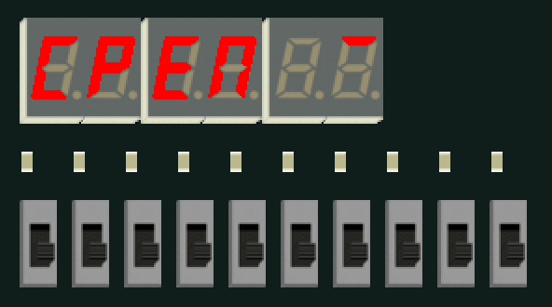
HEX0…HEX5
Q. when is it safe
to interact?
LEDR
SW
we can always receive something — outputs are always valid
we can always send something — inputs are always ready
simplest kind of module interface

Slide 4
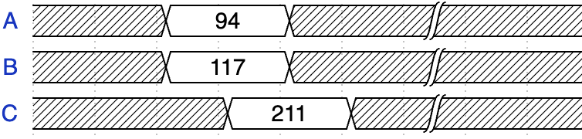
Hardware blocks that process data
request
A
B
+
response
C
t_{prop}
interface timing
Q. how can we reuse this module?

Slide 5
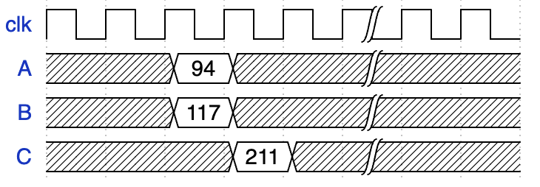
What about sequential modules?
A
B
+
request on
posedge clk
read response at
next clock edge
C
1 clock cycle
timing specified in terms of clock cycle delays

Slide 6
What do hardware interfaces need to specify?
request format and semantics (like software interfaces)
but also:
when is it safe to make a request?
  like a permission to write to the module
when is it safe to read a response?
  like a permission to read from the module
(possibly) which response corresponds to which request?

Slide 7
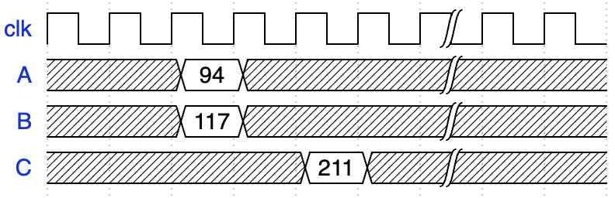
Interfaces with fixed delays
A
B
+
2-clock-cycle delay
C
timing specified in terms of clock cycle delays

Slide 8
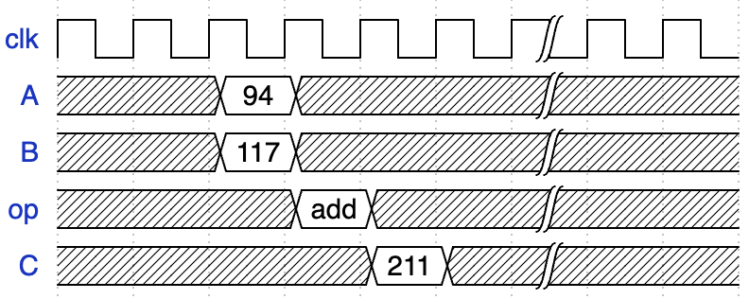
Interfaces with fixed delays: more complexity
A
B
ALU
op
C
different timing for different inputs…
Q. how easy is this to specify and verify?
Q. how easy is it to change the implementation?

Slide 9
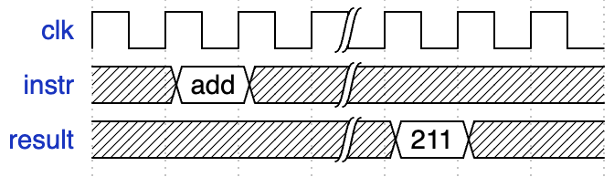
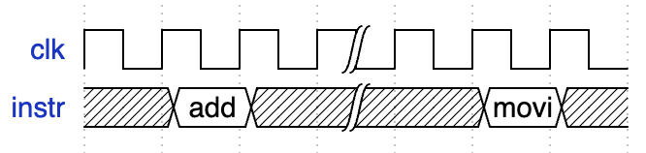
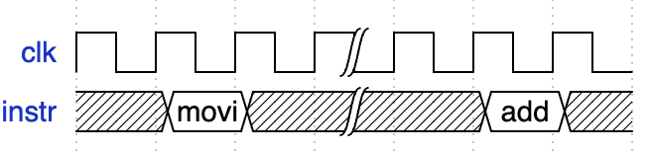
Interfaces with fixed delays
instr
lab 6 cpu
out
Q. when can we read the output?
Q. when can we issue the next instruction?

Slide 10
Variable timing issues
operations may take different amounts of time
  e.g., move-immediate vs add in lab 6
  variable operation delays common in real processors
easy fixed-delay solution: wait for longest possible delay
  likely significant reduction in throughput
hard fixed-delay solution: know specific delay for every operation
  hard to program: programmer has to precisely schedule ops
  hard to verify hardware: higher risk of mistakes in design / testcases
  might be impossible (e.g., loads from a memory with caches)
we need some kind of timing abstraction

Slide 11
instr
rst_n
start
waiting
load
results
Q. how is this problem solved in lab 6?

Slide 12
Flow control protocols
encode permissions as actual signals (module ports)
must check some signal before making a request to a module
must check some signal before reading from a module

Slide 13
response is ready
can accept next request
request to start computation
instr
rst_n
start
waiting
load
results
this is a simple flow control interface

Slide 14
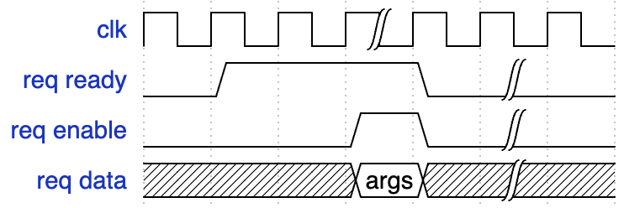
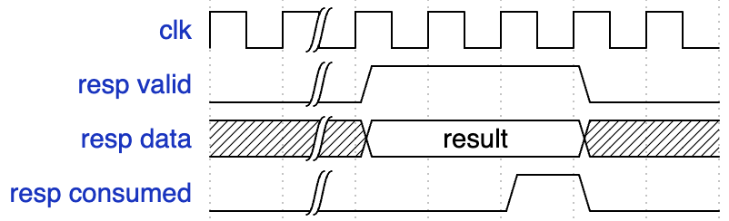
Ready-Valid Flow Control
ready
enable
data
interface rules
enable only if ready
req data with enable
read resp data only if valid
signal consumed once read
hardware module
with flow control
valid
data
consumed
request timing
response timing
[Dally 22.1.3]

Slide 15
Example: FIFO
specification
two operations: enq and deq
data leaves in arrival order
data does not get lost
just two flow-controlled interfaces!
  can_enq + enq = ready / enable
  can_deq + deq = valid / consumed
can_enq
enq
data
can_deq
data
deq
flexible: interface permits different FIFO depths

Slide 16
Connecting interfaces with flow control
can_enq
can_deq
can_enq
can_deq
data
data
data
data
enq
deq
enq
deq
interfaces with flow control are composable

Slide 17
Tolerating latency
data
+ en
Q. how do we know it’s safe to send?
Q. how can we get a ready signal across?

Slide 18
Tolerating latency
data
+ en
ready
Q. what is the throughput of this?
Q. how can we get better throughput?

Slide 19
Idea: credit-based interfaces
sender keeps track of the number of credits it has
  initialize to 0
  when credits ≥ 1
    send request
    decrement # credits
consumer hands out credits
  initially
    send as many credit grants to sender as we have buffer space
  when a request is processed
    send credit grant to sender

Slide 20
Tolerating latency
data
+ en
grant
credit-based interfaces tolerate arbitrary latency

Slide 21
Summary
fixed-latency interfaces
flow-control interfaces
composability
tolerating latency

