Slide 1
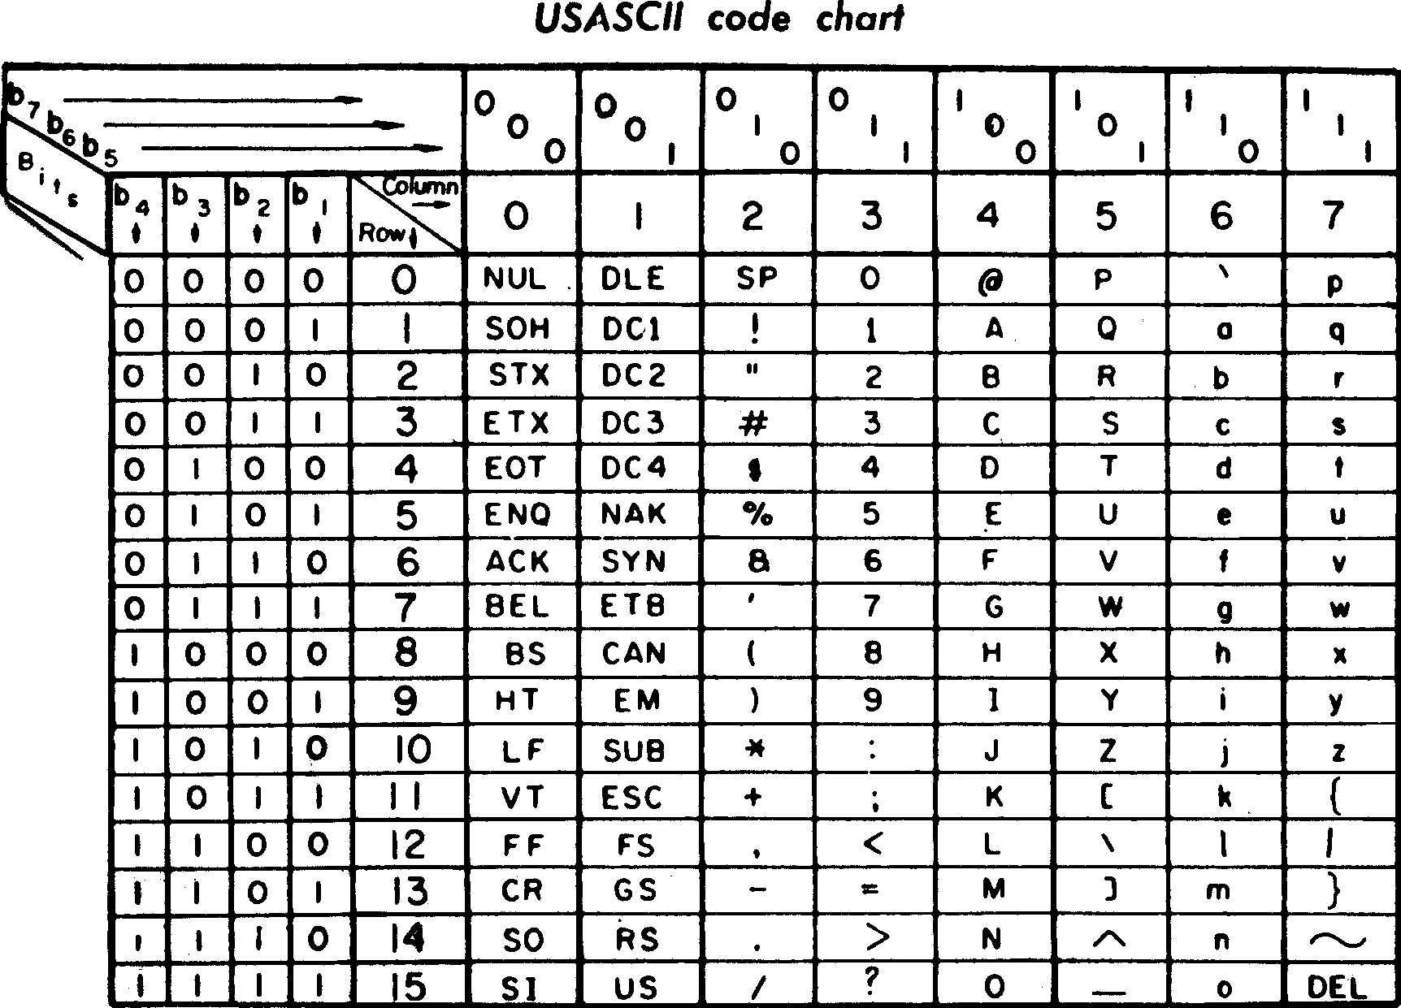
CPEN 211: Introduction to Microcomputers Slide Set 18: ASCII, Pointers, Structs, 2D Arrays
Instructor: Prof. Tor Aamodt
Background: By an unknown officer or employee of the United States Government - http://archive.computerhistory.org/resources/text/GE/GE.TermiNet300.1971.102646207.pdf (document not in link given), Public Domain, https://commons.wikimedia.org/w/index.php?curid=63485656
Notes:
1

Slide 2
Learning Objectives
After this slide set you should be able to:
Write code that uses strings of human readable characters (and/or emoji’s)
Explain a simple performance optimization you can make by changing assembly code
Write ARM code for programs that uses pointers and/or structs.

Slide 3
Communicating with People
How are letters and numbers that you write on your computer represented?
Two common representations: ASCII and UNICODE.
Oldest is “ASCII”: American Standard Code for Information Interchange
8-bits per ASCII character
UNICODE more recent (16-bits per character)
Text: COD4e §2.9

Slide 4
Printable ASCII Codes
Hex | ASCII | Hex | ASCII | Hex | ASCII | Hex | ASCII | Hex | ASCII | Hex | ASCII
20 | (space) | 30 | 0 | 40 | @ | 50 | P | 60 | ` | 70 | p
21 | ! | 31 | 1 | 41 | A | 51 | Q | 61 | a | 71 | q
22 | " | 32 | 2 | 42 | B | 52 | R | 62 | b | 72 | r
23 | # | 33 | 3 | 43 | C | 53 | S | 63 | c | 73 | s
24 | $ | 34 | 4 | 44 | D | 54 | T | 64 | d | 74 | t
25 | % | 35 | 5 | 45 | E | 55 | U | 65 | e | 75 | u
26 | & | 36 | 6 | 46 | F | 56 | V | 66 | f | 76 | v
27 | ' | 37 | 7 | 47 | G | 57 | W | 67 | g | 77 | w
28 | ( | 38 | 8 | 48 | H | 58 | X | 68 | h | 78 | x
29 | ) | 39 | 9 | 49 | I | 59 | Y | 69 | i | 79 | y
2A | * | 3A | : | 4A | J | 5A | Z | 6A | j | 7A | z
2B | + | 3B | ; | 4B | K | 5B | [ | 6B | k | 7B | {
2C | , | 3C | < | 4C | L | 5C | \ | 6C | l | 7C | |
2D | - | 3D | = | 4D | M | 5D | ] | 6D | m | 7D | }
2E | . | 3E | > | 4E | N | 5E | ^ | 6E | n | 7E | ~
2F | / | 3F | ? | 4F | O | 5F | _ | 6F | o | 7F
Text: COD4e §2.9

Slide 5
UNICODE
UNICODE was introduced in 1991, but it is an evolving standard.
UNICODE includes characters for other languages such as Chinese, Japanese and Korean.
16-bits means UNICODE has 65536 encodings, but there is also a 32-bit variant of UNICODE (UTF-32)

Slide 6
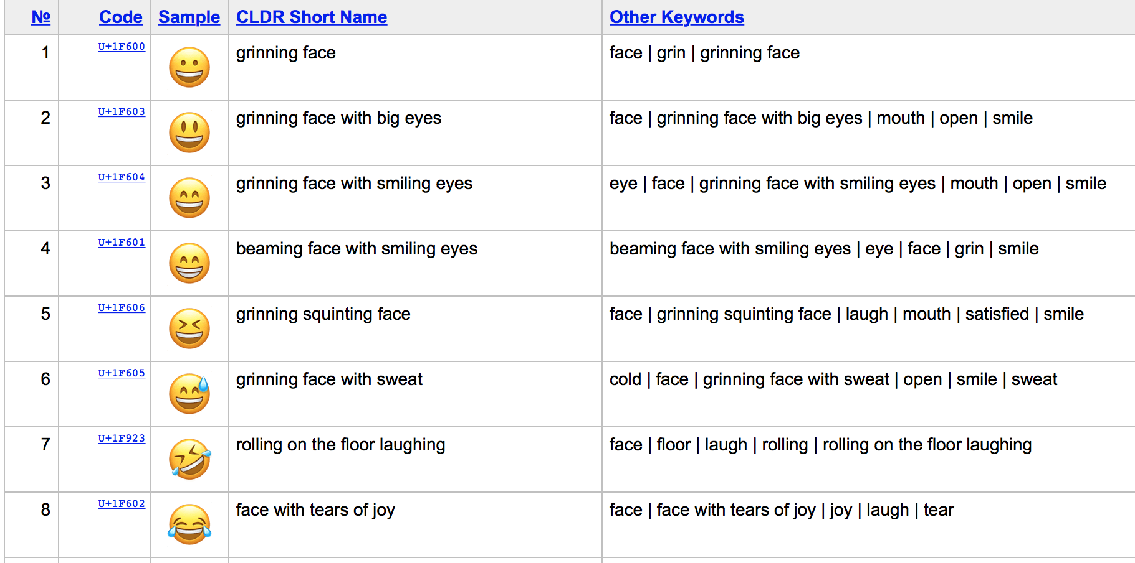
Sample of Emoji in UTF-16
[ https://unicode.org/emoji/charts/emoji-list.html ]

Slide 7
Copying a Character
We can move a single byte using LDR and STR but need to use bitwise logical operations.
Suppose R0 is 100, and ASCII string starting at MEM[100] is “Hello World!”
LDR R1,[R0,#0] // R1 = 6C6C6548
MOV R2,#255 // R2 = 000000FF
AND R1,R1,R2 // R1 = 00000048
‘l’
‘l’
‘e’
‘H’
11111111
Text: COD4e §2.9

Slide 8
Copying a Character
While we can using logical operations and LDR, working with ASCII characters is so common ARM has special load and store instructions for reading and writing a single byte.
Suppose R0 is 100, R10 is 200 and ASCII string starting at MEM[100] is “Hello World!”
LDRB R1,[R0,#0] // R1 = 00000048
STRB R1,[R10,#0] // MEM[200] = 48
Zero extend upper 24-bits
Text: COD4e §2.9

Slide 9
Signed Load
If read an 8-bit value from memory which represents a 2’s complement number we should sign extend the upper 24 bits.
Suppose R0 is 100, and the byte value at MEM[100] is 0x80
LDRSB R1,[R0] // R1 = 0xFFFFFF80
Sign extend upper 24-bits
Text: COD4e §2.9

Slide 10
Arrays versus Pointers
Example: Write ARM assembly for the for loop in the following C code. Do not show instructions for saving and restoring registers on the stack. Assume R0 holds the base address of “array” and R1 holds size.
clear1(int array[], int size)
{
int i;
for (i = 0; i < size; i += 1)
array[i] = 0;
}
Text: COD4e §2.14

Slide 11
Array Version
We will use R2 for i. First, we need to initialize i to zero:
MOV R2,#0 // i = 0
We will use R3 to hold the value 0 we will write to memory (R2 will change each iteration):
MOV R3,#0 // zero = 0
Text: COD4e §2.14

Slide 12
Array Version
Use scaled register offset addressing mode to multiply i by 4 to get the byte address and then add it to the index to get the address of array[i]:
loop1: STR R3, [R0,R2, LSL #2] // array[i] = 0
R0 + (R2 << 2)
Text: COD4e §2.14

Slide 13
Array Version
Increment loop counter:
ADD R2,R2,#1 // i = i + 1
Test if i < size:
CMP R2,R1 // i < size
BLT loop1 // if (i < size) go to loop1
Text: COD4e §2.14

Slide 14
Clearing Using Array indicies
R0 holds array, R1 holds size:
MOV R2,#0 // i = 0
MOV R3,#0 // zero = 0
loop1: STR R3, [R0,R2, LSL #2] // array[i] = 0
ADD R2,R2,#1 // i = i + 1
CMP R2,R1 // i < size
BLT loop1 // if (i < size) go to loop1
Text: COD4e §2.14

Slide 15
Pointers TL;DR
A pointer is a variable containing a memory address. It is like the base register in load/store instruction. That’s it. C/C++ introduce syntax to expose to SW.
<type name> * <pointer name>; // declare <pointer name> to be of type pointer to <type name>
&<variable name> // returns address of <variable name>
*<pointer name> = <value> // dereference <pointer name> : write to memory
<variable name> = *<pointer name> // dereference <pointer name> : read memory
<pointer name> -> <field name> // dereference field inside of struct/class
Adding an integer N to a pointer of type pointer to <type name> changes value by N * sizeof(type name)
Text: COD4e §2.14

Slide 16
Arrays versus Pointers
Example: Write ARM assembly for the for loop in the following C code. Do not show instructions for saving and restoring registers on the stack. Assume R0 holds the base address of “array” and R1 holds size.
clear2(int *array, int size)
{
int *p;
for (p = &array[0]; p < &array[size]; p = p + 1)
*p = 0;
}
Text: COD4e §2.14

Slide 17
Pointer Version
We will use R2 to hold p and R3 to hold zero
MOV R2,R0 // p = address of array[0]
MOV R3,#0 // zero = 0
Text: COD4e §2.14

Slide 18
Post-indexed addressing
STR R3,[R2],#4 // Memory[R2] = R3; R2 = R2 + 4
STR R3,[R2] // Memory[R2] = R3
ADD R2,R2,#4 // R2 = R2 + 4
Specifies addressing mode is “post-indexed”.
The above is equivalent to:
Text: COD4e §2.14

Slide 19
Pointer Version
To write zero to memory use a store instruction. We can use ARM’s immediate post-indexed addressing mode to increment p.
loop2: STR R3,[R2],#4 // Memory[p] = 0; p = p + 4
Specifies addressing mode is “post-indexed”
Text: COD4e §2.14

Slide 20
We will use R4 to hold end address of array. We compute it using “array + (size<<2)”:
ADD R4,R0,R1,LSL #2 // R4 = address of array[size]
Then, loop test simply checks if p < end of array:
CMP R2,R4 // p < &array[size]
BLT loop2 // if (p<&array[size]) go to loop2
Text: COD4e §2.14

Slide 21
Clearing Array using Pointers
Putting it all together:
MOV R2,R0 // p = address of array[0]
MOV R3,#0 // zero = 0
loop2: STR R3,[R2],#4 // Memory[p] = 0; p = p + 4
ADD R4,R0,R1,LSL #2 // R4 = address of array[size]
CMP R2,R4 // p < &array[size]
BLT loop2 // if (p<&array[size]) go to loop2
Text: COD4e §2.14

Slide 22
Optimization
R4 (end of array) same each iteration means ADD can move outside of loop to make code faster (compiler can do this: “gcc -O2”):
MOV R2,R0 // p = address of array[0]
MOV R3,#0 // zero = 0
ADD R4,R0,R1,LSL #2 // R4 = address of array[size]
loop2: STR R3,[R2],#4 // Memory[p] = 0; p = p + 4
CMP R2,R4 // p < &array[size]
BLT loop2 // if (p<&array[size]) go to loop2
Text: COD4e §2.14

Slide 23
The Heap
Most real programs create large data structures such as linked lists, trees, etc… and they do this “dynamically” meaning the size varies while the program runs.
These data structures placed in memory in a special region called the “heap”.
Like the stack the heap can grow.
Text: COD4e §2.8

Slide 24
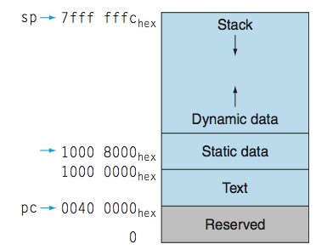
The Heap
Stack grows down
Heap grows up
C allocates data from heap using “malloc()” and returns space using “free()”.
Heap
Text: COD4e §2.8

Slide 25
C Structures and Linked Lists
A common data structure for holding variable amounts of data is a “linked list”. For example, consider the C “struct” below.
struct Node {
int value;
struct Node *pNext;
};
The above C code declares a new type “Node” that contains one field named “value” of type “int” and another field “pNext” of type pointer to “struct Node”.
4 bytes
4 bytes

Slide 26
Example Program
Returns address of memory allocated in heap
struct Node *head = malloc(sizeof(struct Node));
struct Node *tail = malloc(sizeof(struct Node));
head->value = 10;
head->pNext = tail;
tail->value = 20;
tail->pNext = NULL;
8
0x70000000
0x70008C00
head
10
0x70008C00
20
0x0

Slide 27
Write corresponding ARM assembly following two lines assume “head” is in R3, R4 contains 10 and R5 contains “tail”.
head->value = 10;
head->pNext = tail;
Answer:
STR R4,[R3,#0]
STR R5,[R3,#4]

Slide 28
Two Dimensional (2D) Arrays
How to write assembly code for following?
#define N 3
float Array[N][N] = {{1,0,0},{0,1,0},{0,0,1}};
float sum=0.0;
for(int i=0; i<N; i++)
for(int j=0;j<N;j++)
sum += Array[i][j];

Slide 29
2D to linear address mapping
“Array[i][j]” is a function. Inputs “i”, “j”; Output data value in Array for those inputs.
Challenge: Memory is a one-dimensional (linear) map from address to data
Need to convert “i”, “j” to address.
Two approaches: Row or Column Major.
Addr_{Row Major} = base + (i*size(row) + j)*size(elem)
Addr_{Col Major} = base + (j*size(col) + i)*size(elem)
C language specifies row major for 2D arrays.

Slide 30
Loading 2D Array in Memory
0.0 in IEEE single precision is 0x00000000
1.0 in IEEE single precision is 0 01111111 0000…000 = 0x3f800000
Array: .word 0x3f800000
.word 0
.word 0
.word 0
.word 0x3f800000
.word 0
.word 0
.word 0
.word 0x3f800000
Zero: .word 0
First row of matrix Array is 1,0,0
Second row of matrix Array is 0,1,0
Third row of matrix Array is 0,0,1
We’ll use this for “sum = 0.0;”

Slide 31
ARMv7 Assembly Code
LDR R0,=Zero
FLDS S0,[R0] // S0 = 0.0
MOV R0, #0 // R0 is i
MOV R2, #3 // R2 is N
LDR R3,=Array // R3 is base of Array
L1: MOV R1, #0 // R1 is j
L2: MUL R4, R0, R2 // R4 = (i * size(row))
ADD R4, R4, R1 // R4 = (i * size(row)) + j
MOV R4, R4, LSL#2 // R4 = ((i * size(row)) + j)*size(elem)
ADD R4, R4, R3 // R4 = base + ((i * size(row)) + j)*size(elem)
FLDS S1, [R4] // S1 = Array[i][j]
FADDS S0, S0, S1 // sum += Array[i][j]
ADD R1, R1, #1 // j++
CMP R1, R2
BLT L2 // while (j<N)
ADD R0, R0, #1 // i++
CMP R0, R2
BLT L1 // while (i<N)
We can convert “for” to “do…while” since we can infer j<N is true first “iteration” of loop since we know j starts at 0 and we also know N is greater than 0.

Slide 32
Summary
Learned about character encodings.
Learned a little about performance optimization.
Saw how “pointers” actually work, both with arrays and with structs.
Saw how 2D arrays work at the assembly level.

