Slide 1
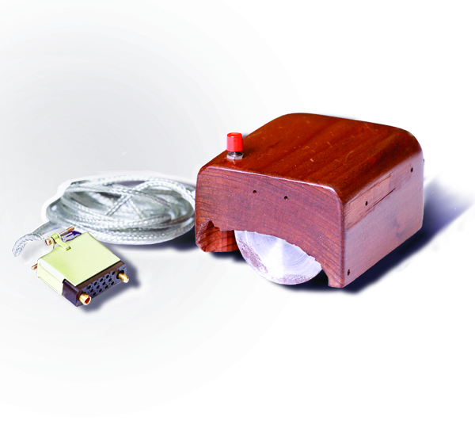
CPEN 211: Introduction to Microcomputers
Slide Set 10: I/O, Exceptions and Interrupts
Prof. Tor Aamodt
[Background: The first computer mouse,
By SRI International - SRI International,
CC BY-SA 3.0, https://commons.wikimedia.org/w/index.php?curid=17294412]
Notes:
1

Slide 2
Internet of Things
[Slide from Keysight Technologies Canada, Inc]

Slide 3
Internet of Things
[Slide from Keysight Technologies Canada, Inc]

Slide 4
Learning Objectives
After this slide set you should be able to:
Describe and implement polling in ARM
Explain what an exception is
Add hardware support for interrupts to the Simple RISC Machine
Write a software interrupt service routine in ARM assembly for your DE1-SoC
Write software that implements multitasking using an interrupt service routine.

Slide 5
Reading?
No coverage in either assigned textbook; some coverage in: Hamacher, Vranesic, Zaky, Computer Organization, McGraw-Hill
“Using the ARM Generic Interrupt Controller” (Altera) available on Piazza (see Lab 10)
Take good notes in lecture.

Slide 6
Connecting I/O to the Computer
Recall from Lab 7: I/O devices connected to processor using memory bus.
Access device using regular memory (LDR/STR) instructions.
Some processor use special instructions (x86 uses “in”/”out”).
[Hamacher, Vranesic, Zaky §4.1]

Slide 7
Memory Mapped Registers
How to interact with I/O device using LDR/STR? Memory mapped registers.
These are registers inside the I/O device.
Each register associated with an address that is outside range of normal memory addresses.
How does this work at hardware/software level?

Slide 8
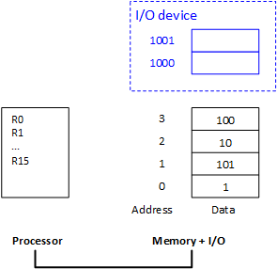
Memory Mapped Registers: Software
STR
LDR
Notes:
This figure shows an abstracted view of main memory in a computer. The main memory is on the right and is connected to the processor on the left…
… using a bus…

Slide 9
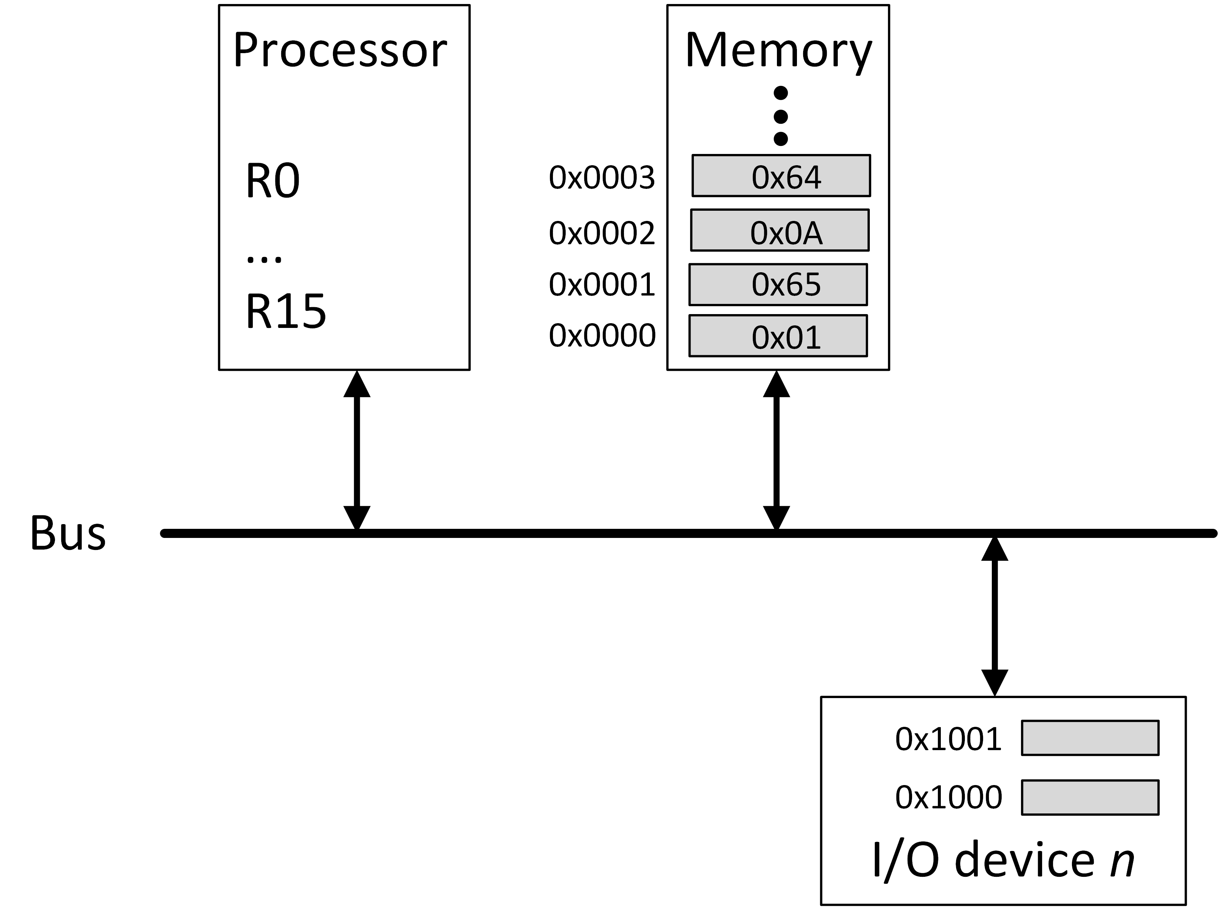
Connecting I/O to the Computer
LDR R0, [R4]
STR R1, [R5]

Slide 10
Memory Mapped Registers: Hardware
Decoder detects when address is for this device. Control signal indicates read/write to register based upon operation (LDR/STR).
[Hamacher, Vranesic, Zaky §4.1]

Slide 11
Interrupts: Motivation
  The external world is much slower than the computer. Examples: human typing on keyboard, response from a remote webserver. Can computer do something while waiting?
How long should computer wait for user to press a key? What does it do while waiting?
How about when waiting for a webserver to respond?

Slide 12
Two approaches
Polling – “do nothing”; wait for I/O device
Interrupts – do something else (typically unrelated) and only “deal with” I/O device when the I/O device tells you that it is ready.

Slide 13
Solution #1: Polling
When your program expects input check a status register in the input device.
Status register indicates if there is valid input.
This is called “polling”:
while ( input != ready )
/* do nothing */;
/* input ready */

Slide 14
Example: Simplified Keyboard and Monitor
System has “STATUS” register, a “DATAIN” register and a “DATAOUT” register.
Each register is one byte and has an address.
[Hamacher, Vranesic, Zaky §4.1]

Slide 15
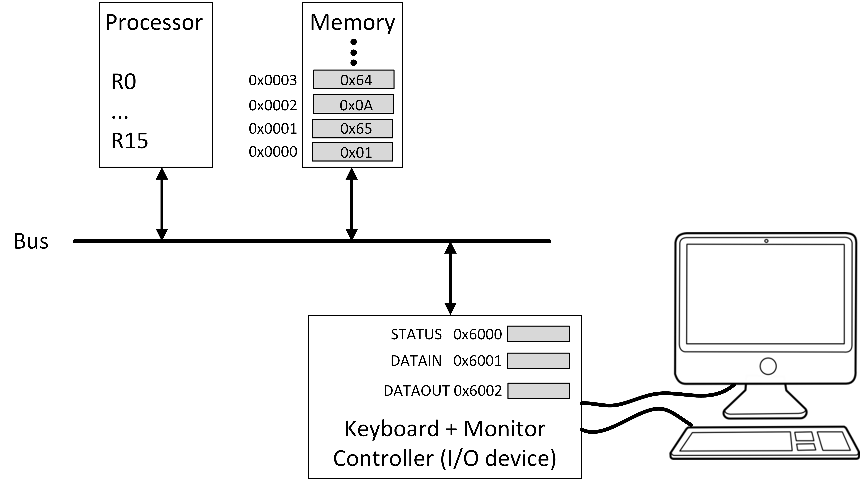
Simplified Keyboard and Monitor

Slide 16
If value in STATUS is 0x03 (00000011 in binary), then SOUT=1, SIN=1.
SOUT=1 means monitor ready to receive another character
SIN=1 means keyboard has received another character

Slide 17
Using polling to wait for character from keyboard, echo to display and buffer until reach carriage return, then process.
LDR r0,=STATUS // r0 = 0x00006000
LDR r1,=DATAIN // r1 = 0x00006001
LDR r2,=DATAOUT // r2 = 0x00006002
LDR r3,=buffer // r3 = pointer to buffer
waitk: LDRB r4,[r0] // read STATUS
If r0 is 0x6000 and the 32-bit word in memory starting memory at address 0x6000 have value 0x12345678 then what is the contents of r4 after executing “LDRB r4,[r0]”?
A: 0x78
B: 0x12
C: 0x5678
D: 0x12345678
E: Not sure
If r0 is 0x6000 and the 32-bit word in memory starting memory at address 0x6000 have value 0x12345678 then what is the contents of r4 after executing “LDRB r4,[r0]”?
A: 0x78 ✔
B: 0x12
C: 0x5678
D: 0x12345678
E: Not sure
[Hamacher, Vranesic, Zaky §4.1]

Slide 18
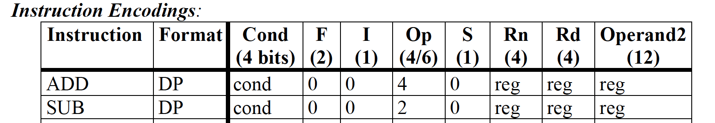
Using polling to wait for character from keyboard, echo to display and buffer until reach carriage return, then process.
LDR r0,=STATUS // r0 = 0x00006000
LDR r1,=DATAIN // r1 = 0x00006001
LDR r2,=DATAOUT // r2 = 0x00006002
LDR r3,=buffer // r3 = pointer to buffer
waitk: LDRB r4,[r0] // read STATUS
ANDS r4,r4,#1 // test SIN (AND, set Z=1 if r4=0)
BEQ waitk // wait for character
Suppose value in STATUS (address 0x6000) is 0x03. Does ANDS set Z flag to 1?
A: Yes
B: No ✔
C: Not sure
Suppose value in STATUS (address 0x6000) is 0x03. What value does r4 get after executing “ANDS r4, r4, #1”
A: 0x0000001 ✔
B: 0x0000002
C: 0x0000003
D: 0x0000004
E: Not sure
Suppose value in STATUS (address 0x6000) is 0x03. Does BEQ branch to “waitk”?
A: Yes
B: No ✔
C: Not sure
Suppose value in STATUS (address 0x6000) is 0x03. Does BEQ branch to “waitk”?
A: Yes
B: No
C: Not sure
Suppose value in STATUS (address 0x6000) is 0x03. Does ANDS set Z flag to 1?
A: Yes
B: No
C: Not sure
Suppose value in STATUS (address 0x6000) is 0x03. What value does r4 get after executing “ANDS r4, r4, #1”
A: 0x0000001
B: 0x0000002
C: 0x0000003
D: 0x0000004
E: Not sure
while ( input != ready )
/* do nothing */;
[Hamacher, Vranesic, Zaky §4.1]

Slide 19
Using polling to wait for character from keyboard, echo to display and buffer until reach carriage return, then process.
LDR r0,=STATUS // r0 = 0x00006000
LDR r1,=DATAIN // r1 = 0x00006001
LDR r2,=DATAOUT // r2 = 0x00006002
LDR r3,=buffer // r3 = pointer to buffer
waitk: LDRB r4,[r0] // read STATUS
ANDS r4,r4,#1 // test SIN (“and” + set status)
BEQ waitk // wait for character
LDRB r5,[r1] // read character
[Hamacher, Vranesic, Zaky §4.1]

Slide 20
Using polling to wait for character from keyboard, echo to display and buffer until reach carriage return, then process.
LDR r0,=STATUS // r0 = 0x00006000
LDR r1,=DATAIN // r1 = 0x00006001
LDR r2,=DATAOUT // r2 = 0x00006002
LDR r3,=buffer // r3 = pointer to buffer
waitk: LDRB r4,[r0] // read STATUS
ANDS r4,r4,#1 // test SIN (“and” + set status)
BEQ waitk // wait for character
LDRB r5,[r1] // read character
waitd: LDRB r4,[r0] // read STATUS
ANDS r4,r4,#2 // test SOUT (“and” + set status)
BEQ waitd // wait for display to be ready
Suppose value in STATUS (address 0x6000) is 0x03. Does second BEQ branch to “waitd”?
A: Yes
B: No
C: Not sure
Suppose value in STATUS (address 0x6000) is 0x03. Does second BEQ branch to “waitd”?
A: Yes
B: No ✔
C: Not sure
Suppose value in STATUS (address 0x6000) is 0x03. What value does r4 get after executing “ANDS r4, r4, #2”
A: 0x0000001
B: 0x0000002
C: 0x0000003
D: 0x0000004
E: Not sure
Suppose value in STATUS (address 0x6000) is 0x03. What value does r4 get after executing “ANDS r4, r4, #2”
A: 0x0000001
B: 0x0000002 ✔
C: 0x0000003
D: 0x0000004
E: Not sure
while ( display != ready )
/* do nothing */;
[Hamacher, Vranesic, Zaky §4.1]

Slide 21
Using polling to wait for character from keyboard, echo to display and buffer until reach carriage return, then process.
LDR r0,=STATUS // r0 = 0x00006000
LDR r1,=DATAIN // r1 = 0x00006001
LDR r2,=DATAOUT // r2 = 0x00006002
LDR r3,=buffer // r3 = pointer to buffer
waitk: LDRB r4,[r0] // read STATUS
ANDS r4,r4,#1 // test SIN (“and” + set status)
BEQ waitk // wait for character
LDRB r5,[r1] // read character
waitd: LDRB r4,[r0] // read STATUS
ANDS r4,r4,#2 // test SOUT (“and” + set status)
BEQ waitd // wait for display to be ready
STR r5,[r2] // send character to display
STR r5,[r3],#1 // save char and advance pointer
CMP r5,#0x0D // compare with carriage return
BNE waitk // if not, get another character
BL process // call function to process input
[Hamacher, Vranesic, Zaky §4.1]

Slide 22

Problem with polling?
The processor does nothing useful while waiting for I/O device.
Often there are many programs waiting to run.
[http://www.relatably.com/m/still-waiting-meme-computer]

Slide 23
How to avoid waiting?
Need a way for hardware to “tell” program waiting for I/O device when it can access the device.
Allow a different program to run while first is waiting for I/O.
Tackle #1 with ”interrupts”.
Tackle #2 with “multitasking”.

Slide 24
Interrupt Signal
Need to design hardware to allow I/O device to alert processor when input is ready using “interrupt” input:
I/O device
MEMORY
Processor
Interrupt
Memory bus

Slide 25
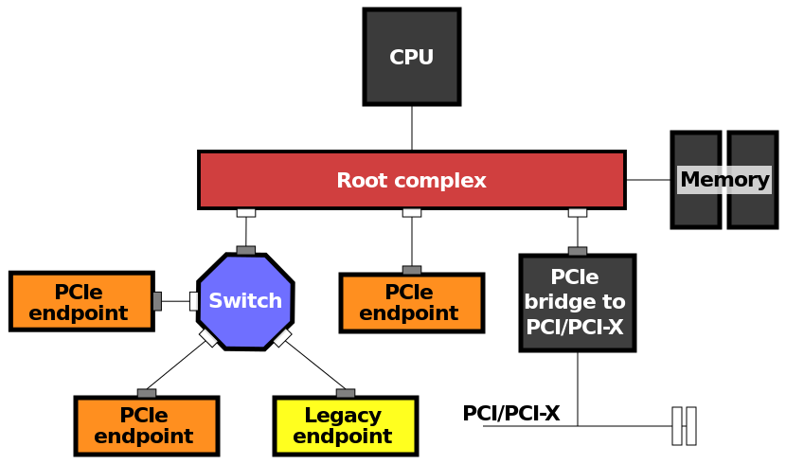
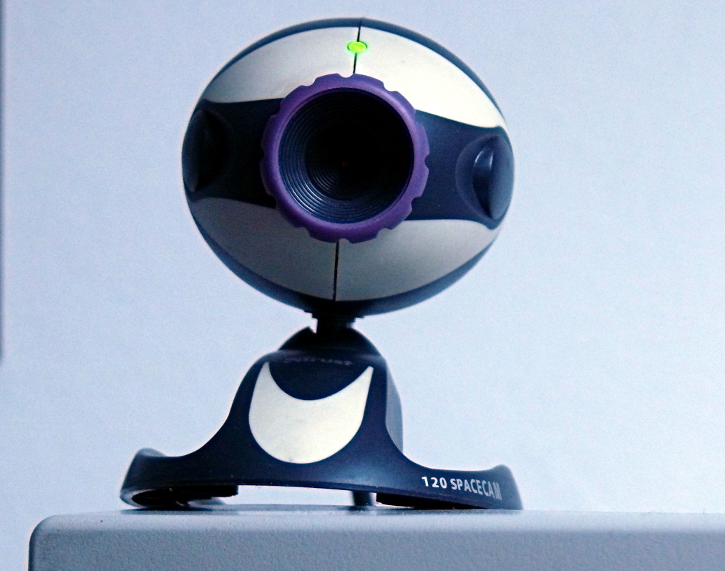
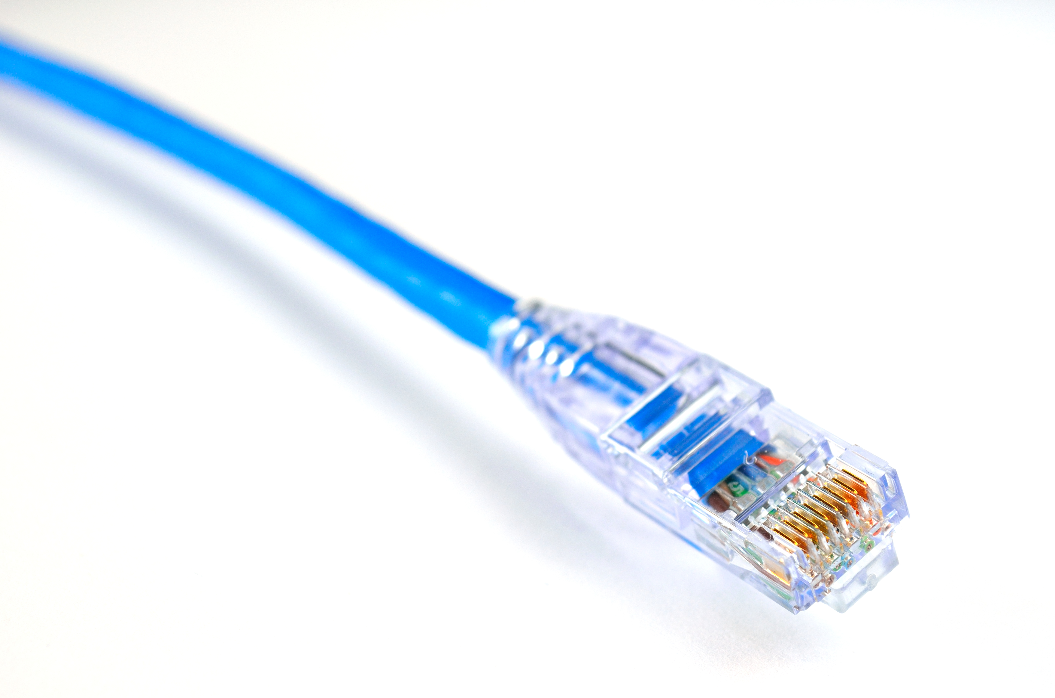
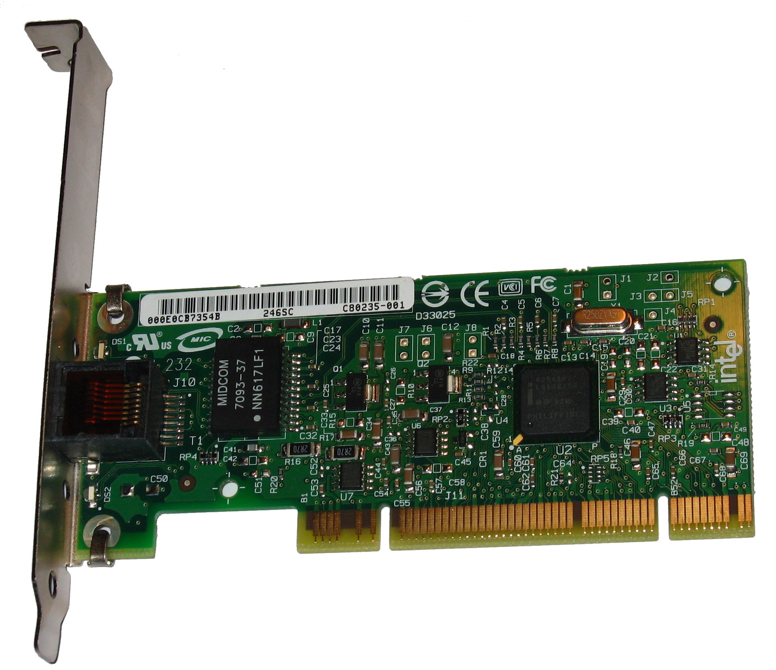
Example: Online Video Conferencing
[https://en.wikipedia.org/wiki/Webcam]
[https://en.wikipedia.org/wiki/PCI_Express]
[https://en.wikipedia.org/wiki/Ethernet]
[https://en.wikipedia.org/wiki/Gigabit_Ethernet]

Slide 26
Example: Online Video Conferencing
“Encode” function generates “packets” of data
“Send” transfers one “packet” to network card
Could have Encode call “Send” after each packet is generated
Send takes time -- network might be busy.
Better to overlap encoding of next packet with sending of prior packet.
Use interrupt to signal when network is ready for next packet

Slide 27
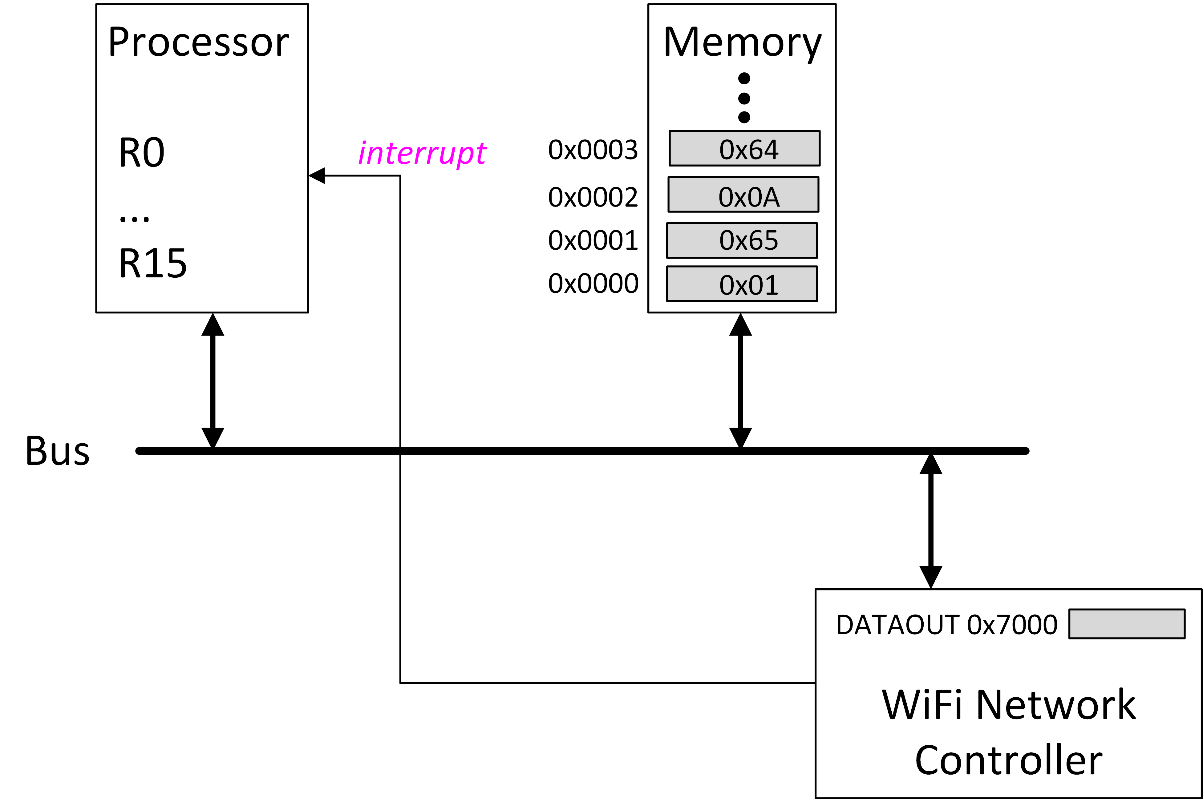
Interrupt: Hardware Input to Processor

Slide 28
module CPU(reset,clk,interrupt);
input reset;
input clk;
input interrupt;
…
module CPU(reset,clk);
input reset;
input clk;
…
clk
RAM
FSM
reset
Datapath
interrupt

Slide 29
ENCODE function SEND function
(“main program”) (“interrupt service routine”)
Does “instruction i” need to be a BL instruction?
A: Yes
B: No
C: Not sure
Does “instruction i” need to be a BL instruction?
A: Yes
B: No ✔
C: Not sure
instruction 1
instruction 2
Interrupt
occurs
here
…
instruction i
instruction i+1
…
…
instruction M

Slide 30
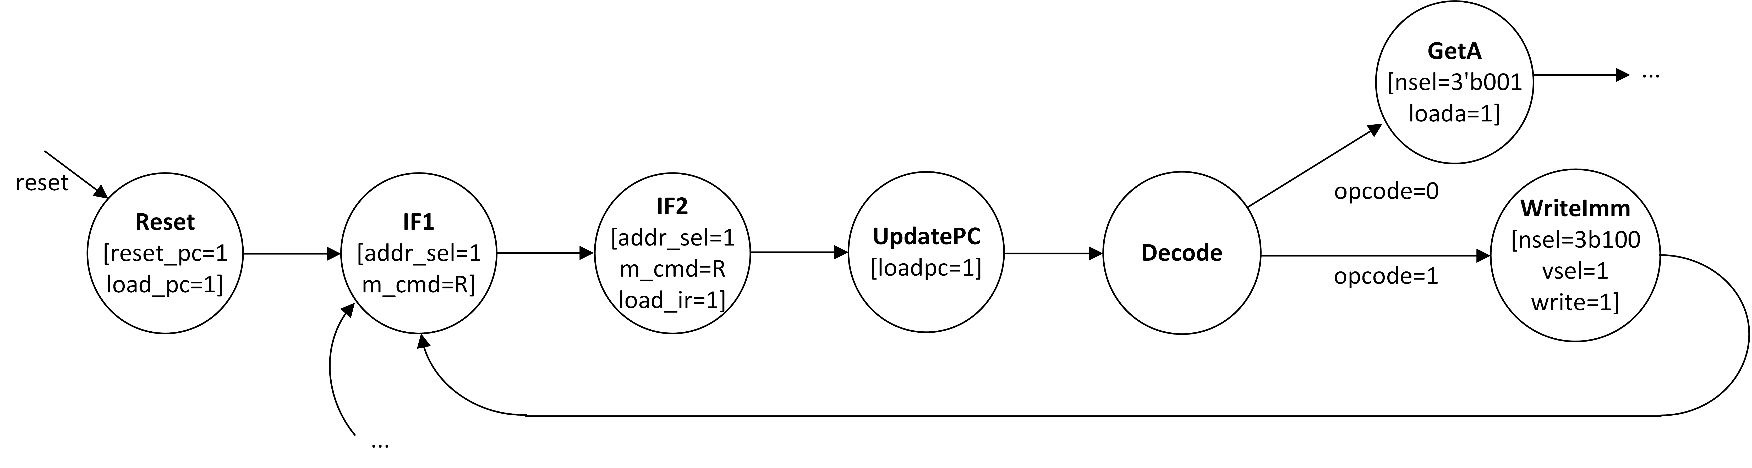
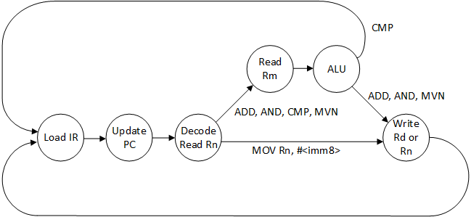
Branch to Interrupt Subroutine?
Need to change the finite state machine controller to enable branching to ISR.

Slide 31
Interrupt Timeline
Interrupt arrives
ISR queries “interrupt controller” to identify I/O device
ISR returns to main program
main program
ISR interacts with I/O device
main program
Hardware switches to ISR

Slide 32
Interrupt Service Routine (ISR)
A function executed in response to an interrupt signal is called an interrupt service routine (ISR). E.g., “SEND” in prior example.
Interrupt arrives during instruction “i”, where the specific “i” is not known in advance (when writing software).
Finish executing “i” then load PC of ISR.
After executing ISR, restore PC to “i+1”.

Slide 33
Interrupt Challenges
How to know the address of the first instruction in ISR (e.g., SEND)?
How to perform branch to ISR and remember where to return without changing main program (w/ no BL)?
How to execute ISR without disturbing the interrupted program’s operation?
How to support more than one I/O device and determine which I/O device caused interrupt?
How to stop I/O device asserting interrupt signal?
How to return to main program that was interrupted after ISR done?

Slide 34
Finding the first instruction in ISR
We could assign a specific location in memory for the interrupt service routine.
How to pick this address?
What if more than one reason to interrupt (e.g., reset, program error, other)?

Slide 35
Finding the first instruction in ISR?
Typical solution used is to specify a “vector table” at a known location in memory. Table is array that holds information about where the ISR is located. Operating system loads location of the ISR in vector table array before starting program.
In ARM, addresses 0-0x20 “reserved” for use with interrupts and other “exceptions”. PC (R15) set to 0x00000018 when interrupt input signal asserted.

Slide 36
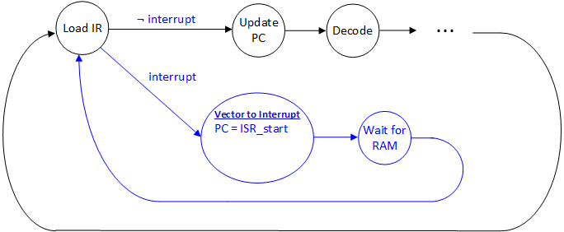
How to Branch to ISR?
Add interrupts to Simple RISC Machine:
Interrupt arrives while here
Add state “Vector to Interrupt” to load PC with address of subroutine -- e.g., address of first instruction in SEND
VERY IMPORTANT: All instructions executed by interrupt service routine (ISR) are run using the original state machine (Update PC, Decode…). The new states “Vector to Interrupt” and “Wait for RAM do NOT implement instructions from the ISR! They ONLY implement a “branch” to the start of the ISR when interrupt equals 1’b1.
What is wrong with this hardware design for controller?

Slide 37
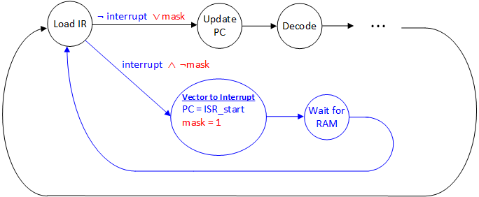
Problem #1: Hardware Infinite Loop
Interrupt arrives while here
Solution: Add an interrupt “mask” bit to force interrupt service routine (ISR) to execute while interrupt is still asserted.

Slide 38
Problem #2: Saving Return Address
Interrupt arrives while here
Solution: Add register that acts like “link register” does for BL, but dedicated for interrupts. Why can’t we just use the regular link register?

Slide 39
Why not use regular link register?
Recall factorial example from Slide Set 9:
fact:
SUB sp, sp, #8 // adjust stack for 2 items
STR lr, [sp,#4] // save the return address
If interrupt received while executing SUB overwriting LR would prevent “fact” from returning properly.

Slide 40
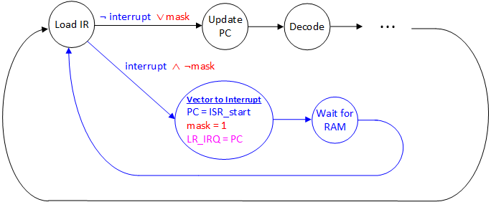
Problem #2: Saving Return Address
Solution: Add additional “link register” for exclusive use by interrupt service routine (called LR_IRQ above).

Slide 41
Problem #3: Execute ISR without disturbing the interrupted program?
Problem: ISR may have nothing in common with program being interrupted.
Solution: ISR must save/restore any registers it will change. This is done by ISR software. But, where to save registers? May not be safe to use main program’s stack since in general we do not know how interrupted program was written and what ABI conventions it is following (if any).

Slide 42
Problem #5:
How to stop I/O device from asserting interrupt?
I/O device
MEMORY
Processor
Interrupt
Memory bus

Slide 43
Problem #5: How to stop I/O device asserting interrupt?
During interrupt handling the ISR must inform device that its request has been handled to remove interrupt request.
Details depend upon specific device being accessed.
One common approach: reading/writing a memory mapped data register in I/O interface

Slide 44
Interrupt: Hardware Input to Processor

Slide 45
Problem #3, continued…
fact:
SUB sp, sp, #8 // adjust stack for 2 items
STR lr, [sp,#4] // save the return address
STR r0, [sp,#0] // save the argument n
CMP r0,#1 // compare n to 1
BGE L1 // if n >= 1, go to L1
Interrupt
here!
What if interrupt occurs during CMP?
Also need to save main program’s status register when interrupt occurs.

Slide 46
Problem #6: How to return to main program after ISR done?
Two things need to happen at same time:
  Set program counter to address of next instruction in main program.
  Restore status register to original contents and unmask interrupts.
Normal return operation (e.g. MOV) does not do both. Solution: “new” instruction (SUBS pc,lr,#4)

Slide 47
Problem #4: More than one I/O device
Two challenges:
  Typically we want to run more than one program “at the same time” (multitasking). For security and/or system robustness, we do not want these programs to directly access I/O devices themselves. How to enable programs to use I/O if program is not allowed to do so itself?
  How do we connect multiple devices to single interrupt input wire?

Slide 48
Solution (4a): Processor Modes
I/O devices must be shared by all programs running on computer.
This requires coordination! Typical solution is to use special software called an operating system (OS).
CPU has special modes enabling access to I/O devices. Only OS software allowed to run in these modes.
ARMv7 supports 8 processor modes.

Slide 49
Solution (4b): Interrupt Controller
Computer has more than one I/O device
Solution: Interrupt controller
Aggregates interrupt requests. Contains control/data registers to indicate device(s) causing interrupts.
I/O devices
(keyboard, mouse, disk, network …)
MEMORY
ARM
CPU
Interrupt (irq_i)
Interrupt
Controller
Memory bus
(address,data,control)

Slide 50
Interrupts on ARM

Slide 51
ARM Processor Modes
ARMv2 had 4 modes:
  USR: Regular program execution (User mode)
  IRQ: When running an Interrupt mode (irq_i)
  FIQ: When running a Fast Interrupt mode (irq_f)
  SVC: When running Supervisor mode (OS code) – typically entered by executing SWI instruction from User mode (this is how printf and other functions that do I/O transfer control to OS.)
ARMv6 added 3 additional modes (Abort, Undefined, System)
ARMv7 adds 1 more (Monitor)

Slide 52
Recall you built this in Lab 5….

Slide 53
Problems: Need register for mask (problem #1) and special link register (problem #2), status registers and stack pointer (problem #3)
Solution ARM: Add additional registers inside register file that are selected based on processor mode.

Slide 54
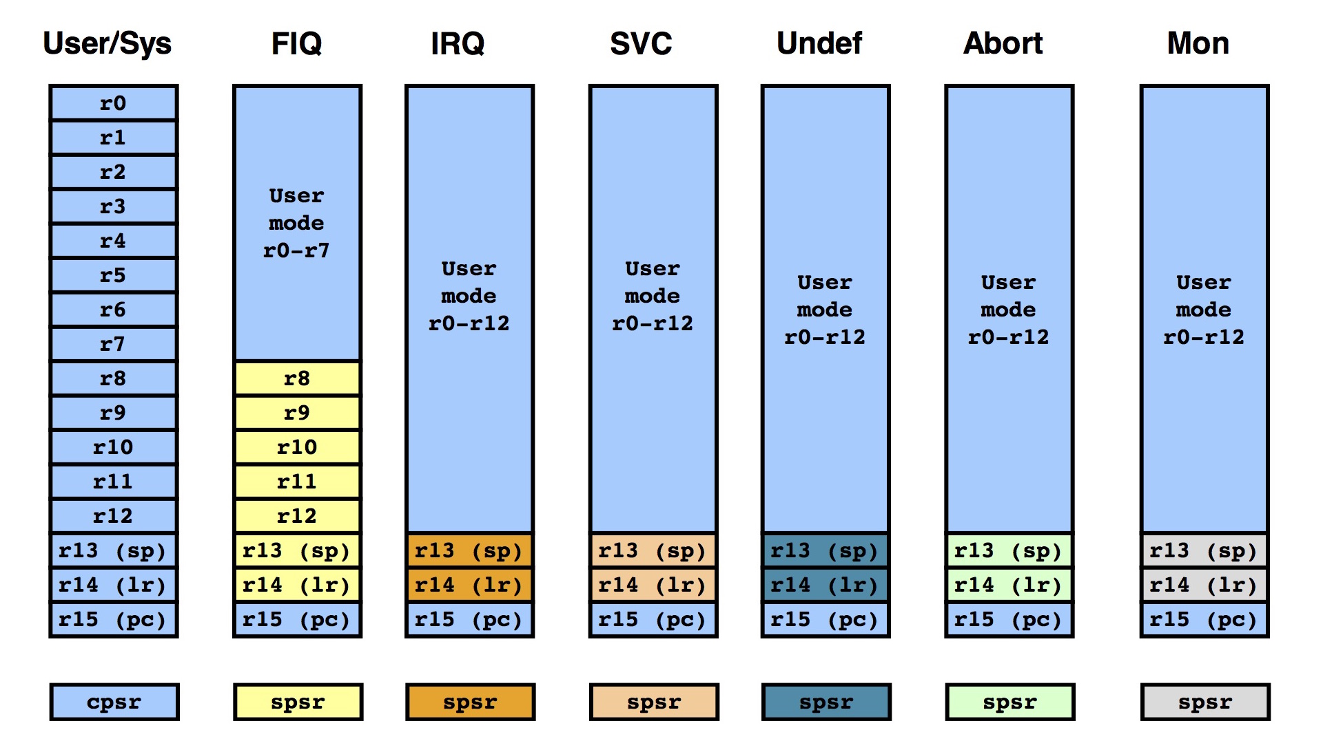
ARM Processor Modes: Register Banks
Lab 10
Each processor mode has own copy of stack pointer (R13) and link register (R14); also own “saved” copy of processor status register (spsr)

Slide 55
ARM Exception Handling
When exception occurs hardware automatically:
  Copies CPSR into SPSR_<mode>
  Sets CPSR bits (e.g., masks interrupt)
  Changes processor mode
  Stores return address to LR_<mode>
  Sets PC to vector address
To return software needs to
  Restore CPSR from SPSR_<mode>
  Restore PC from LR_<mode>
name | address
FIRQ | 0x0000001C
IRQ | 0x00000018
Reserved | 0x00000014
Data abort | 0x00000010
Prefetch abort | 0x0000000C
Software Interrupt | 0x00000008
Undefined Inst. | 0x00000004
Reset | 0x00000000

Slide 56
Vector Table
B irq_handler
0x00000018
…
0x00000004
0x00000000
0xEA000100
Vector table: Set of
branch instructions
to code for ISRs

Slide 57
Vector Table
name | Address | CODE
FIRQ | 0x0000001C | B firq_handler
IRQ | 0x00000018 | B irq_handler
Reserved | 0x00000014 | 0x00000000
Data abort | 0x00000010 | B dabt_handler
Prefetch abort | 0x0000000C | B pabt_handler
Software Interrupt | 0x00000008 | B swi_handler
Undefined Inst. | 0x00000004 | B undef_handler
Reset | 0x00000000 | B reset_handler
Example: If firq_i input to ARM CPU is ‘1’, then after current instruction completes, next instruction will be “B firq_handler”
Problem: If firq_i is still ‘1’ do we just keep resetting PC to 0x1C?

Slide 58
Program Status Register (PSR) -ARMv3 onward
“PSR” contains information about the running state of the program
CPSR = current program status register
SPSR = saved program status register

Slide 59
Program Status Register – ARMv4
NZCV: Condition code flags (set by CMP)
I = 1 disables IRQ (i.e., like “mask” but inverted)
F = 1 disables FIRQ
T = 1 processor in “Thumb” state (16-bit inst)
Mode = Processor Mode

Slide 60
ARM Processor Modes
Mode | CPSR Bits 4-0
User | 10000
FIQ | 10001
IRQ | 10010
Supervisor | 10011
Abort | 10111
Undefined | 11011
System | 11111

Slide 61
Exceptions vs Interrupts
Interrupts are one form of “Exception”.
More generally “exceptions” involve transfer of control away from the main program for some reason.
Generally, exceptions require transfer of control to the operating system (OS) or interrupt service routine.
Causes:
  I/O device request (e.g., interrupt)
  Invoking an OS service from a user program
  Page fault (virtual memory – we’ll discuss this in Slide Set 14)
  Memory protection violation (again, virtual memory – Slide Set 14)
  Floating-point arithmetic anomaly (we’ll discuss floating-point in Slide Set 11)
  Integer arithmetic overflow
  etc...

Slide 62
Categories of Exceptions
Synchronous versus Asynchronous
  Async: external device or hardware failure.
User requested versus coerced
  user requested => handle after instruction
User maskable versus user nonmaskable
  e.g., overflow can be masked (ignored) by user.
Within versus between instructions
  within => hard
Resume versus terminate
  terminate => easier

Slide 63
Updating Program Status Register
Do you need to use MSR to disable interrupts inside your interrupt service routines (ISR)?
A: Yes
B: No
C: Not sure
Do you need to use MSR to disable interrupts inside your interrupt service routines (ISR)?
A: Yes
B: No ✔
C: Not sure
ARM versions after v3 include instructions to read/write CPSR directly
MRS Rd, cpsr // read status register
MSR cpsr_<fields>, Rm // update status register
<fields> letter | Meaning | Bits set in <mask>
C | Control byte | 0x000000FF
X | eXtension byte | 0x0000FF00
S | Status byte | 0x00FF0000
F | Flags byte | 0xFF000000

Slide 64
Recall: Vector Table
B irq_handler
0x00000018
…
0x00000004
0x00000000
0xEA000100
Vector table: Set of
branch instructions
to code for ISRs

Slide 65
Example ARM ISR (DE1-SoC)
Part 1 of 2: Interrupt Vectors
Memory addr.
0x00000000
0x00000004
0x00000008
0x0000000C
0x00000010
0x00000014
0x00000018
0x0000001C
.section .vectors, "ax"
B _start // reset vector
B SERVICE_UND // undefined instruction vector
B SERVICE_SVC // software interrrupt vector
B SERVICE_ABT_INST // aborted prefetch vector
B SERVICE_ABT_DATA // aborted data vector
.word 0 // unused vector
B SERVICE_IRQ // IRQ interrupt vector
B SERVICE_FIQ // FIQ interrupt vector

Slide 66
Example ARM ISR on DE1-SoC using
“DE1-SoC Computer”

Slide 67
Example ARM ISR (DE1-SoC)
Pushbutton Keys Interface
“Each bit in [the Edgecapture register] has the value 1 if the corresponding bit location in the parallel port has changed its value from 0 to 1 since it was last read. Performing a write operation to the Edgecapture register sets all bits in the register to 0, and clears any associated interrupts.”
[page 10, DE1-SoC Computer System with ARM Cortex-A9]

Slide 68
Example ARM ISR (DE1-SoC)
Part 2 of 2: Interrupt Service Routine
.text
.global _start
... // configuration interrupts here
SERVICE_IRQ:
STMFD R13!, {R0-R7,R14} // store multiple; also: “PUSH {R0-R7,LR}”
LDR R4, =0xFFFEC100 // interrupt controller (IC) base address
LDR R5, [R4, #0xC] // determine source of interrupt
CMP R5, #73 // 73 is interrupt ID for push KEYs
STOP:BNE STOP // if not recognized, stop here
LDR R0, =0xFF200050 // base addr of pushbutton KEY port
LDR R1, [R0, #0xC] // R1 indicates KEY(s) pressed
MOV R2, #0xF
STR R2, [R0, #0xC] // clear source of interrupt
STR R5, [R4, #0x10] // clear interrupt from CPU interface
... // do something given KEY(s) pressed
POP {R0-R7, LR} // load multiple (LDMFD SP!,{R0-R7,LR})
SUBS PC, LR, #4 // return from interrupt

Slide 69
Returning From ISR
To return from an interrupt handler:
SUBS pc,lr,#4
ARMv6 and later also support an “RFE” instruction that provides similar functionality (similar to LDM but restores only PC and CPSR). See COD4e Appendix B1 on Canvas.

Slide 70
Determining Source of Interrupt
Multiple I/O devices send signal to interrupt controller which then passes a single interrupt to CPU.
How to know which device to service?
I/O devices
(keyboard, mouse, disk, network …)
MEMORY
ARM
CPU
Interrupt Signal
Interrupt
Controller
Memory bus
(address,data,control)

Slide 71
Interrupt Controller Pending Mask
Interrupt Controller
Devices 5 and 2 have raised their interrupt flag
Like any other I/O device Interrupt Controller will have various memory mapped registers
At least one memory mapped register, often called a “pending mask”, will indicate which device raised interrupt

Slide 72
Edge versus Level Sensitive Interrupts
Question: When I/O device sends interrupt how is interrupt cleared?
Level-Sensitive: Perform (device specific) operation that causes I/O device to lower it’s request. E.g., read character from keyboard.
Edge-Sensitive: Interrupt controller remembers request. So, need to also reset flag in interrupt controllers (IC specific)
I/O devices
(keyboard, mouse, disk, network …)
MEMORY
ARM
CPU
Interrupt (irq_i)
Interrupt
Controller
Fast Interrupt (firq_i)
Memory bus
(address,data,control)

Slide 73
ARM Generic Interrupt Controller
All computer systems require interrupts
ARM “Generic Interrupt Controller” (GIC) provided by ARM and used in many systems including Cyclone V inside your DE1-SoC.
You will use the GIC during Lab 10.

Slide 74
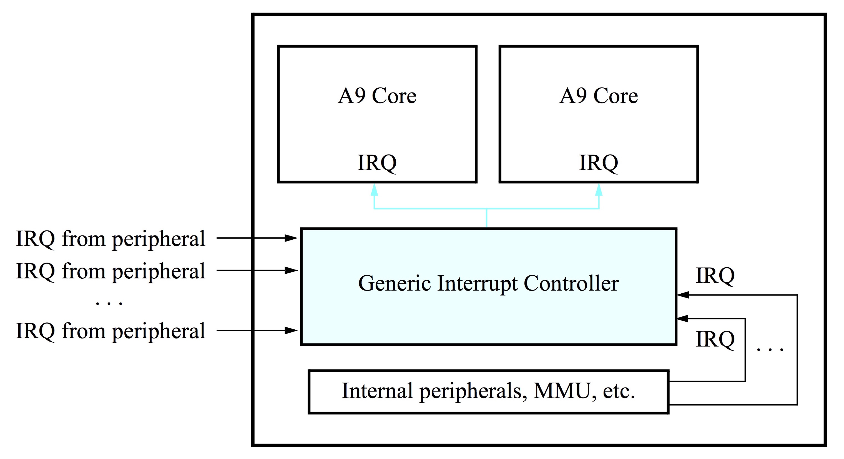
ARM GIC Overview
Generic Interrupt Controller and 2 ARM cores:
[Altera, “Using the ARM Generic Interrupt Controller”]
[Altera, Using ARM GIC, §4]

Slide 75
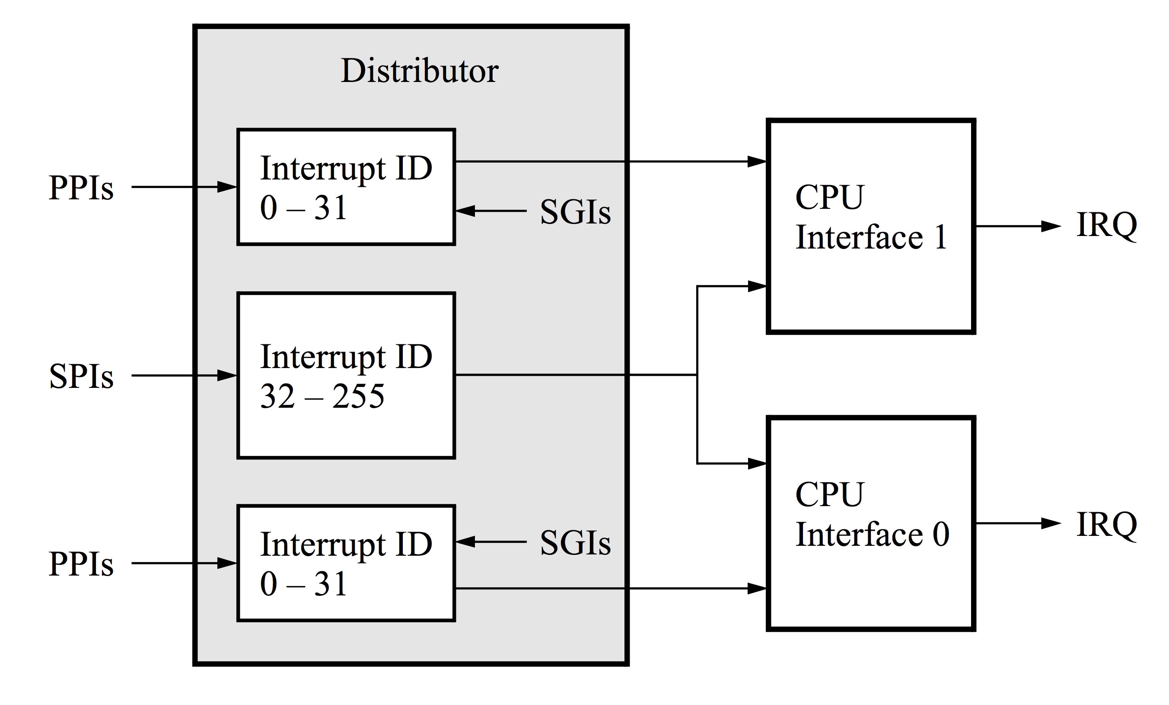
GIC Architecture
SPIs = shared peripheral interrupts
PPIs = private peripherals interrupts
[Altera, “Using the ARM Generic Interrupt Controller”]
[Altera, Using ARM GIC, §4]

Slide 76
Interrupt Controller Interface
Configure Interrupt Controller via Memory Mapped Registers
I/O devices
(keyboard, mouse, disk, network …)
MEMORY
ARM
CPU
Interrupt Signal
Interrupt
Controller
Memory bus
(address,data,control)

Slide 77
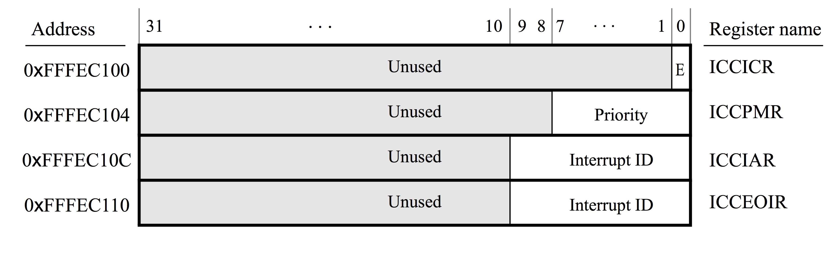
CPU Interface Control Register (ICCICR): 1=enable interupts on this interface
Interrupt Priority Mask Register (ICCPMR): 0-255 interrupts with higher priority (lower value) sent to CPU
Interrupt Acknowledge Register (ICCIAR): holds the ID of peripheral causing current interrupt
End of Interrupt Register (ICCEOIR): Write ID of interrupt to clear.
[Altera, “Using the ARM Generic Interrupt Controller”]

Slide 78
DE1-SoC Computer

Slide 79
Example ARM ISR (DE1-SoC)
Part 2 of 2: Interrupt Service Routine
.text
.global _start
... // configuration interrupts here
SERVICE_IRQ:
STMFD R13!, {R0-R7,R14} // store multiple; also: “PUSH {R0-R7,LR}”
LDR R4, =0xFFFEC100 // interrupt controller (IC) base address
LDR R5, [R4, #0xC] // determine source of interrupt
CMP R5, #73 // 73 is interrupt ID for push KEYs
STOP:BNE STOP // if not recognized, stop here
LDR R0, =0xFF200050 // base addr of pushbutton KEY port
LDR R1, [R0, #0xC] // R1 indicates KEY(s) pressed
MOV R2, #0xF
STR R2, [R0, #0xC] // clear source of interrupt
STR R5, [R4, #0x10] // clear interrupt from CPU interface
... // do something given KEY(s) pressed
POP {R0-R7, LR} // load multiple (LDMFD SP!,{R0-R7,LR})
SUBS PC, LR, #4 // return from interrupt

Slide 80
GIC Architecture
SPIs = shared peripheral interrupts
PPIs = private peripherals interrupts
[Altera, “Using the ARM Generic Interrupt Controller”]

Slide 81
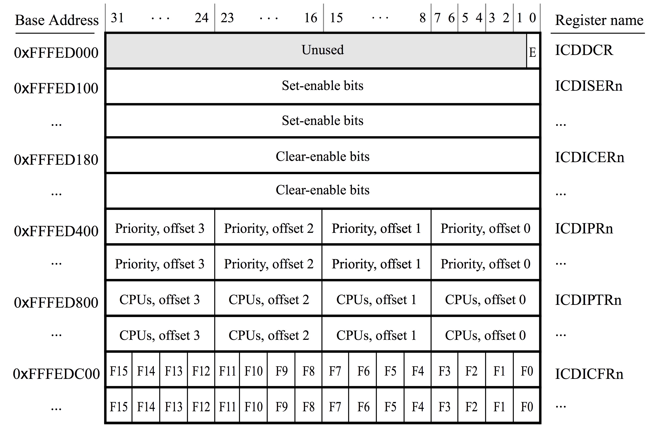
Distributor Control Register (ICDDCR): 1 = enabled
Interrupt Set Enable Registers (ICDISERn): 1 = enabled
Interrupt Clear Enable Registers (ICDICERn): 1 = disabled
Interrupt Priority Registers (ICDIPRn): 0 is highest priority
Interrupt Processor Targets Registers (ICDIPTRn): 8-bit mask supporting up to eight CPUs (bit 0 is CPU 0, etc…)
Interrupt Configuration Registers (ICDICFRn): 2-bit field, upper bit set to 1 if edge sensitive
[Altera, “Using the ARM Generic Interrupt Controller”]

Slide 82
CONFIG_GIC:
PUSH {LR}
/* To configure the FPGA KEYS interrupt (ID 73):
* 1. set the target to cpu0 in the ICDIPTRn register
* 2. enable the interrupt in the ICDISERn register */
/* CONFIG_INTERRUPT (int_ID (R0), CPU_target (R1)); */
MOV R0, #73 // KEY port (interrupt ID = 73)
MOV R1, #1 // this field is a bit-mask; bit 0 targets cpu0
BL CONFIG_INTERRUPT
/* configure the GIC CPU interface */
LDR R0, =MPCORE_GIC_CPUIF // base address of CPU interface
/* Set Interrupt Priority Mask Register (ICCPMR) */
LDR R1, =0xFFFF // enable interrupts of all priorities levels
STR R1, [R0, #ICCPMR]
/* Set the enable bit in the CPU Interface Control Register (ICCICR). This bit
* allows interrupts to be forwarded to the CPU(s) */
MOV R1, #1
STR R1, [R0]
/* Set the enable bit in the Distributor Control Register (ICDDCR). This bit
* allows the distributor to forward interrupts to the CPU interface(s) */
LDR R0, =MPCORE_GIC_DIST
STR R1, [R0]
POP {PC}

Slide 83
CONFIG_INTERRUPT:
PUSH {R4-R5, LR}
/* Configure Interrupt Set-Enable Registers (ICDISERn).
* reg_offset = integer_div(N / 32) * 4
* value = 1 << (N mod 32) */
LSR R4, R0, #3 // calculate reg_offset
BIC R4, R4, #3 // R4 = reg_offset
LDR R2, =MPCORE_GIC_DIST+ICDISER
ADD R4, R2, R4 // R4 = address of ICDISER
AND R2, R0, #0x1F // R2 = N mod 32
MOV R5, #1 // enable
LSL R2, R5, R2 // R2 = 1 << (N mod 32)
/* now that we have the register address (R4) and value (R2), we need to set the
* correct bit in the GIC register */
LDR R3, [R4] // read current register value
ORR R3, R3, R2 // set the enable bit (leave other set bits unchanged)
STR R3, [R4] // store the new register value
/* Configure Interrupt Processor Targets Register (ICDIPTRn)
* reg_offset = integer_div(N / 4) * 4
* index = N mod 4 */
BIC R4, R0, #3 // R4 = reg_offset
LDR R2, =MPCORE_GIC_DIST+ICDIPTR
ADD R4, R2, R4 // R4 = word address of ICDIPTR
AND R2, R0, #0x3 // R2 = N mod 4
ADD R4, R2, R4 // R4 = byte address in ICDIPTR
/* now that we have the register address (R4) and value (R2), write to (only)
* the appropriate byte */
STRB R1, [R4]
POP {R4-R5, PC}

Slide 84
Multitasking (Lab 10, Part 4)
Most operating systems “multitask”
  Program A and B appear to run at the same time
  In practice, A and B do not actually run at exactly the same time:
    Run Program A for 20ms
    Run Program B for 20ms
    Run Program A for 20ms, etc
Each program contains at least one “thread”.
A thread has its own program counter and stack pointer.
NOTE: Multitasking is different than “hardware multithreading” or “Multicore”.
  Hardware multithreading (e.g., Intel “Hyperthreading”): hardware can run instructions from two or more threads at exactly the same time. Used extensively in graphics processor units (GPUs).
  Multicore: different CPU cores – each can run a different thread.
  Windows, OS X, Linux, Android, iOS, etc…. Create more software threads than CPU hardware can run at once (need multitasking).

Slide 85
Multitasking (Lab 10, Part 4)
Modern implementations of multitasking involve providing short “time slices” to programs.
At any time only instructions from one thread are running if the hardware is single threaded.
Implemented using a timer to interrupt the processor and copy current registers to region of operating system memory called a “process descriptor”.
Process descriptor contains summary information about the process. This includes the contents of registers when swapped out. E.g., Linux “task_struct”
In Lab 10 you use a very simplified process descriptor containing only R0-R15 and CPSR.

Slide 86
Address Value in memory
PD_ARRAY:
0x00001000
Saved R0 for Process 0
Saved R1 for Process 0
… (omitted)…
Saved R12 for Process 0
Saved R13 (SP) for Process 0
Saved R14 (LR) for Process 0
Saved R15 (PC) for Process 0
Saved CPSC for Process 0
0x00001004
0x00001030
0x00001034
0x00001038
0x0000103C
0x00001040
0x00001044
Saved R0 for Process 1
Saved R1 for Process 1
… (omitted)…
Saved R12 for Process 1
Saved R13 (SP) for Process 1
Saved R14 (LR) for Process 1
Saved R15 (PC) for Process 1
Saved CPSC for Process 1
0x00001048
0x00001070
0x00001074
0x00001078
0x0000107C
0x00001080

Slide 87
Saved R0 for Process 0
0x00010000
…
0x00000004
0x00000000
0x00000001

Slide 88
Task switch Interrupt Service Routine
DE1-SoC Computer has a timer (interrupt ID 29)
I/O devices
(keyboard, mouse, disk, network …)
MEMORY
ARM
CPU
Interrupt Signal
Interrupt
Controller
Memory bus
(address,data,control)

Slide 89
Address Value in memory
PD_ARRAY:
0x00001000
Saved R0 for Process 0
Saved R1 for Process 0
… (omitted)…
Saved R12 for Process 0
Saved R13 (SP) for Process 0
Saved R14 (LR) for Process 0
Saved R15 (PC) for Process 0
Saved CPSC for Process 0
0x00001004
1. Save registers for
current process
0x00001030
0x00001034
0x00001038
0x0000103C
0x00001040
0x00001044
Saved R0 for Process 1
Saved R1 for Process 1
… (omitted)…
Saved R12 for Process 1
Saved R13 (SP) for Process 1
Saved R14 (LR) for Process 1
Saved R15 (PC) for Process 1
Saved CPSC for Process 1
0x00001048
0x00001070
0x00001074
2. Restore registers for process that was not running (this makes it start running)
0x00001078
0x0000107C
0x00001080

Slide 90
Summary
Polling in ARM
Exceptions versus interrupts
Hardware support for interrupts
Writing interrupt service routines (in ARM)
(Preemptive) Multitasking using a timer ISR.

