Slide 1
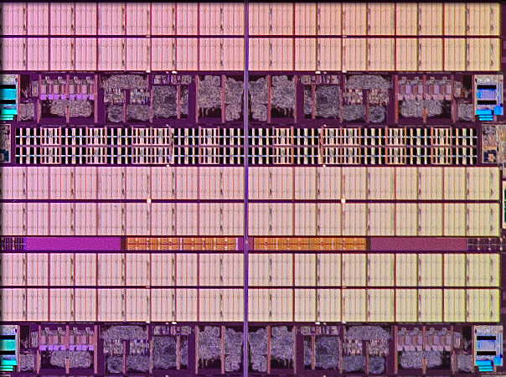
CPEN 211: Introduction to Microcomputers
Slide Set 13: Caches and Virtual Memory
Prof. Tor Aamodt
[Background: Portion of Intel Core i7-5960X Extreme Edition 20 MB L3 Cache;
Source: https://www.anandtech.com/show/8426/the-intel-haswell-e-cpu-review-core-i7-5960x-i7-5930k-i7-5820k-tested]
Notes:
1

Slide 2
Learning Objectives
After this lecture you should be able to:
  Explain the motivation for using caches and describe levels of the memory hierarchy
  Define simple cache terminology and explain operation of several types of cache
  Calculate relationship between cache parameters; evaluate which accesses will hit or miss out of a sequence of accesses; evaluate performance impact of caches using a simple analytical model
  Explain the motivation for using virtual memory.
  Explain what a page table is and how it is used to implement virtual memory. Explain what a translation look aside buffer (TLBs) is and how it operates. Explain interaction of TLBs and caches (virtual indexed physically tagged cache, synonym problem)

Slide 3
Reading
COD ARM Edition Chapter 5

Slide 4
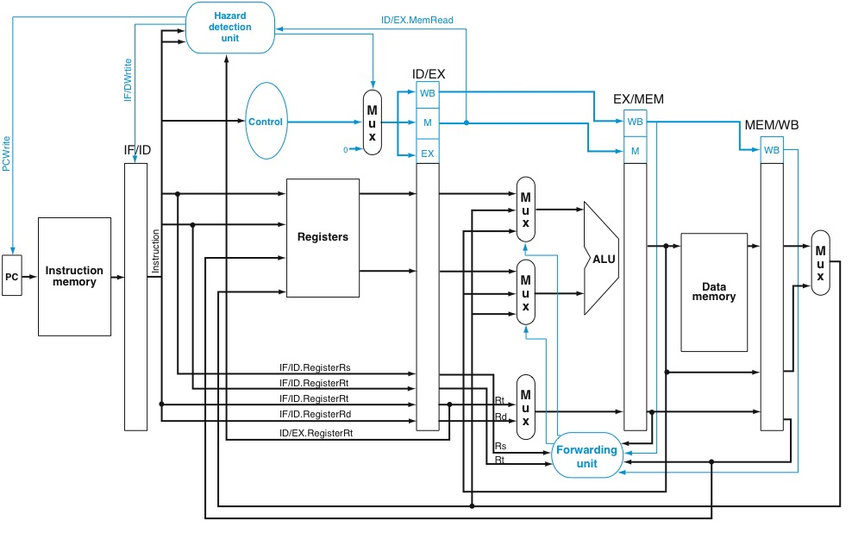
How to Design “Memory” Blocks?

Slide 5
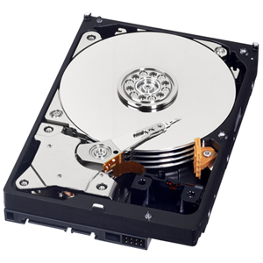
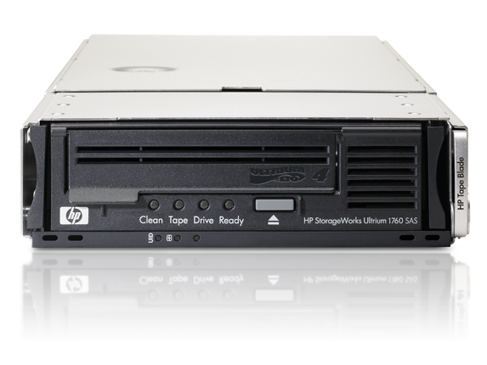
Magnetic storage?
[image source: http://news.bbc.co.uk/2/hi/technology/7908666.stm ]
E.g., HP Ultrium. Sequential access 1TB/hour. 3TB cartridge cost (circa 2016) $32.95 @ Office Depot (93 GB per $)
Tape: lowest cost per bit… low bandwidth,
Problem w/ Tape: instructions & data not accessed sequentially

Slide 6
Random Access Memory
64x1-bit RAM: value at address “011010” = 1
decoder
0 | 0 | 0 | 0 | 0 | 1 | 1 | 1
0 | 1 | 0 | 1 | 0 | 1 | 0 | 0
0 | 0 | 0 | 1 | 0 | 1 | 1 | 1
0 | 0 | 0 | 0 | 1 | 1 | 0 | 0
0 | 0 | 0 | 0 | 0 | 0 | 0 | 0
1 | 0 | 0 | 0 | 0 | 0 | 0 | 0
0 | 0 | 0 | 0 | 0 | 0 | 0 | 1
0 | 0 | 1 | 0 | 1 | 0 | 0 | 0
011
3
010
mux
1

Slide 7
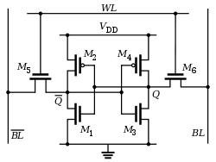
Static RAM
How many transistors in a master-slave D flip-flop (Flipped Lecture 2)?
A: 6
B: 16
C: 34 ✔︎
D: 48
E: Not sure
Single ported SRAM uses six to store a single bit.
How many transistors in a master-slave D flip-flop (Flipped Lecture 2)?
A: 6
B: 16
C: 34
D: 48
E: Not sure

Slide 8
SRAM Tradeoffs
Small SRAM is very fast
~200 picosecond access time for 4096 byte SRAM at 32 nm (single cycle access 5GHz)
Large SRAM much slower
~5 nanosecond access time for 32 MB SRAM at 32 nm (25 cycle access at 5 GHz)

Slide 9
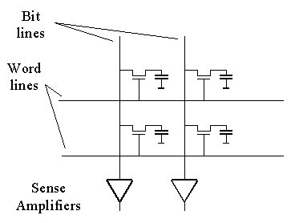
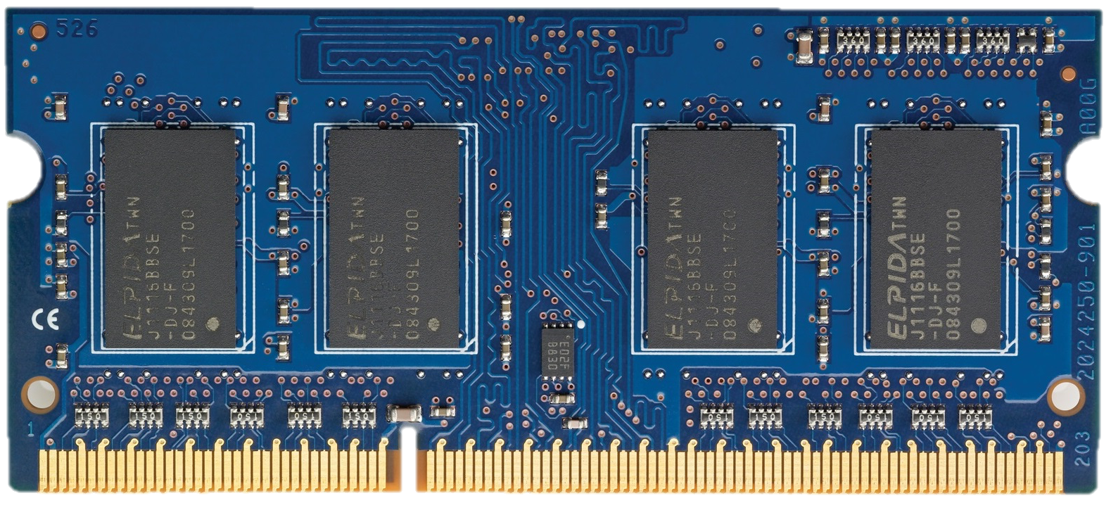
Dynamic RAM
DRAM uses single transistor and capacitor to store a bit.
DRAM chips
DRAM Module
[Courtesy: Onur Mutlu, ETH Zurich]

Slide 10
DRAM Chip Internals
[Onur Mutlu, ETH Zurich]
DRAM Cell
Bitline
Peripheral
Circuitry
DRAM
Array
Wordline
Control
Logic
Bank
S
S
S
S
I/O
Sense amplifiers
(row buffer)
Off-chip channel

Slide 11
DRAM Operations
[Onur Mutlu, ETH Zurich]
What is the minimum number of DRAM commands to read from three different rows?
A: 3
B: 6
C: 8
D: 9
E: Not sure
What is the minimum number of DRAM commands to read from three different rows?
A: 3
B: 6
C: 8 ︎ ✔︎
D: 9
E: Not sure
1
ACTIVATE: Store the row
into the row buffer
1
1
1
1
2
READ: Select the target
cache line and drive to CPU
3
PRECHARGE: Prepare the array for a new ACTIVATE
to I/O

Slide 12
DRAM Access Latency
[Onur Mutlu, ETH Zurich]
1
Activation latency
(13ns / 50 cycles)
2
Precharge latency
(13ns / 50 cycles)
Command
ACTIVATE
READ
PRECHARGE
Data
1
1
1
1
Cache line (64B)
Duration
Next
ACT

Slide 13
DRAM Tradeoffs
Cheaper than SRAM but more expensive than disk or tape: E.g., “16GB Corsair DDR3-2000” for $243.13 on shop.ca ($15 per GB --1395 times more per bit versus tape).
Longer access time than SRAM
DDR3-2000 minimum latency is 9 ns

Slide 14
Flash Memory
NOR:
NAND:
[image source: https://en.wikipedia.org/wiki/Flash_memory ]

Slide 15
Fundamental Problem
Faster memory is smaller.
At this point, we know how to design a very fast computer that uses a very small memory.
How can we design a fast computer that can use large memory?

Slide 16
The Memory Wall
CPU-DRAM Gap
1980: no cache in µproc; 1995 2-level cache on chip
(1989 first Intel µproc with a cache on chip)
1000
µProc
60%/yr.
CPU
“Moore’s Law”
100
Processor-Memory
Performance Gap:
(grows 50% / year)
Performance
10
DRAM
7%/yr.
DRAM
1
1989
1980
1990
1981
1982
1983
1984
1985
1986
1987
1988
1991
1992
1993
1994
1995
1996
1997
1998
1999
2000
Notes:
Y-axis is performance
X-axis is time
Latency
Cliché:
Not e that x86 didn’t have cache on chip until 1989

Slide 17
Solution: Memory Hierarchy
Regs
Faster
L1-Cache
L2-Cache
Memory
Bigger
Disk, Tape, etc.

Slide 18
What do real programs do?
Consider “SAXPY” loop:
void saxpy( float a, float *X, float *Y, unsigned N )
{
for( i=0; i < N; i++ )
Y[i] = a*X[i] + Y[i];
}
Two observations:
1. Read then write Y[i] (temporal locality)
2. Read X[0], then X[1], then X[2] (spatial locality)

Slide 19
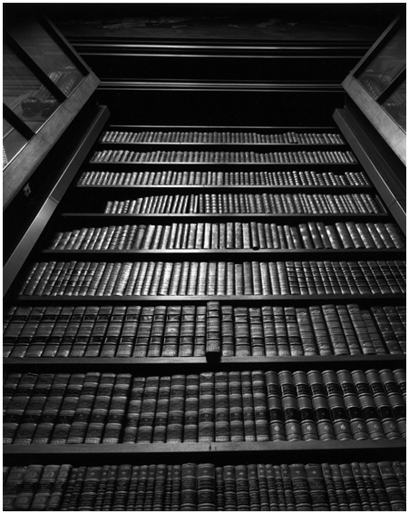


A Silly Locality Analogy
Fast RAM: Is book I want in backpack?
Slow RAM: Is book in UBC library?
Disk: inter-library loan (or chapters.ca)
Temporal Locality (analogy):
If use book once, likely to
use it again soon.
Spatial Locality (analogy):
If last time went to library
borrowed book on “mystery
novels” next time likely get
another book from same
section.

Slide 20
Temporal Locality
Temporal Locality: After accessing single location once the program accesses it again.
Example: Y[i] = a*X[i] + Y[i];
1: FLDS S3,[R1] ; read X[i]
2: FMULS S5,S3,S4 ; a*X[i]
3: FLDS S6,[R2] ; read Y[i]
4: FADDS S7,S5,S6 ; a*X[i]+Y[i]
5: FSTS S7,[R2] ; write Y[i]
line 3: read Y[i]
line 5: write Y[i] (note: same location)

Slide 21
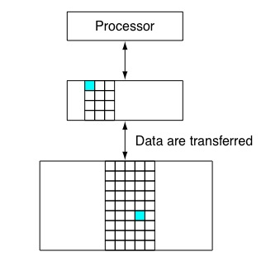
Exploiting Temporal Locality
Idea: When accessing location (address) make copy of data in small fast memory. If there is temporal locality program will (likely) try to access the same data again soon.
Small fast memory
Y[0]
Large slow memory

Slide 22
How is data transferred?
Option 1: Software moves data
  Small fast RAM called a “scratchpad” memory
  Used by recent GPUs
  Typically, the programmer must decide when to move data between slow big memory and fast small memory. Add extra code to move data.
  Benefits: Programmer can optimize what to put in fast memory and when.
  Drawbacks: More work for programmer
Option 2: Hardware managed cache
  Most CPUs take this approach. Our focus.

Slide 23
Hardware managed cache design
We will have hardware automatically copy data to “cache” when program accesses the location holding that data.
Problem: Need mechanism for hardware to find data next time program accesses it.
Solution: Save address (“tag”) in cache along with copy of the data at that address.

Slide 24
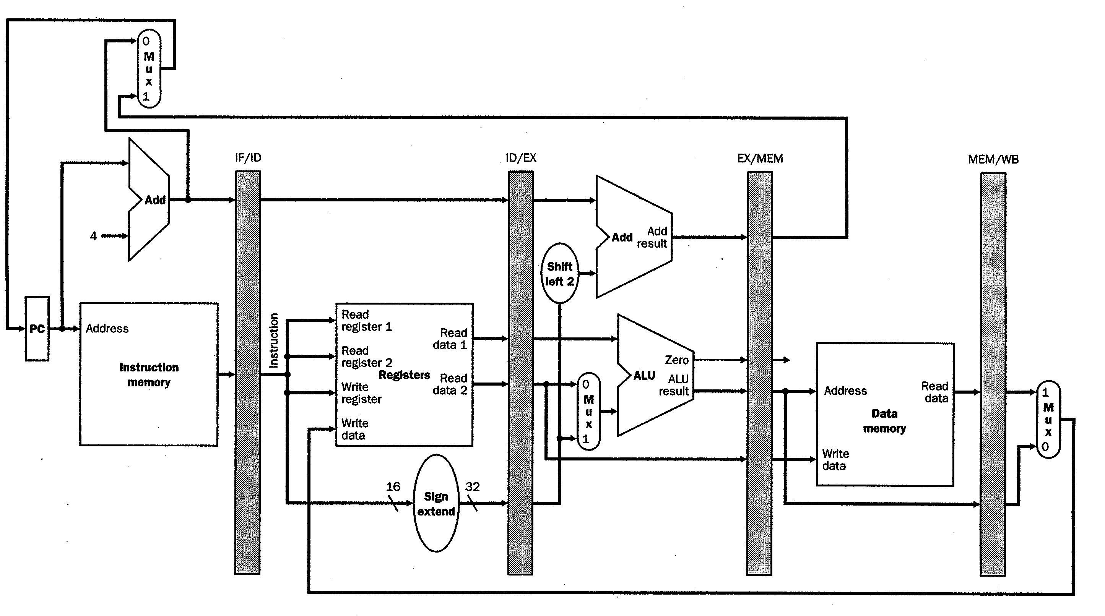
First level caches in typical pipeline
Instruction
Cache
First level caches
(separate to avoid
structural hazard)
Data
Cache

Slide 25
Example
Show cache contents when executing following code on “fully associative” data cache with two 4 byte blocks.
FLDS S3,[R2] ; read Y[i]
FADDS S4,S2,S3 ; a*X[i]+Y[i]
FSTS S4,[R2] ; write Y[i]
Initially: Regs[R2]=0x8, Regs[S2]=78.2, memory state:
Address | Memory contents | Description
0x0000000c | C4 7A 00 00 | Y[3] = -1000.0
0x00000008 | 40 2D F8 54 | Y[2] = 2.718282
0x00000004 | 40 49 0F DB | Y[1] = 3.141593
0x00000000 | 42 28 00 00 | Y[0] = 42.0

Slide 26
Example, continued…
valid? | modified? |  | tag | data
0 | 0 |  | 0x00000000 | 00 00 00 00
0 | 0 |  | 0x00000000 | 00 00 00 00
cache holding two 4-byte “blocks”
Each row in cache contains four fields:
  “data” holds copy of memory data
  “tag” indicates address associated with data
  “modified” indicates if data in cache was written to since copying from memory
  “valid” indicates the row contains valid information.

Slide 27
Example, continued
Executing:
FLDS S3,[R2] ; read Y[i]
Step 1: compute effective address of memory access R2 = 0x00000008
Step 2: Check if block containing contents of memory
at address 0x00000008 is present in cache:
Answer = no (“cache miss”). (If yes, “cache hit”)
valid? | modified? |  | tag | data
0 | 0 |  | 0x00000000 | 00 00 00 00
0 | 0 |  | 0x00000000 | 00 00 00 00

Slide 28
Example, continued
How many copies are there of the data “40 2D F8 F4” after Step 3?
A: 0
B: 1
C: 2
D: 3
E: Not sure
How many copies are there of the data “40 2D F8 F4” after Step 3?
A: 0
B: 1
C: 2 ︎ ✔︎
D: 3
E: Not sure
Executing:
FSTS S3,[R2] ; read Y[i]
Step 3: Copy data into cache (use block with “valid=0”)
valid? | modified? | tag | data
0 | 0 | 0x00000000 | 00 00 00 00
0 | 0 | 0x00000000 | 00 00 00 00
valid? | modified? | tag | data
1 | 0 | 0x00000008 | 40 2D F8 F4
0 | 0 | 0x00000000 | 00 00 00 00
Address | Memory contents | Description
0x0000000c | C4 7A 00 00 | Y[3] = -1000.0
0x00000008 | 40 2D F8 54 | Y[2] = 2.718282
0x00000004 | 40 49 0F DB | Y[1] = 3.141593
0x00000000 | 42 28 00 00 | Y[0] = 42.0

Slide 29
Example, continued
Cache after executing
FADDS S4,S2,S3; Regs[F4]=80.918 (0x42A1D629)
FSTS S4,[R2]; write Y[i]
valid? | modified? | tag | data
1 | 1 | 0x00000008 | 42 A1 D6 29
0 | 0 | 0x00000000 | 00 00 00 00
valid? | modified? | tag | data
1 | 0 | 0x00000008 | 40 2D F8 F4
0 | 0 | 0x00000000 | 00 00 00 00
Address | Memory contents | Description
0x0000000c | C4 7A 00 00 | Y[3] = -1000.0
0x00000008 | 40 2D F8 54 | Y[2] = 2.718282
0x00000004 | 40 49 0F DB | Y[1] = 3.141593
0x00000000 | 42 28 00 00 | Y[0] = 42.0

Slide 30
Question
Consider the following series of memory references (byte addresses, in decimal): 2, 3, 2, 8, 10, and 2.
Assume fully associative cache with 8 one-byte blocks that are initially empty (valid=0), label each reference in the list as a hit or a miss, report the total number of hits and show the final contents of the cache.
Ignore “modified” and “data” fields.

Slide 31
Solution
2 m, 3 m, 2 h, 8 m, 10 m, 2 h
Valid | Tag
0 | -
0 | -
0 | -
0 | -
0 | -
0 | -
0 | -
0 | -
Valid | Tag
1 | 2
1 | 3
1 | 8
1 | 10
0 | -
0 | -
0 | -
0 | -
Valid | Tag
1 | 2
0 | -
0 | -
0 | -
0 | -
0 | -
0 | -
0 | -
Valid | Tag
1 | 2
1 | 3
0 | -
0 | -
0 | -
0 | -
0 | -
0 | -
Valid | Tag
1 | 2
1 | 3
1 | 8
0 | -
0 | -
0 | -
0 | -
0 | -

Slide 32
Problem with this design
  Where do we put data if cache is full?
Return to this question after considering spatial locality.

Slide 33
Spatial Locality
Definition: After accessing a location program accesses nearby location.
Example:
Y[2] = a*X[2] + Y[2];
Y[3] = a*X[3] + Y[3];
Program reads Y[2], then Y[3].

Slide 34
Exploiting Spatial Locality
If we accessed Y[3] first what should hardware copy to cache?
A: Just Y[3]
B: Y[3] and Y[4]
C: Y[2] and Y[3]
D: Not sure
If we accessed Y[3] first what should hardware copy to cache?
A: Just Y[3]
B: Y[3] and Y[4]
C: Y[2] and Y[3] ✔︎
D: Not sure
When program accesses Y[2] transfer both Y[2] and Y[3].
In general, transfer a “block” of data (or instructions) at a time. Block size
typically 32 to 128 bytes.
In figure at left have a block containing Y[2] and Y[3] but more typical 64 byte block can hold sixteen 4-byte values.
Y[2], Y[3]

Slide 35
Cache Blocks (Cache Lines)
Which byte value is at address 0x00000009?
A: 98
B: 00
C: F8 ✔︎
D: C4
E: Not sure
Which byte value is at address 0x00000009?
A: 98
B: 00
C: F8
D: C4
E: Not sure
Want to move nearby data at same time to exploit spatial locality. Divide up memory into blocks that are power of two multiples of word size. Block starts at address aligned to block size (whole number multiple of block size).
memory
address
memory
contents
0xfffffff8 | 00 00 00 00 00 00 00 00
0xfffffff0 | 00 00 00 00 00 00 00 00
… | …
0x00000010 | 01 00 70 95 42 3C E7 98
0x00000008 | C4 7A 00 00 40 2D F8 54
0x00000000 | 40 49 0F DB 42 28 00 00
8 byte block. First byte at 0x00000008 contains “54”. Last byte at 0x0000000f contains “C4” (“little endian” byte order).
Copy entire block at once.

Slide 36
Modified Cache Design
Increase data field size to hold block of size 8 bytes. Now cache can exploit both spatial and temporal locality.
valid? | modified? | tag | data
0 | 0 | 0x00000000 | 00 00 00 00 00 00 00 00
0 | 0 | 0x00000000 | 00 00 00 00 00 00 00 00

Slide 37
Block Size Impact on Tag
Blocks start at address aligned to block size.
This means lower log₂(block size) bits of block address are always zero.
Would be a waste of transistors if we explicitly store these zero values.

Slide 38
Question
For a fully associative cache with 16 byte blocks what is the tag in hex for a block with starting address 0x00008020?
What is the tag value?
A: 0x00008020
B: 0x0000
C: 0x000080
D: 0x0000802 ✔︎
E: Not sure
What is the tag value?
A: 0x00008020
B: 0x0000
C: 0x000080
D: 0x0000802
E: Not sure

Slide 39
Example, revisited (FLDS F3, [R2])
Would we copy C4 7A 00 00 into cache if block size was 4 bytes and read address 0x00000008?
A: Yes
B: No ✔︎
C: Not sure
Would we copy C4 7A 00 00 into cache if block size was 4 bytes and read address 0x00000008?
A: Yes
B: No
C: Not sure
Regs[R2] = 0x00000008 implies tag=0x0000001 -- why?
In binary 0x00000008 = 0000 … 000000001000
Drop least significant 3 bits since using 8 byte blocks
Cache after executing
FLDS F3 [R2] ; read Y[i]
valid? | modified? | tag | data
0 | 0 | 0x00000000 | 00 00 00 00 00 00 00 00
0 | 0 | 0x00000000 | 00 00 00 00 00 00 00 00
valid? | modified? | tag | data
1 | 0 | 0x00000001 | C4 7A 00 00 40 2D F8 54
0 | 0 | 0x00000000 | 00 00 00 00 00 00 00 00
copy 8 byte block to cache
memory
address
memory
contents
4 byte value written to Regs[F3] by FLDS is 0x402DF854
0x00000010 | 01 00 70 95 42 3C E7 98
0x00000008 | C4 7A 00 00 40 2D F8 54
0x00000000 | 40 49 0F DB 42 28 00 00

Slide 40
Multiple words in block
For the SAXPY loop 8 byte block contains two elements – e.g., Y[2] and Y[3]:
How to find specific data (e.g., Y[2] or Y[3]) accessed by load/store instruction?
valid? | modified? | tag | data
1 | 0 | 0x00000001 | C4 7A 00 00 40 2D F8 54
Y[2]
Y[3]

Slide 41
Solution: Block Offset
Recall, block starts at address aligned to log₂(block size) and data stored within block in same order as in memory.
So, we can compute location of word in block by using lower log₂(block size) bits of address of word.

Slide 42
Solution: Block Offset
Example block offset calculation (8 byte block)
address (hex) address (binary)
0x00000008 = 0000 … 000000001000
0x0000000C = 0000 … 000000001100
valid? | modified? | tag | data
1 | 0 | 0x00000001 | C4 7A 00 00 40 2D F8 54
Block Offset = 0
Block Offset = 4

Slide 43
Question
For a cache with 16 byte blocks what is the block offset in hex for a 4 byte float stored in memory at starting address 0x00008028?
What is the block offset?
A: 0x00008028
B: 1000₂ ✔︎
C: 0x28
D: 00₂
E: Not sure
What is the block offset?
A: 0x00008028
B: 1000₂
C: 0x28
D: 00₂
E: Not sure

Slide 44
Example, revisited
Regs[R2] = 0x8 => Tag=0x1, Block Offset=0
Cache after executing
FADDS S4,S2,S3 ; Regs[S4] = 0x42A1D629
FSTS S4,[R2] ; write Y[i]
valid? | modified? | tag | data
1 | 1 | 0x00000001 | 42 A1 D6 29 C4 7A 00 00
0 | 0 | 0x00000000 | 00 00 00 00 00 00 00 00
valid? | modified? | tag | data
1 | 0 | 0x00000001 | C4 7A 00 00 40 2D F8 54
0 | 0 | 0x00000000 | 00 00 00 00 00 00 00 00

Slide 45
What if cache is full?
So far we assumed we “fill” blocks into cache starting at first available (“invalid”) row and when accessing cache do parallel search for tag match in all rows (“fully associative”)
If cache full (no blocks are “invalid”), need to make space for new block by “evicting” a “valid” block from cache.

Slide 46
Which block gets evicted?
Which is best block to evict? Recall we want to keep useful data in cache. So, we need to consider locality.
Provably optimal: evict block that will be accessed again furthest in future.
Problem: Hardware does not know future. Need prediction mechanism.

Slide 47
How to predict?
Goal: Want to predict which block will be accessed furthest in future.
Observation: For many programs, the longer a block has not been accessed, the less likely it is that we will access it soon.
Can quantify this using “reuse distance”.

Slide 48
Reuse Distance (Definition)
Consider sequence of memory accesses to blocks A, B, C, D, and E:
ABBCBCCDBBEDBBBA
Between two accesses to block A made 14 accesses to four unique blocks (B, C, D, E)
Reuse distance for A is four.

Slide 49
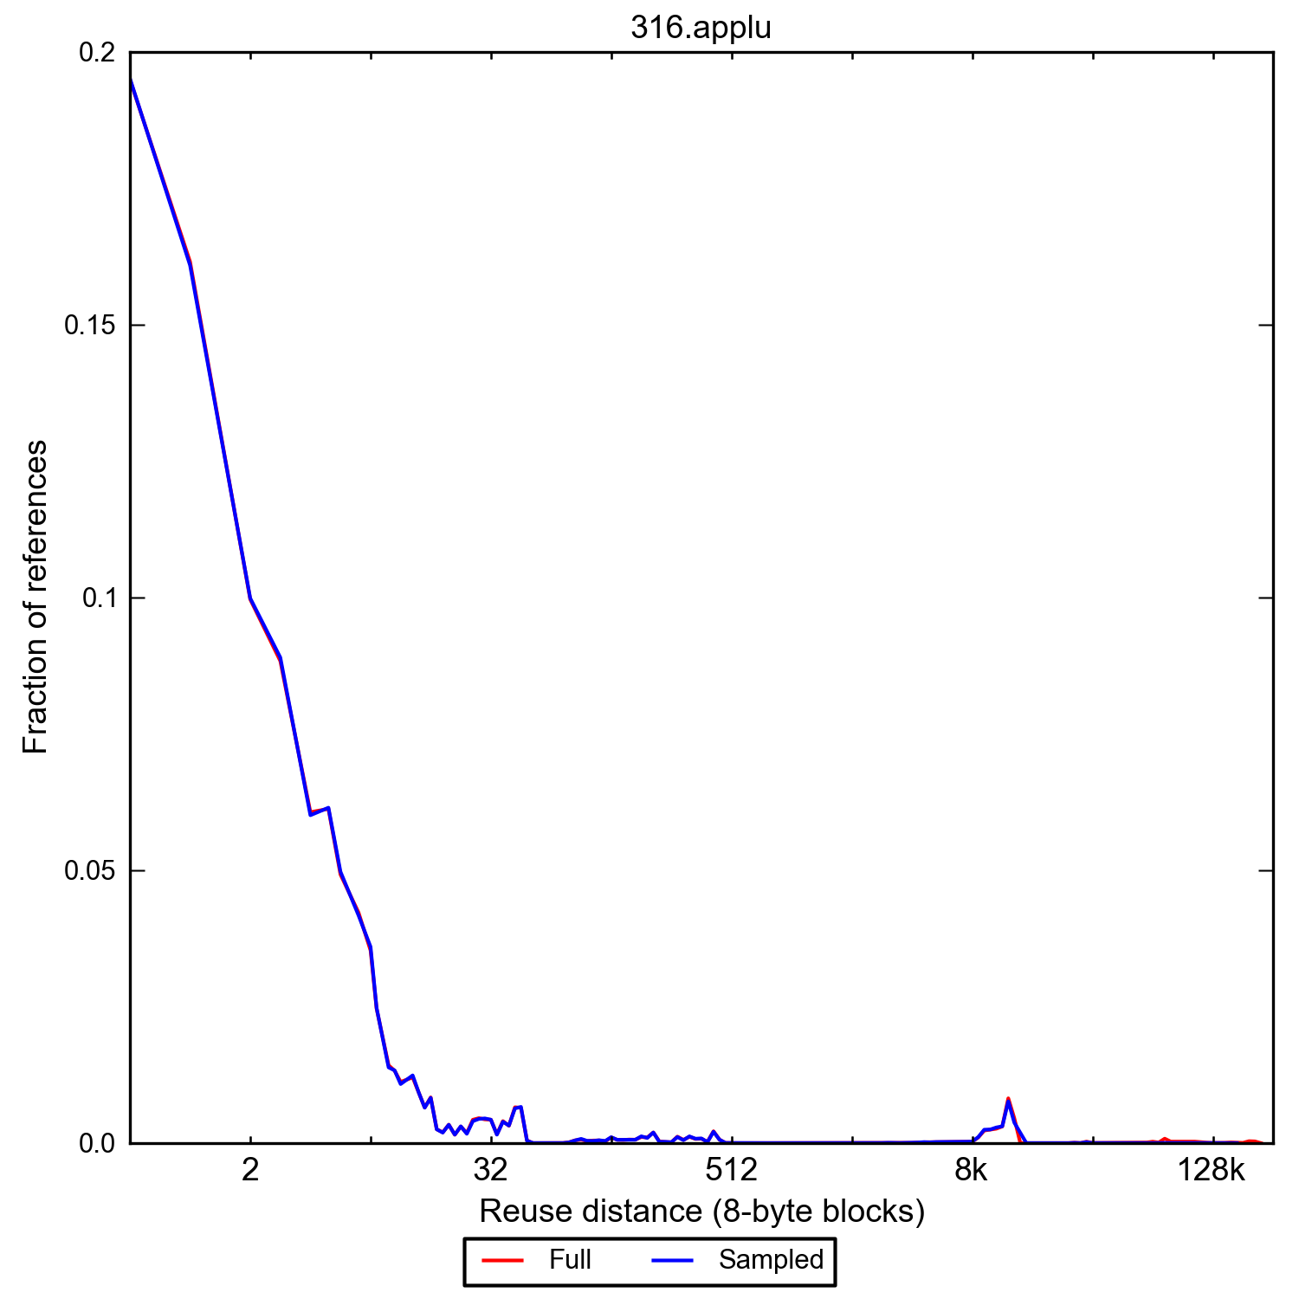
Reuse distance measurement
Typically access recently used data most frequently.

Slide 50
Replacement Policy
The algorithm used to decide which block to evict is called a “replacement policy”.
Observation on last slide suggests good replacement policy is to evict the “least recently used” (LRU) block.

Slide 51
Least Recently Used
LRU Implementation?
  Naïve: add timestamp field to row updated each time block accessed. To evict, compare all timestamps to find smallest.
  In practice try to limit search to small number of blocks (e.g., “set associative” later in slides). With two blocks can use bit to indicate which one most recently used.
  Patents on approximate LRU (pseudo-LRU).
Random & FIFO get similar hit rates to LRU.
Recently, replacement policy very active area of innovation due to multicore and “big data”.

Slide 52
Research
Subhasis Das, Tor M. Aamodt, William J. Dally Reuse Distance Based Probabilistic Cache Replacement,
in ACM Transactions on Architecture and Code Optimization (TACO),
Volume 12 Issue 4, Article No. 33 (Oct 2015), 22 pages.

Slide 53
Question
Assume fully associative cache with 8 one-byte blocks. Consider the following series of memory references (byte addresses, in decimal): 2, 3, 2, 8, 10, and 2. After this sequence has been observed, what is the tag of the least recently used block?
What is the block offset?
A: 2
B: 3 ✔︎
C: 8
D: 10
E: Not sure
What is the block offset?
A: 2
B: 3
C: 8
D: 10
E: Not sure

Slide 54
Fully Associative Implementation
4-bit tag comparison hardware
=

Slide 55
Problem with Fully Associative
Comparing all tags in parallel is expensive (time, area and energy).
Can avoid multiple tag comparisons if block can only be stored in single row in cache. This is called “direct mapped”. Then, only one tag needs to be checked.
Also makes replacement decision easy (only one choice of what to evict).

Slide 56
Direct Mapped Cache
Given start address of block need way for hardware to select single row of cache to place block in.
Start of block is aligned so least significant log₂(block size) bits in address are zero. Use hash on remaining address bits to compute an index used to select row.
Typically, use next log₂(number of rows) least significant bits of block start address as hash function: index = block address % num. rows

Slide 57
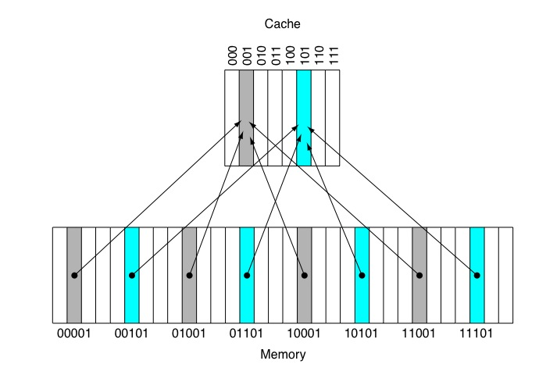
Direct Mapped Cache
“Block Address” is starting address of block with log₂(block size) least significant bits truncated (removed).
Address:
Index = (Block Address) modulo (Number of Rows)
Address:
Block Address Block Offset
Tag Index Block Offset

Slide 58
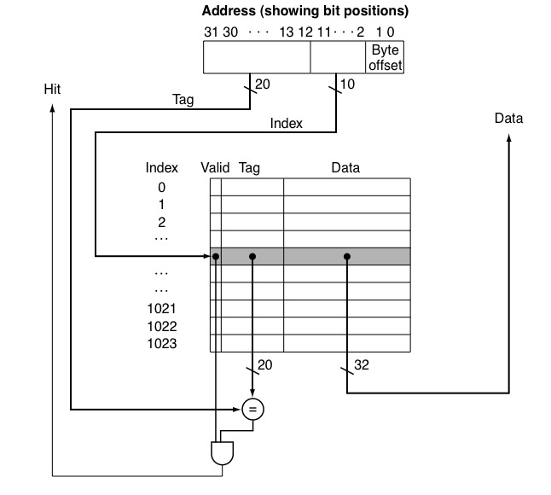
Direct Mapped Cache
LDR R1, [R2, #8]
4-byte blocks, so block offset is 2-bits.
1024 rows so use log₂(1024)=10-bits of address to select row. These bits are called “index”.

Slide 59
Problem: Conflict Misses
Some “rows” (blocks) in direct mapped cache used more than others.
Data that index to these blocks may get evicted before reused even though there was enough space in cache to keep them.
Would like to have flexibility of fully associative without cost of parallel comparison of all tags in cache.

Slide 60
Set Associative Cache
Index selects row containing set of blocks.
Search tags of all blocks in this set in parallel.

Slide 61
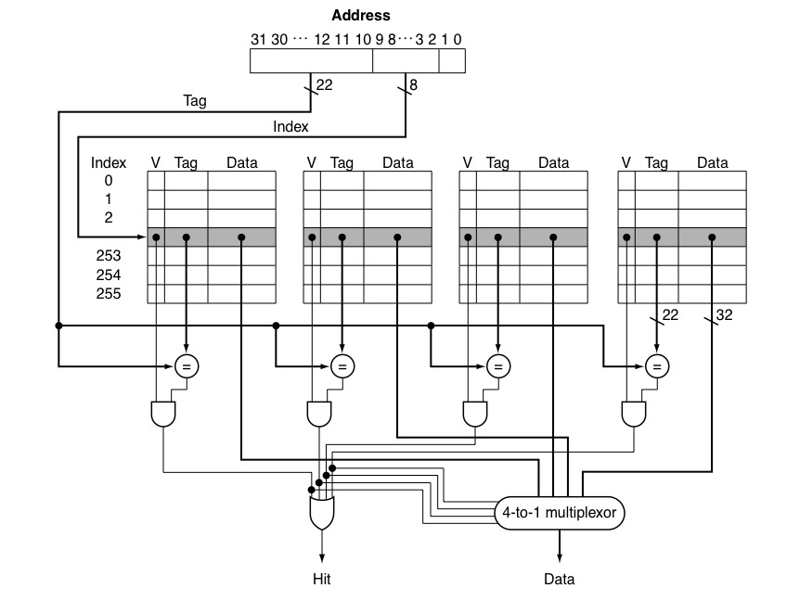
Set Associative Cache

Slide 62
Question
Consider the following series of memory references (byte addresses, in decimal): 2, 3, 2, 8, 10, and 2. Assuming first a direct mapped cache with one byte blocks and total capacity of 8 bytes, then a two-way set associative cache with 2-byte blocks and total size of 16 bytes that are initially empty. Label each reference in the list as a hit or a miss and show the final contents of the cache.

Slide 63
Solution
2 m, 3 m, 2 h, 8 m, 10 m, 2 m
2 m, 3 h, 2 h, 8 m, 10 m, 2 h
Cache set | Address
000
001
010
011
100
101
110
111
8
Cache Set | Address
00 | { - , - }
01 | { - , - }
10 | { - , - }
11 | { - , - }
10
[8,9]
2
2
2
3
[2,3]
[10,11]
[2,3]
[2,3]
Direct-mapped cache 2-way set associative
1 byte blocks 2 byte blocks
8 bytes total 16 bytes total

Slide 64
What happens on a write? Cache Writing Policies
Write-through
  Store to both cache and memory on every write
    Slow writes
  Conservative: memory always holds valid data
  Simple cache
Write-back
  Store to cache only
    Fast writes
  On write, mark data block in cache as dirty
    Need extra memory bit for each cache line (dirty bit)
  Memory may hold invalid/stale data (must fix!)
  More complex cache
Text: COD ARM Edition §5.3

Slide 65
Write Misses
(how are they handled by hardware?)
Writes can miss in cache… leads to a hardware design choice (the design choice options are answers to question “how do we deal with write miss”). Two choices are:
  Write-allocate
    First, read cache block from memory into cache
    Second, proceed with write
  No write-allocate
    Write to memory directly
    Memory access is slow, CPU must wait
    Improve performance using “write buffers” (see later)
Most common design choices:
  Writeback cache uses write-allocate
  Write-through cache uses no write-allocate (keep it simple)
Text: COD ARM Edition §5.3

Slide 66
Counter-Intuitive Case 1:
Load instruction may cause Writes
Write-back cache problems
  Over time, many cache blocks marked “dirty”
  Eventually, must write dirty data back to memory
    Usually, when cache block is evicted
    (Also, if cache is “flushed” for OS context switch)
  Called a “writeback” event
Load may cause writes
  Load instruction miss, may evict a dirty cache block
    Write first: (old) dirty cache block writes to memory
    Read second: (new) memory block loaded into cache
  …but CPU is waiting for read result to do Load…
    Many CPUs do the “read first”
    Holds dirty cache block in special “write buffer” during read
Text: COD ARM Edition §5.3

Slide 67
Counter-Intuitive Case 2:
Store instruction may cause Reads
Writes can miss in the cache!
Store may cause Reads
  Writeback cache with write-allocate policy
    Store misses in cache
    CPU performs READ from memory, puts data in cache
    CPU performs write in cache, marks block dirty
It can be even more complex
  When store misses in cache above
    Must evict existing cache block
    If marked dirty, must first write back the cache block to memory
  CPU performs read from memory
  CPU performs write in cache
Text: COD ARM Edition §5.3

Slide 68
Write Buffers for Write-Through Caches
Cache
Lower Level Memory
Processor
Write Buffer
Holds data awaiting write-through to
lower level memory
Q. Why a write buffer ?
A. So CPU doesn’t stall
Q. Why a buffer, why not just one register ?
A. Bursts of writes are
common.
Q. Are Read After Write (RAW) hazards an issue for write buffer?
A. Yes! Drain buffer before next read, or send read after 1st checking write buffers.
Text: COD ARM Edition §5.3

Slide 69
Performance / Multilevel Caches
Impact of caches on performance?
Reduce “Miss Penalty” by adding second-level of caching:
CPU
CPU
1 cycle
1 cycle
L1 $
L1 $
10 cycles
200 cycles
L2 $
200 cycles
Memory
Memory

Slide 70
Example Problem
How much faster is a processor with both L1 and L2 caches versus a processor with only an L1 cache?
Assume the following:
  CPI is 1.0 when all memory references hit in the L1 cache.
  All instruction references hit in L1 instruction cache.
  Loads and stores comprise 30% of instructions.
  L1 data cache hit rate is 80%
  L2 data cache hit rate is 40% and a L2 cache hit takes 10 cycles.
  Main memory takes 200 cycles to access.

Slide 71




Solution
$$Speedup with L2= \frac{Performance with L2}{Performance without L2}$$
$$= \frac{Execution Time without L2}{Execution Time with L2}$$
$$= \frac{{IC}_{without L2}× {CPI}_{without L2}×{cycle time}_{without L2}}{{IC}_{with L2}× {CPI}_{with L2}×{cycle time}_{with L2}}$$
(Adding L2 cache does not impact instruction count or cycle time)
$$Speedup with L2= \frac{{CPI}_{without L2}}{{CPI}_{with L2}}$$

Slide 72
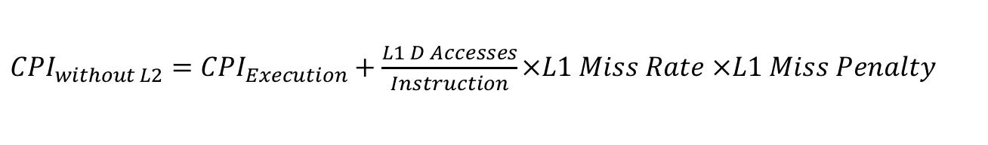

Solution, Continued…
$$Speedup with L2= \frac{{CPI}_{without L2}}{{CPI}_{with L2}}$$
${CPI}_{without L2}=$ ${CPI}_{Execution}+\frac{L1 D Accesses}{Instruction}×L1 Miss Rate ×L1 Miss Penalty$
$=$ $1.0+0.3×(1−0. 8)×200$
$=$ $13$

Slide 73
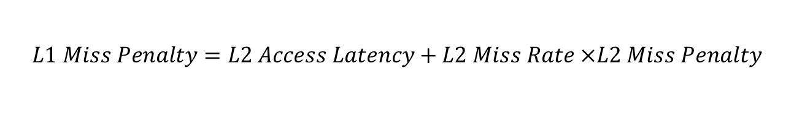
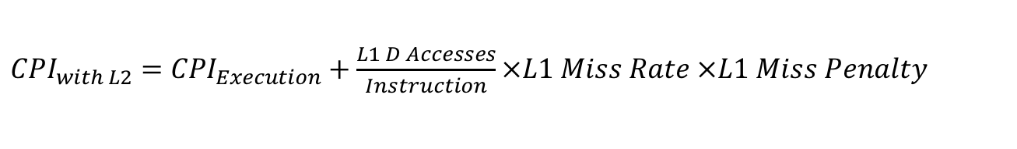
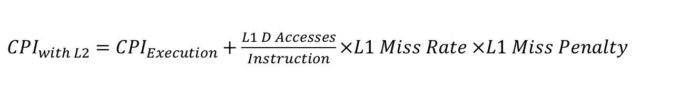
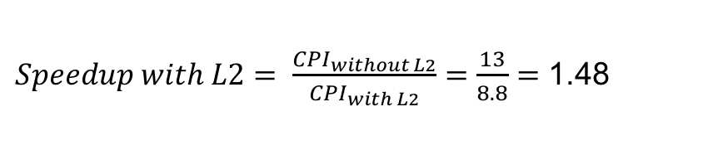
Solution, Continued…
${CPI}_{with L2}=$ ${CPI}_{Execution}+\frac{L1 D Accesses}{Instruction}×L1 Miss Rate ×L1 Miss Penalty$
$$L1 Miss Penalty=L2 Access Latency+L2 Miss Rate ×L2 Miss Penalty$$
$=$ $10+(1−0. 4)×200$
$=$ $13$0
${CPI}_{with L2}=$ ${CPI}_{Execution}+\frac{L1 D Accesses}{Instruction}×L1 Miss Rate ×L1 Miss Penalty$
$=$ $1.0+0.3×(1−0. 8)×130$
$=$ $8.8$
$Speedup with L2= \frac{{CPI}_{without L2}}{{CPI}_{with L2}}=\frac{13}{8.8}=$ 1.48

Slide 74
Virtual Memory
Next we look at the virtual memory system present on all modern computer systems.
We will see how virtual memory can lead to page faults in the normal operation of a program.
The motivation for virtual memory is that it simplifies software development by freeing the programmer from having to think about low level details when trying to get their program to run correctly

Slide 75
Multiple Programs Using Memory
Computer has 1024 MB DRAM
  Internet Explorer (IE) uses 30 MB
  MS Word uses 20 MB
  Vista uses 1280 MB
  Total: 1330 MB
How to run all three programs at once?
It gets worse….
  Firefox assumes memory starts at address 0
  Word assumes memory starts at address 0
    How can they both run if they both assume memory starts at 0 ??
  Vista ? It’s the OS…. who knows!

Slide 76
Multiple Programs Using Memory
Word
It gets even worse
  Vista starts using 1280 MB
  IE starts using 30 MB
  Word starts using 20 MB
  User opens web page (cnn.com), IE wants + 72MB
  User opens document (ps3 soln) Word wants +30MB
  User opens 2nd web page(youtube), IE wants +40MB
  User edits document, Word wants +10MB
  TOTAL
    Vista 1280MB, IE 142 MB, Word 60 MB
IE
Main
Mem
Word
IE
Word
IE
Vista

Slide 77
How can we divide up memory between programs?
It gets even worse
  Exit Word
  Start engineering program
    Wants 300MB for a matrix
    Must be contiguous!
    How?
    Move IE? Not realistic
Solution?
  Divide Main Memory into pages,
  say 4KB each
  Divide Programs into pages (same size)
  Map Program Pages into Main Memory Pages
  Store extra Program Pages on disk
IE
Main
Mem
IE
IE
Vista

Slide 78
Solution: Virtual Memory
IE sees this
Main Memory sees this
V
i
r
t
u
a
l
a
d
d
r
e
s
s
e
s
P
h
y
s
i
c
a
l
a
d
d
r
e
s
s
e
s
A
d
d
r
e
s
s
t
r
a
n
s
l
a
t
i
o
n
IE
IE
IE
Pages
IE
IE
IE
IE
IE
IE
Fragmented:
Non-contiguous (holes),
out-of-order,
some on disk
Can store some on disk!
D
i
s
k
a
d
d
r
e
s
s
e
s

Slide 79
Address Translation
LDR R1, [R2, #8]
Page Size:
2^12 = 4096 bytes
V
i
r
t
u
a
l
a
d
d
r
e
s
s
3
1
3
0
2
9
2
8
2
7
1
5
1
4
1
3
1
2
1
1
1
0
9
8
3
2
1
0
V
i
r
t
u
a
l
p
a
g
e
n
u
m
b
e
r
P
a
g
e
o
f
f
s
e
t
Table Lookup
T
r
a
n
s
l
a
t
i
o
n
2
9
2
8
2
7
1
5
1
4
1
3
1
2
1
1
1
0
9
8
3
2
1
0
P
h
y
s
i
c
a
l
p
a
g
e
n
u
m
b
e
r
P
a
g
e
o
f
f
s
e
t
P
h
y
s
i
c
a
l
a
d
d
r
e
s
s

Slide 80
Virtual Memory
Program Viewpoint
  Addresses start at 0
  Malloc() gives program contiguous memory (consecutive addresses)
  Malloc(), Free(), Malloc(), Free()
    Can malloc() re-use parts that are freed?
    Causes internal fragmentation within one program
  There is lots of free memory available
CPU/OS Viewpoint
  Keep all programs separate
    Don’t all start at 0
    Security implications…. programs should not read each other’s data!
  Dynamic program behavior causes memory fragmentation
    Starting & ending programs, swapping to disk
    Causes external fragmentation between programs
    Mitigated by virtual memory.
  Limited memory available
    Use Disk to hold extra data
    Use Main Memory like a cache for the program data stored on disk
New structure: Page Table

Slide 81
Page Table: Big Lookup Table
Firefox sees this
Main Memory sees this
Virtual Addresses
Physical Addresses
Address
Translation
IE
IE
Pages
IE
IE
IE
IE
IE
IE
IE
Fragmented:
Non-contiguous (holes),
out-of-order,
some on disk
Page Table
D
i
s
k
a
d
d
r
e
s
s
e
s

Slide 82
Page Table
Holds virtual-to-physical address translations
Access like a memory
  Input: Virtual Address
    Only need Virtual PageNumber portion (upper bits)
    Lower bits are PageOffset, ie which byte inside the page
  Output: Physical Address
    Lookup gives a Physical PageNumber
    Combine with PageOffset to form entire Physical Address
Where to hold the PageTable for a program?
  Dedicated memory inside CPU? Too big! not done!
  Instead, store it in main memory

Slide 83
Page Table Translation Structure
Page Table Register
Virtual Address
Size of
Page Table?
2^20 or
~1 million
entries
1 Page Table
Per Program
3
1
3
0
2
9
2
8
2
7
1
5
1
4
1
3
1
2
1
1
1
0
9
8
3
2
1
0
Virtual Page Number
Page Offset
2
0
1
2
Valid
Physical Page Number
Page
Table
If 0 then page
is on disk
1
8
2
9
2
8
2
7
1
5
1
4
1
3
1
2
1
1
1
0
9
8
3
2
1
0
Physical Page Number
Page Offset
Physical Address

Slide 84
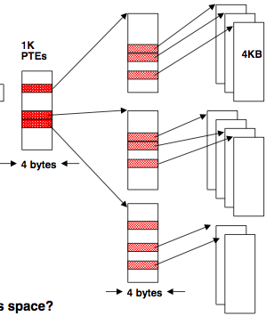
Page tables may not fit in memory!
A table for 4KB pages for a 32-bit address space has 1M entries
Each process needs its own address space!
Two-level Page Tables
1K
PDEs
32 bit virtual address
31
22
21
12
11
0
P1 index
P2 index
Page Offset
Top-level table wired in main memory
Subset of 1024 second-level tables in main memory; rest are on disk or unallocated
1K
PTEs

Slide 85
Page Table Implications
CPU executes “Load” instruction
  Recall: address is now a Virtual Address
  First step: Lookup address translation
    Where is page table? In main memory
    Special CPU register called Page Table Register (PTR)
      Holds starting address of page table
    Read DataMem from PTR+PageNumber to get Physical Address
  Second step: Access the data
    Read DataMem from Physical Address
Every load/store requires TWO memory accesses
  Slow!
  Can we speed up the translation step? Yes, use a cache!

Slide 86
TLB: Translation Looksaside Buffer
(A special cache for the Page Table)
V
i
r
t
u
a
l
p
a
g
e
Physical Page
Number
n
u
m
b
e
r
V
Tag
TLB
1
Physical Memory
1
1
1
0
1
Physical Page Number
or Disk Address
V
1
1
Disk
1
1
0
1
Page
Table
1
0
1
1
0
1

Slide 87
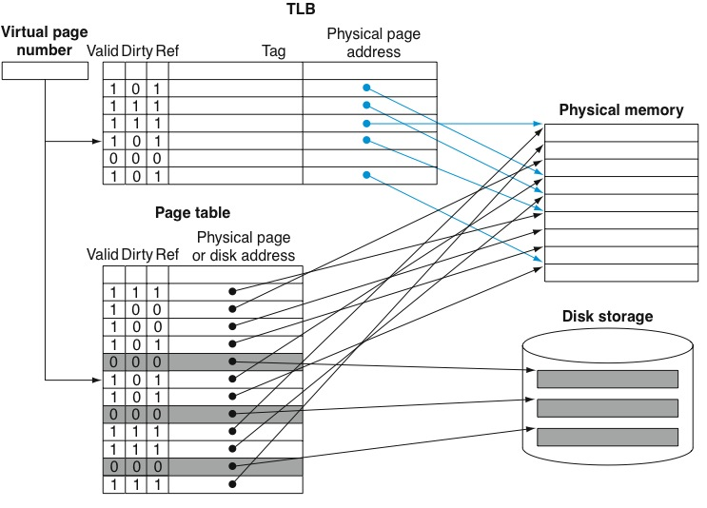
What about writes? How to determine what to put on disk?

Slide 88
Memory Access:TLB Usage Algorithm
NOTICE: software designates some memory pages as READ-ONLY
Example: pages holding instructions.
It will may share some read-only pages with multiple programs, eg you run Firefox twice.
Both hardware and software solutions are possible for TLB miss

Slide 89
TLB Notes
TLB Miss
  If handled by software: raises exception on TLB miss.
  If handled by hardware: special hardware unit will check DRAM for translation
  If page is not in DRAM, then need OS to transfer it in (“page fault”).
  OS handles security issues (invalidating TLB entries, etc…)
Read-only pages
  Can share non-sensitive data, eg instructions and pre-compiled data tables in a program such as Firefox
  Writes to read-only pages cause exception
  OS handles, possible outcomes:
    Illegal to write to this page
    Change page to writable
    If page is shared, make a new writable copy of this page for this program only. Remaining program share the original read-only copy. This is called “copy on write”

Slide 90
Combined TLB & Cache Structure
V
i
r
t
u
a
l
a
d
d
r
e
s
s
3
1
3
0
2
9
1
5
1
4
1
3
1
2
1
1
1
0
9
8
3
2
1
0
V
i
r
t
u
a
l
p
a
g
e
n
u
m
b
e
r
P
a
g
e
o
f
f
s
e
t
2
0
1
2
V
a
l
i
d
D
i
r
t
y
T
a
g
P
h
y
s
i
c
a
l
p
a
g
e
n
u
m
b
e
r
1. TLB lookup
T
L
B
T
L
B
h
i
t
2
0
2. Convert VA to PA
P
h
y
s
i
c
a
l
p
a
g
e
n
u
m
b
e
r
P
a
g
e
o
f
f
s
e
t
P
h
y
s
i
c
a
l
a
d
d
r
e
s
s
t
a
g
P
h
y
s
i
c
a
l
a
d
d
r
e
s
s
B
y
t
e
C
a
c
h
e
i
n
d
e
x
o
f
f
s
e
t
3. Access data cache
1
6
1
4
2
V
a
l
i
d
T
a
g
D
a
t
a
NOTE: TLB is
now slowing
our cache!!
C
a
c
h
e
3
2
C
a
c
h
e
h
i
t
D
a
t
a

Slide 91
TLB first, Cache second ?
TLB first, Cache second strategy is slow
  Called Physically Indexed, Physically Tagged
To improve performance:
  Lookup TLB, Lookup Cache at same time
  Must use Virtual Address to lookup in cache
  Compare Physical Address (output of TLB) to TAG (output of cache) when checking cache hit
  If OK, we can use the data
  Called Virtually Indexed, Physically Tagged

Slide 92
Fast hits by Avoiding Address Translation
CPU
CPU
CPU
VA
VA
VA
TB
VA
Tags
$
PA
Tags
$
TB
PA
VA
PA
$
TB
L2 $
PA
PA
MEM
MEM
MEM
Overlap $ access
with VA translation:
requires $ index to
remain invariant
across translation
Naive
Organization
Virtually Addressed Cache?

Slide 93
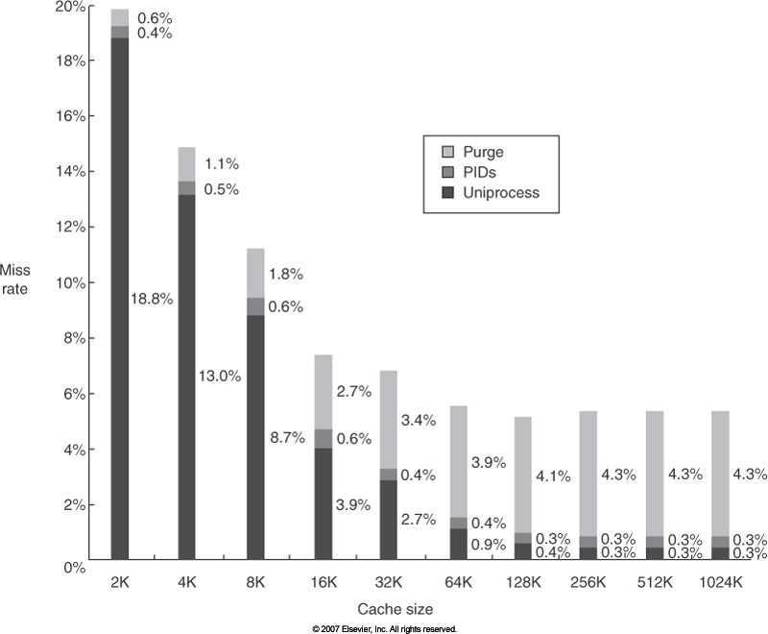
Why not just use virtual addresses for cache?
“cold start misses” resulting from flushing cache (increasing cache capacity does not help)
Substantial overhead to flush cache on context switch (dirty lines need to be written to memory if using writeback cache)

Slide 94
Summary
Caches improve performance by giving the appearance of a very fast and very large memory.
Different cache designs: Fully associative, direct mapped, set associative. Replacement policies, cache write policies
Performance impact.
Virtual memory motivation; optimization of virtual memory using TLBs

Slide 95
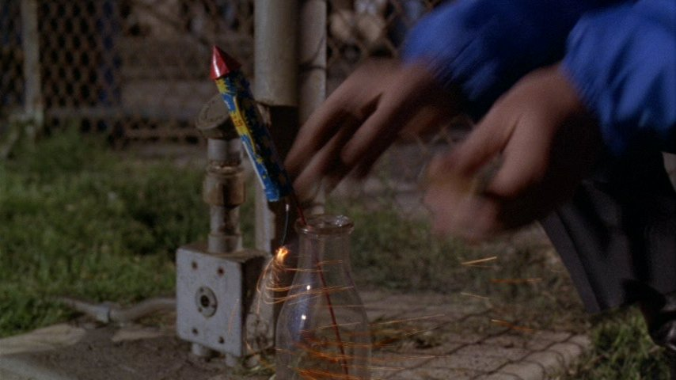
CPEN 211: In the beginning…

Slide 96


Slide 97


Slide 98
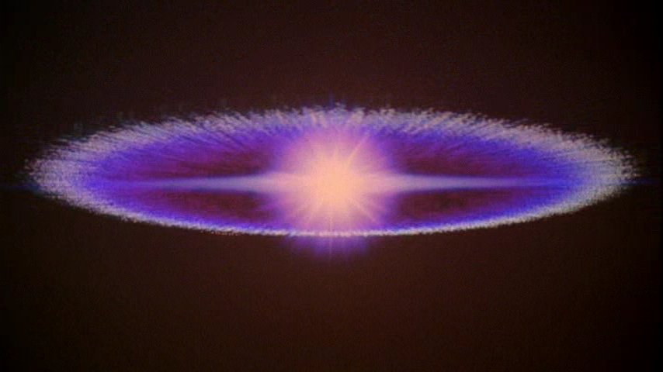

Slide 99


Slide 100


